Slide 1
Aim of the session:
By the end of the session learners will be able to
Practice speaking using dates, weather, past, present and present continuous tenses
recap previous session
practise conversations-health problems
Put the words in alphabetical order
give advice

Slide 2
What is the date today? 05/10/2021 The fifth of October
What was the date yesterday?
The fourth of October
4/10/2021
What was the date before yesterday?
The third of October
3/10/2021

Slide 3
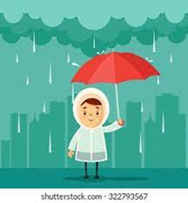
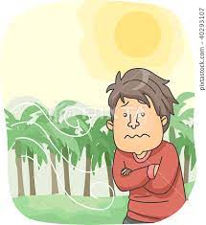
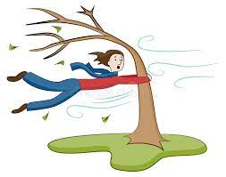
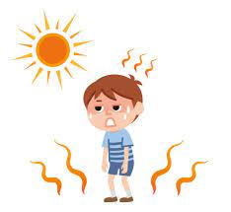
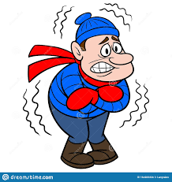
rainy
cool
windy
warm
sunny
snowy
cold
hot
cloudy

Slide 4
The weather
What is the weather like today?
It’s rainy, sometimes sunny, sometimes cloudy and cool.
What was the weather like yesterday?
It was rainy afternoon, cloudy in the morning.

Slide 5
What did you do yesterday?
Action verbs
Watch I watch TV. I watched TV
Play
Swim
Walk
Think I thought about my childhood.
Sit I sat at home.
Do I did some gardening.
State verbs
I am woman. To be: am, is, are
She is beautiful. Past tense for to be: was, were
You are late.

Slide 6
What did you do yesterday?
Where were you yesterday? To be
I was at home.
Were you late the class yesterday?
No, I wasn’t late yesterday.
Was she happy yesterday?
Yes, she was.
Were you happy yesterday?
Yes I was. / No, I wasn’t.

Slide 7
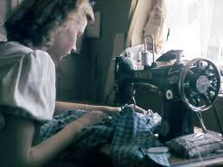
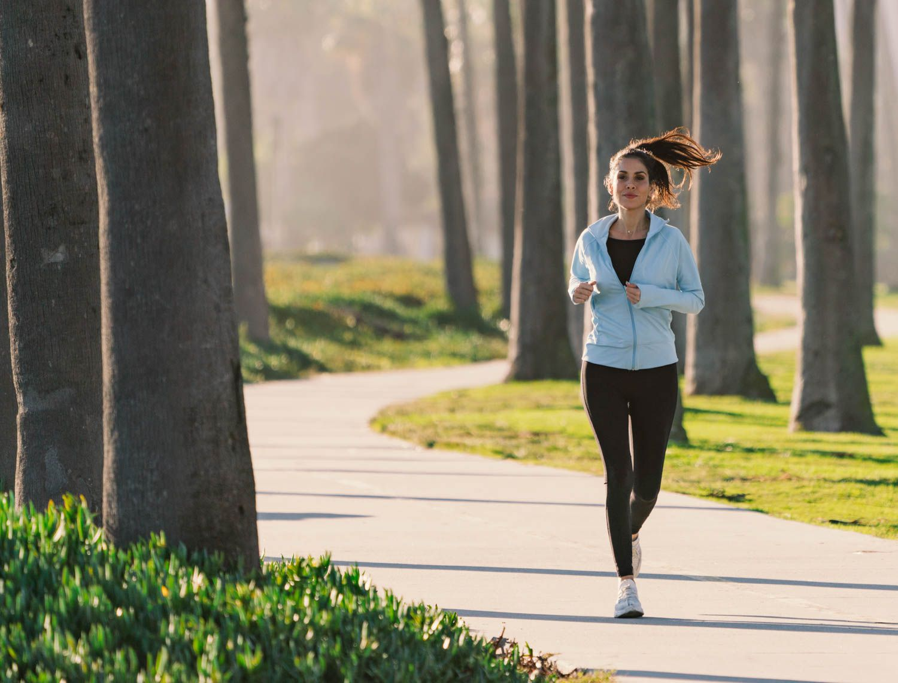
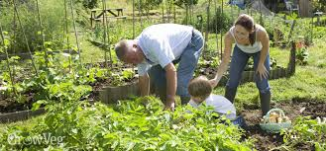
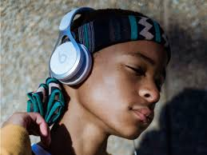
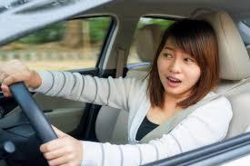
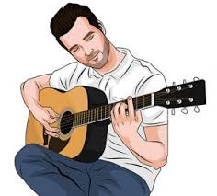
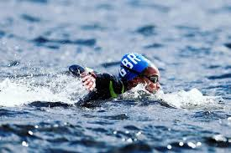
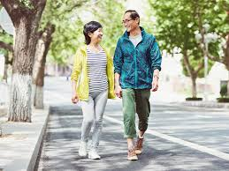
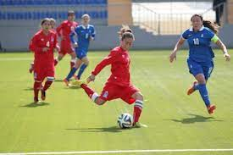
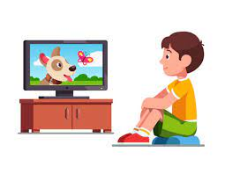
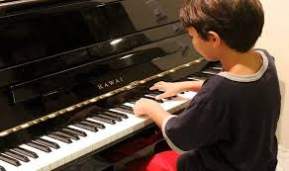
Hobbies-playing football, watching TV, running, singing, playing the guitar, playing the piano, walking, swimming, painting, sewing, gardening, driving, listening to music

Slide 8
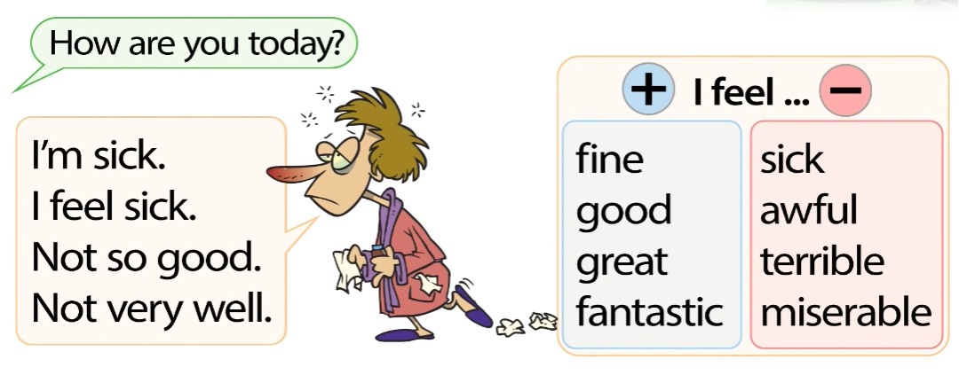

Slide 9
Conversations about health problems- recap and fill in the gaps
https://www.vocabulary.cl/english/health-problems.htm

Slide 10
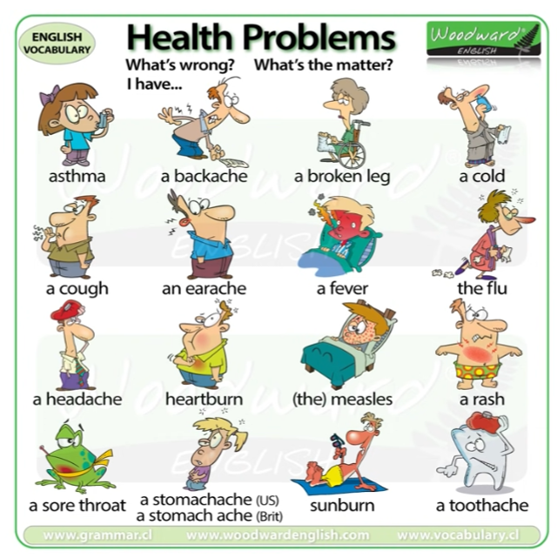
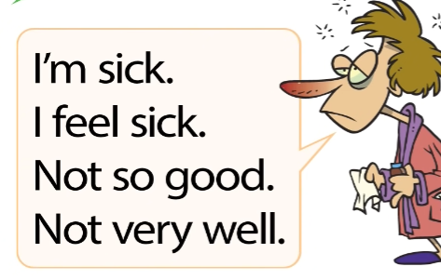
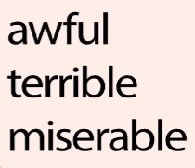
How are you? /How do you feel?
I ……………..
What’s wrong? / What’s the matter?
I have a …………………………
I am …….. to hear that./Oh, dear.
You should see a doctor.

Slide 11
Put these words in alphabetical order
Headache- 3
Awful -2
Terrible -6
Miserable -5
Measles -4
Asthma - 1

Slide 12
Giving advise- health problems
https://www.youtube.com/watch?v=EBk2haPR0_s

Slide 13
activities (giving advice)
Activity -corona
https://www.liveworksheets.com/worksheets/en/English_as_a_Second_Language_(ESL)/Giving_advice/Coronavirus_advice_an1619026tt
She/he should
https://www.liveworksheets.com/worksheets/en/English_as_a_Second_Language_(ESL)/Giving_advice/Should_or_Should_not_uu80388sr
Healthy life style-should
https://www.liveworksheets.com/worksheets/en/English_as_a_Second_Language_(ESL)/Giving_advice/Healthy_life_hx1433676xu

