Slide 1
Analysing language features
Week 2 – Functional skills

Slide 2
Persuasive statements - starter statements
This English course is the best in the whole country. There is no course better than this one!
The Ofsted report stated that “the provision of care at Islington is excellent. Students state that they feel proud to attend”
75% of the students leave having achieved their goals

Slide 3
The learners at Islington are well behaved, motivated and enthusiastic.
If you were to become a student with Islington ACL, you would be getting the best education in the area. You will become part of a community that cares about your future… it will be all about you!
(personal pronouns/direct address)
Don’t delay – make your voice heard. Vote today!
What would life be like without education at Islington ACL?

Slide 4
Descriptive language use
descriptive language video
Write a descriptive sentence, each using a particular language technique that has been mentioned in the video in each.

Slide 5
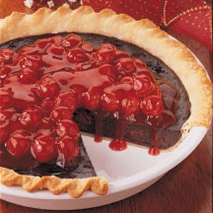
A. F.O.R.E.S.T. P.I.E – to persuade!
Alliteration
Facts
Opinion
Repetition/
Rhetorical Question
Emotive language
Statistics
Triplets
Personal Pronouns
Imperatives
Exaggeration
Maths challenge – how may techniques are here? Is the total number a prime number
Task
Write 3 of these techniques down in your books and give a short example of each –on any subject (5 minutes)
Stretch and challenge – complete 5 examples in the time allowed

Slide 6
Mayoral speech
Persuasive devices - Literary techniques - GCSE English Language Revision - Other - BBC Bitesize
Try to identify the language techniques used in the following video
Think about the impact of the language chosen
What effect do they have on the reader?
Mayoral speech

Slide 7
Did you manage to identify the following techiques?
Emotive alliteration
Rule of three
Personal pronouns( me /I)
Repetition of key words
Flatter the audience
Include simple facts
Use imperatives

Slide 8
Tone and sentence structures
Can be:
Emotive
Sarcastic
Negative
Positive
SENTENCES
Using repetition/lists/short for impact/ impatience

Slide 9
Homework
Writing a campaigning speech
You are standing as a candidate for Mayor of London. Prepare your campaign speech. It should be approximately 300 words.
You must include a variety of the language techniques and sentence structures we have discussed. Don’t forget to choose your words carefully to express your message and to get the right tone in your speech. Remember, the purpose is to persuade people to vote for you.
Things to think about:
Structure
Beginning
Think about a way to open in an engaging way
Remember to greet the audience, introduce yourself and make your purpose clear
Outline the main structure of your speech
Main body of the speech
What are the three main campaign ideas/points that you would like to make?
How will you expand your points to drive your points home?
End
Sum up your main points with a strong statement
Include a call to action/repeat your campaign slogan
Thank the audience
Language techniques
Commonly used techniques include:

