Slide 1
Menu
How to develop small actions and get BIG results
The 7 ‘P’s and your business
Develop a F.A.B (features, advantages and benefits selling proposition)
Marketing schedule and calendar
Get and keep customers
Low cost strategies
Free tools to grow your business

Slide 2
What is Marketing?
‘The management process responsible for identifying, anticipating and satisfying customer requirements profitably’

Slide 3
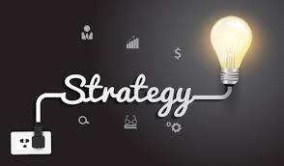
Marketing & Communications
Marketing Strategy
Your message
How you will promote your business
Engage with your customers
The steps you need to take get there

Slide 4
Perception
People are unique
People will receive information in different ways
Perception is personal to the individual
Words will mean different things to different people

Slide 5
Know what is right for you and your business
Plan and Measure
Discipline and Focus
Know your limits

Slide 6
What do you want to do/achieve
Resources time and money?
Outputs
Measurements

Slide 7
Your Communications Plan

Slide 8
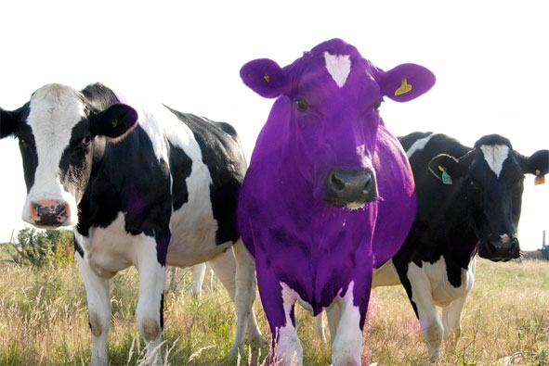
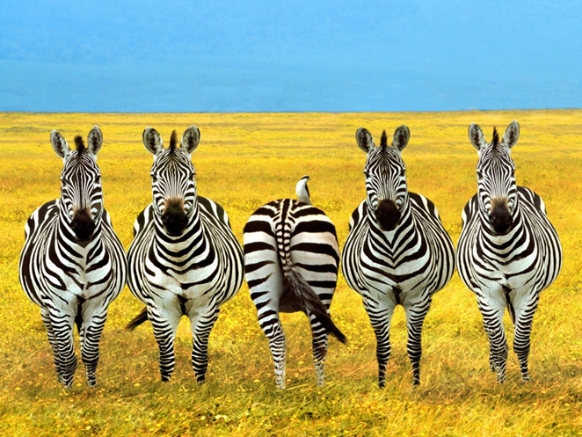
Unique Selling Point
Develop a Value Proposition

Slide 9
Why is Marketing Important
If no one knows about your business and the products/services you produce, they won’t sell

Slide 10
Why Marketing Works
familiarity
trust
authority
followership
conversations
community

Slide 11
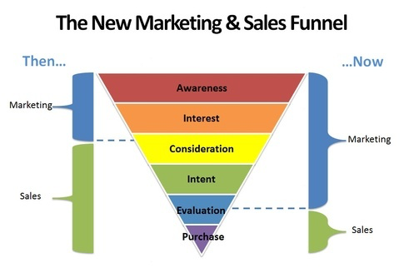
4 Stages of buying
Awareness
Interest
Desire
Action
(Follow-up)

Slide 12
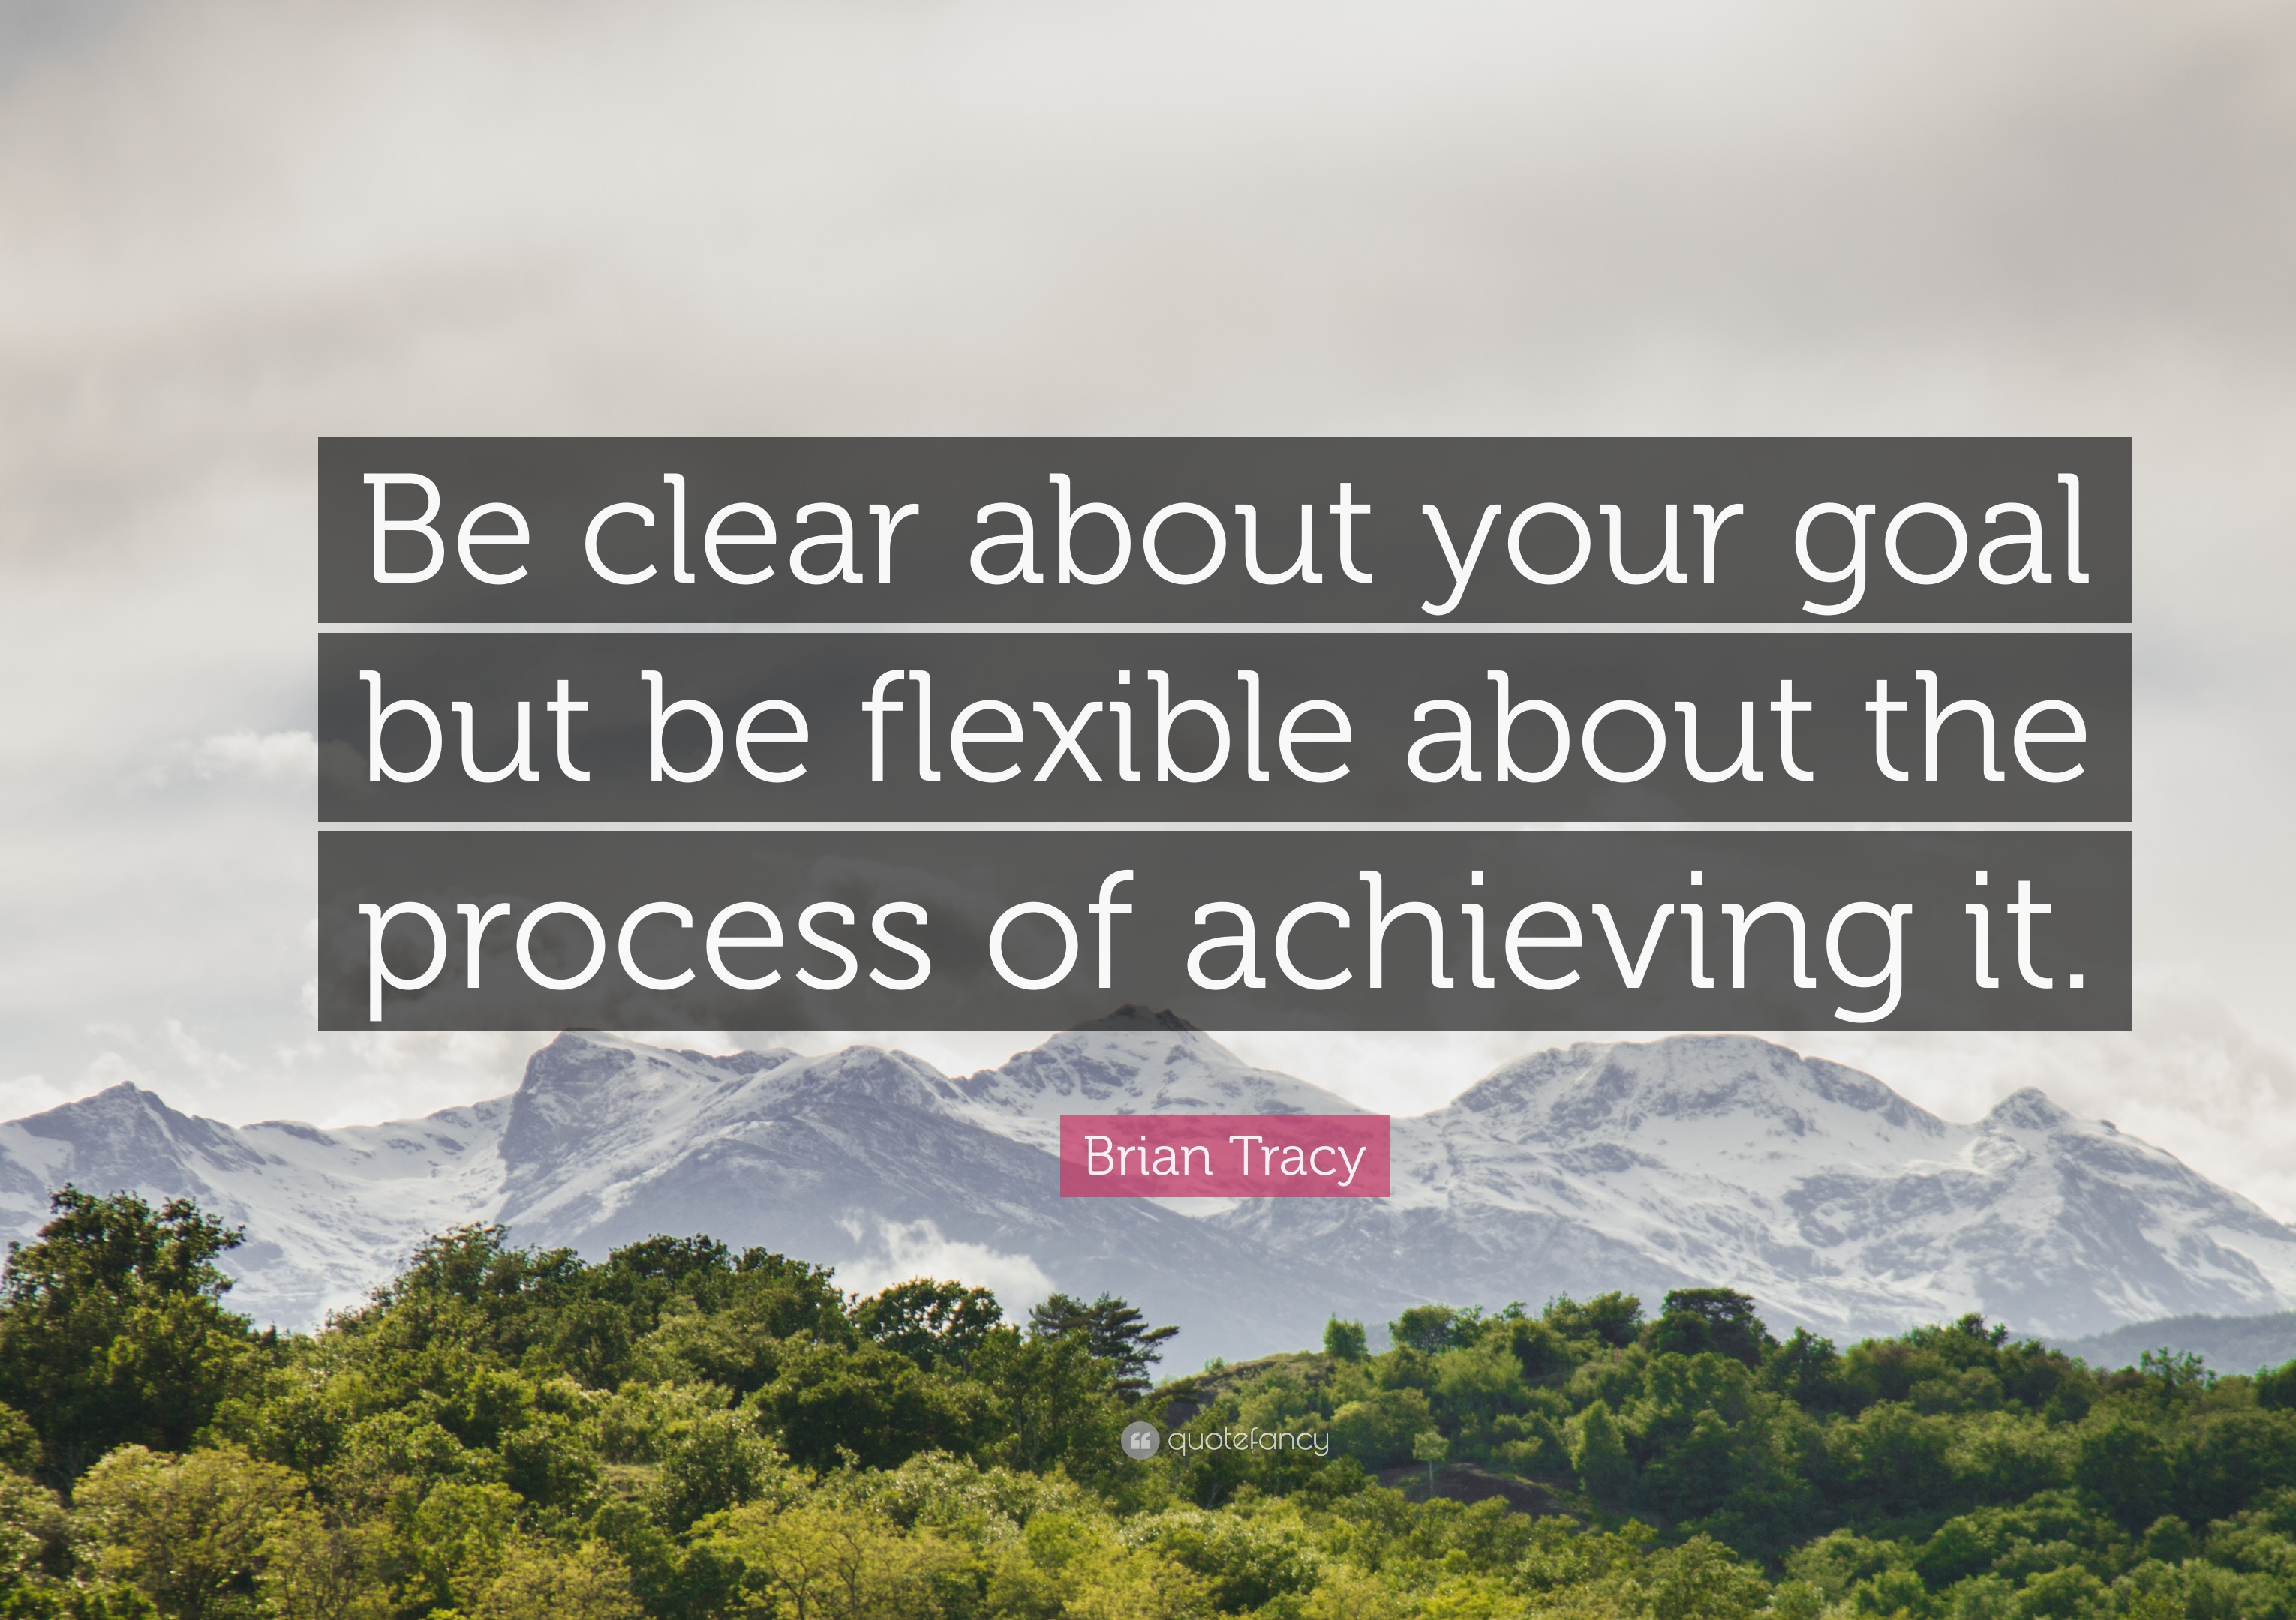
Marketing Goals
Building awareness
Educating buyers (awareness, trust)
Moving leads along the purchase path (nurturing)
Engaging with all influencers
Serving existing customers
Cross-selling or up-selling
Generating new sales leads
Establishing your expertise
Notes:
EXERCISE: Using your GOALS worksheet – compete the form accordingly.
Firstly, you must decide what the business wants to achieve in the next 6 - 12 months; increase in existing sales, new products, entering new markets. Think about what will have to change to make these happen and don’t be afraid to AIM HIGH – this isn’t about doing what you always do…
Next, decide what your MARKETING specific goals are for the next 6 – 12 months and prioritise what content can do for you, such as:
Building awareness
Educating buyers
Moving leads along the purchase path (nurturing)
Engaging with all influencers
Serving existing customers
Cross-selling or up-selling
Generating new sales leads
Establishing your expertise
And for each goal that you choose – decide a form of metric you will use to measure your success:

Slide 13
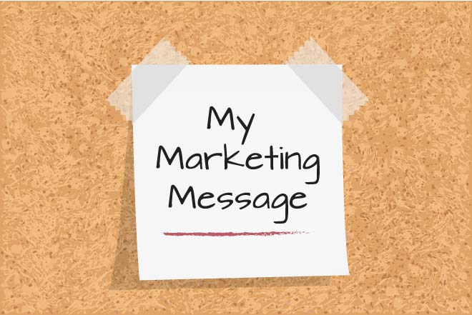
Your Message

Slide 14
What is a Marketing Budget?
A Marketing Budget is Marketing Plan in terms of costs.
Marketing Budget is an estimated amount of cost that will be required to promote products or services.
Marketing Budget is generally part of a marketing plan and crucial part of the marketing process.

Slide 15
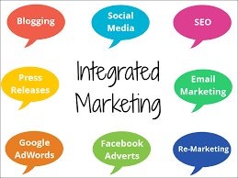
Marketing Calendar

Slide 16
Importance of creating a Marketing Budget
Monitors direction of plan
Effectively budget for your marketing activities
Anticipate upcoming costs

Slide 17
Things to Consider for your budget
Make it strictly for marketing:
Paid advertising: direct mail campaigns, any online advertising, such as videos, banner ads, email marketing, pay-per-click (PPC) ads, content marketing, and blog maintenance.
Marketing collateral: Include brochures, flyers, car wraps, catalogues, give-away items like T-shirts or pens, as well as other items that are designed to spread the news about your company and its offerings.
Production costs: This includes any art, design, photography, graphic art, and any other expenses necessary to create your advertising.
Technology costs: The cost of building a website and maintaining it should be included in your budget.

Slide 18
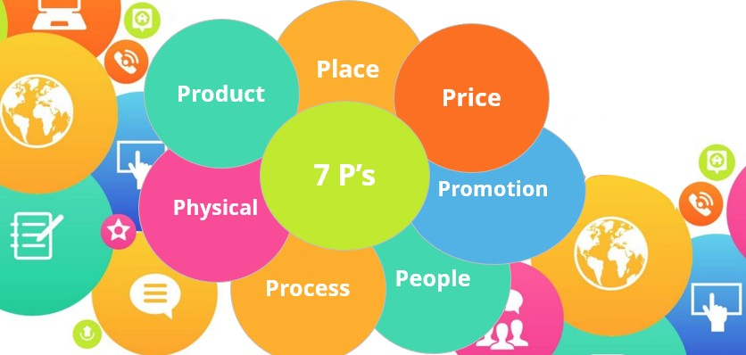
THE Seven ASPECT OF MARKETING

Slide 19
Create a Customer Persona
My target persona number is:
Jane Bloggs, aged 35
Founder of a small boutique
Ambitious, confident and patient
Feels stuck trying to access new markets
Is not confident about being able to access finance to help her grow her business.
Believes in the marketing

Slide 20
REMEMBER: Use short, visual personas.
Include psychographics) (beliefs and values, not just demographics

Slide 21
What is Jane passionate about?
How do we grab her attention?
How do we generate a call to action

Slide 22
It isn’t what you are selling, it’s what you are solving for your customers’ life
– Helps to reflect a positive self image – Helps to solve a well defined problem – Helps to reach a certain goal – Helps to contribute to the world through the purchase
“In the factory, we make cosmetics. In the drugstore, we sell hope.” Charles Revlon

Slide 23
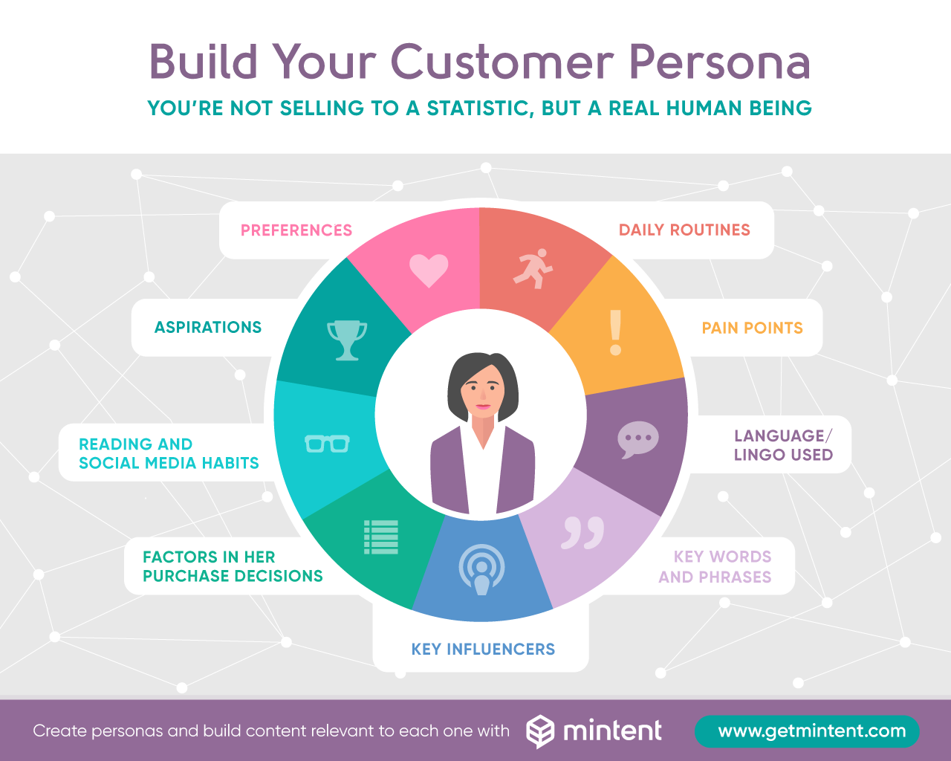
Target Market & Customer Personas Source: Mintent

Slide 24
“How does this Product or Service
solve my problems..?”
What’s in it for me?

Slide 25
Segmentation
'Market Segmentation' definition
The process of splitting customers, or potential customers, in a market into different groups, or segments, within which customers share a similar level of interest in the same or comparable set of needs satisfied by a distinct marketing proposition.

Slide 26
For the customer, this manifests itself as benefits, cost, relevant image and convenience; in other words, a customer value proposition.
Source: www.marketsegmentation.co.uk

Slide 27
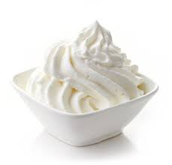

Slide 28
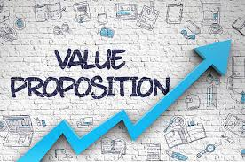
Value Proposition
https://www.youtube.com/watch?v=ReM1uqmVfP0

Slide 29
What is Branding
Brand - image - the impression of a product or service in the minds of potential users or consumers. (O.E.D.)

Slide 30
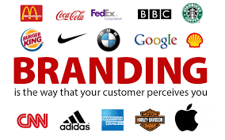
Purpose of Branding
“A key objective of branding is to build a
relationship with customers which keeps them
loyal to the product/business”
David Stokes

Slide 31
Market Positioning
The term ‘positioning’ refers to the consumer’s perception of a product or service in relation to its competitors.
You need to ask yourself, what is the position of the product in the mind of the consumer?

Slide 32
Refresher – Marketing Mix
https://www.youtube.com/watch?v=BTsTMVXHz10&list=PLfwoaiiezPT-E9gcZ6AV1et2hcd92J21C&index=8

Slide 33
Sell the benefits!

Slide 36
Networking
Know your outcome
Meet key people
Be seen
State it in the positive
Attendee list
Follow up
Build contact list

Slide 37
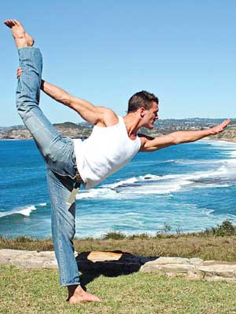
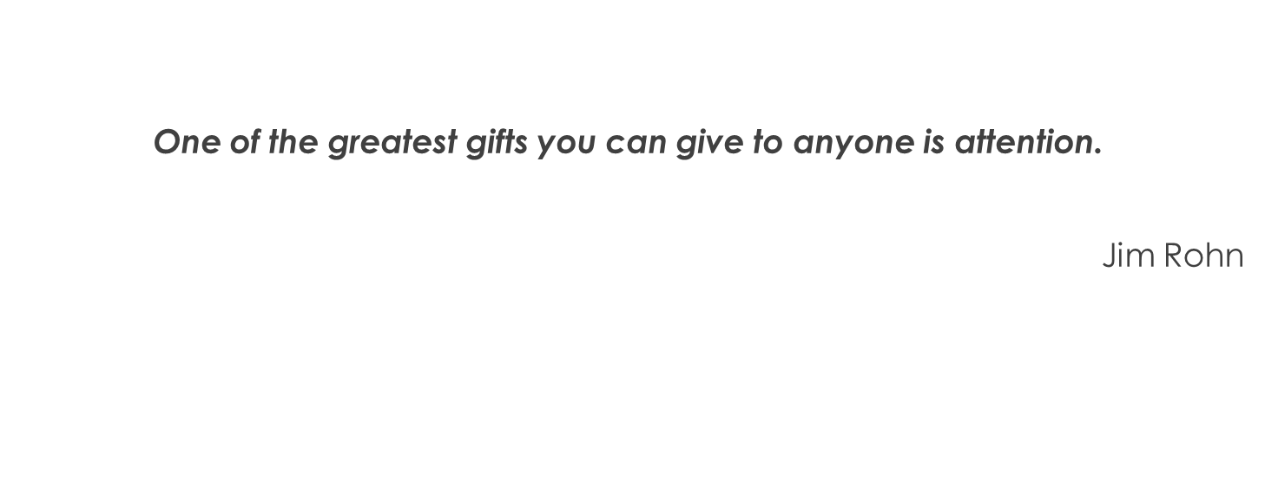
Be Flexible & Adaptable

Slide 38
Be Yourself
Be real
Be prepared
Be the host?
Be believable
Be confident

Slide 39
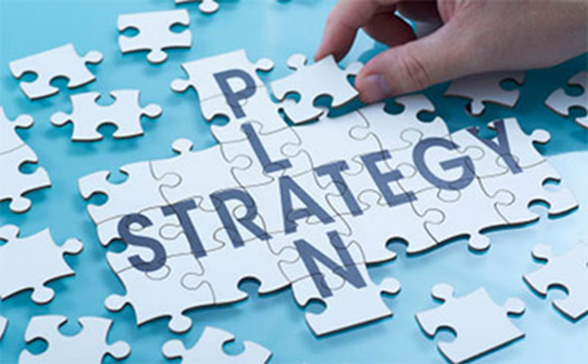
Strategy
Getting others to share your story
Collaboration
Joint ventures

Slide 40
Crystal Knows

Slide 42
Your Customer is King & Queen
It’s all about the customer and nothing about you

Slide 43
SOCIAL MEDIA PLATFORMS
Facebook
Twitter
YouTube
Pinterest
LinkedIn
WordPress
If you are unsure, identify the best platform and be consistent

Slide 44
BENEFITS OF SOCIAL MEDIA
Is a great way to build customer relationships
Provides quick and effective way to share information
It’s free
Can generate networking opportunities

Slide 45
Top Tips
The less people want to work, the more likely they will be on Facebook
Twitter gets checked on commute times and when all else is failed
LinkedIn is about work, stick to work hours
Pin in the evening when people can dedicate tie to their hobbies
Basically any time on Instagram (but better after hours and on Mondays)

Slide 46
Exercise
Blogs – On-site & Off-site
Evergreen Content
Product & Service Descriptions
Emails
Videos
Pictures
Infographics
Quizzes & Competitions
Games

Slide 47
Hints and Tips
Give the customer what they want
Remember existing customers are cheap to keep
Provide a great service
Know your value and set your prices accordingly
Cross Promote with other businesses
Guest Blog

Slide 49
Marketing Tools
Written Material: Leaflets, Newsletters, Brochures, Magazines, Pamphlets, Books, E-Books.
Events: - Seminars, Workshops, Receptions, Launches, Speaking Engagements, Conferences,
Press: Newspapers, radio, TV, Internet.
Media Relations: Press releases, Videos
Internet: Websites, Blogs, Emails.
Social Networking: Facebook, Twitter, You Tube, Flickr, Instagram

Slide 50
Cost Effective Tools

Slide 51
Create a Google My Business Page
Offer exclusive discounts to your followers
You can use creative images to promote your offers; this makes it sound less salesy
Offer a consultation session to your prospects, it will help establish trust
Monitor social media sites and track your brand mention

Slide 53
Keep it simple

Slide 54
Objectives & Measurement

Slide 55
Group Discussion
Action Plan
What will you:
Be
Do
Build
Know

