Slide 1
Aim of the session:
By the end of the session learners will be able to
Check homework
Expand vocabulary-hobbies
use ‘and’ in a sentence
Listen to a song and complete the sentences
Ask and answer question-like, don’t like

Slide 2
What’s the date today? 28/09/2021 The twenty-eighth of September
Tuesday

Slide 3
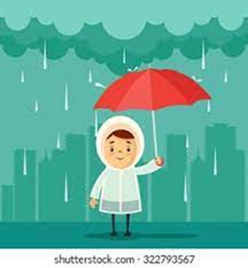
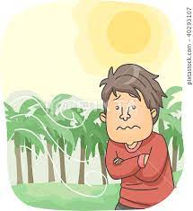
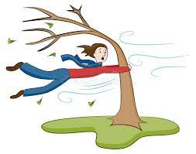
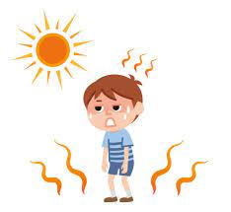
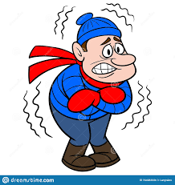
rainy
cool
windy
warm
sunny
snowy
cold
hot
cloudy

Slide 4
The weather
What is the weather like today?
It is warm today but a little cloudy.

Slide 5
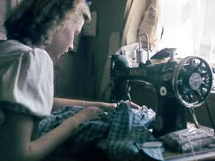
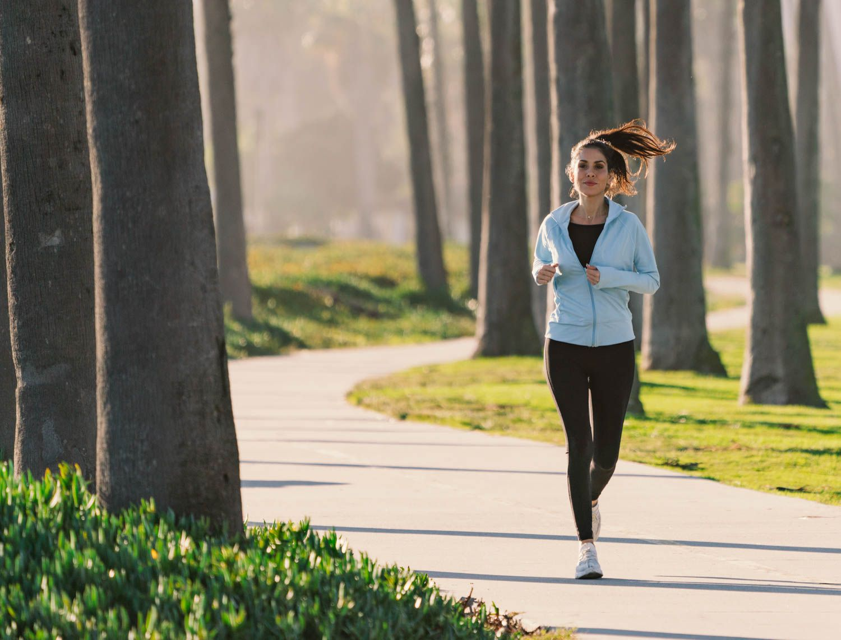
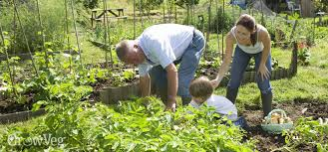
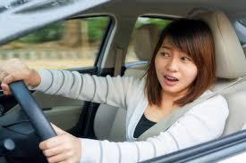
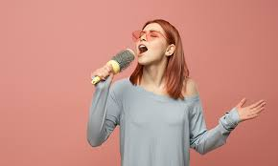
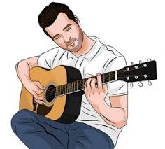
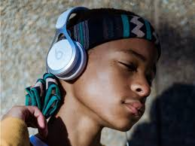
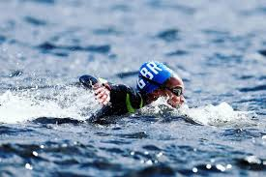
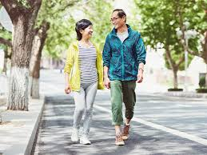
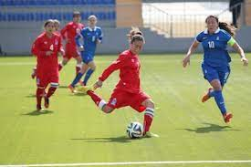
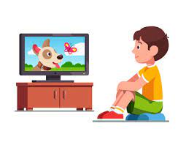
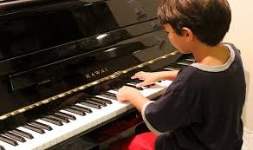
Hobbies-playing football, watching TV, running, singing, playing the guitar, playing the piano, walking, swimming, painting, sewing, gardening, driving, listening to music

Slide 6
What do you like doing?
I like singing, watching TV and playing football.
I like gardening, walking and painting.
I like driving, running and gardening.
What do you not like doing?
I don’t like playing the piano and sewing.
I don’t like swimming and playing the piano.
I don’t like playing football and sewing.

Slide 7
Activities: Listen to the song and fill in the gaps
https://www.liveworksheets.com/worksheets/en/English_as_a_Second_Language_(ESL)/Like_%5E_ing/What_do_you_like_doing$_nd627182mf

Slide 8
Activities: order the words to make a sentence
https://www.liveworksheets.com/worksheets/en/English_as_a_Second_Language_(ESL)/Like_%5E_ing/What_do_you_like$_Order_ep246021uf

Slide 9
Homework:
https://www.liveworksheets.com/worksheets/en/English_as_a_Second_Language_(ESL)/Like_%5E_ing/What_do_you_like_doing$_nd627182mf

