Slide 1
Kick Start Your Business

Slide 2
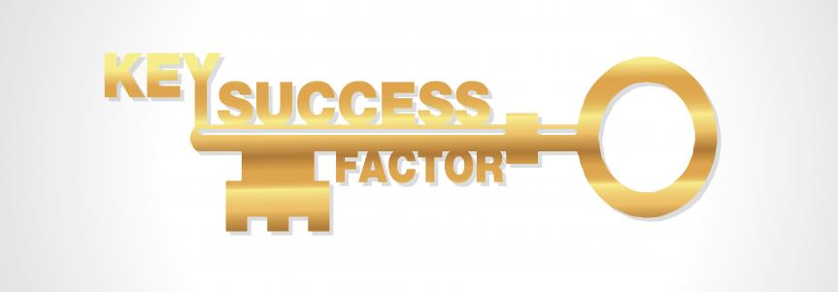

Slide 4
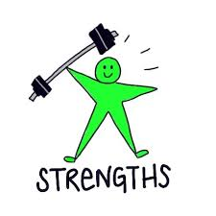
Invest in your strengths

Slide 5
Development Plans

Slide 6
Self-evaluation
Self-evaluation
Make regular assessments of the way you work and progress you are making
Ask yourself whether you are managing your work efficiently, whether you achieve the deadlines you set you and whether you are taking advantage of opportunities to increase your self-confidence and learn from new experiences
As part of your assessment you should identify areas for improvement and skills you may need to learn
Having identified these, set yourself targets within a sensible timescale to achieve them

Slide 7
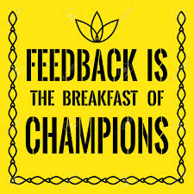
Feedback
Customers, peers and other stakeholders will be able to identify what you have done well and will also be able to objectively identify areas for improvement
Feedback helps you to identify areas for improvement (such as skills to develop, the level of customer service you provide clients, your planning and coordination skills, etc.)
You play a part in encouraging feedback.
You should be open to feedback and encourage an honest appraisal
You should also ask for specific examples so that you fully understand what you need to improve

Slide 8
How to make the most of feedback
DO:
Seek feedback on a regular basis, especially after you have identified development goals
Remember that exchanging information and perceptions is a process, not a single event
Receive feedback as a gift that provides you with honest information about your perceived behaviour/performance
Be open to what you will hear
Ask clarifying questions and ask for specifics, if not provided
Ask the person to give you alternatives to your behaviour
Monitor your non-verbal and emotional responses
Thank the person for being helpful to you
Take the time after the feedback interaction to evaluate the information and consider specific actions for improvements.
Teach yourself to recognise situations in which certain behaviour needs to be altered
Use feedback to clarify goals, track progress toward those goals and improve the effectiveness of your behaviours over a period of time

Slide 9
DON’T:
Take it personally
Become defensive or explain your behaviour.
Defending your actions is counterproductive, where listening is extremely useful
Interrupt the other person
Ask the person to defend his or her opinion (there is a difference between ‘defending’ and ‘explaining’)
Be afraid to allow pauses and periods of silence when you receive feedback. This gives you time to understand what is being said and it gives the other person time to think about what they say
Feedback is purely subjective perceptions of information. You can place your own value on it later

Slide 10
Self-evaluation helps improve
Self-confidence, motivation and morale
You are more likely to succeed if you use play to your strengths and use your talents to their fullest extent. You will experience fewer problems if you know what your areas of development are and can manage them so that they don’t affect your business.

Slide 11
Personal Development Plan (PDP)
A PDP is a structured framework used to:
Identify skills you have
Highlight and develop skills you need
Work out what you want to achieve and how to go about it
Focus on development options and goals
Your PDP will help you track achievements, areas for improvement, long-term objectives and plans to improve/update your skills

Slide 12
In order to be effective, you must consider the following:
Success criteria must be realistic – if they are not, you are just setting
yourself up for failure.
You should identify reasonable goals.
Your action plans should be accessible – consider the resources you have
available to you.
Your development plan should take feedback into account

Slide 13
Steps to complete your PDP
Self- Analysis
Setting Goals
Review and Update

Slide 14
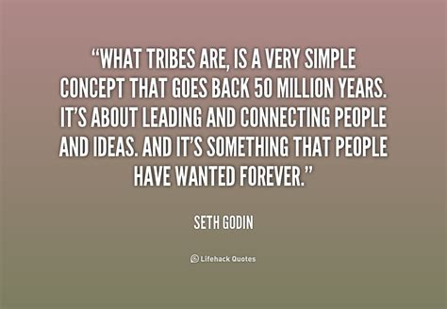

Slide 15
Tribe Characteristics
A group of like-minded people
Active members that do more than just show up
Membership is voluntary
They are not sheep, they are evangelists
Tribes don’t do what leaders want them to do, they do what they want
People belong to many tribes
Every tribe is different

Slide 16
FLOW
In positive psychology, a flow state, also known colloquially as being in the zone, is the mental state of operation in which a person performing an activity is fully immersed in a feeling of energized focus, full involvement, and enjoyment in the process of the activity.
In essence, flow is characterized by complete absorption in what one does, and a resulting loss in one's sense of space and time.
From Wikipedia, the free encyclopaedia

Slide 17
Flow is when a person
is engaged in a doable task
is able to focus
has a clear goal
receives immediate feedback
moves without worrying
has a sense of control
Adapted from Mihaly Csikszentmihalyi

Slide 18
Creativity

Slide 19
How to feel your best

Slide 20
Disney Strategy
Dreamer: Here you allow your imagination to run free - You consider your vision and the benefits of achieving it
Planner: Here you act as if the plan is entirely possible – Your job is to look for ways to make it happen
Critic: Here you look for flaws and loopholes in the Plan - Act as the Constructive Critic
Aim to find weaknesses, pre-empt problems and ensure the success of the Plan – but leave the resolution of these potential weaknesses to the Planner

