Slide 1
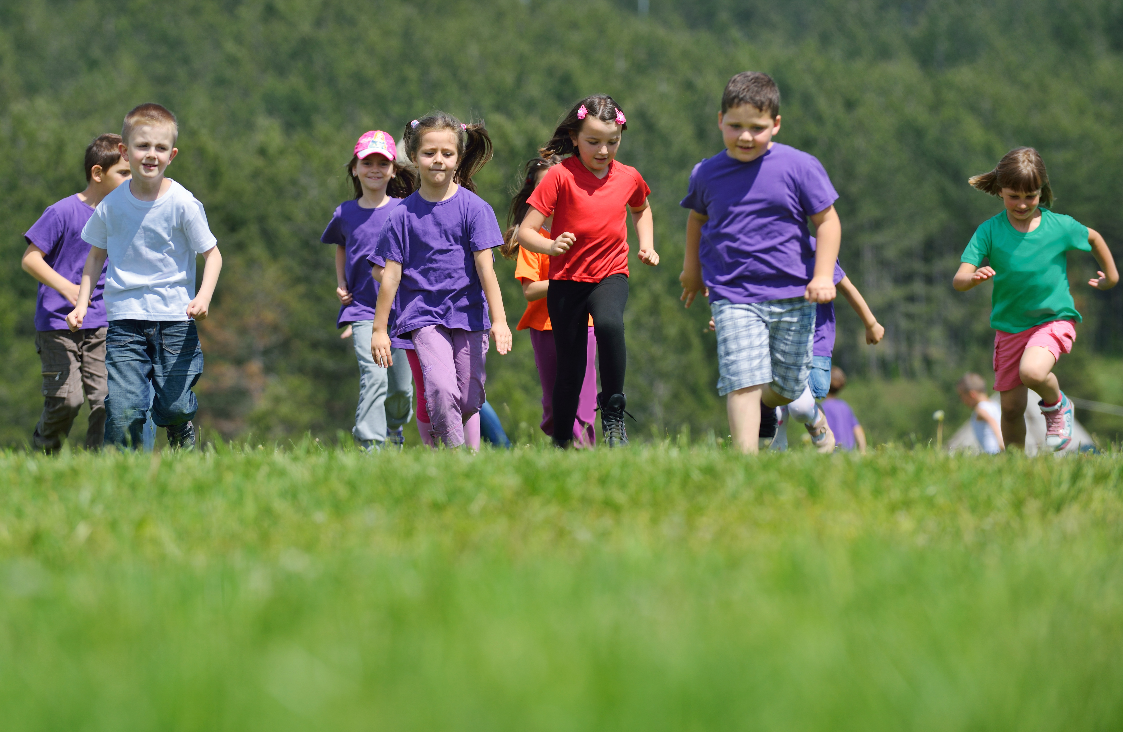
Physical Activity
Being physically active has many benefits which will improve both your physical and mental health and wellbeing:
Improved cardiovascular fitness
Improved sleep
Improved learning attainment
Contributes to maintaining a healthy weight
can improve behaviour
Improved mental health and overall wellbeing

Slide 2
Active Life Style
Physical activity should be built into children’s lives in order for them to continue to live a physically active life style into adulthood and to reap the health benefits of being physically active. As well as taking part in organised physical activity, try building physical activity into your day, such as:
Taking the stairs whenever possible
Active travel – walking, scooting, cycling, walking, jogging, getting off the bus one stop earlier and walking part of the way
Regular Movement- Minimising the amount of time spent being sedentary (sitting) for extended periods
Standing up regularly – if your children spend time on video games, whilst playing on games consoles or watching television, stand up and play or watch at regular intervals

Slide 3
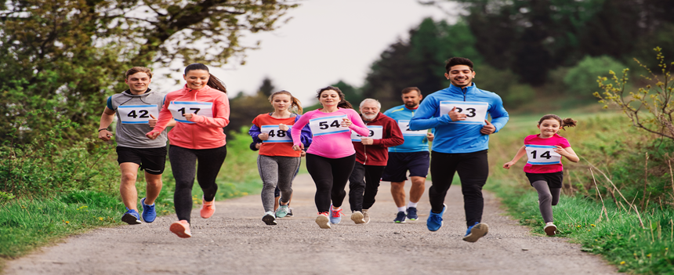
Family Physical Activity
As a family, you can support each other to be physically active and as parents and carers, you can be a role model for the children and young people in the family. There are many ways to be physically active as a family, the most important thing is that being physically active together as a family should be fun. Here are a few ideas:
Take part in family run events, such as the Family Community Virtual Fun Run – Click here for further details and the entry form - https://survs.com/survey/xrvfoxfaam
Do the Daily Mile as a family (it is not just for schools!), 15 minutes of walking, running or jogging - Parents and Carers | The Daily Mile UK
Take part in free activity challenges by downloading the free Strava app
Cycle together as a family
Go on long family walks

Slide 4
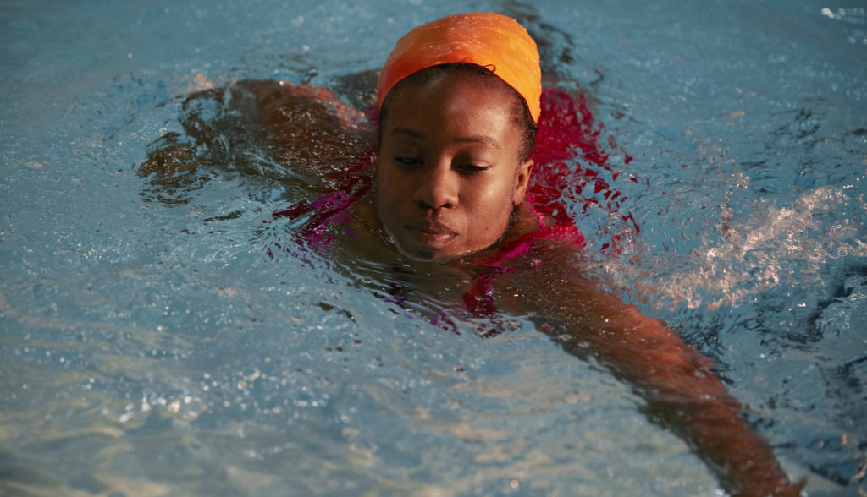
…more Family Physical Activity Ideas
• Swimming together as a family – Islington has free swimming lessons for children in the summer holidays and are launching free family swimming lessons this summer!
• Joe Wicks - Follow along with fitness workouts for all the family on YouTube. Videos
are available online to use at a time that suits you – PE With Joe | 2021 - YouTube
• Change4Life - Change 4 Life and Disney have teamed up to create 10 minute Shake Ups and fun physical activity indoor games - Disney Shake Up Games | 10 Minute Shake Up | Change4Life (www.nhs.uk)
• YST Family Activities Youth Sport Trust have collated a range of Family activities from across the School Games network, including Active Board Games, Garden games and Indoor Games
• School Games Active Recovery HUB, The activity HUB provides an extensive list of activities provided by physical activity and sports organisations. https://www.yourschoolgames.com/active-recovery/

