Slide 1
Welcome to ESOL Entry 1/2
Islington Adult Community Learning
Autumn term
Teacher: Gosia

Slide 2
Teacher: Gosia
My contact details:
Email: Malgorzata.jakubowska-chaaban@Islington.gov.uk
Work mobile: 07834172328
This Photo by Unknown Author is licensed under CC BY-SA

Slide 3
Week 1
Monday 20th September
Today we will:
Talk about the course and Zoom classes
Agree online learning class rules
Discuss best ways to send homework
Talk about where you come from
Ask questions and give personal details

Slide 4
Introduce yourself
Say your name, where you come from and what languages you speak.
Tell us about your country. Tell us something interesting, for example what you like or dislike about the weather, food or culture.
This Photo by Unknown Author is licensed under CC BY-NC

Slide 5
Can you find your country on the map? Where can you find a map of the world?
How do you greet people in your language?

Slide 6
Course information
This course is for you if English is not your first language and you would like to improve your speaking, listening, reading and writing skills.
Your learning plan:
Your teacher will support you to set learning goals for your individual learning plan.
Assessment:
You will keep a record of work showing what you have learned and how you are progressing.
There are no formal exams at the end of this course. You will receive a certificate from Islington Adult Community Learning.

Slide 7
After completing your course:
You can progress to higher level ESOL courses.
You may be able to continue your learning with us by joining other ACL courses:
Functional Skills English
Maths
Digital/ computer skills
Family learning
Vocational and employment skills
vocational – (adjective) to prepare you for a specific type of work

Slide 8
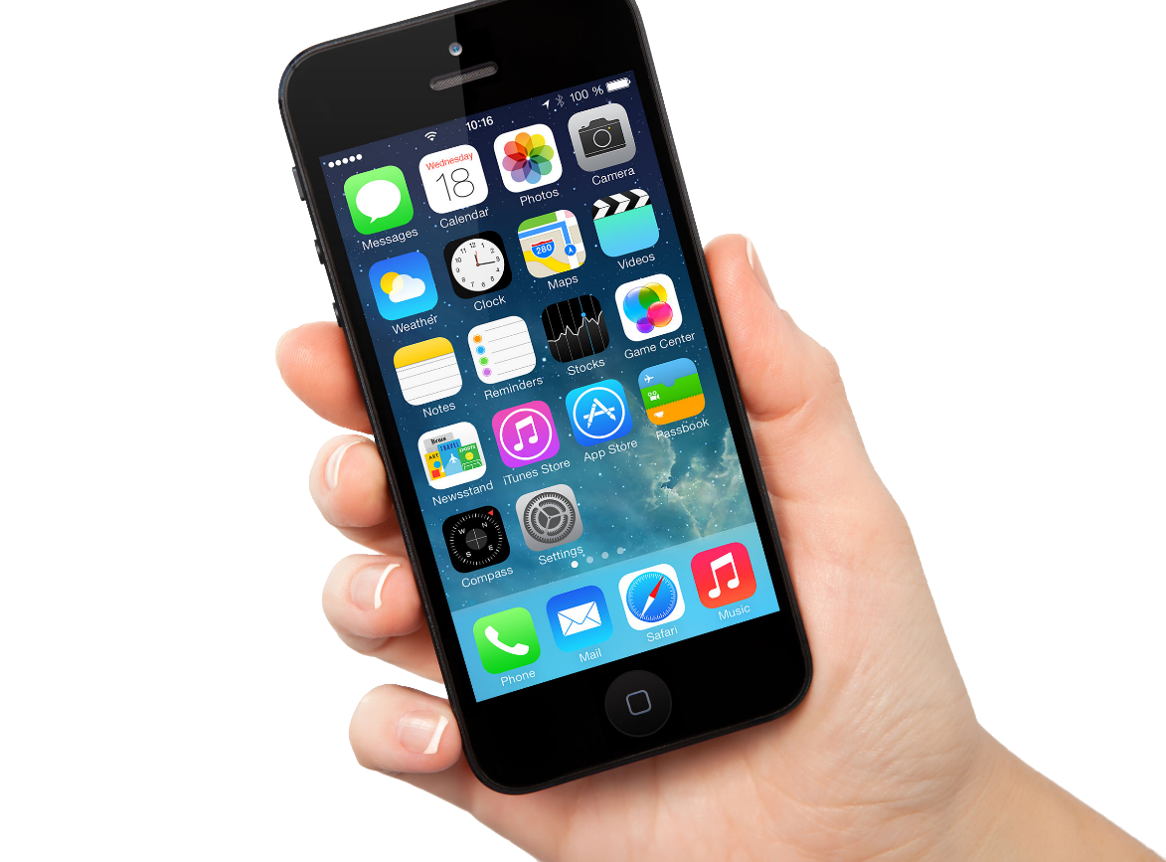
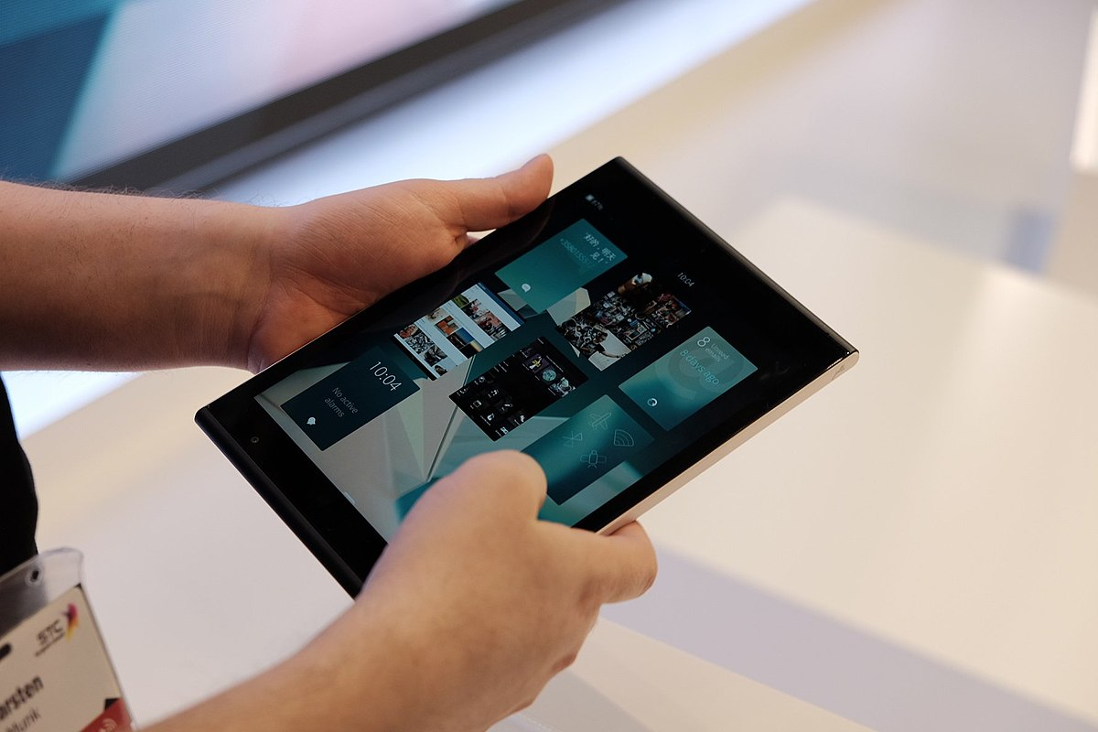
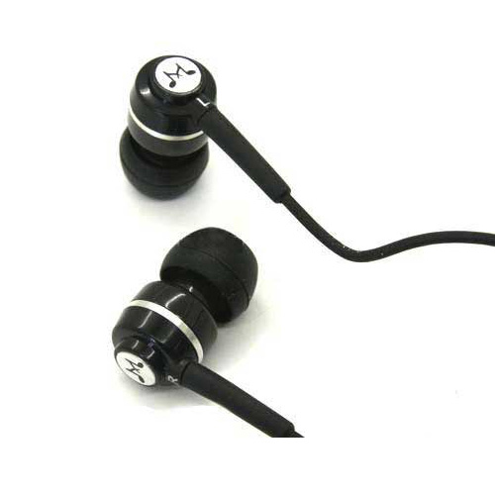
What do you need for online classes?

Slide 9
What do you need for online classes?
pen or pencil
notebook or paper
phone, tablet or laptop
earphones/ headphones
internet connection

Slide 10
Discussion
What are digital skills?
Do you think digital skills are important?
Why?
Do you think that Coronavirus has made digital skills even more important? Why?

Slide 11
Digital skills
How well can you do the following:
1. Type a short text on your phone, tablet or computer
2. Take a picture and send it in a text message, WhatsApp or
email
3. Send an email
4. Open an email attachment/ file
5. Search for information online

Slide 12
Zoom lessons
Monday and Thursday 10:30 am – 12 noon
Log in to the session 5-10 minutes before the start time to give yourself time to test your microphone and speakers (and fix any technical problems)
Try to be somewhere quiet, away from noise where you can concentrate on your learning
Even if you are at home, wear appropriate clothes ☺

Slide 13
Navigating the Zoom menu
Microphone: you can turn your microphone off (= mute) or on (= unmute)
Video: you can turn your camera on or off
Chat: you can message the whole group or send a private message to one person only

Slide 14
Let’s try Zoom chat!
You can choose to send your message to everyone or send a private message to one person, for example to your teacher.
select: “everyone” or the name of the person
you want to message
Task: 1. Say hello in the chat, send the message to everyone.
2. Say hello in the chat, send the message only to your teacher.

Slide 15
Online learning class rules
What rules do you think we should have for our online lessons?

Slide 16
Online learning class rules
Be on time
Respect other people
Respect when other people speak
Try to be somewhere quiet
Mute your microphone if you have a lot of background noise
Have pen and paper ready
Do your homework (on time)
Be patient as some people may have problems with technology or internet connection
Never record any part of the session or take screenshots
Have fun and work hard! 😊
patient – (adjective) able to wait calmly and quietly if there is a problem or something is not working
a patient – (noun) a person in a hospital or GP surgery who isn’t well

Slide 17
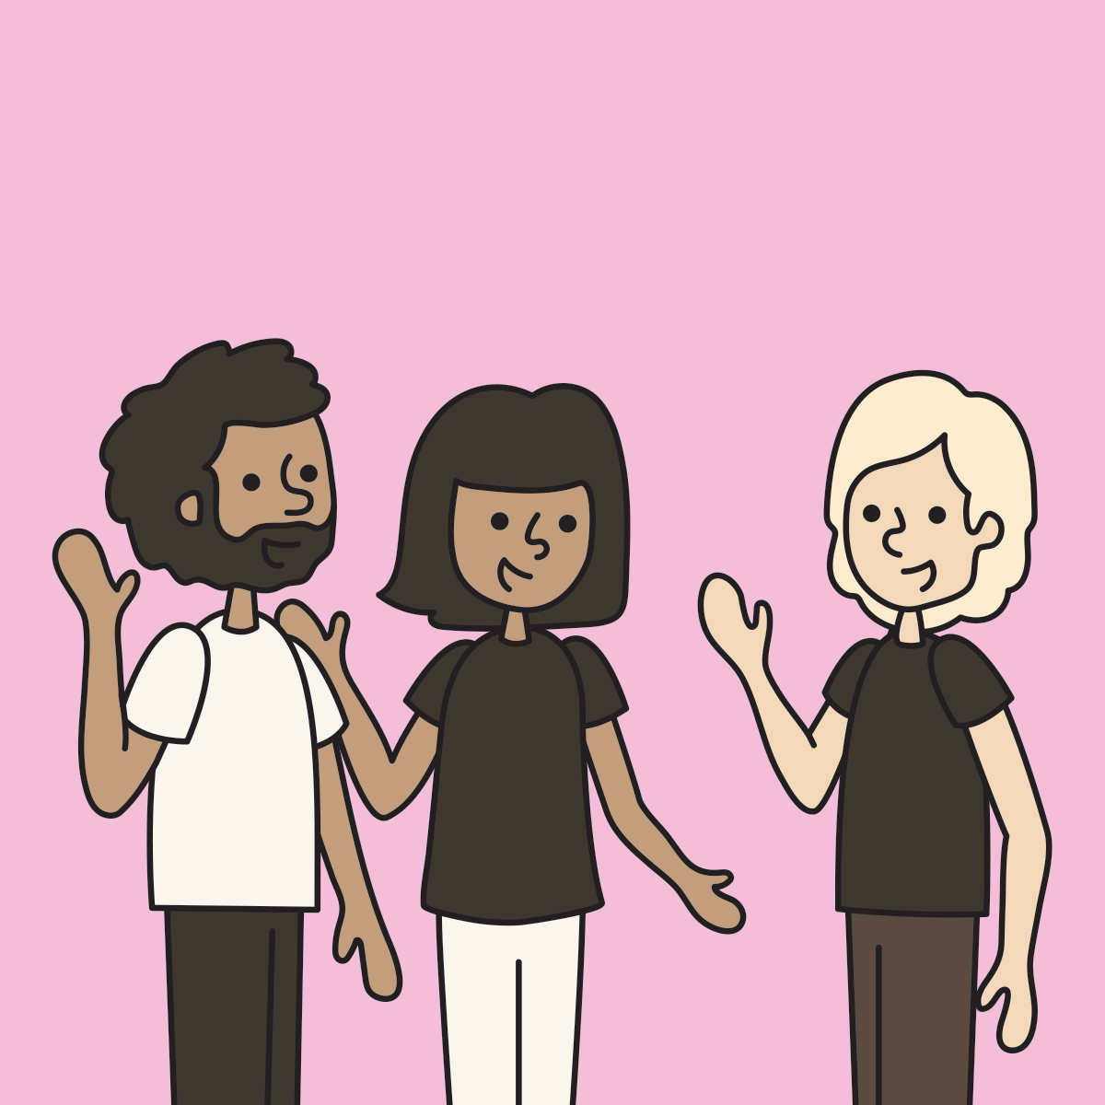
Greetings and getting to know you

Slide 18
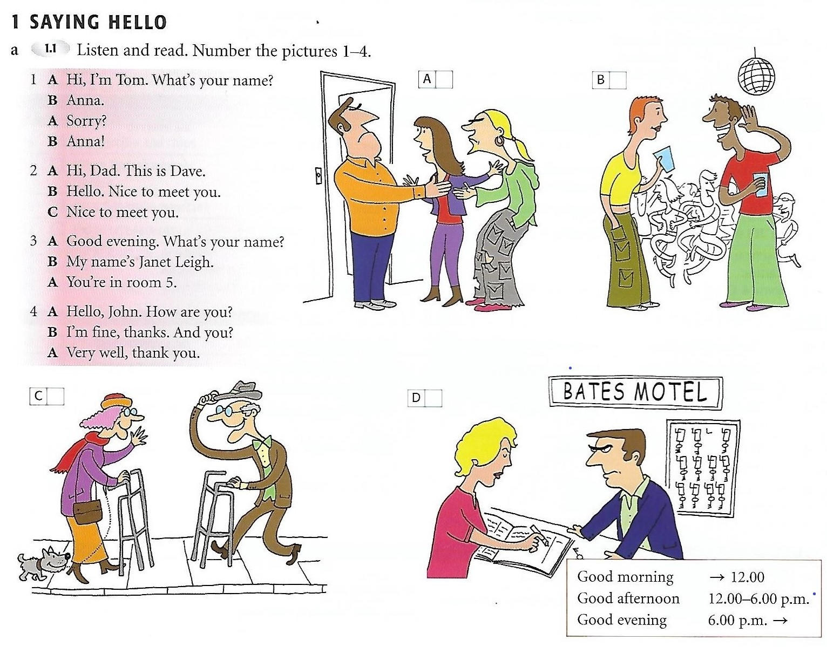

Slide 19
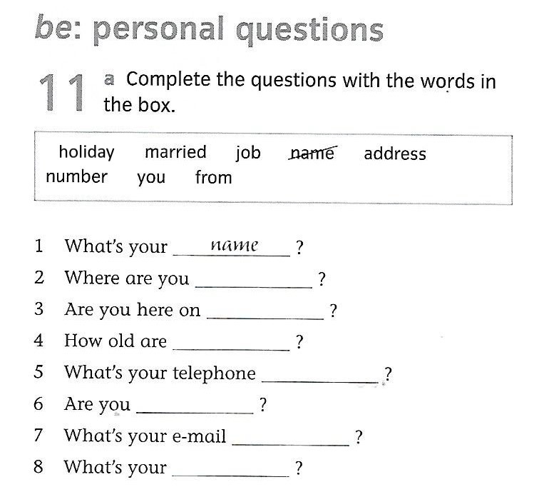

Slide 20
Answers
from
holiday
you
number
married
address
job

Slide 21
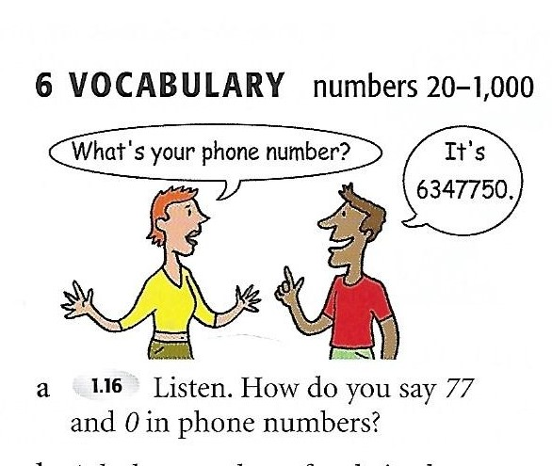

Slide 22
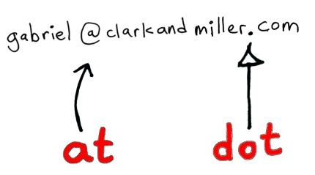
Email addresses:
@ = at . = dot - = dash _ = underscore
Watch a short video about email addresses:
https://www.youtube.com/watch?v=OyiYMpLyAEE
Practise reading these email addresses aloud:
maria.lopez@yahoo.co.uk
ahmed-said@gmail.com
john_smith@britishcouncil.org
Now practise saying your email address.

Slide 23
Talking about you
Ask and answer questions with a partner.
What’s your first name?
What’s your surname?
How do you spell your surname?
Where are you from?
What’s your phone number?
What’s your email address?
Are you married? Yes, I am./ No, I am not.
Yes, I am. NOT Yes, I’m.

Slide 24
SPEAKING
Tip - ‘Returning’ a question:
When you are having a conversation, you often ‘return’ a question, that is ask somebody the same question that they asked you. You can do this by:
Saying And you? Or What about you?
Let’s practise
Where do you live?

Slide 25
Homework
Send an email to your teacher.
Write anything you want in your email.
You can just say ‘Hello’ and ‘How are you?’ if you like.

