Slide 1
Week 4
Reading skills
Layout and language for different types of text
Building English vocabulary

Slide 2
Aims of the session
Be able to recognise particular types of text by their unique layout features
Develop English descriptive vocabulary

Slide 3
Recap layout features
Also known as presentational features or organisational features
Can you remember features we mentioned last week?

Slide 4
Layout features
Heading
Sub-headings
Bullet points
Text box
Font – size, shape, colour, capitals
Images
Columns

Slide 5
Layout features and different types of texts
Some text types have very distinctive layouts
Some use particular layout features
You will need to be able to recognise these and name them in an exam
Make a note of the features as we discuss each text

Slide 6
42, Greyhound Road
Birmingham
B42 6HJ
25 April 2020
Mr. E. Splatt
The Manager
Bestdeal Electrics
113 Main Street
Andover
AN4 9ET
Dear Mr. Splatt,
Complaint about member of staff
I am writing to complain about a member of your staff who was very rude to me on my recent visit to your shop………….
I have been a loyal customer of Bestdeal for many years. I would like you to contact me to tell me how you are going to deal with this member of staff.
Yours sincerely
Jane Teller

Slide 7
Letter
Sender’s address on right
Date
Recipient’s name and address on left
Salutation
Subject (bold, underlined)
Valediction (sign off)
Sender’s name
Paragraphs

Slide 8
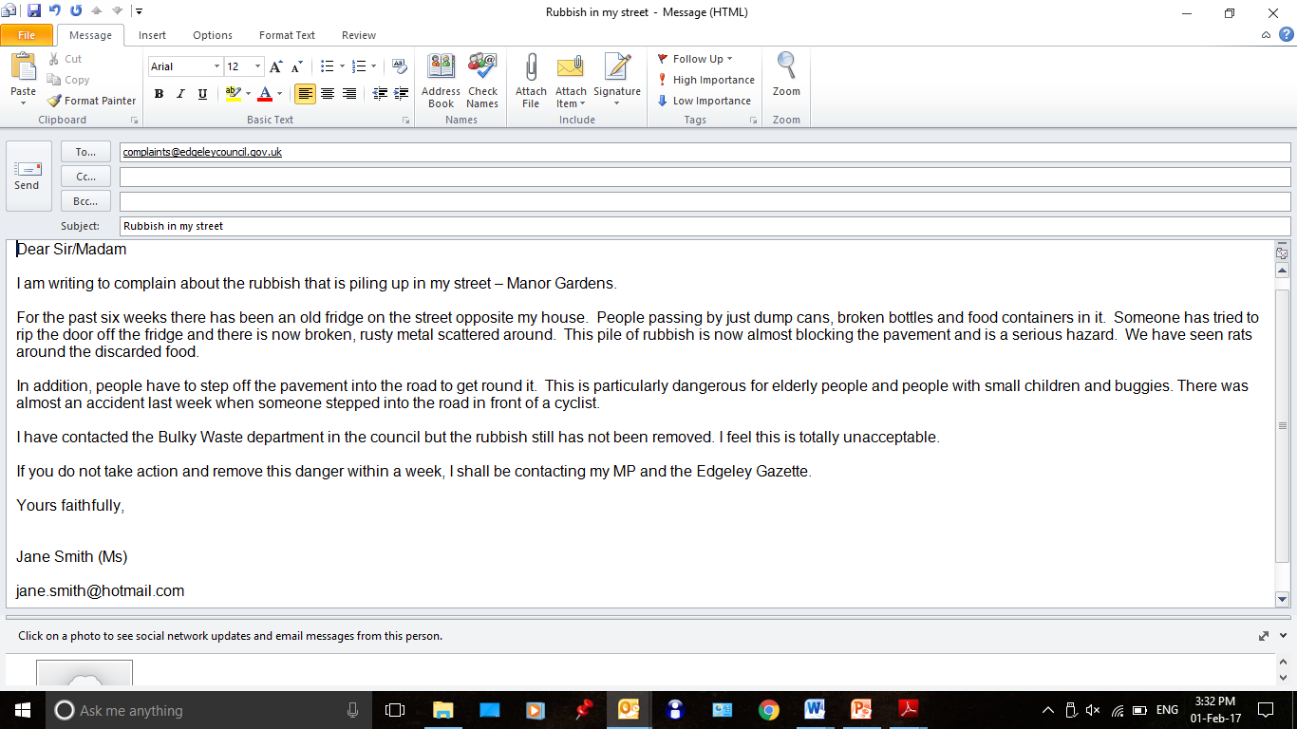

Slide 9
Email
Recipient’s email address
Subject (bold, underlined)
CC
BCC
Send, reply etc buttons
Icons

Slide 10
Grandad and two grandsons in "miraculous" escape after car clips side of house and lands upside down
27 January 2021
by Alex Kingston
A grandad and his two grandsons had a "miraculous" escape after the car they were travelling in launched into the air, clipped the side of a house and landed upside down.
The three are lucky to be alive after their vehicle - which was being driven by the elderly man - left the road and launched over a six foot wall. Paramedics found the vehicle teetering upside down on top of a parked car.
Emergency services said it was a miracle nobody was hurt in the accident in Seabridge Lane in Newcastle-under-Lyme, at around 5.30pm today.
A West Midlands Ambulance Service (WMAS) spokeswoman said: "When the emergency services arrived they found a car which had reportedly left the road, cleared a six foot wall and clipped the side of a house before landing on top of a parked car. Miraculously the three occupants, an elderly man and his two grandsons, believed to be in their late teens, were out of the car and had sustained no serious injuries.”

Slide 11
Article
Columns
Headline
Paragraphs
Byline
Date
(Sub-headings)

Slide 12
www.bbc.co.uk

Slide 13
Website
Underlined text in article shows links (hyperlinks)
Images
Captions
Tabs
Home icon/page
Search bar

Slide 15
Advert
Images
Logo
Strapline
Small amount of text. Short sentences.

Slide 16
Effect of layout features
Clarity
Memory
Impact
Mood
Angry
Romantic
Exciting
Inviting
Pure

Slide 17
Examples
London leaflet
Laptop leaflet
IslingtonLife - Your local online magazine from Islington Council

Slide 18
Colour and mood
Go onto ACL Gateway and complete the matching activity
If there are words there that you don’t know, look them up in a dictionary e.g. Dictionary.com

Slide 19
Aims of the session
Be able to recognise particular types of text by their unique layout features
Develop English descriptive vocabulary

Slide 20
To check your learning …
Homework:
- Organisational and structural features module on BKSB

