Slide 1
Report Writing
L1 Functional Skills English

Slide 2
Learning Outcomes:
Discover the purpose of writing a report.
Discuss different types of report.
Revisit language features linked to report writing.
View an example report.
Explore the official layout of a formal report.

Slide 3
Starter activity Identify some features that tell you that the text is an example of a report Then , we’ll feed back ( see text )

Slide 4
LO1 – Purpose of writing a report.
A report is a straightforward, factual document which outlines a particular issue or problem, evaluating facts and statistics and concluding recommendations…
A specific format is used – and most information and paragraph headings are provided.

Slide 5
LO2 – Types of report.
Weather Reports
News Reports
Local Area Reports
Crime Reports
Progress Reports
Government Reports
What types of report can you have?

Slide 6
LO2 – Types of report.
Weather Reports
News Reports
Local Area Reports
Crime Reports
Progress Reports
Government Reports
What types of report can you have?

Slide 7
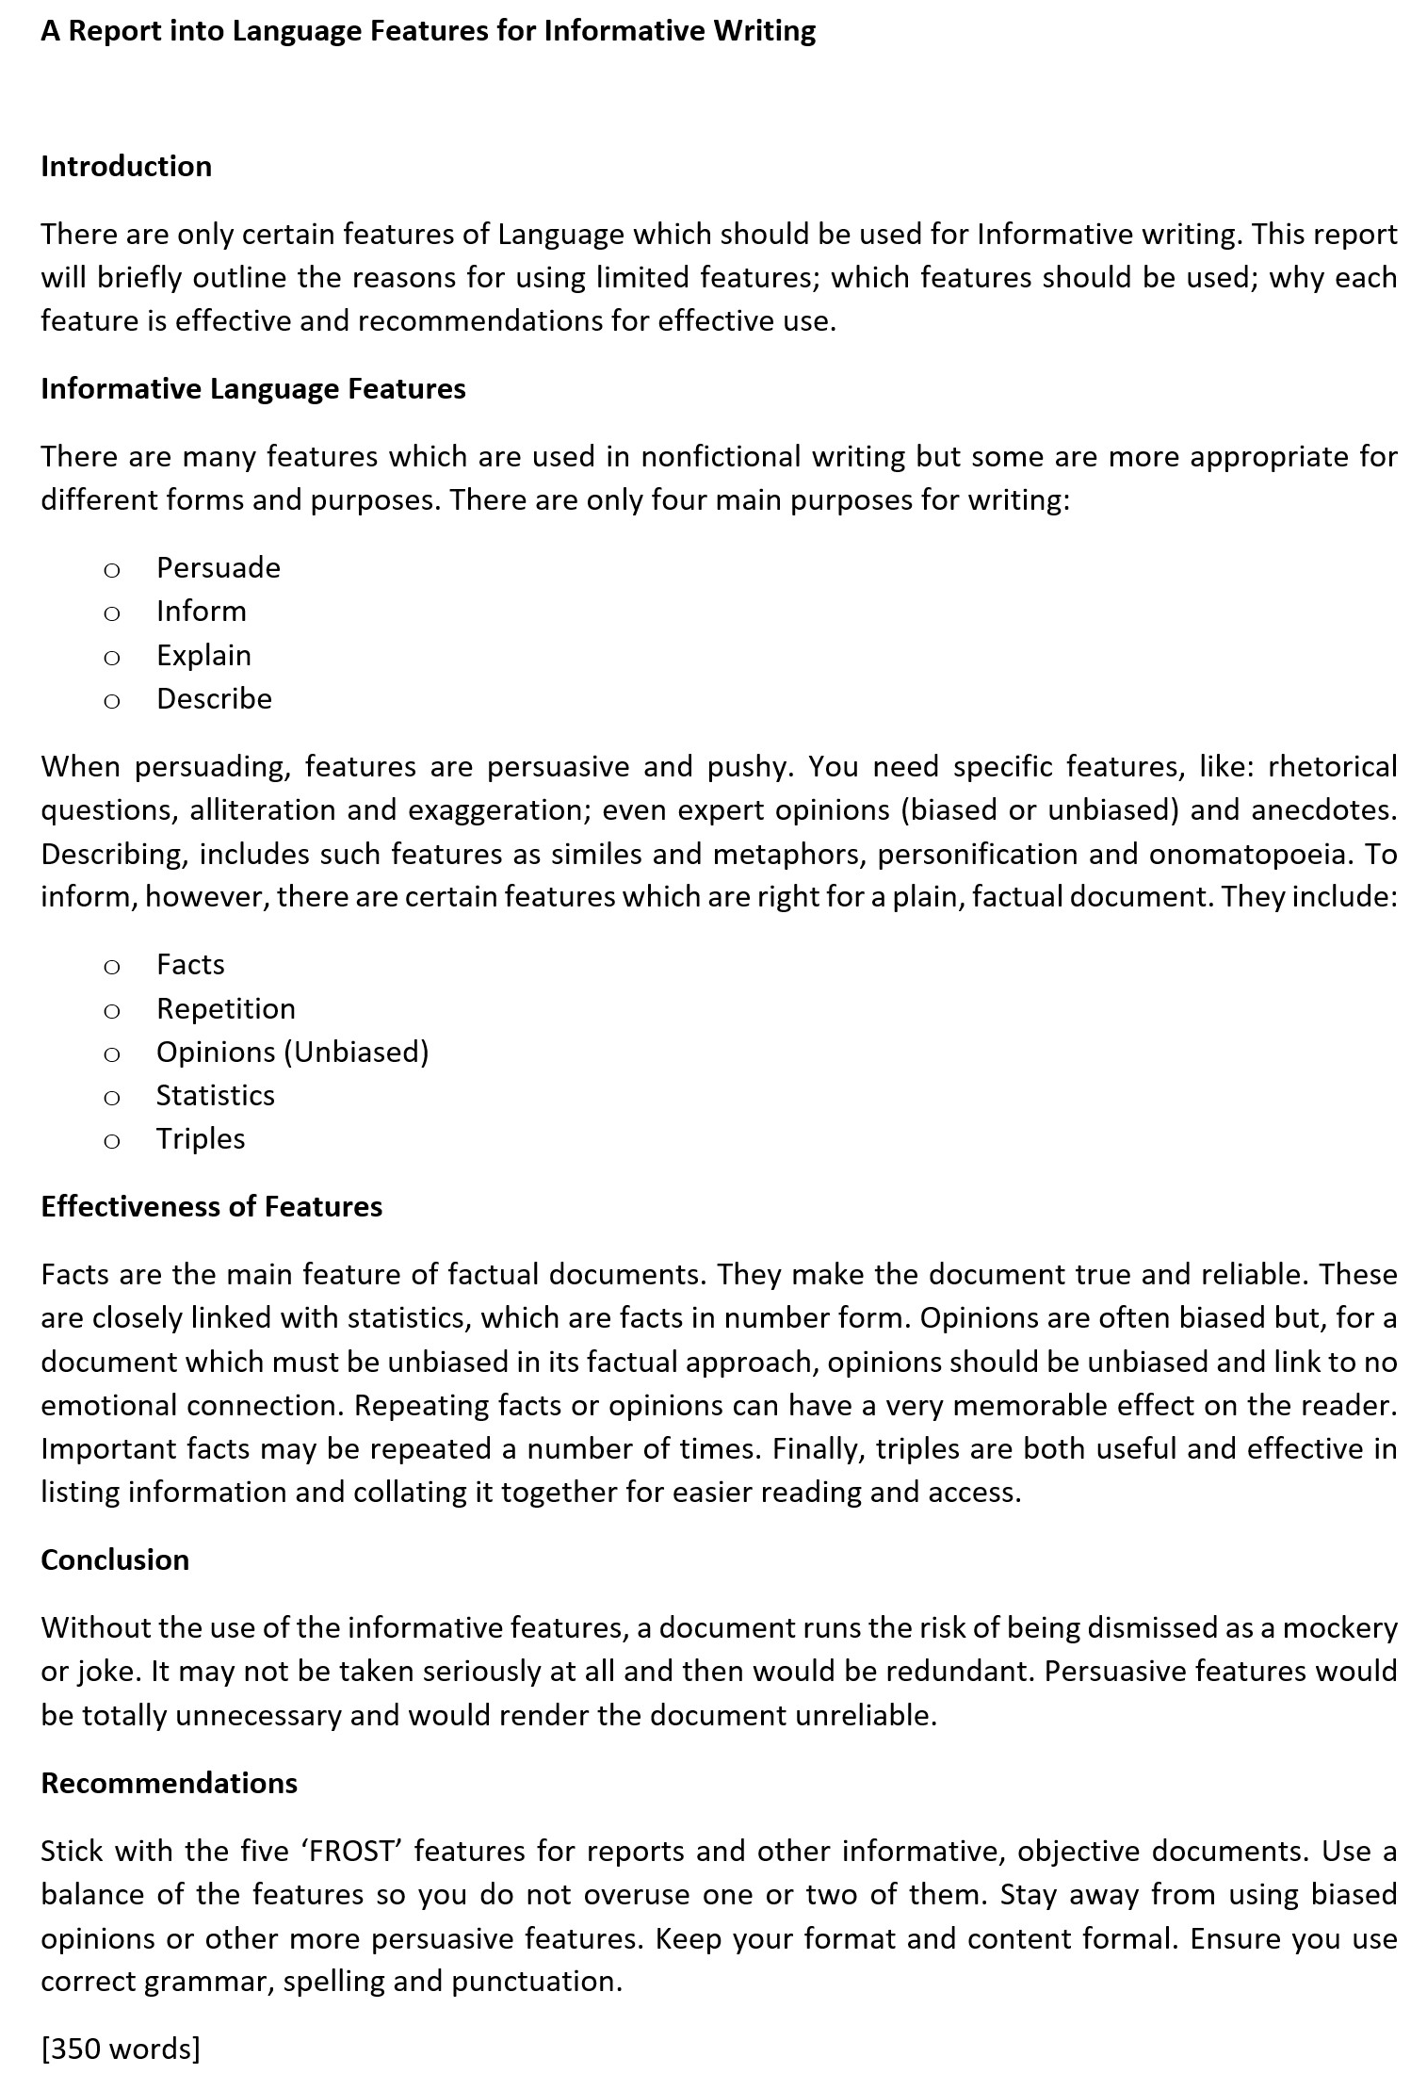
Academic Report.
The type of report you will have to write is an Academic Report.
Every report is specific to a subject and problem but they each will always contain:
Heading
Introduction
Subheadings
Conclusion

Slide 8
A
D
E
E
P
F
O
R
E
S
T
LLITERATION
ESCRIPTIVE FEATURES (ADJECTIVES/ADVERBS/METAPHORS/SIMILES)
XAGGERATION (HYPERBOLE)
MOTIVE LANGUAGE
RONOUNS
ACTS
PINIONS (UNBIAS)
HETORICAL QUESTIONS/REPETITION
XPERT OPINIONS
TATISTICS
RIPLES
Find some in the example:
Informative Features

Slide 9
Task -Give an example of the following:
Facts …eg,
Repetition eg,
Opinions (Unbiased) eg,
Statistics eg,
Triples eg,

Slide 10
Informative Features
Opinions (Unbiased )
Unbiased means to be impartial and objective…
If you’re impartial – you don’t care either way…

Slide 11
Opinions or Facts?
Informative Features
I think the Sun is amazing.
Pizza comes from Italy.
I’m sure the world is round.
The World Cup starts soon.
Time is a healer.
I hate the rain in the UK…
If you’re impartial – you don’t care either way…
You are always being lazy.
The planet is really massive.

Slide 12
Opinions or Facts?
Informative Features
Fact
I think the Sun is amazing.
Pizza comes from Italy.
Opinion
I’m sure the world is round.
The World Cup starts soon.
Opinion
Opinion
Time is a healer.
I hate the rain in the UK…
Opinion
Opinion
If you’re impartial – you don’t care either way…
You are always being lazy.
The planet is really massive.
Opinion
Fact

Slide 13
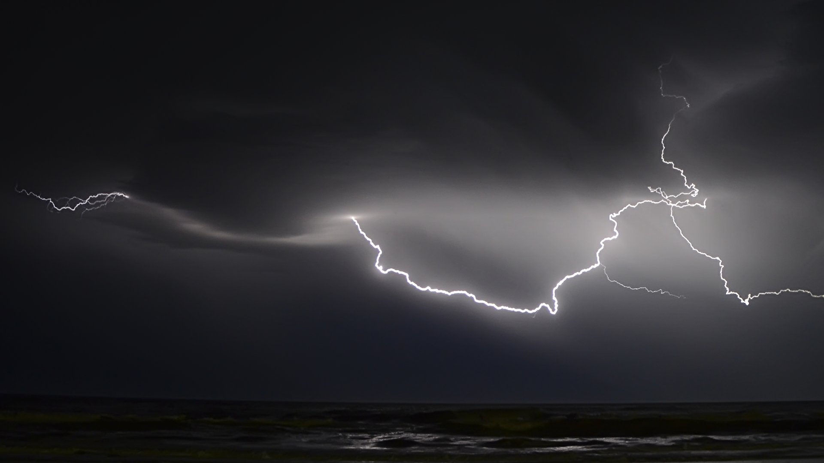
Possible Paragraph Headings
Examples of the layout features that could be in a report:
Title/heading: this explains what the report is about.
Introduction: this section discusses what the report will be looking at and why.
Subheadings: these flag up the parts of the report that include detailed information. There can be many different subheadings depending on the type and content of the report

Slide 14
Possible Paragraph Headings
Method of research or methodology: this section explains how any research carried out was conducted; for example, using a survey or questionnaire.
Findings: this section includes relevant information, such as problems found or the results of a survey carried out.
Conclusion: this summarises the main points in the report.
Recommendations: this section offers thoughts as to what action could be taken as a result of the information in the Findings and Conclusion sections.

Slide 15
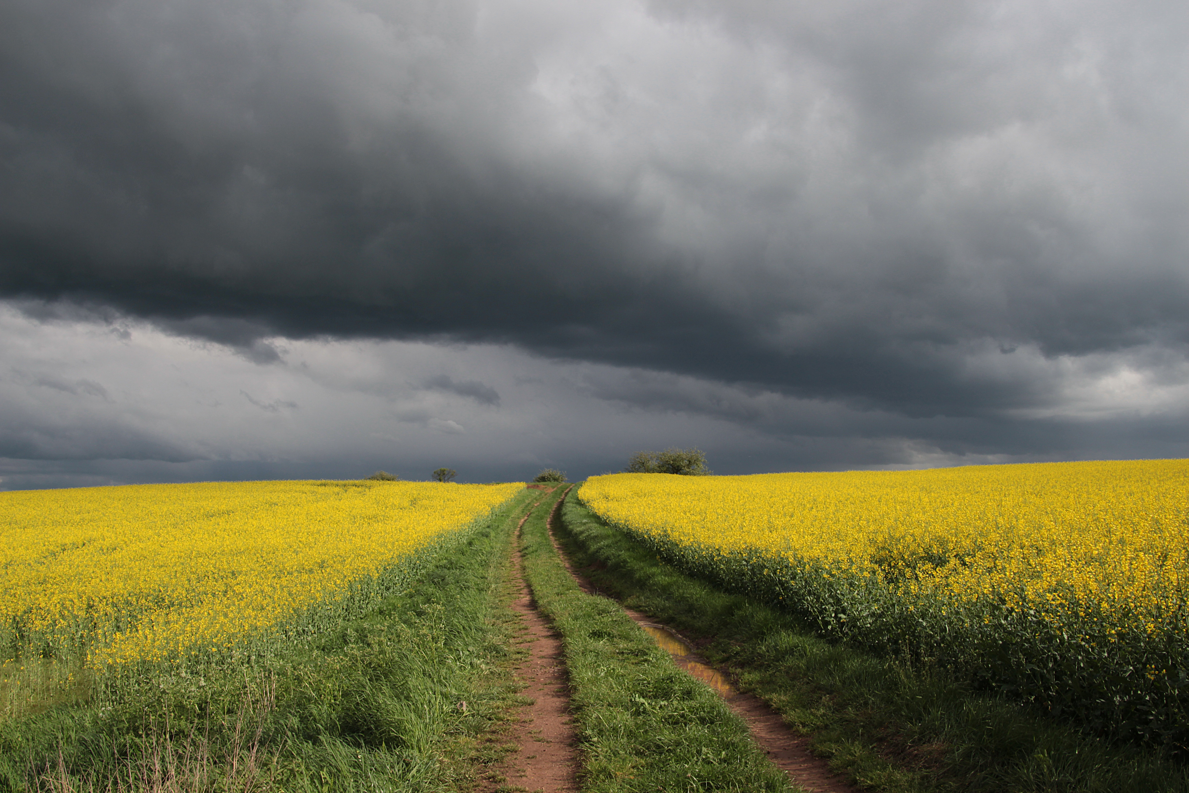
A Report into Bad British Weather:
Brief:
British weather is widely famous for its almost consistent rainfall, lack of sunshine and minimal Christmas snow. It is commonly known that most British people also think that the weather is poor, in comparison to neighbouring European countries such as both Italy and Spain. There have, however been reports, recently, of ‘heatwaves’ in the summer time and some even say that Global Warming is to blame. Write a factual report, with information from online sources, and attempt to recommend solutions to this well-known issue.
Brief:
British weather is widely famous for its almost consistent rainfall, lack of sunshine and minimal Christmas snow. It is commonly known that most British people also think that the weather is poor, in comparison to neighbouring European countries such as both Italy and Spain. There have, however been reports, recently, of ‘heatwaves’ in the summer time and some even say that Global Warming is to blame. Write a factual report, with information from online sources, and attempt to recommend solutions to this well-known issue.
Use this to plan a report on
British weather.

Slide 16
Planning: Bad British Weather
STRUCTURE
Report: Bad British Weather
Introduction
Subheadings:
Constant Rainfall
Lack of Sunshine
Limited Holiday Snow
Findings – How does it affect people/businesses?
Conclusion – summary.
Recommendations – how can it be improved?
CONTENT
Facts to Include:
UK Public dislike it.
It’s well-known globally.
Reports of heatwaves.
Some think Global Warming is heating UK up.
Online Articles/Websites/Blogs
Is it really that bad?
Emigrate or have more holidays!
Use this as your plan if you can’t think of a topic to focus on yourself.
The main titles would be the same no matter which you decide to do.

Slide 17
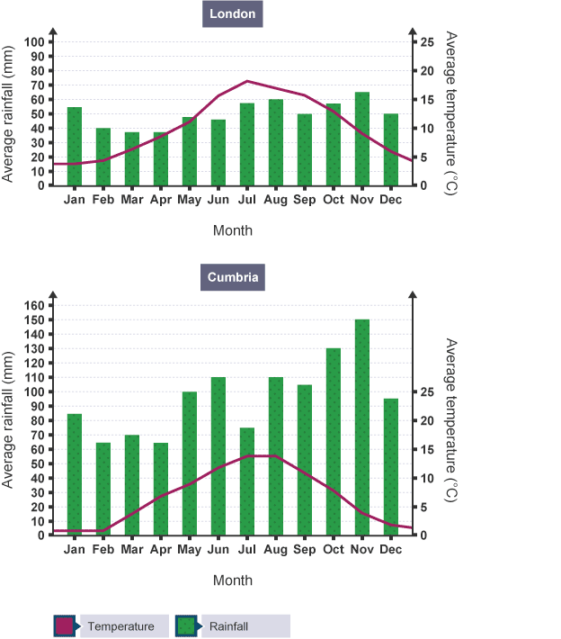
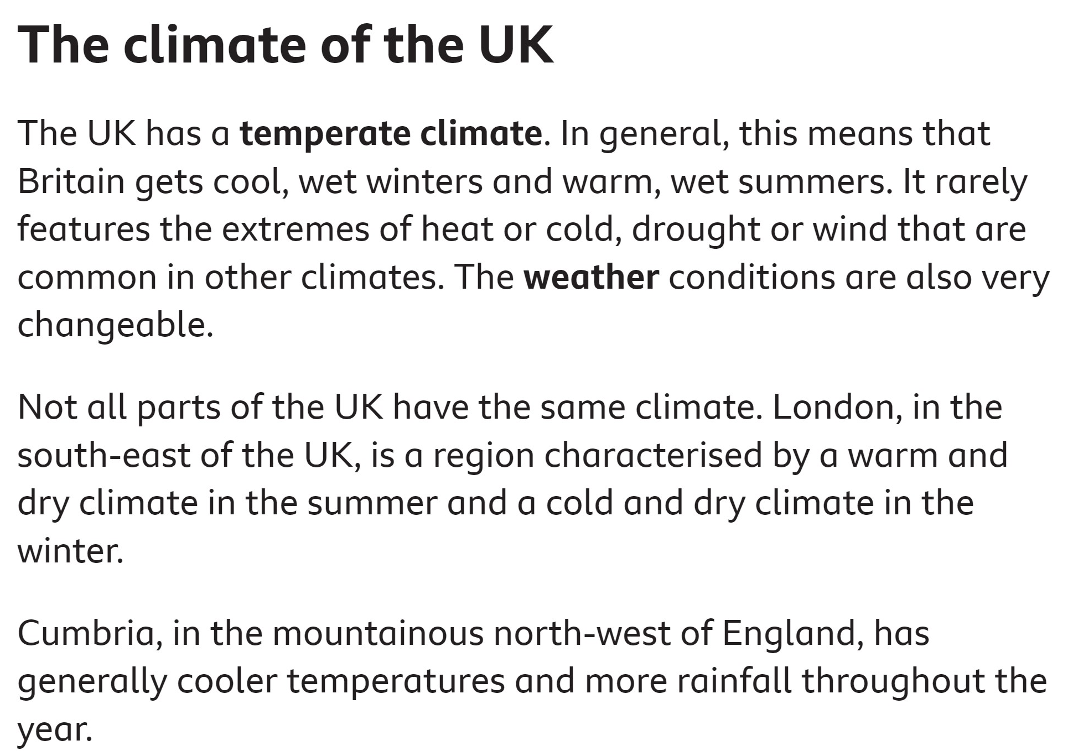

Slide 20
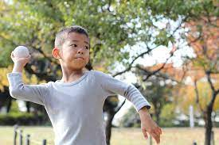
Over to you! Take 10 minutes to plan your ideas for a report on British weather

Slide 21
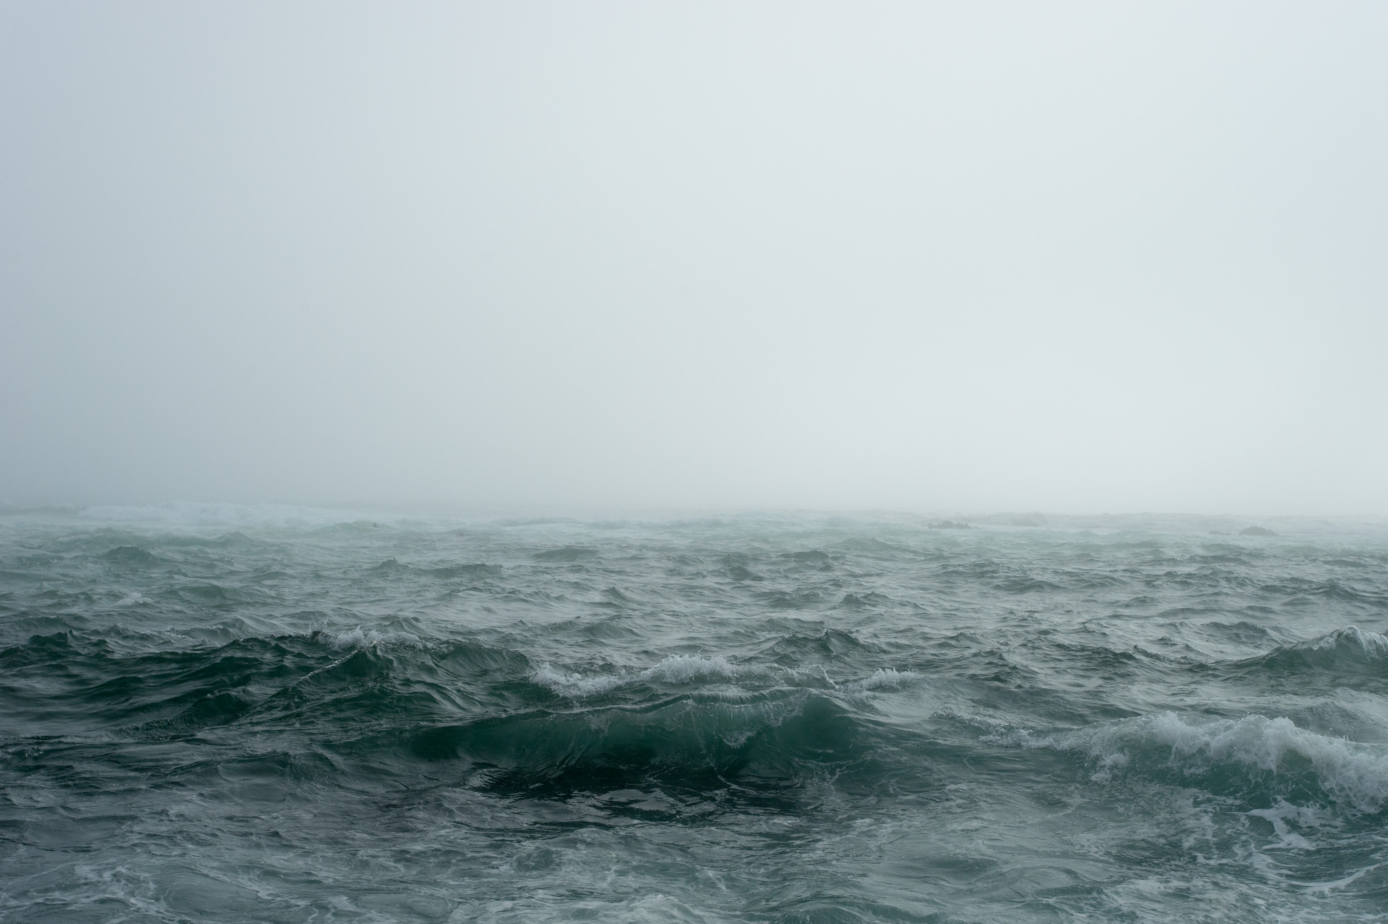
What could you report about?
Local Shops Closing
College Improvements
Local Town/City Improvements
The British Obesity Crisis
Education
Politics
Crime
Local/National/Global Events
Homelessness/Poverty
Racism/Ageism/Sexism
Discrimination
Equal Rights
Shopping
Holidays/Travel/Tourism
Immigration/Emigration
War
Scientific Discovery
Films
Media/Social Media
Music
Jobs/Careers
Capital Punishment
Medical Advancements
Technology/Advancements

Slide 22
Now you decide what to write a report about…
Plan it for your homework task!
Local Shops Closing
College Improvements
Local Town/City Improvements
The British Obesity Crisis
Education
Politics
Crime
Local/National/Global Events
Homelessness/Poverty
Racism/Ageism/Sexism
Discrimination
Equal Rights
Shopping
Holidays/Travel/Tourism
Immigration/Emigration
War
Scientific Discovery
Films
Media/Social Media
Music
Jobs/Careers
Capital Punishment
Medical Advancements
Technology/Advancements

