Slide 1
Aim of the session:
By the end of the session learners will be able to
Practice speaking using dates, weather, hobbies
recap previous session
practise conversations-health problems

Slide 2
What’s the date today? 05/10/2021 The fifth of October yesterday? 04/10/2021 The fourth of October
Tuesday

Slide 3
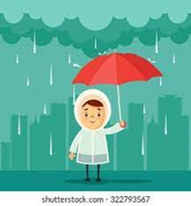
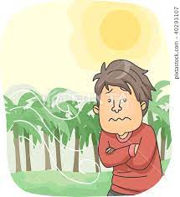
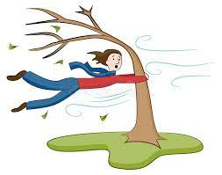
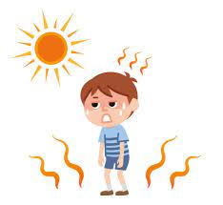
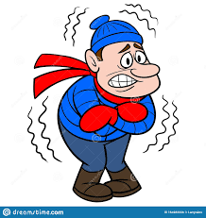
rainy
cool
windy
warm
sunny
snowy
cold
hot
cloudy

Slide 4
The weather
What is the weather like today?
It’s sunny and cool. A little bit cloudy.

Slide 5
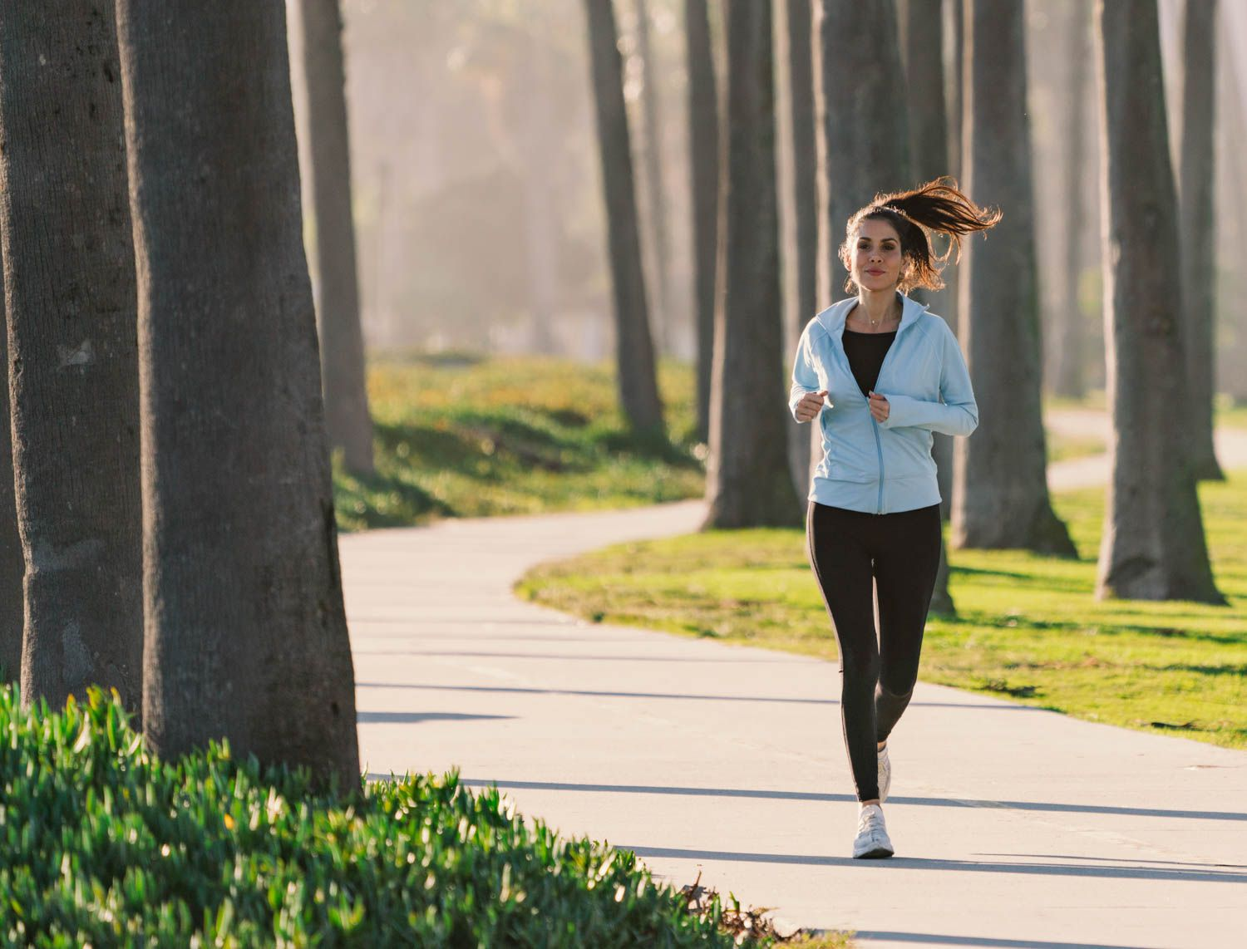
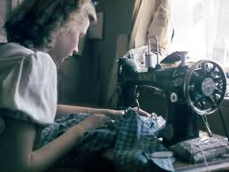
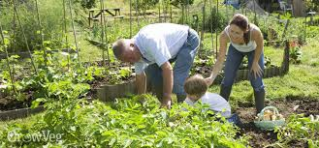
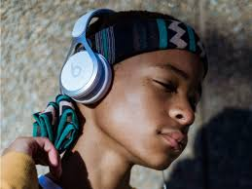
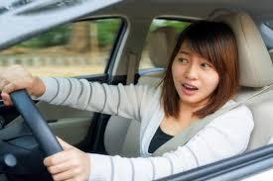
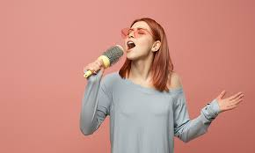
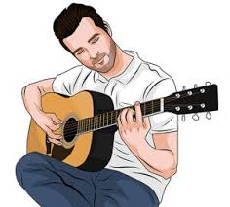
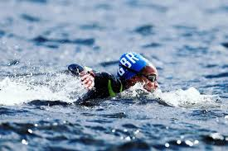
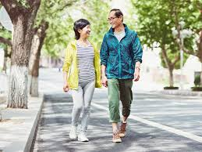
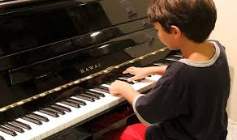
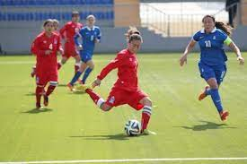
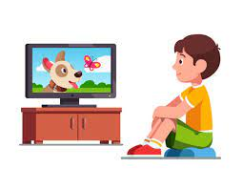
Hobbies-playing football, watching TV, running, singing, playing the guitar, playing the piano, walking, swimming, painting, sewing, gardening, driving, listening to music

Slide 6
I+like+Ving (+)
I like walking, watching TV and painting.
I like swimming, driving and walking.
I like watching TV, playing football and driving.
I like playing the guitar, swimming and listening to music.
I + don’t+ Ving (-)
I don’t like swimming and playing the guitar.
I don’t like listening to music and painting.
I don’t like swimming and singing.
I don’t like playing football and watching TV.

Slide 7
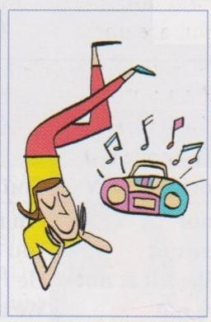
1- What’s she doing?
She is listening to music.

Slide 8
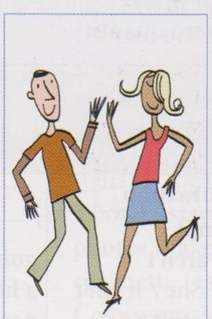
1- What are they doing?
They are dancing.

Slide 9
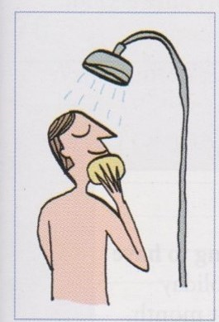
1- What is he doing?
He is taking shower.

Slide 10
Conversations about health problems- What’s the matter?
https://www.vocabulary.cl/english/health-problems.htm

Slide 11
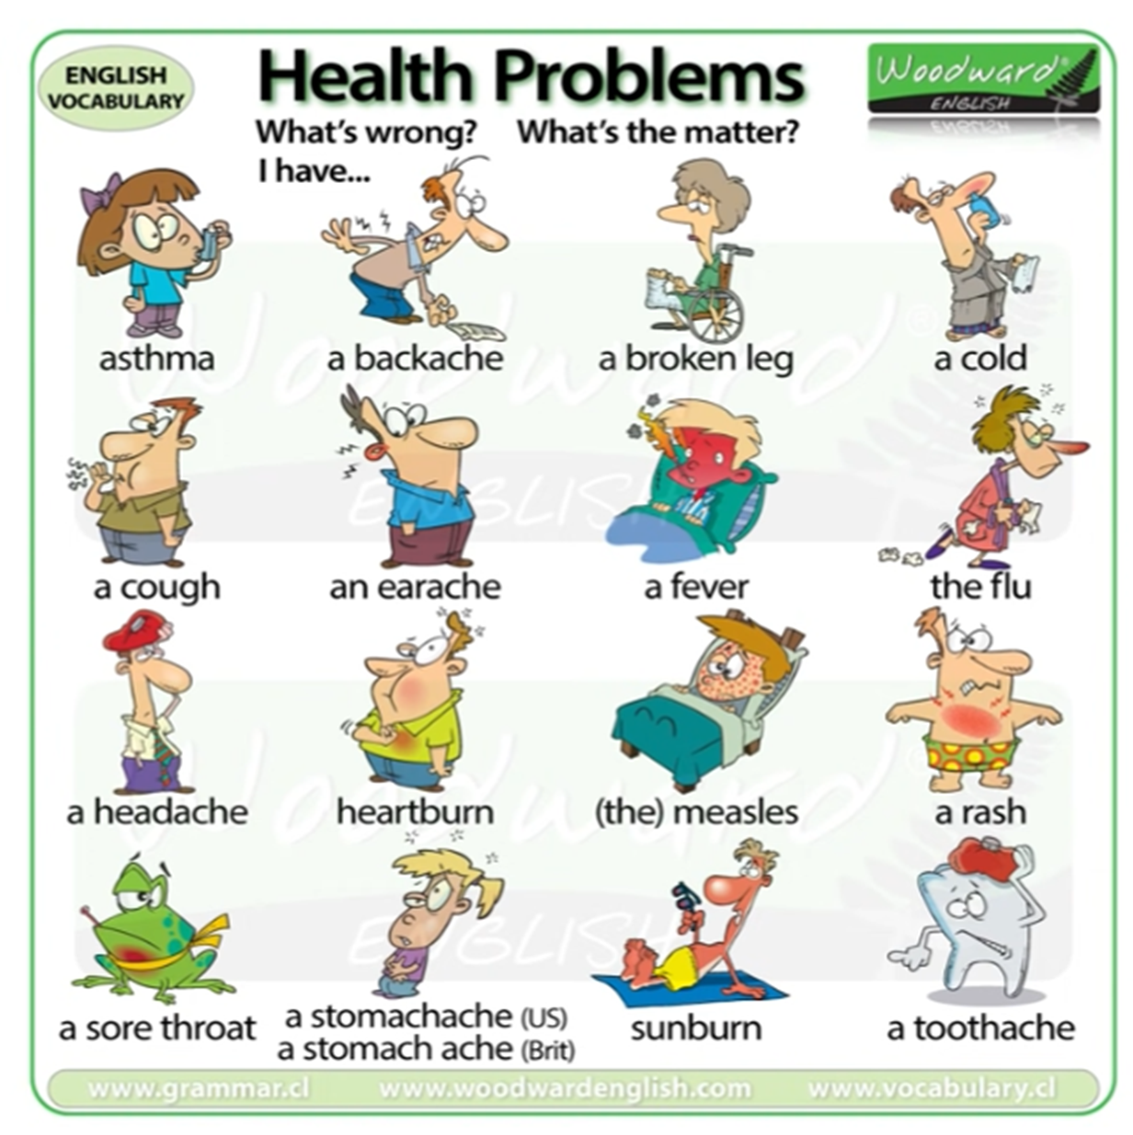

Slide 12
What’s the matter teacher? What’s wrong?
I have a headache.
I have a sore throat.
I have a fever.
I have an earache.
I have a backache.
I have a cough.
I have a cold.
I have the flu.
I have a toothache.

Slide 13
What’s the matter teacher? What’s wrong?
I have a headache.
I have an earache.
I have a backache.
I have a stomach ache.
I have a toothache
I’ve got a headache.
I’ve got an earache.
I’ve got a sore throat.

Slide 14
Word+ache
backache.
stomach ache.
toothache
headache.
earache.

Slide 15
Write the questions and answers
https://www.liveworksheets.com/cu2301725kx in the class - I
https://www.liveworksheets.com/yi2324632pr individually - I

