Slide 1
ESOL L1 Spring Term
1st Feb 2021

Slide 2
Session aims/objs
Aim: advertising a home service
Objs: by the end of this session, you will be able to
Identify purpose of text
Identify features of persuasive language
Use persuasive language to advertise a home service
Write to persuade

Slide 4
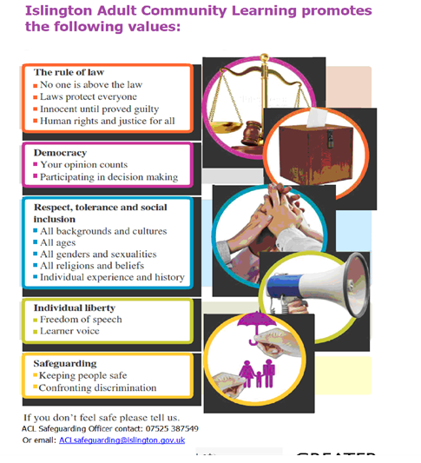

Slide 5
Our ACL 1-1 IAG offer
A confidential service for learners
Up to 3 one hour sessions with a qualified adviser
Adherence to the Guidance Council’s Code of Principles (impartial, current, confidential, in accordance with equality and diversity legislation, accessible, individual ownership, transparency)
and the Career Development Institute’s Code of Practice (as above, also duty of care, accountability and CPD)
Notes:
Any organisation which manages, administers and delivers an IAG service to support individuals in their career, learning, work or life goals has the chance to achieve matrix accreditation.
This is regardless of whether the service or services are delivered face-to-face, through training, learning, remotely, or through a website.

Slide 6
How can learners book an appointment?
For the summer term we are offering IAG sessions via telephone and/or via MS Teams
For ESOL tutors and their learners:
Contact Gulcoy on 07712 403428
Email gulcoy.esen@islington.gov.uk
Appointments available:
Mondays and Tuesdays 1.30 - 3pm
For general appointments:
Contact Alison on 07808 879044
Email Alison.moore@islington.gov.uk
Appointments available:
Tuesdays and Thursdays
9.30am - 12.30pm and 1 – 4pm
To find out about all or our courses on offer visit: www.adultlearning.islington.gov.uk

Slide 7
Head of Service Q&A session
Duration: 1 hour
Date: Tuesday 2nd March
Time: 10 to 11am
If you are interested in attending this online Zoom session, please let your tutor know.

Slide 8
What does purpose of text mean?
What does purpose of text mean? (reason)
Can you name some?
Persuade
Advise
Inform
Describe
Entertain
Instruct
3. What are the features of each purpose?
Complete these boxes

Slide 9
Persuasive text contains the following features
Repetition (tripling)
Exclamation marks
Rhetorical question
Colourful images
Extreme adjectives
Different font styles
Emboldened font
Use of personal pronoun
One sided argument

Slide 10
Identify features of persuasive language
Colourful images
Exclamation marks
Emboldened/bold/capital letter
Rhetorical question
Extreme adjectives
Personal pronouns
Mixed font styles

Slide 11
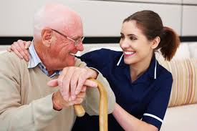
Can you name the services that are provided at home from these images?

Slide 12
Can you think of some services that are provided by companies to people at home?
For example
Domestic cleaning
Gardening services
Delivering items
Electrical services
Plumbing
Hairdressing
Window cleaning
Painting/decorating
Carpet fitting
Removal service
Tutoring
Event management

Slide 13
What can you see? What is being advertised? What features of persuasive text has been used?

Slide 14
What can you see?
What is being advertised?
What features of persuasive text has been used?

Slide 15
Independent task
Use persuasive language to advertise a home service

Slide 16
Summary
Today we…..
Used persuasive language
Talked about purposes of text
Independent work
Planning to write an advertisement
H/W: complete learner profile and Health & Safety quiz on Moodle or any other outstanding work.

Slide 17
The end

Slide 18
References:

