Slide 1
Welcome to the Family Language Class With Lauren স্বাগত Sbāgata soo dhawoow Hoşgeldiniz

Slide 2
Key Words and Phrases
yes
no
please
thank you
sorry
welcome
How are you?
Are you alright?
Are you OK?
Do you understand?

Slide 3
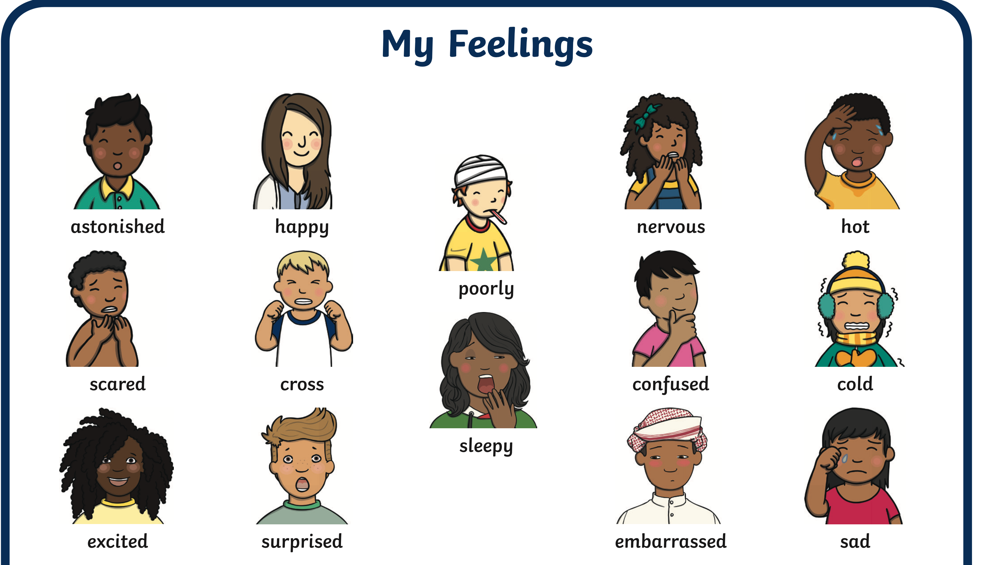

Slide 6
First Second Third Fourth Fifth Sixth Seventh Eighth Ninth Tenth
Eleventh
Twelfth
Thirteenth
Fourteenth
Fifteenth
Sixteenth
Seventeenth
Eighteenth
Nineteenth
Twentieth

Slide 7
Days of the week Monday Tuesday Wednesday Thursday Friday Saturday Sunday

Slide 8
What is your favourite day of the week? What do you do ?

Slide 9
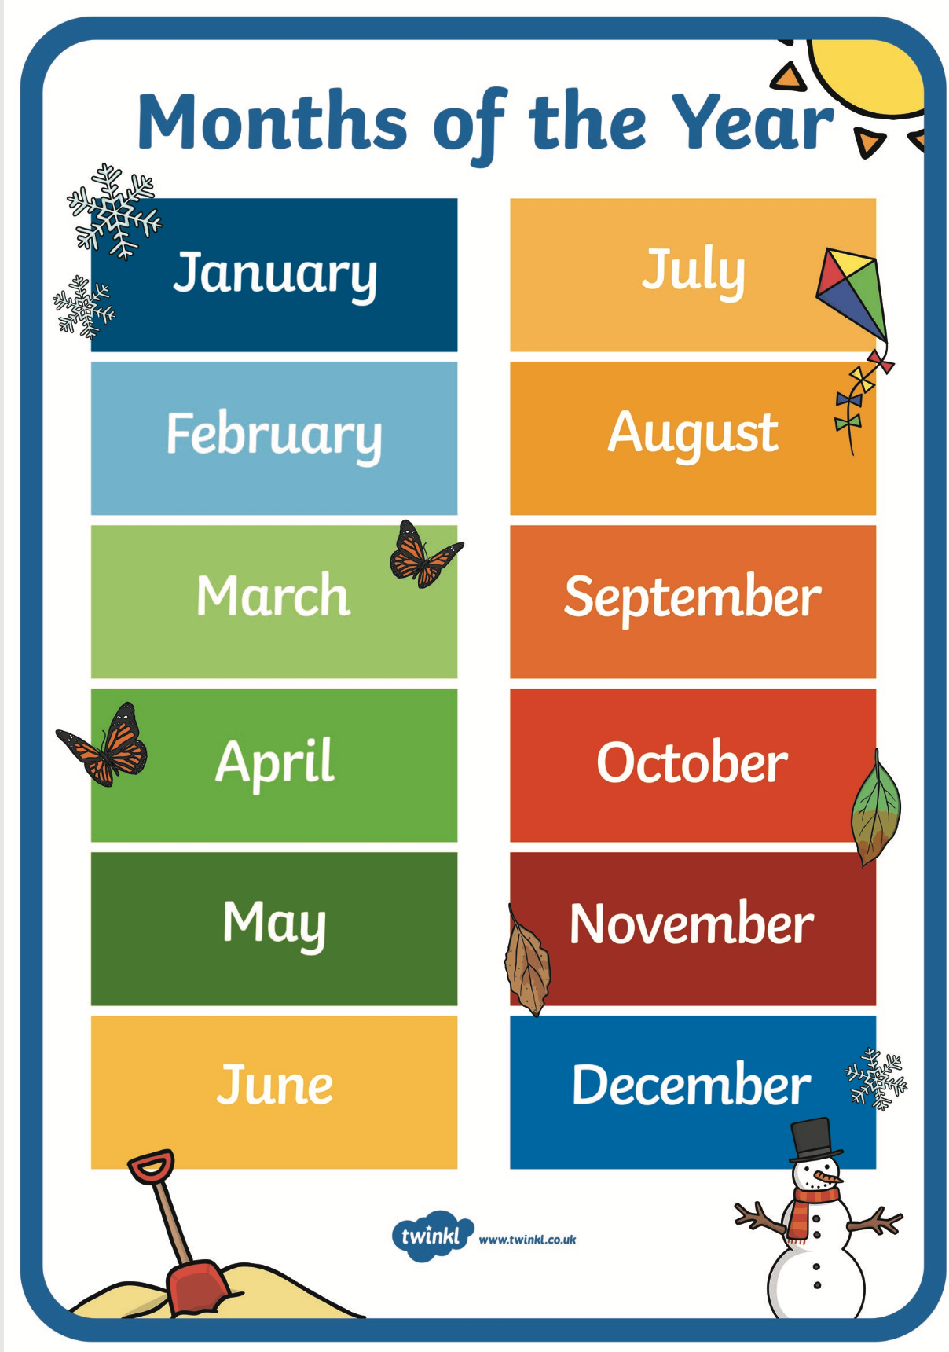

Slide 10
When is your birthday? When is your husbands birthday? When were your children born?

Slide 11
Winter
Autumn
Summer
Spring

Slide 16
What is your favorite season? Why do you like it?

Slide 18
Numbers Days of the week Months Seasons Weather

