Slide 1
Aim of the session:
By the end of the session learners will be able to
Familiarize with Moodle website
Check homework
Expand health vocabulary
Keep a spelling diary
Understand questions and say what’s wrong.

Slide 2
What’s the date today? 28/09/2021 The twenty-eighth of September

Slide 3
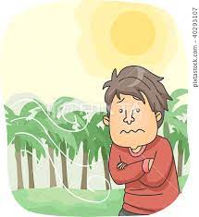
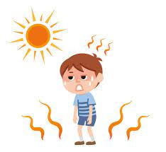
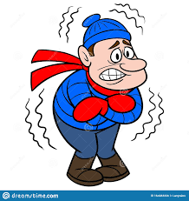
hot
windy
warm
snowy
sunny
cold
cloudy
rainy
cool

Slide 4
The weather
What is the weather like today?
It is miserable.
It was rainy in the morning but now it is not raining.
It’s cloudy.

Slide 5
1-It is Tuesday. It was Monday.
2- It is September. It was August.
3- No, it’s not. No, it wasn’t.
4-I’m at home. I was at home.

Slide 6
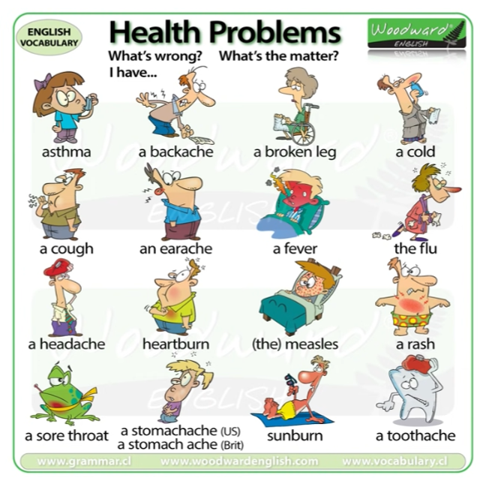

Slide 7
Health vocabulary- video
https://www.vocabulary.cl/english/health-problems.htm

Slide 8
Homework1:
https://www.liveworksheets.com/worksheets/en/English_as_a_Second_Language_(ESL)/Illnesses_and_health_problems/What's_the_Matter_oe615158tf
Homework2:
https://www.liveworksheets.com/worksheets/en/English_as_a_Second_Language_(ESL)/What's_the_matter$/Matters_hd1841240qk

