Slide 1
What’s the date today? 08/10/2021 The eighth of October yesterday? 7/10/2021 The seventh of October tomorrow? 9/10/2021 The ninth of October
What day is it today?
It’s Friday.
Yesterday?
Thursday
Tomorrow?
Saturday

Slide 2
Aim of the session:
By the end of the session learners will be able to
Practice speaking using dates, weather, hobbies and classroom language
recap previous session-play games
Alphabet- put the words in alphabetical order
Listen to information and put them in order-registering a GP
Fill in a simple form

Slide 3
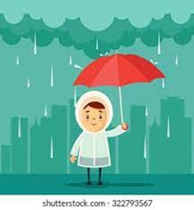
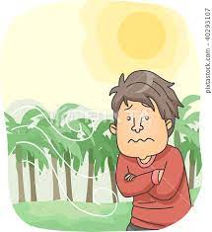
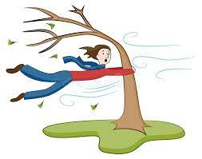
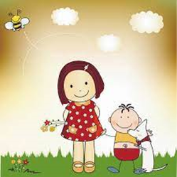
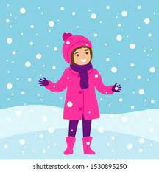
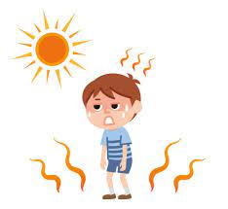
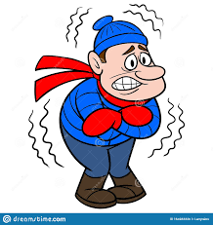
rainy
cool
windy
warm
sunny
snowy
cold
hot
cloudy

Slide 4
The weather
What is the weather like today?
It’s cloudy, cool but dry. (not rainy)
Yesterday?

Slide 5
Classroom language
Repeat
Can you repeat that please? (Say it again please)
Mean
What does that mean?
What does cool mean? (Tell me the meaning of cool)
It means not very cold.

Slide 6
I+like+Ving (+)
I like walking, watching TV and painting.
I like swimming, driving and walking.
I like watching TV, playing football and driving.
I like playing the guitar, swimming and listening to music.
I + don’t+like+ Ving (-)
I don’t like swimming and playing the guitar.
I don’t like listening to music and painting.
I don’t like swimming and singing.
I don’t like playing football and watching TV.

Slide 7
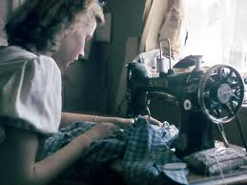
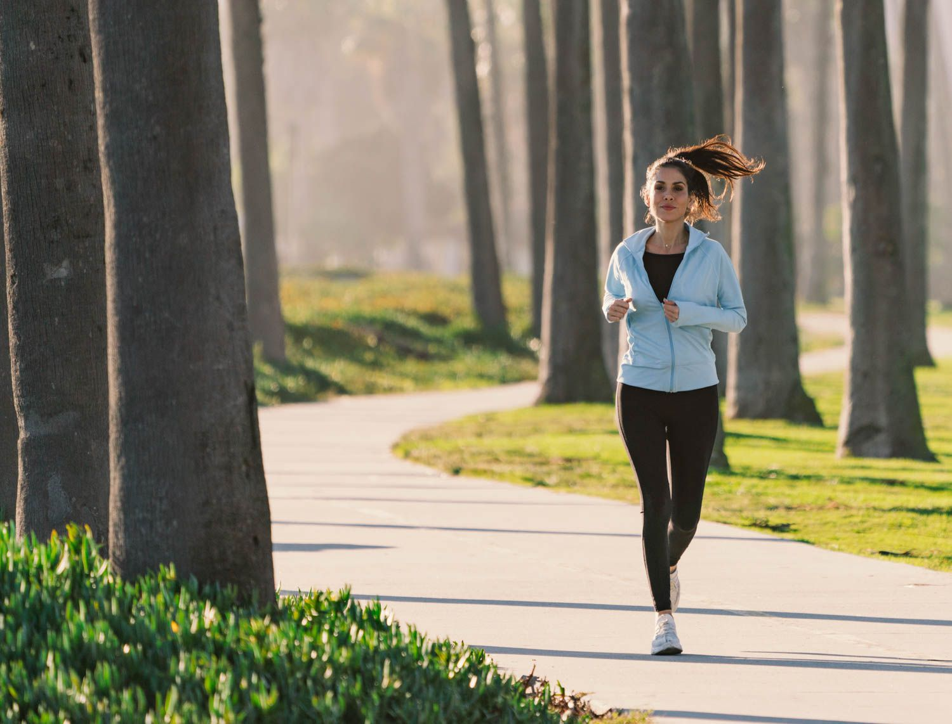
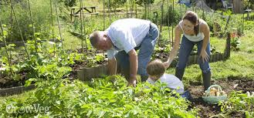
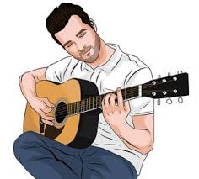
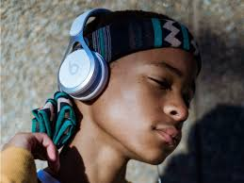
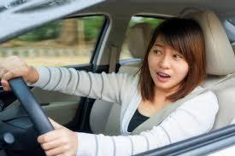
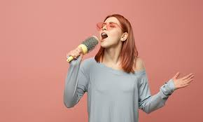
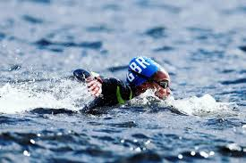
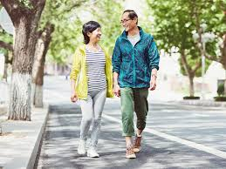
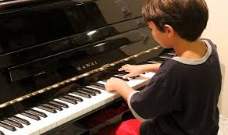
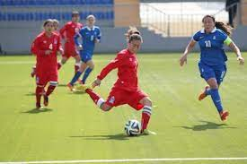
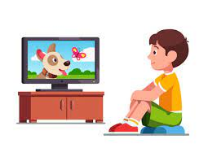
Hobbies-playing football, watching TV, running, singing, playing the guitar, playing the piano, walking, swimming, painting, sewing, gardening, driving, listening to music

Slide 8
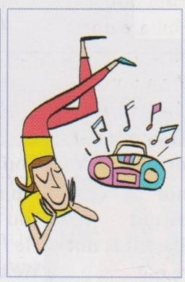
1- What’s she doing?
She is listening to music.

Slide 9
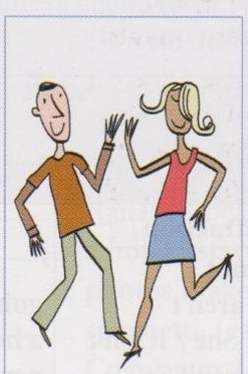
1- What are they doing?
They are dancing.

Slide 10
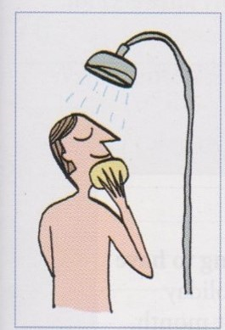
1- What is he doing?
He is taking shower.

Slide 11
Conversations about health problems- What’s the matter?
https://www.vocabulary.cl/english/health-problems.htm

Slide 12
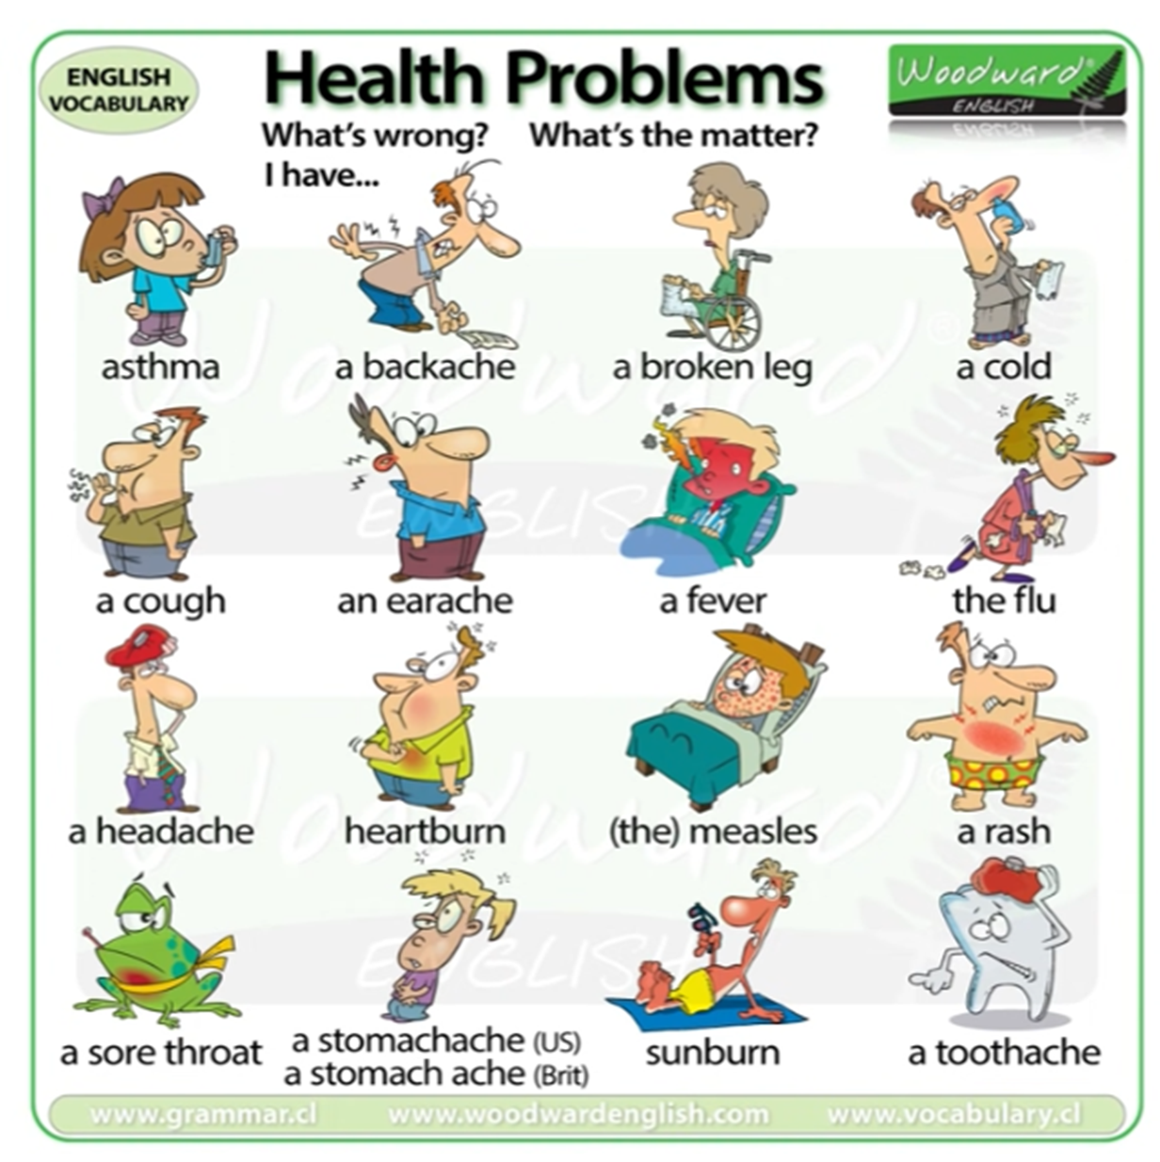

Slide 13
What’s the matter teacher? What’s wrong?
I have a headache.
I have a sore throat.
I have a fever.
I have an earache.
I have a backache.
I have a cough.
I have a cold.
I have the flu.
I have a toothache.

Slide 14
Write the questions and answers
https://www.liveworksheets.com/cu2301725kx in the class - I
https://www.liveworksheets.com/yi2324632pr individually - I

Slide 15
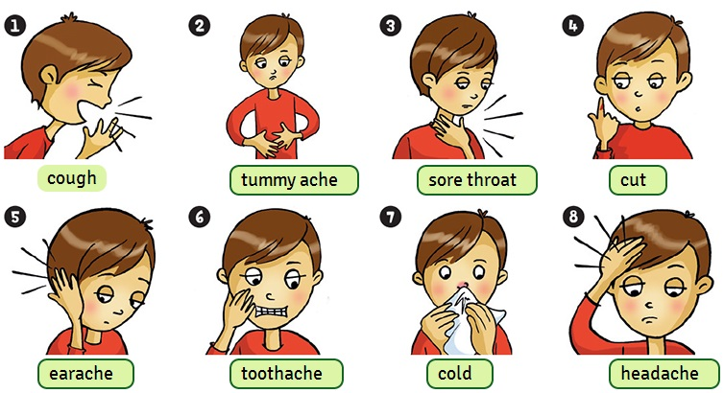
What’s the matter teacher? What’s wrong?
I have a headache.
I have an earache.
I have a backache.
I have a stomach ache.
I have a toothache
He has a cut on his finger.
I’ve got a headache.
I’ve got an earache.
I’ve got a sore throat.

Slide 16
Word+ache Where is your ear?
backache.
stomach ache. =tummy ache eyk
toothache
headache. Ache=pain
Earache.
What does ache mean?
Ache means pain.

Slide 17
Body parts
https://www.liveworksheets.com/worksheets/en/English_as_a_Second_Language_(ESL)/Parts_of_the_body/Body_parts_pj330239lk
https://www.liveworksheets.com/worksheets/en/English_as_a_Second_Language_(ESL)/Parts_of_the_body/Body_Matching_Game_sl95116vh

Slide 18
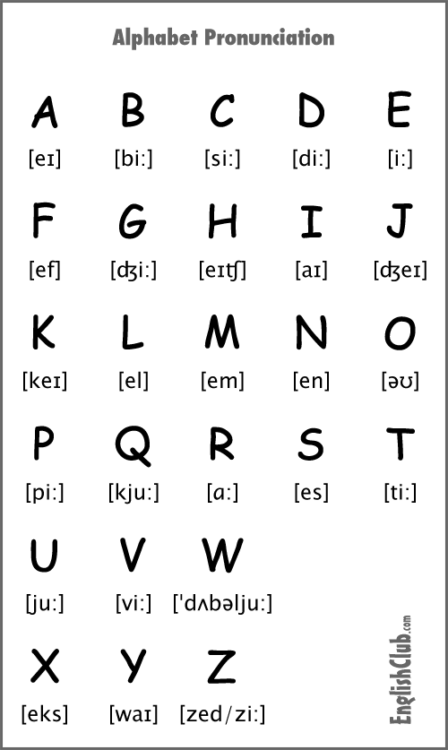
backache. 1
stomach ache 4
Toothache 5
headache. 3
earache. 2

Slide 19
Games- illnesses
https://wordwall.net/resource/16990783/illnesses
What’s the matter?
https://wordwall.net/resource/16990783/illnesses
I’ve got
https://wordwall.net/resource/17085739/esol-esl/whats-the-matter-whats-wrong-illness
Anagram-illnesses
https://wordwall.net/resource/16390585/whats-the-matter
Quiz-illnesses
https://wordwall.net/resource/3467115/whats-the-matter-memory

Slide 20
Registering with a doctor
https://www.excellencegateway.org.uk/content/etf685
Listen to the conversation and write the questions

Slide 21
Registering with a doctor
Can I help you?
What’s your family name?
Can you spell that?
What’s your first name?
What’s your nationality?
What’s your date of birth?
Where do you live?
Sorry, what’s your post code, again?
Do you have a telephone number?

Slide 22
Family name: ……… First name: ……….. Date of birth:………… Address:……………. …………………………… ……………………… Telephone number:……………. Nationality: ……………. Male/Female (please circle)

