Slide 1
Learning objectives
By the end of today you will be able to:
define a fact and opinion
identify facts and opinions from a text
define bias
understand inference

Slide 2
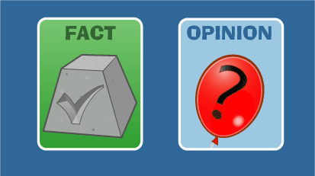
Fact and opinion

Slide 3
Define and give examples

Slide 4
Exam question
Give one fact and one opinion from Document X (L1)
Give two facts and two opinions from Document X (L2)
May ask you to look in a specific section of the document. Remember to read the question carefully!
Facts
Statistics e.g. 40% of …
Proper nouns (capital letters) e.g. The conference was held in Glasgow.
Opinions
Exaggerated language e.g. essential, best ever
Personal language e.g. I think you should …

Slide 5
Try it on the exam text
Give two facts and two opinions from the Document.

Slide 6
Bias

Slide 7
Bias
Define bias
one-sided opinion
personal bias
assumptions
structural bias
discrimination and -isms

Slide 8
Bias
What sorts of texts might be biased?
adverts
political flyers
newspapers/news online
blogs/opinion pieces online

Slide 9
Bias
Why is important to think about bias?
awareness – be informed
prevent manipulation
stop misinformation spreading

Slide 10
Bias
How can you identify bias?
one-sided opinions
selective use of facts
language – best, never, only
language – use of adjectives
use of personal experience
purpose of text – what is it aiming to do?

Slide 11
Try it on the exam text
Is the Document biased? Give evidence for your answer.

Slide 12
Inference

Slide 13
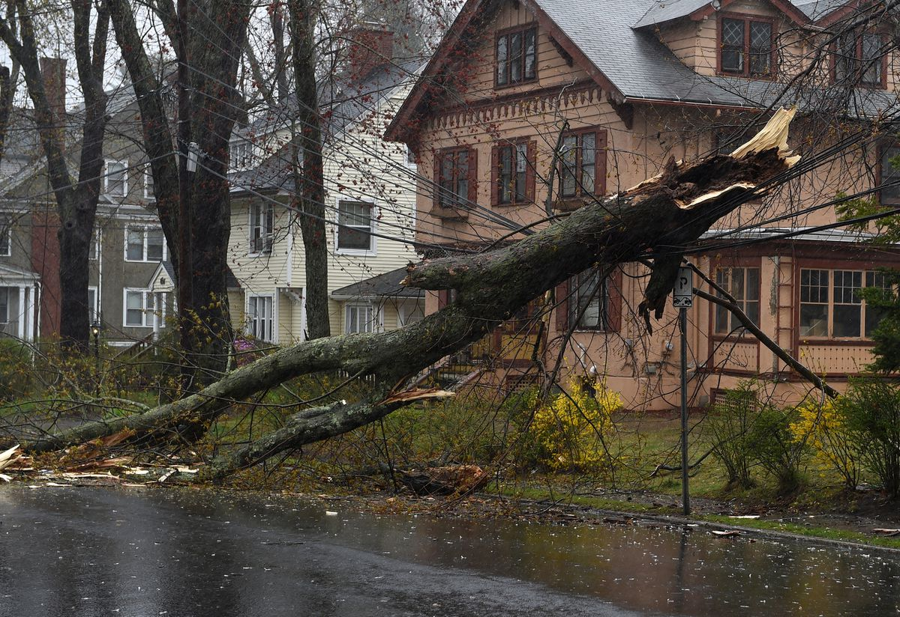
We use inference all the time

Slide 14
Inference
Sometimes meaning is not stated clearly or obviously. It is implied.
This might be because the author:
Is being creative
Doesn’t want to be rude or too blunt
Wants the reader to come to their own conclusion
Wants to be deliberately vague

Slide 15
How to recognise inference
Look for clues or references in the text.
Think about the meanings or suggestions of words used in the text.
Match something in the text to your own understanding, experience or knowledge.

Slide 16
Task
Read the text about Clara
Discuss the questions with your partner
Feed back to the group

Slide 17
Clara
Clara walked slowly down the wet street trying to keep her skirts out of the puddles. The sun was out again, making the ground steam. She found the uneven path painful to her twisted feet and she wished she could see the way better. The heat made her tired and her head ached. She was glad that her bonnet shaded her face. She hoped that she would be able to sell the vegetables in her basket.

Slide 18
Exam question
Example: Liz feels that urgent change is required. Give two phrases she uses to suggest this.
Example: What are four possible implications of job hunters not using social media?
Be aware of the range of language that can be used in the question – infer, inference, imply, implication, suggest. All mean you are looking for something that is implied.

Slide 19
Homework
Complete the modules on BKSB
L2 – Implied Meaning module

Slide 20
Recap learning objectives
By the end of today you will be able to:
define a fact and opinion
identify facts and opinions from a text
define bias
understand inference

