Slide 1
Islington Adult Community Learning Service.
Autumn 2023. Parent House. Thursday 1 to 3 pm
Lesson 4 Teacher: Mercedes F Regalado-Tivy
Phone:07595462023 Email: Mercedes.Regalado@islington.gov.uk

Slide 2
Ice Breaker
FIND SOMEONE WHO… | Question to ask… | Name of person
Speaks Spanish | Excuse me, do you speak Spanish? | Mercedes
Is a vegetarian or vegan | Excuse me, are you vegetarian or vegan?
Is a football player
has a UK driving license
Wants to win the lottery
Is Turkish
Is from Somalia

Slide 3
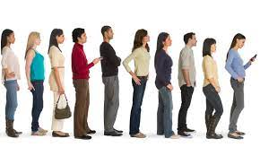
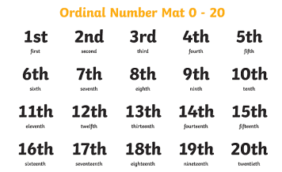
Cardinal numbers are the normal numbers: 1, 2, 3, 4…
Ordinal numbers gives order: 1st, 2nd, 3rd, 4th for example in a queue:
He is the…………. (2nd) in the queue
Today is the ……..(5th) of October
She celebrated her …….(12th) birthday
Peter is my ……. (7th) pet
Today is my…… (42nd) birthday
Today is my…… (35th) birthday

Slide 4
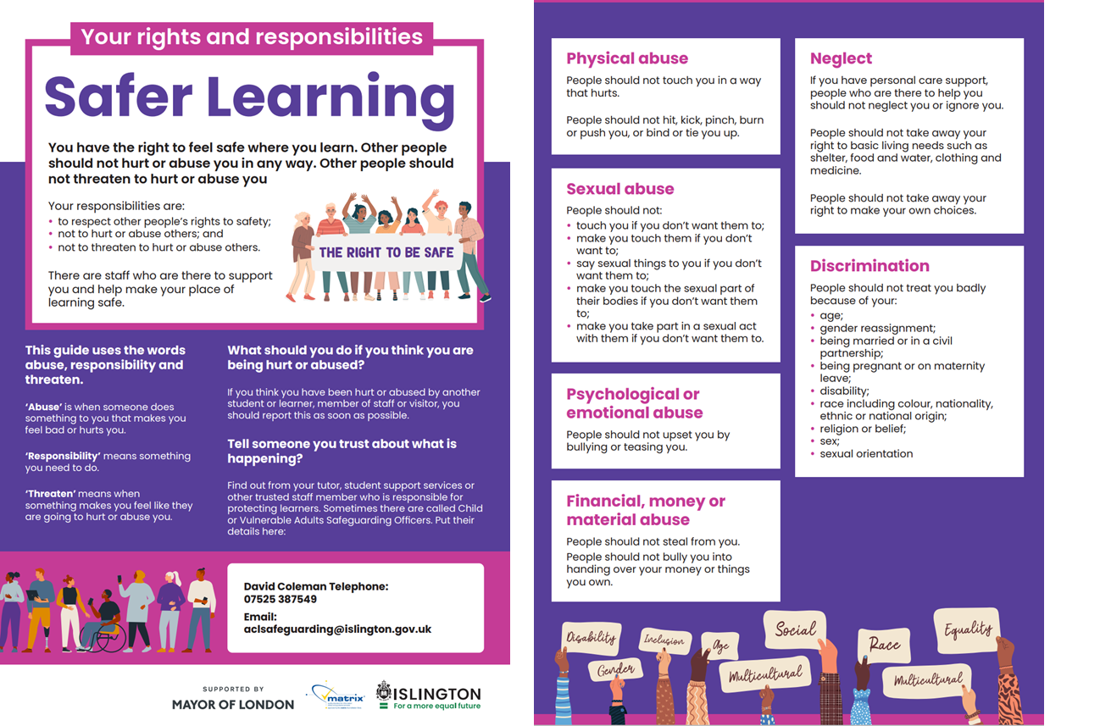

Slide 6
word | sentence | word | sentence
air | I need fresh air | heir | Ivanka is the heir to the Trump empire
aisle |  | Isle
eye |  | I
bare |  | bear
be |  | bee
brake |  | break
buy |  | bye &by
cent |  | scent
cereal |  | serial
coarse |  | course
dear |  | deer
die |  | dye

Slide 7
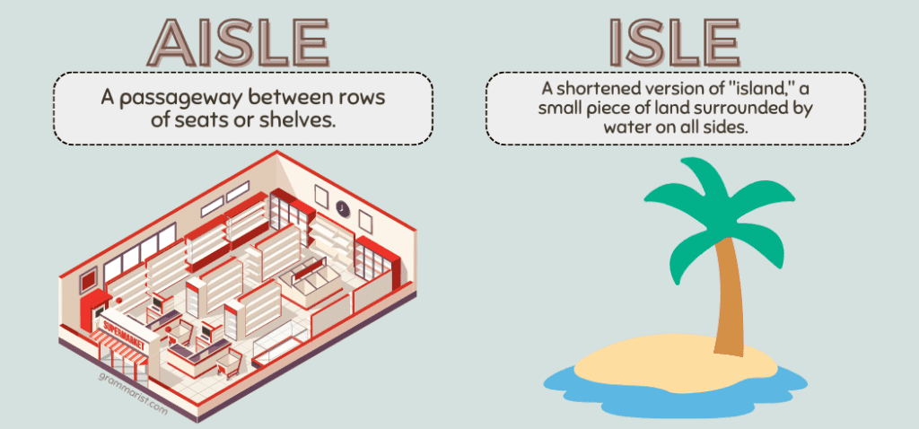
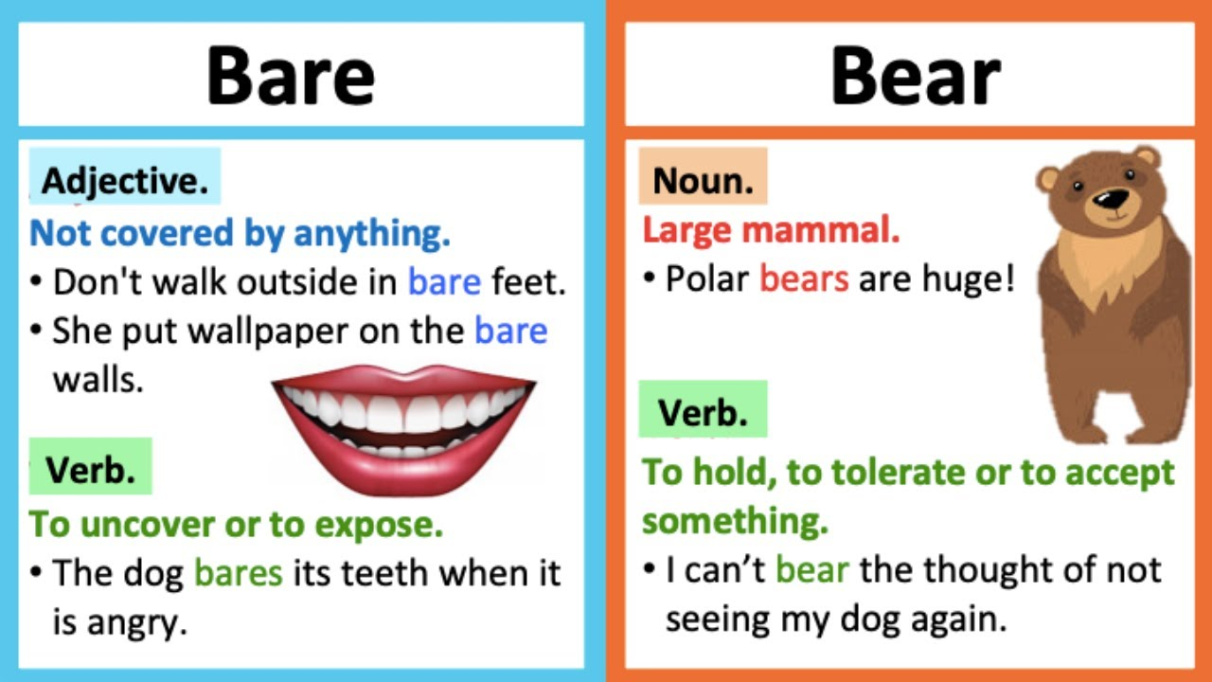
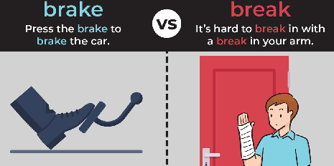
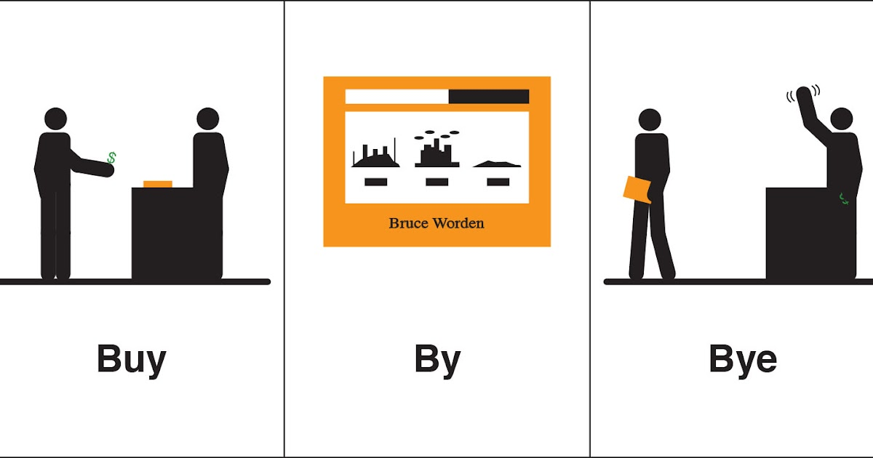
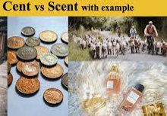
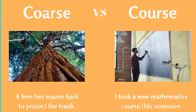
Be:
Verb:
I am
You are
He is
….
Bee

Slide 8
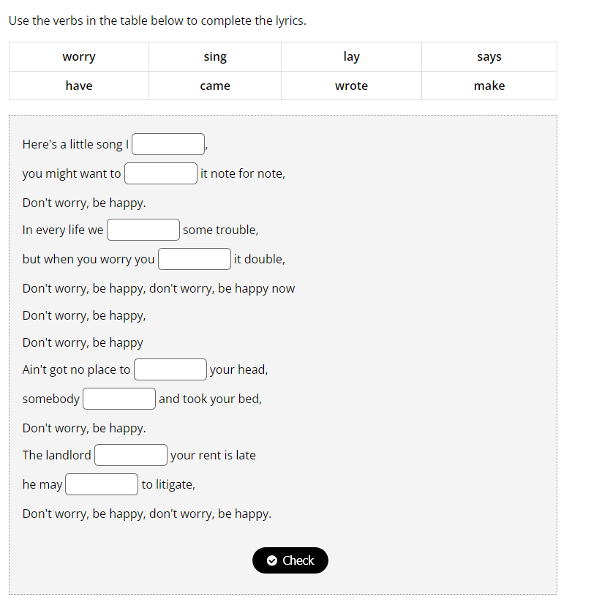
https://www.esolcourses.com/content/topics/songs/various-artists/dont-worry-be-happy.html
https://wordwall.net/resource/47890403/esl/present-simple-
https://wordwall.net/resource/3674029/present-simple
https://wordwall.net/resource/15449538/angielski/present-simple
https://wordwall.net/resource/36034543/english/present-simple-missing-verbs

Slide 9
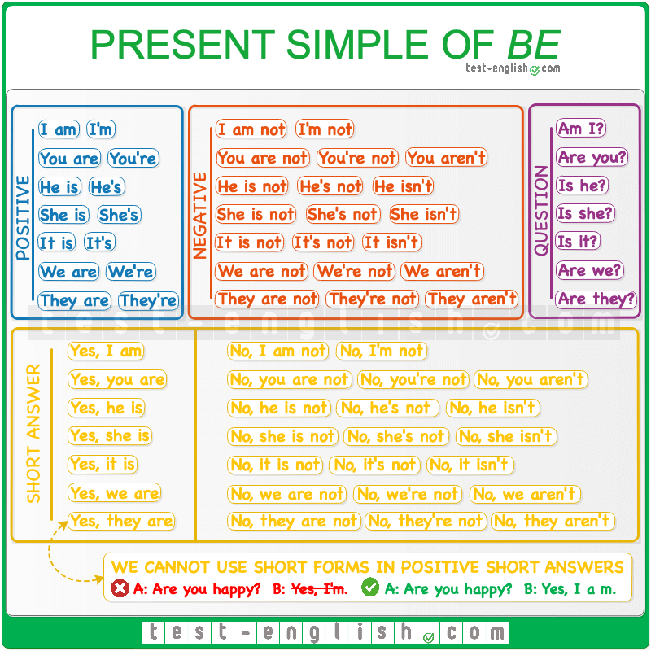
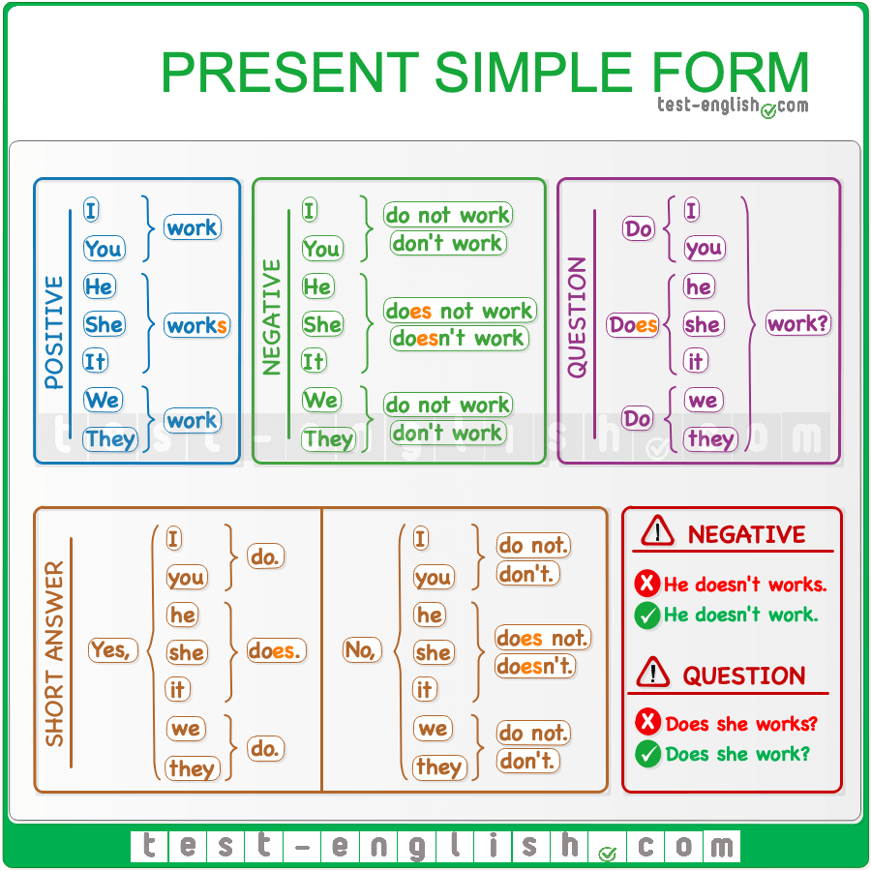

Slide 10
Reading exercise:
Hassan and Maria have 3 children. They are a busy family. Hassan works in a factory at night. Maria goes to college to learn hairdressing. Mo goes to University, Abdul and Peter go to school. The problem is they don’t have a car .
How do they get to work, college, university and school?
Hassan goes to work by bike, it takes about 30 minutes, he loves cycling but he is saving up for a motorbike. Peter goes to college by bus, she catches two buses and it takes 45 minutes. Mo goes to university by train, it takes an hour. He reads his books while he is travelling. Abdul walks to school with her friends, it takes about 10 minutes on foot. Abdul rides to school on his skateboard, it only takes five minutes.
Questions:
What are the parents’ names?
How many children are there in this family?
What is the text about (choose one answer): (1) Family (2) Transport (how they get to work/ school) (3) Food
What is Hassan’s job?
What does Maria do?
How does Hassan go to work?
How does Peter to go college?
How does Mo go to university?
How does Abdul go to school?

Slide 11
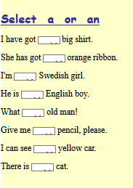
A means one
We write A before nouns with consonant sound
A hotel, a cat, a parrot, a car, a friend, a pen, a table
We write An before nouns with vowel sound (a, e,i ,o, u- sometimes h)
An animal, an elephant, an apple, an hour,
https://www.baamboozle.com/quiz/1117800
https://www.baamboozle.com/game/1727425
https://www.englishexercises.org/makeagame/viewgame.asp?id=1203

Slide 12
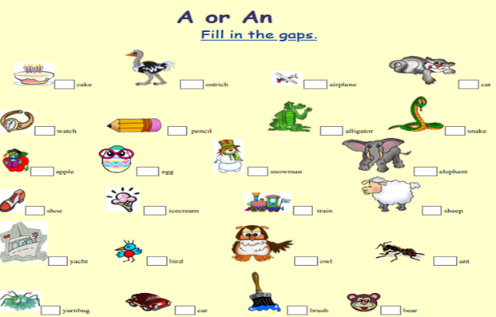

Slide 13
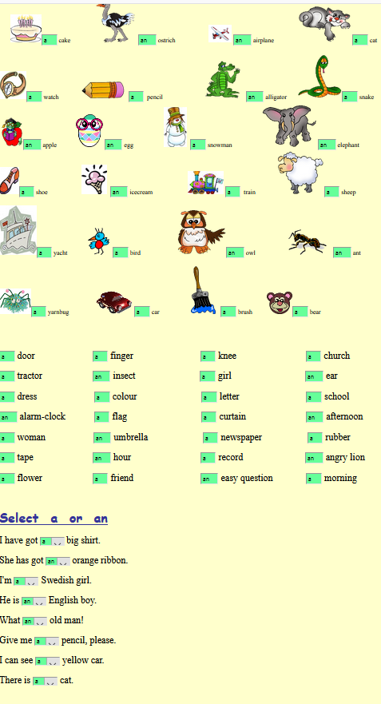
https://wordwall.net/resource/25419600/english/a-or-an

Slide 14
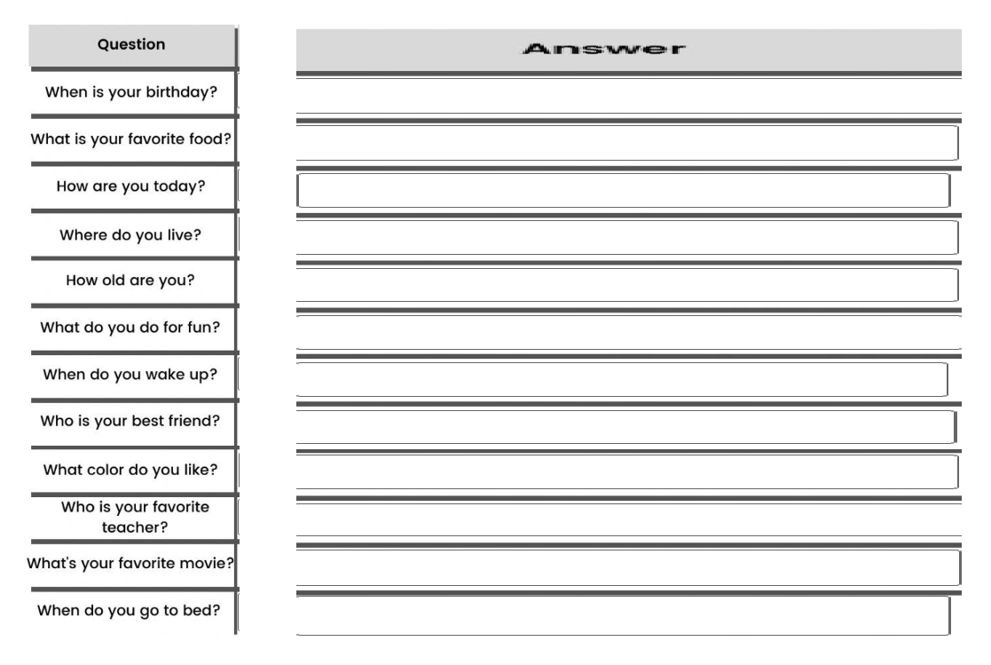
https://wordwall.net/resource/307607/esl-tefl/wh-questions

Slide 15
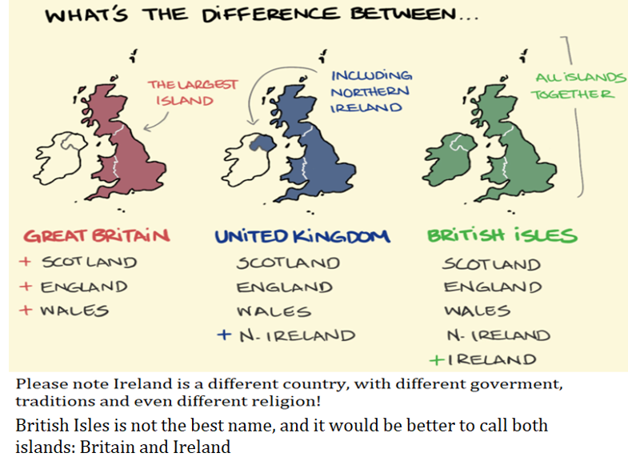
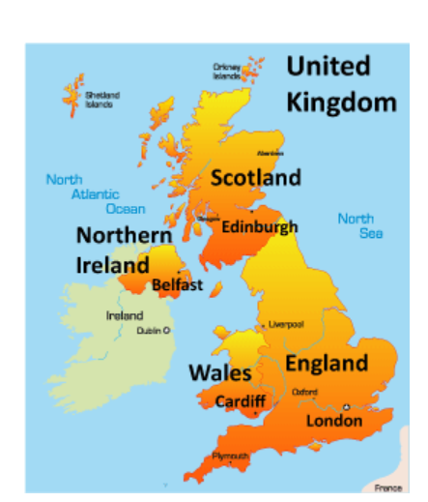
Is England the same as Great Britain?
What is the difference between England, Great Britain, United Kingdom and The British Isles?

Slide 16
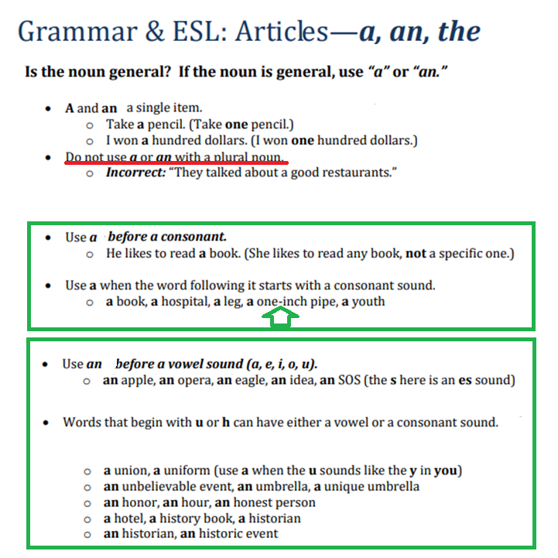

Slide 17
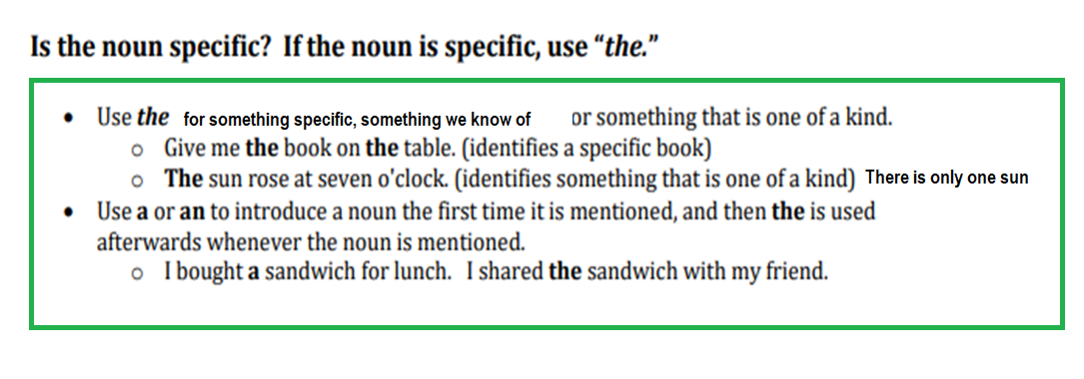
https://www.baamboozle.com/game/1348022
This, that, these, those
https://wordwall.net/resource/27451418/this-that-these-those

Slide 18
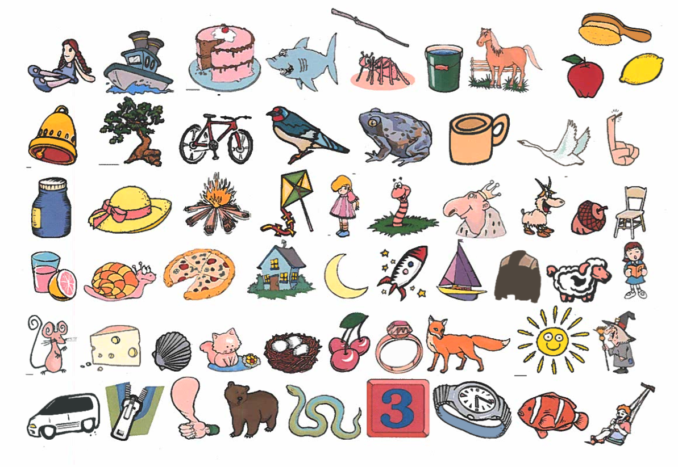
Find word and make a sentence: Writing and speaking

Slide 19
https://www.youtube.com/watch?v=ZwSmUux1ZSg&t=225s

Slide 20
Homework:Watch at home: Names:
https://www.youtube.com/watch?v=LC4QSKkXoTQ
Practice online
https://wordwall.net/play/15449/538/76000
https://www.liveworksheets.com/worksheets/en/English_as_a_Second_Language_(ESL)/Wh_questions/Question_words_iq1459212ak
https://www.liveworksheets.com/da2886397tn
https://www.liveworksheets.com/worksheets/en/English_as_a_Second_Language_(ESL)/Wh_questions/Question_words_jj118035nx
https://www.liveworksheets.com/worksheets/en/English_as_a_Second_Language_(ESL)/Wh_questions/WH_questions_with_DO_or_DOES_uj1599143ll
https://www.liveworksheets.com/worksheets/en/English_as_a_Second_Language_(ESL)/Yes-no_questions/Yes-No_questions_-_to_be_and_to_have_got_sv1390350jq
https://www.liveworksheets.com/worksheets/en/English_as_a_Second_Language_(ESL)/Yes-no_questions/Simple_present_yes-no_questions_yf29389ga

