Slide 1
What’s the date today? 19/10/2021
The nineteenth of October
What day is it?
Tuesday

Slide 2
Aim of the session:
By the end of the session learners will be able to
Check homework
Recap simple present tense questions and how to answer them
use countable and uncountable nouns with correct grammar

Slide 3
homework
https://www.liveworksheets.com/worksheets/en/English_as_a_Second_Language_(ESL)/Present_Simple/Simple_Present_Tense_test-2_vz1891862io

Slide 4
homework
https://www.liveworksheets.com/worksheets/en/English_as_a_Second_Language_(ESL)/Present_Simple/Simple_Present_Tense_test-2_vz1891862io
Simple Present tense
subject | Verb (do) | exercise | everyday
I | do | exercise | everyday
You | do
He | does
She | does
It | does
We | do
They | do

Slide 5
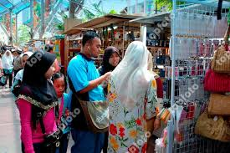
Every Saturday
What do they usually do ever Saturday?
They go shopping.
What does Mohammed do every Saturday?
He goes shopping every Saturday.

Slide 6
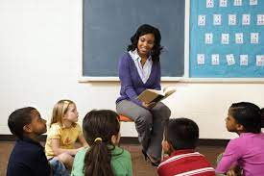
Every Monday
What does she usually do every Monday?
The teacher goes to school.
She is a teacher.
She teaches to children.
What do the children do every Monday?
They go to school.

Slide 7
What do you usually do everyday this time? (Routine)
I look after my grandchildren.
I drink my coffee.
I have breakfast.
I sleep.
I drink tea and have breakfast.
I do exercise at home.
She does exercise at home.

Slide 8
Video- aren’t for countables -isn’t for uncountables
https://www.youtube.com/watch?v=Srglu-yI9Ow
activity
https://www.liveworksheets.com/worksheets/en/English_as_a_Second_Language_(ESL)/Countable_and_uncountable_nouns/Countables_and_uncountables_fo857352pl
Video-a/an some/any
https://www.youtube.com/watch?v=MIDOnliWyew
https://www.liveworksheets.com/worksheets/en/English_as_a_Second_Language_(ESL)/Countable_and_uncountable_nouns/A_AN_SOME_ANY_%5E_there_is_-_there_are_ki1675732jh

Slide 9
Countable nouns uncountable nouns
a/an some
One any (questions and negatives)
some
any
An apple two apples
Some apples some salt
There are some apples. There is some salt.
There aren’t any apples. There isn’t any salt.

Slide 10
Countable nouns uncountable nouns
Books water
There are some books. There is some water.
Are there any books? Is there any water?
There aren’t any books. There isn’t any water.
Apples milk
There are/is some apple/apples. There are/is some milk./milks
Are/Is there any apple/apples? Are/Is there any milk/milks?
There isn’t/aren’t any apple/apples. There isn’t/aren’t any milk/milks.

Slide 11
HW-
https://www.liveworksheets.com/worksheets/en/English_as_a_Second_Language_(ESL)/There_is_-_there_are/There_is_-_There_are_%5E_a,_an,_some,_any_gy25424bs

