Slide 1
ESOL L1 Summer Term
17th May 2021 – 12th Jul 2021

Slide 2
Session aims/objs
Aim: To explore vocabulary relative to travel & transport
Objectives: by the end of this session, you will be able to
Use words related to travel & transport
Use words to extend your sentences in your speech
Use correct pronunciation when communicating verbally
Take part in a conversation

Slide 3
Online Learning Class Rules
Try to be somewhere quiet.
Even if you’re at home wear appropriate clothes.
Be on time.
Respect everyone and do as the teacher asks.
Wait until you’re asked to speak.
Turn your microphone off when others are talking.
Be patient because sometimes the systems don’t work.
Do your homework.
Never record or screenshot any part of the lesson.
Have fun and learn!

Slide 4
Our ACL 1-1 IAG offer
A confidential service for learners
Up to 3 one hour sessions with a qualified adviser
Adherence to the Guidance Council’s Code of Principles (impartial, current, confidential, in accordance with equality and diversity legislation, accessible, individual ownership, transparency)
and the Career Development Institute’s Code of Practice (as above, also duty of care, accountability and CPD)
Notes:
Any organisation which manages, administers and delivers an IAG service to support individuals in their career, learning, work or life goals has the chance to achieve matrix accreditation.
This is regardless of whether the service or services are delivered face-to-face, through training, learning, remotely, or through a website.

Slide 5
How can learners book an appointment?
For the summer term we are offering IAG sessions via telephone and/or via MS Teams
For general appointments:
Contact Alison on 07808 879044
Email Alison.moore@islington.gov.uk
Appointments available:
Tuesdays and Thursdays
9.30am - 12.30pm and 1 – 4pm
To find out about all or our courses on offer visit: www.adultlearning.islington.gov.uk

Slide 6
Safeguarding
David Coleman
Safeguarding Lead
Tel 020 7527 3343
ACLSafeguarding@islington.ac.uk
Details/video available on Moodle (our VLE platform)

Slide 7
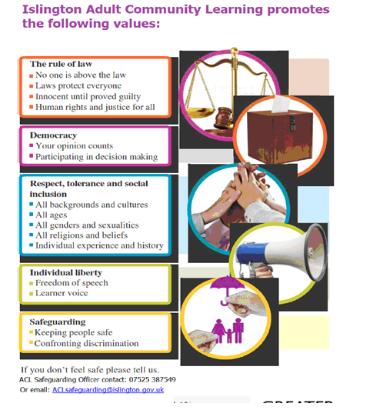

Slide 8
Skills you will develop on this course (ESOL Level 1)
Spelling
Grammar
Language related
to Travel and Transport
ESOL Level 1
Speaking &
listening
Writing
Reading
Punctuation

Slide 9
My role
Ensure successful learning for all
Make learning relevant
Group work & individual tasks
Peer support
Provide individual feedback and support

Slide 10
Your role
Ensure you take responsibility for your own learning
Attend classes regularly
Be punctual
Complete group work & individual tasks
Provide/seek support form your peers

Slide 11
Vocabulary related to travel and transport
Voyage | = (noun) distant travel, usually by ship.
Tube | = (noun) the subway, or underground system in London.
Tourist office | = (noun phrase) an office which helps tourists discover what attractions and other sightseeing activities they should do.
Suitcase = | (noun) a case in which you put your clothes and other articles.
Sightseeing | = (noun) the activity of visiting famous tourist attractions.
Set sail | = (verb phrase) to leave on a boat to go somewhere.
Self-catering holiday | = (noun phrase) a vacation during which you pay for your own meals (as opposed to package holidays in which meals are included).

Slide 12
Boarding pass | = (noun) slip of paper like a ticket that allows you to board a plane.
Camping trips | = (noun) trip into nature during which you sleep in a tent.
Check in | = (verb) to state to an airline that you have arrived and will board your flight.
By rail | = (prepositional phrase) by train.
Destination | = (noun) the place to which you are traveling.
Last minute deal | = (noun phrase) an offer to travel at a much lower price because you will leave within in the next few days.
Package holiday Remote location = (noun phrase) a place very far away from cities. | = (noun phrase) a holiday or vacation which includes the flight, hotel, meals and so on.

Slide 13
We will play a matching (travel) vocab game
https://www.languageguide.org/english-uk/vocabulary/travel/

Slide 14
https://www.thoughtco.com/travel-vocabulary-quiz-for-esl-students-4171488
Now, we will complete a ‘fill-in-the-gap’ quiz. This will test your knowledge of vocabulary related to traveling.

Slide 15
We will now watch a YT video.
Please list the tips mentioned in the video.

Slide 16
1: open your mind (different cultures/opinions/don’t assume)
2: Don’t go to usual travel agents (go to difficult to reach places/get lost/take time to walk/gain a unique experience)
3: Get out of own comfort zone (learn useful phrases/ say yes to invitation)
4: Identify different cultures (learn about different gestures and body languages)
5: Keep in touch with loved ones (update them on your whereabouts/share lessons/experiences with them)

Slide 17
Thoughts??

Slide 18
Summary of lesson
Use words related to travel & transport
Use words to extend your sentences in your speech
Use correct pronunciation when communicating verbally
Take part in a conversation

Slide 19
The end

Slide 20
Conversation starter
This conversation segment is for you, to be run by you.
It is 30 minutes of talking time to enable you to just chat! This will help you to build confidence and fluency in English S/L. You could use these prompts to help get the conversation started but you can also talk about any other topics/matters too.
What is your favourite smell? Why?
Do you find that certain smells transport you to a certain time, space or moment? If so, what?

Slide 21
References
https://www.languageguide.org/english-uk/vocabulary/travel/
Travel - British English Vocabulary - LanguageGuide.org
https://www.youtube.com/watch?v=gTWoZvztO5M

