Slide 1
Welcome back to Family Language Class
Session 6
Verbs
Verbos
Fiiller
Fal
Lêker
ক্রিয়া
Kriẏā

Slide 2
Finde my mistakes
Yesterday, it was too cold for go outside
my son abdul likes play football.
I can not do my homework I be busy.
i want have rice with my dinner
Yesterday, it was too cold to go outside.
My Son Abdul likes to play football.
I can not do my homework, I am busy.
I want to have rice with my dinner.

Slide 3
Verbs

Slide 4
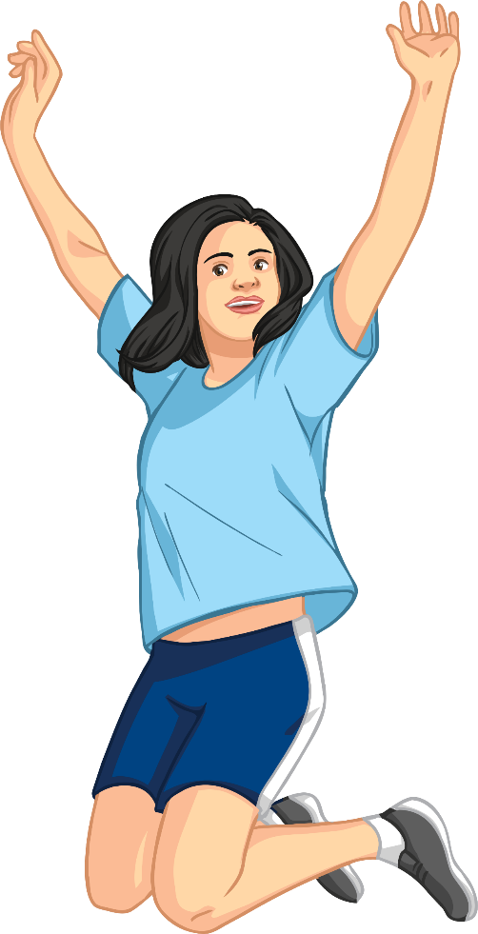
What Is a Verb?
jump

Slide 5
What Is a Verb?
clap

Slide 6
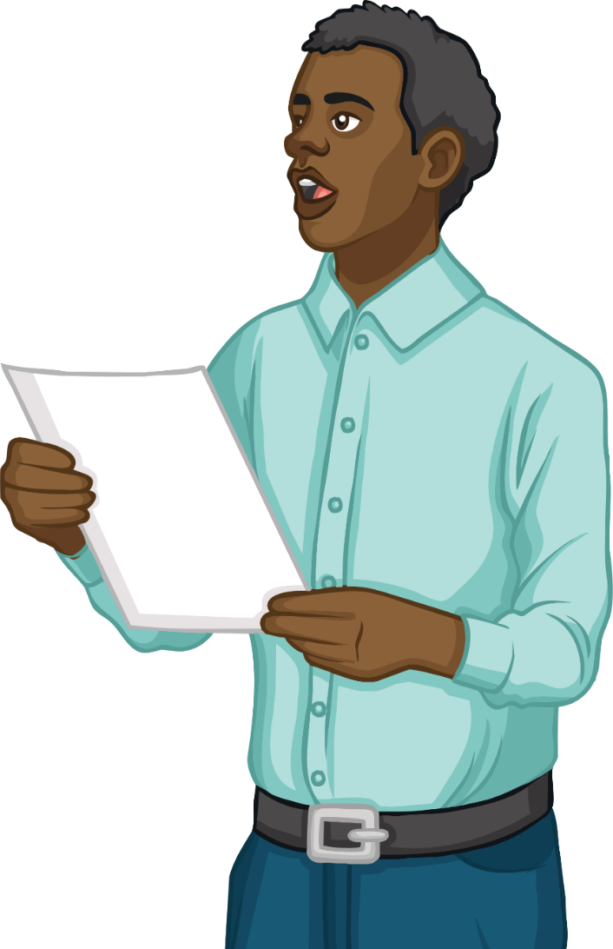
What Is a Verb?
sing

Slide 7
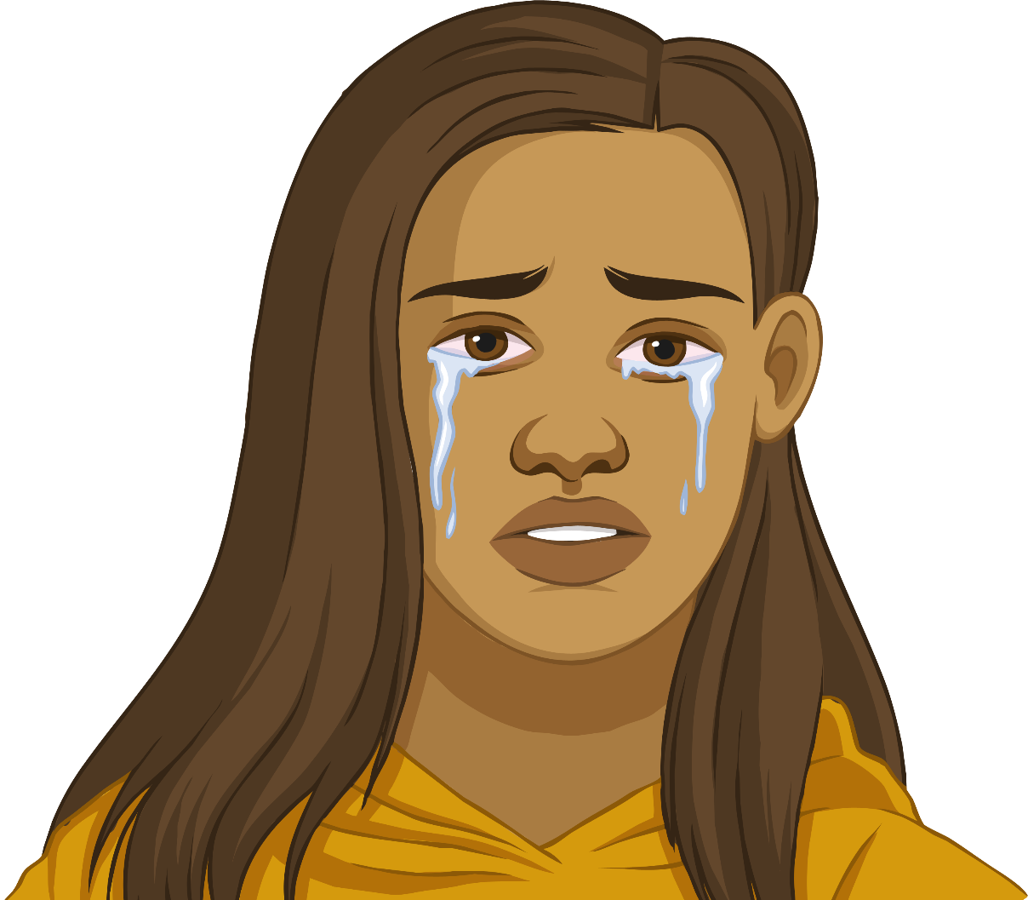
What Is a Verb?
cry

Slide 8
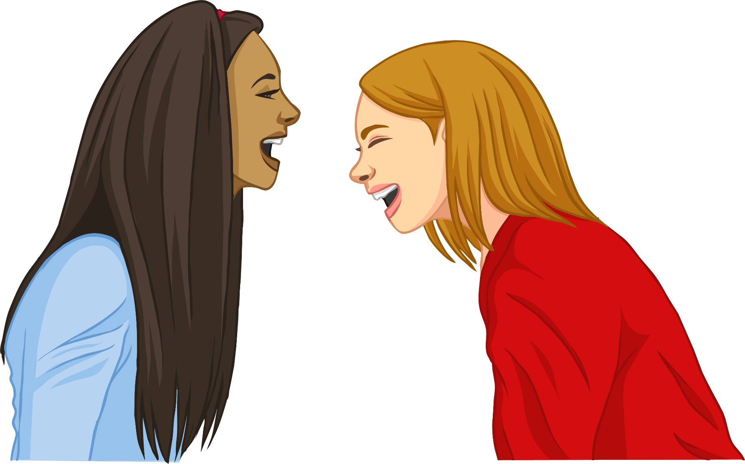
What Is a Verb?
laugh

Slide 9
What Is a Verb?
jump
clap
sing
cry
laugh
Verbs are action words. They describe what someone is doing.

Slide 10
Find the Verbs
Tom painted his picture.

Slide 11
Find the Verbs
Tom painted his picture.

Slide 12
Find the Verbs
Annie brushed her hair.

Slide 13
Find the Verbs
Annie brushed her hair.

Slide 14
Find the Verbs
Amjid read his books in the library.

Slide 15
Find the Verbs
Amjid read his books in the library.

Slide 16
Find the Verbs
Neena swam without arm bands.

Slide 17
Find the Verbs
Neena swam without arm bands.

Slide 18
Find the Verbs
Ben rode his bike to school.

Slide 19
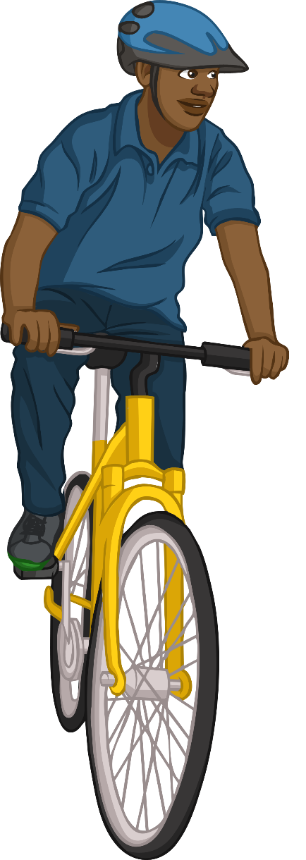
Find the Verbs
Ben rode his bike to school.

Slide 20
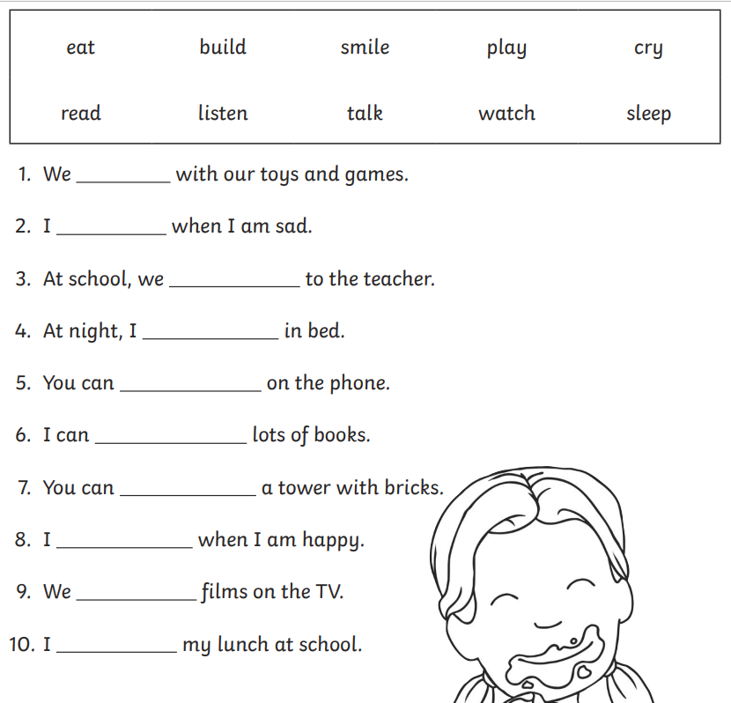

Slide 21
play
cry
listen
sleep
talk
read
build
smile
watch
eat

Slide 23
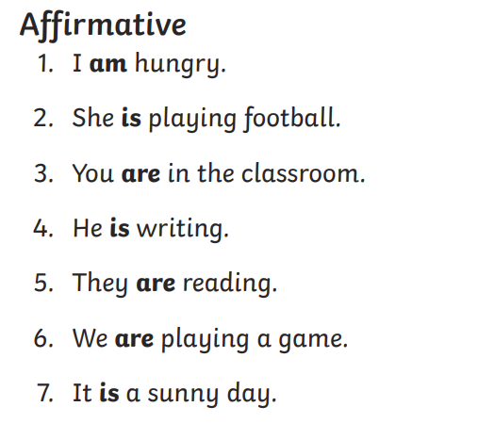

Slide 24
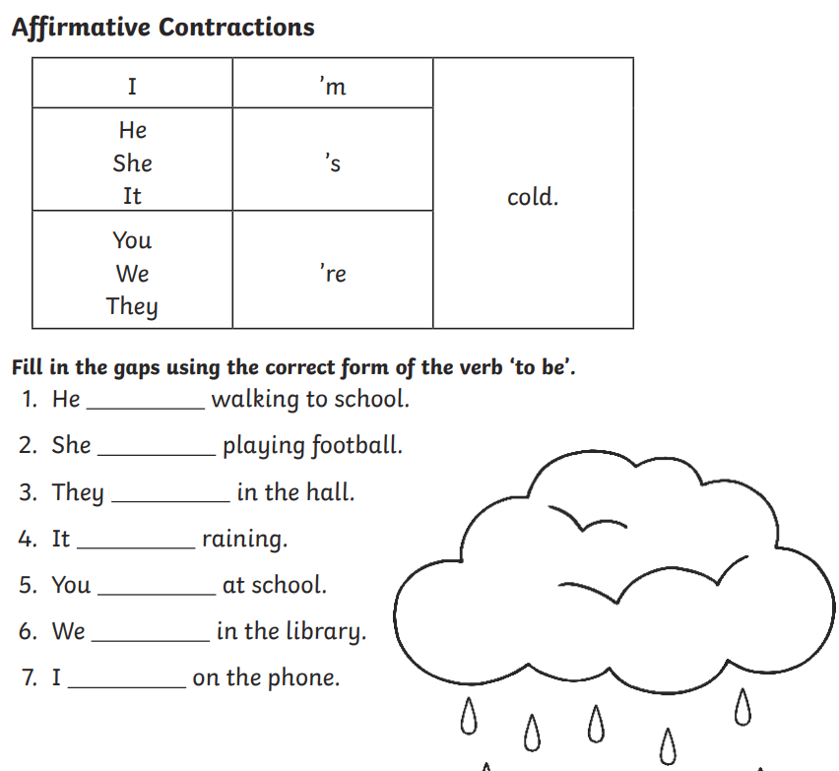

Slide 25
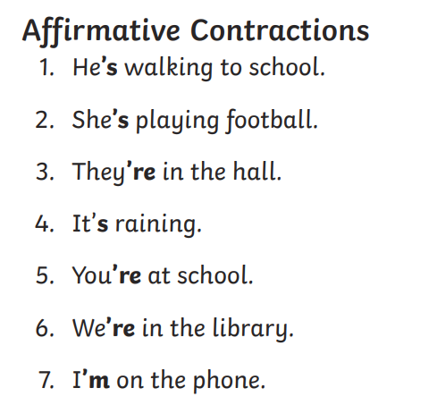

Slide 26
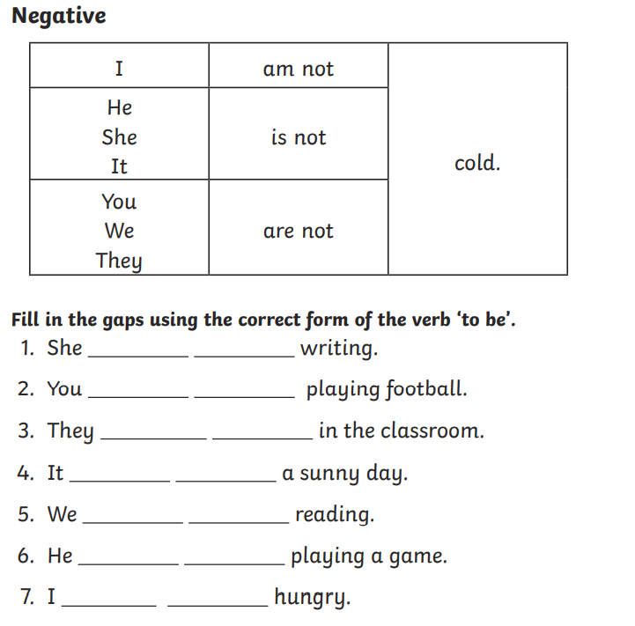

Slide 27
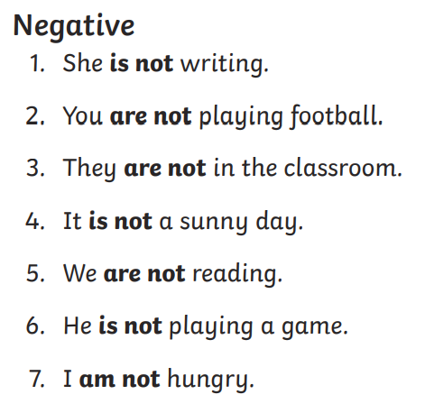

Slide 28
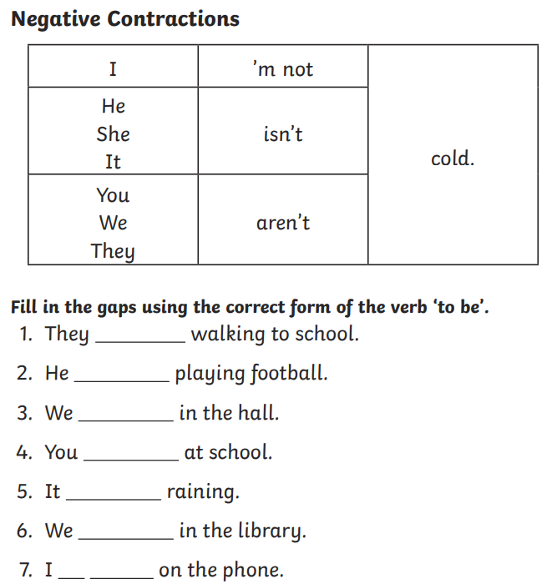

Slide 29
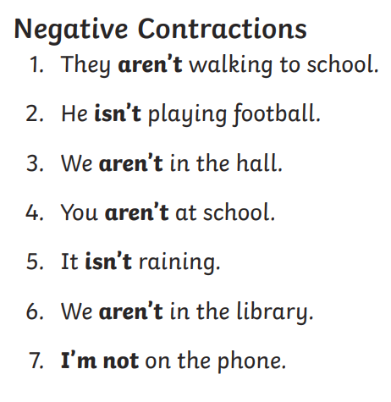

Slide 32
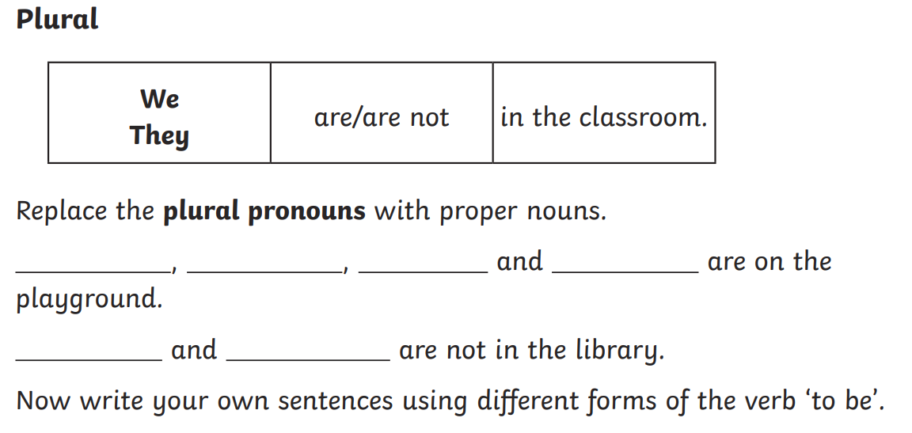

Slide 33
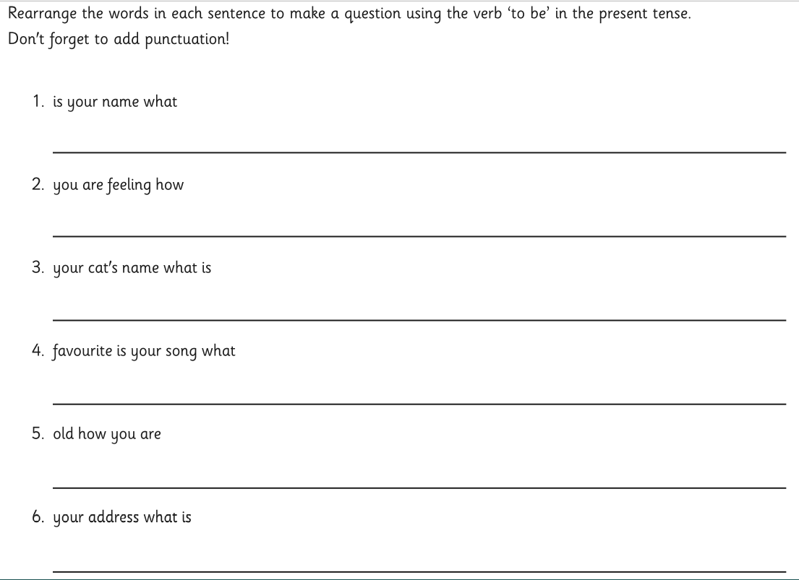

Slide 34
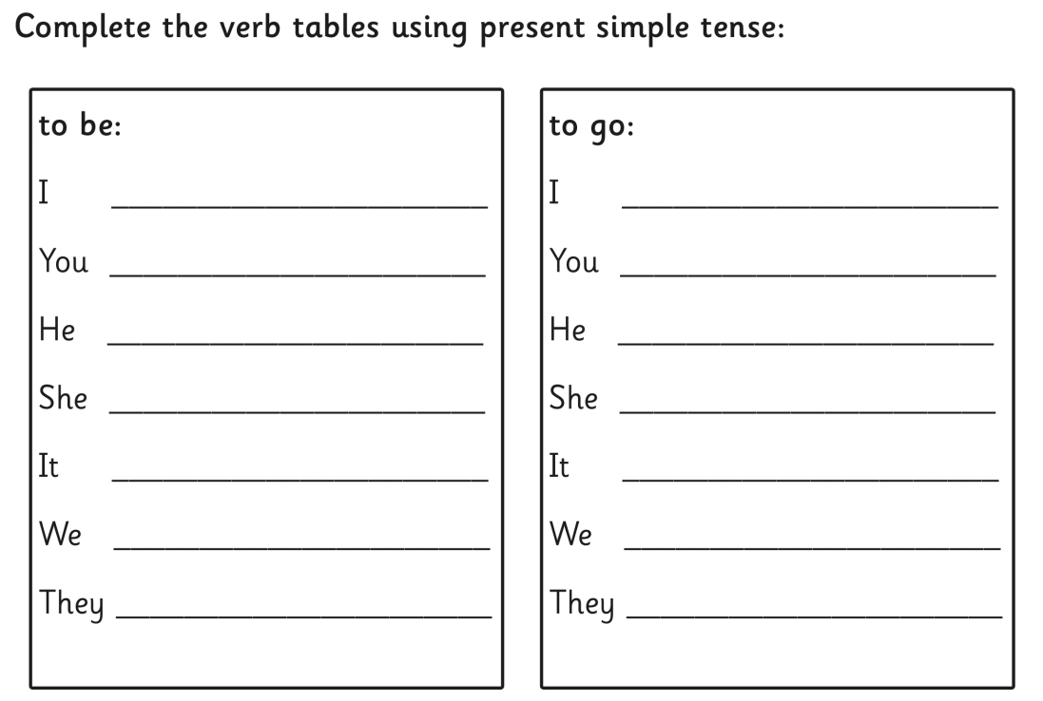
am
go
are
go
is
goes
is
goes
is
goes
are
go
are
go

Slide 35
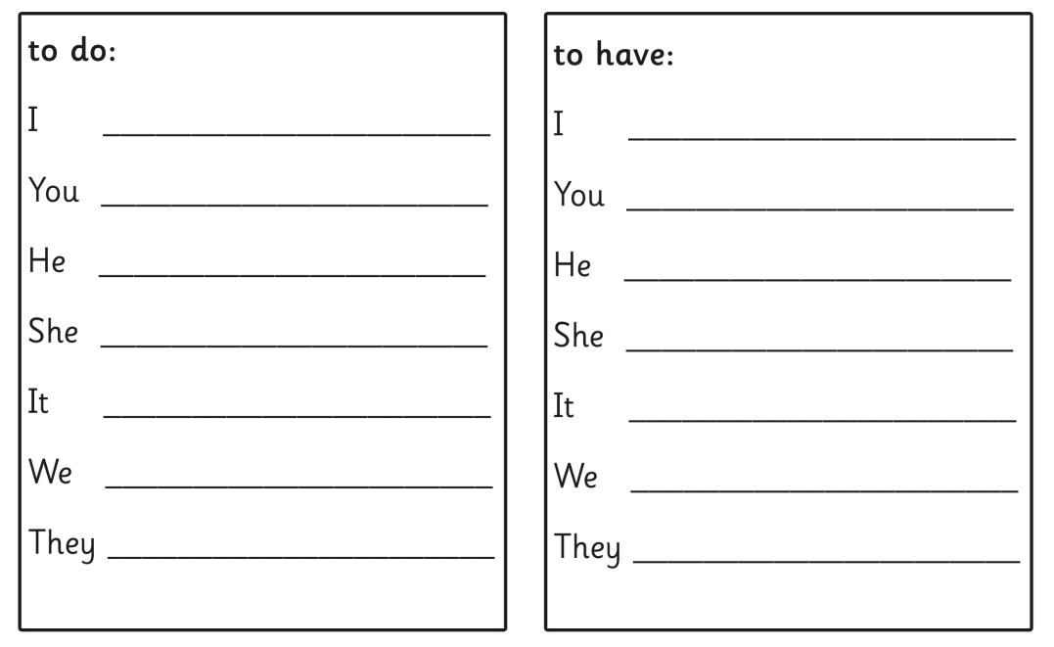
do
have
do
have
does
has
does
has
does
has
do
have
do
have

