Slide 1
ESOL E2/E3 Spring Term
22nd Feb 2021

Slide 2
Session aims/objs
Aim: Virtual trip to British Museum
Objs: by the end of this session, you will be able to
Explore the British Museum online
View some artefacts from the British Museum
Read some historical facts
Discuss questions on buildings
Practise grammar

Slide 4
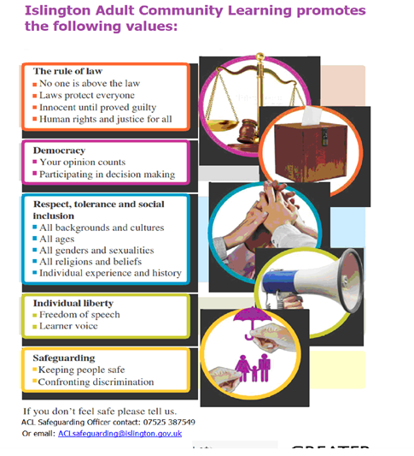

Slide 5
Our ACL 1-1 IAG offer
A confidential service for learners
Up to 3 one hour sessions with a qualified adviser
Adherence to the Guidance Council’s Code of Principles (impartial, current, confidential, in accordance with equality and diversity legislation, accessible, individual ownership, transparency)
and the Career Development Institute’s Code of Practice (as above, also duty of care, accountability and CPD)
Notes:
Any organisation which manages, administers and delivers an IAG service to support individuals in their career, learning, work or life goals has the chance to achieve matrix accreditation.
This is regardless of whether the service or services are delivered face-to-face, through training, learning, remotely, or through a website.

Slide 6
How can learners book an appointment?
For the summer term we are offering IAG sessions via telephone and/or via MS Teams
For ESOL tutors and their learners:
Contact Gulcoy on 07712 403428
Email gulcoy.esen@islington.gov.uk
Appointments available:
Mondays and Tuesdays 1.30 - 3pm
For general appointments:
Contact Alison on 07808 879044
Email Alison.moore@islington.gov.uk
Appointments available:
Tuesdays and Thursdays
9.30am - 12.30pm and 1 – 4pm
To find out about all or our courses on offer visit: www.adultlearning.islington.gov.uk

Slide 8
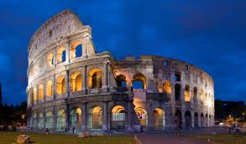
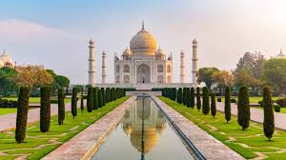
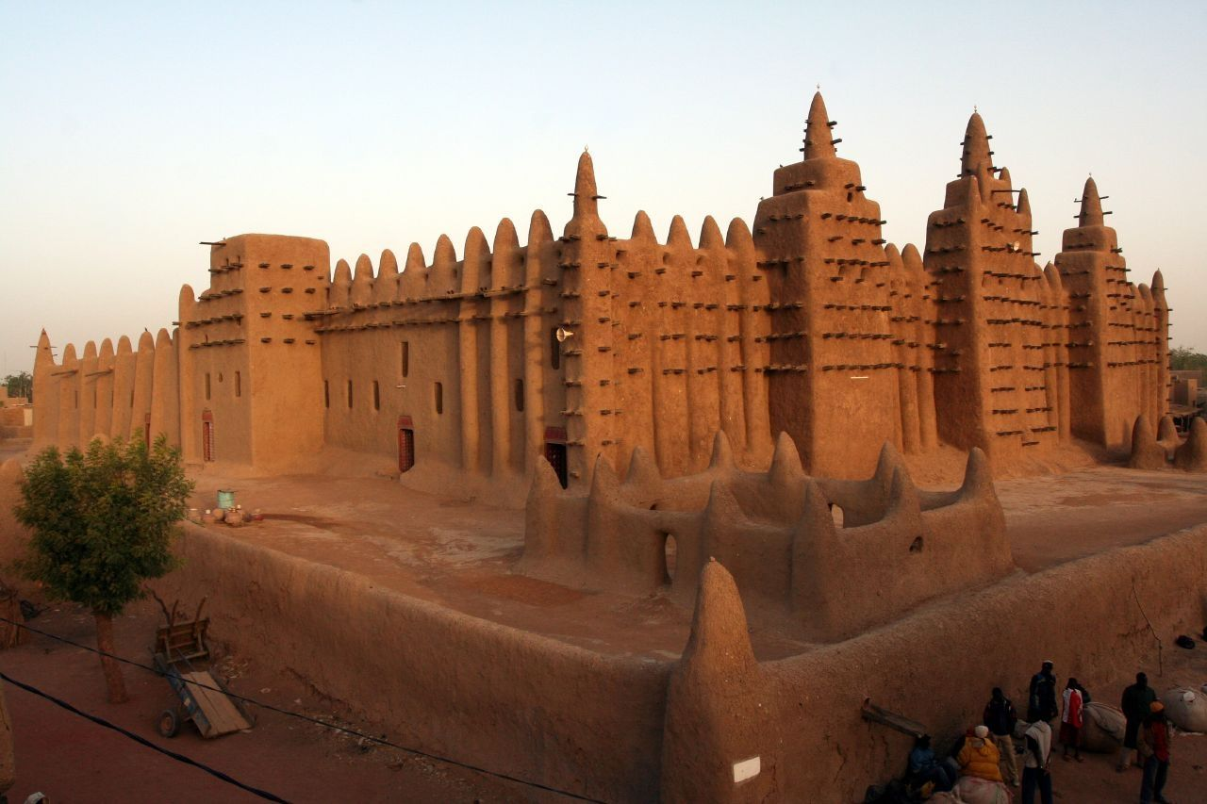
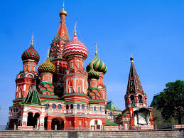
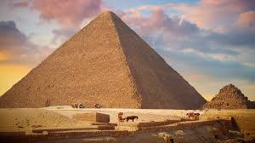
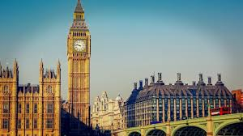
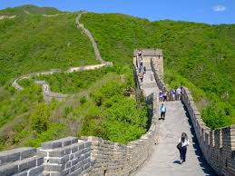
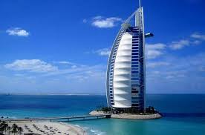
Do you recognise these buildings? Can you name them?
The Colosseum in Rome
Taj Mahal in India
The University of Timbuktu
St. Basils Cathedral in Russia
The Pyramids of Giza
Big Ben in London
The Great Wall of China
Burj Khalifa in Dubai

Slide 9
Discussion question
Why were some of the greatest buildings constructed?
Were they built for practical or protective uses?
How can a building record an event or person?
What is the value of this?
Can you describe a building in your country that relates to the history of a person?

Slide 10
We are going to take a virtual trip to the British Museum
https://artsandculture.google.com/streetview/british-museum/AwEp68JO4NECkQ?sv_lng=-0.1266024509257022&sv_lat=51.51905368906714&sv_h=286&sv_p=0&sv_pid=JeKwUFYAMWXNWPh3IOg3jw&sv_z=1
https://www.britishmuseum.org/collection/galleries#virtual-galleries

Slide 11
Historical facts

Slide 12
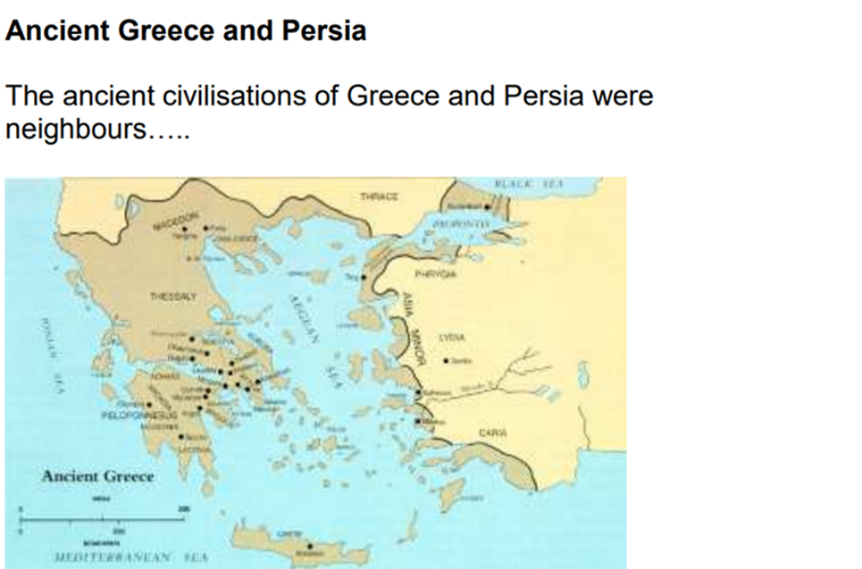
Greece was in the West
We are going to explore the Greek and Persian collection in the BM and read about them.
Persia was in the East

Slide 15
Lesson summary
In the lesson, you…
Explored the British Museum online
Read some historical facts
Discussed questions on buildings
Practised grammar/pronunciation

Slide 16
References:
https://www.britishmuseum.org/learn/adult-learning/esol
https://www.britishmuseum.org/collection/galleries#virtual-galleries
https://www.britishmuseum.org/sites/default/files/2019-11/Persia_Greece_final%20worksheets_self-directed.pdf
https://blog.britishmuseum.org/how-to-explore-the-british-museum-from-home/

