Slide 1
WELCOME TO ESOL 2021
Monday 8th March
Teacher - Nilupa

Slide 2
This year’s theme is #choosetochallenge – can you think of an inspiring woman who overcame challenging moments?

Slide 3
CLASS OBJECTIVES
Learn words to talk about the environment.
Write sentences about the environment.
Say what we can do to protect the environment.
Grammar: introduction to Conditional form.

Slide 4
5 minute chat
Do you know what these words mean?
Can you think of examples for each word?
Why is it important to do these things?

Slide 5
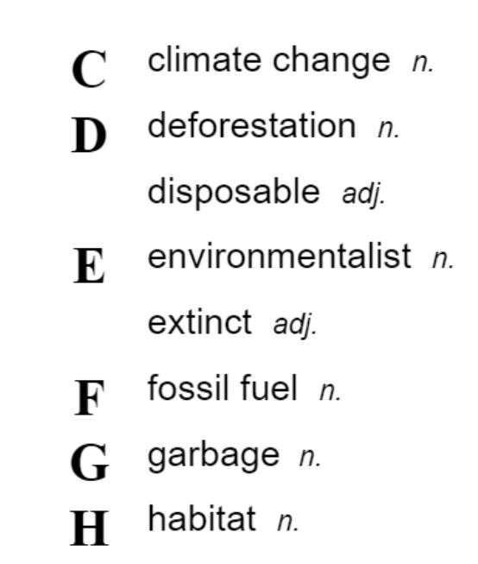
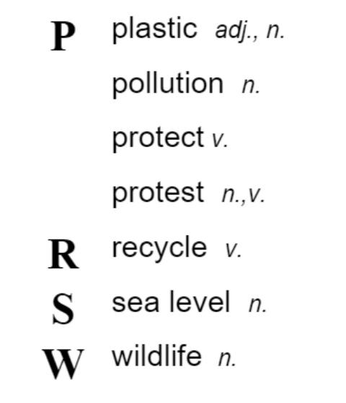
Do you know any of these words?

Slide 6
Watch a video about how the environment is changing.

Slide 7
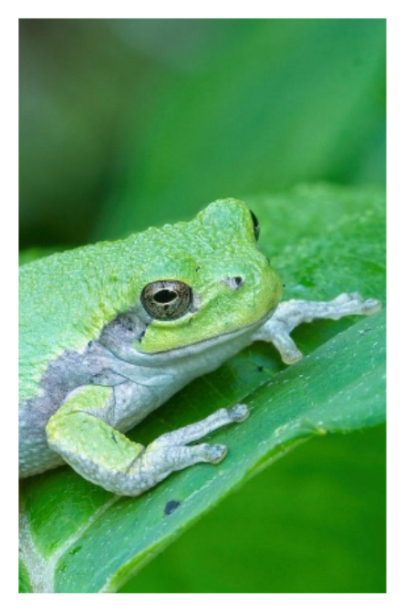
Complete these sentences with words from the video. garbage - pollution - fossil fuel – plastic

Slide 8
Complete these sentences with words from the video: protect sea level deforestation

Slide 9
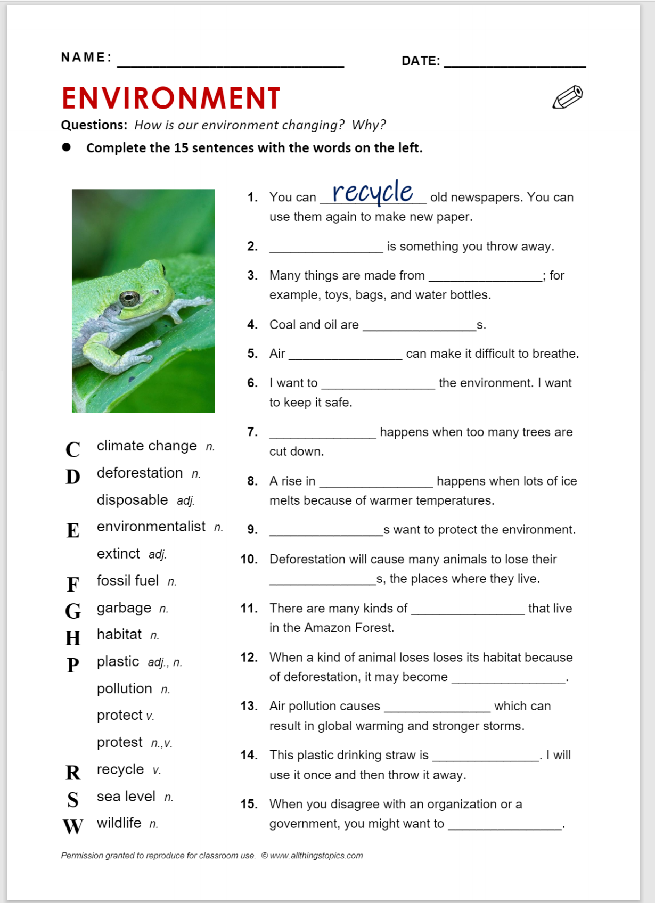
Homework

Slide 10
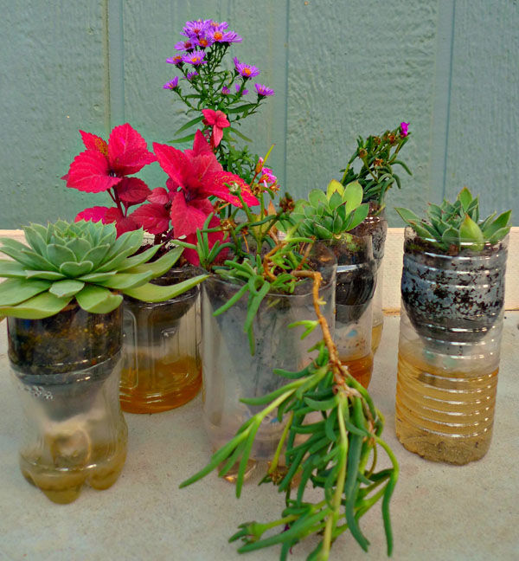
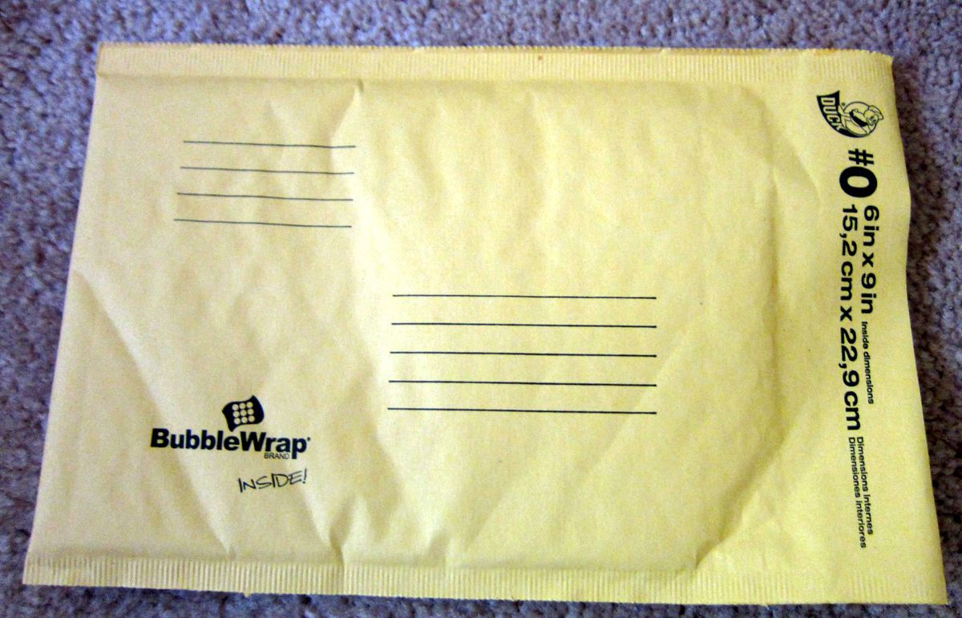
What can we do to protect the environment?
Reuse = use again

Slide 11
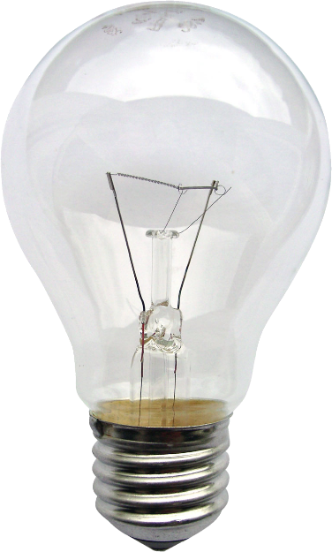
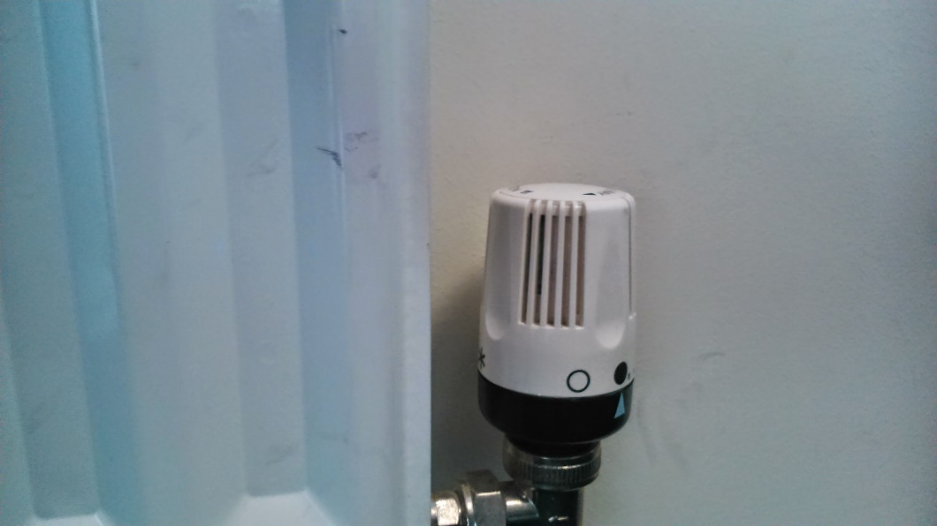
What can we do to protect the environment?
Reduce = use less

Slide 12
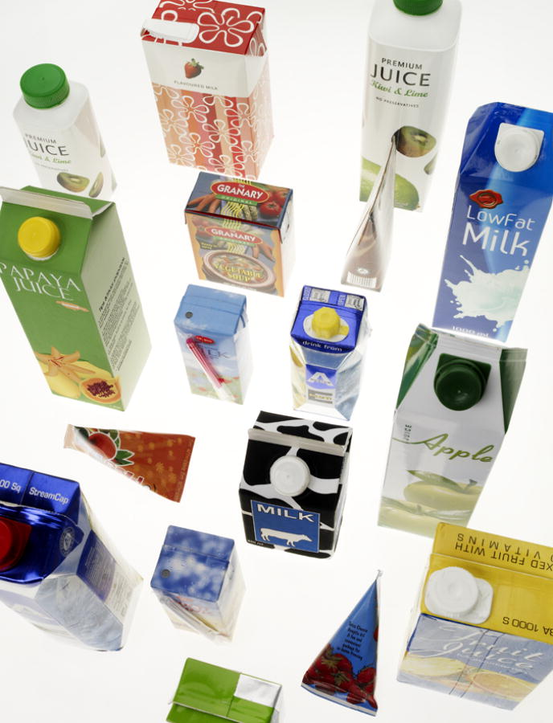
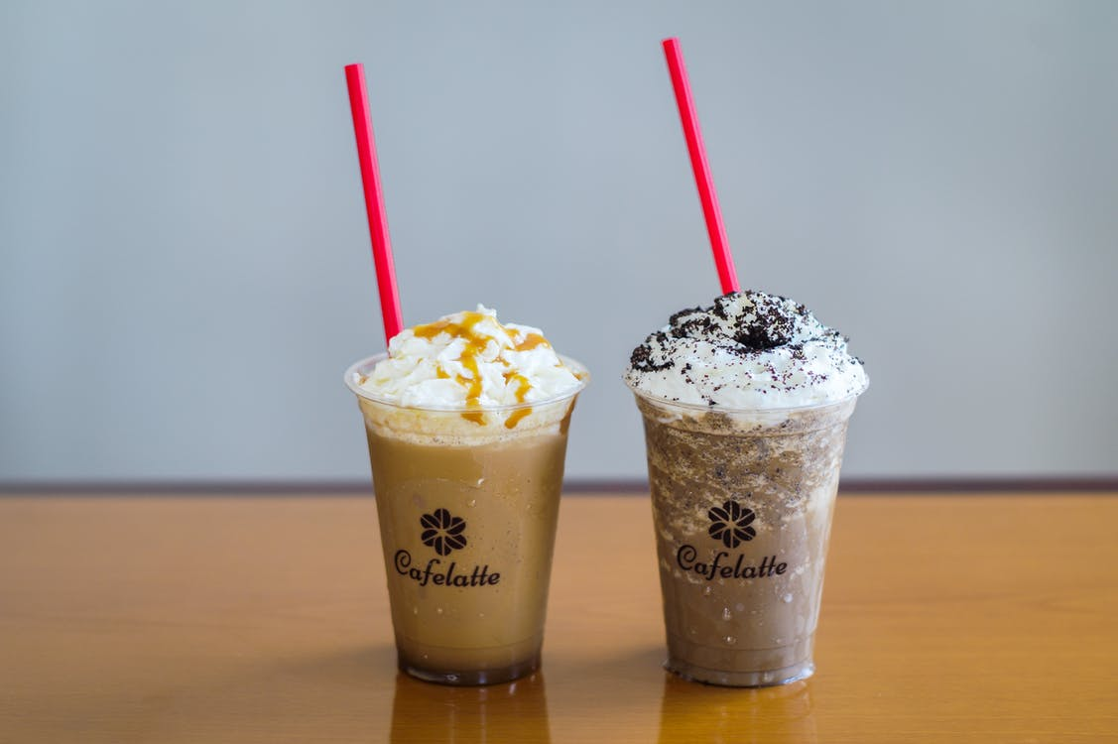
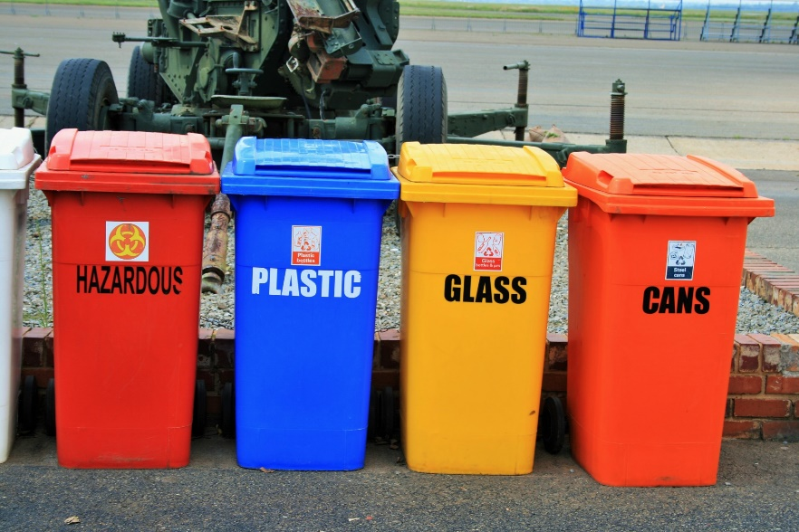
What can we do to protect the environment?
Recycle = make something new out of rubbish/garbage

Slide 13
Video questions https://www.youtube.com/watch?v=-n4A0BssFd0
When did the industrial revolution begin?
2. Name two greenhouse gases mentioned in the video
3. What causes these gases?
4. What do trees and oceans absorb?
5. what are the effects of global warming
6. What are innovators doing to help solve the problem of climate change?

Slide 14
https://www.youtube.com/watch?v=-n4A0BssFd0 Watch the video and answer the following questions
1. When did the industrial revolution begin?
1900s
2. Name two greenhouse gases mentioned in the video
Carbon Dioxide & Methane
3. What causes these gases?
Burning fossil fuels
4. What do trees and oceans absorb?
Carbon Dioxide
5. what are the effects of global warming
Killing coral reefs / rise in sea levels / extreme weather events
6. What are innovators doing to help solve the problem of climate change?
Creating sustainable growth and jobs (through using land, manufacturing products, running businesses)

Slide 15
Grammar: conditionals. Read these sentences:
If global warming continues, temperatures will rise even higher.
If people stopped using cars completely, there would be much less pollution.
We use structures called ‘conditional’ for these situations.
In number 1, there is a real possibility something will happen in the future.
In number 2, we imagine a situation where there is very little possibility that this will happen in the future, it is unlikely to happen.

Slide 18
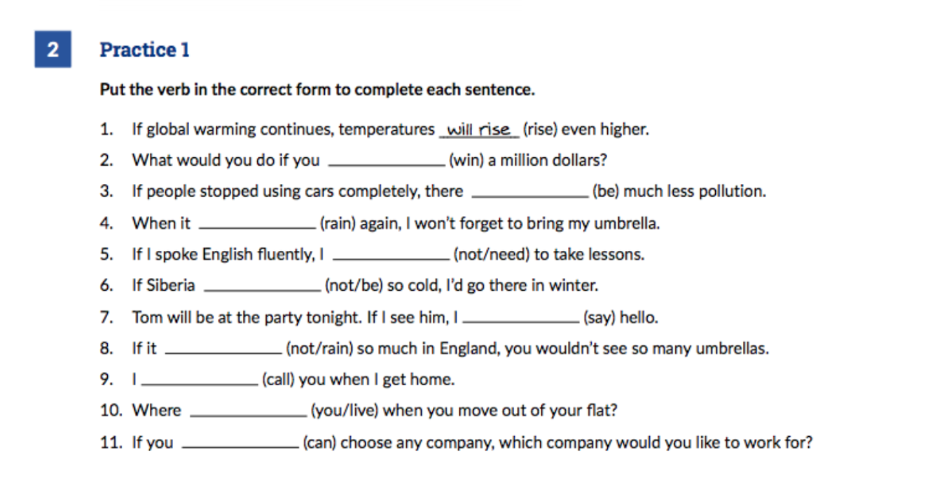

Slide 19
Summary of lesson
Learned words to talk about the environment.
Wrote sentences about the environment.
Said what we can do to protect the environment.
Grammar: Using conditional forms.

Slide 20
HW Learn words to talk about the environment – finish the worksheet

Slide 21
References:
Oxford online YouTube link for learning about how to talk about the environment
https://www.youtube.com/watch?v=zKAYAnLsoUk
YouTube video
https://www.youtube.com/watch?v=-n4A0BssFd0

