Slide 1
Welcome to Summer Term 2021
Types of text, purpose of text

Slide 2
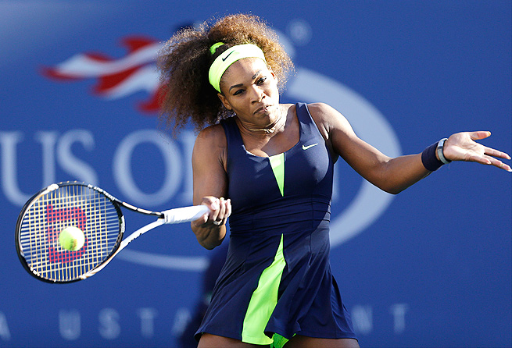
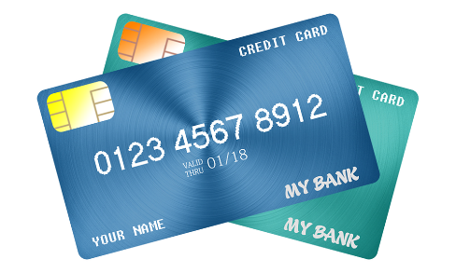
5 minute chat – Sport
Do you know what sport this woman is playing?
It’s a very popular sport in the UK.
What is the national sport in
Your native country?
What sport do you like?

Slide 3
Week 7: Aims and objectives
Put words in alphabetical order.
3. Learn about different types of text and how to recognise them.
4. Practise reading different types of text and find the purpose of text.
5. Read some example exam activities.
.

Slide 4
Alphabetical order – put these words in alphabetical order

Slide 5
Alphabetical order – put these words in alphabetical order
abcdefghijklmnopqrstuvwxyz….
environment
crime
councillor
economic
suggestions
education
childcare
services

Slide 6
What is text?
Can you think of some examples?

Slide 7
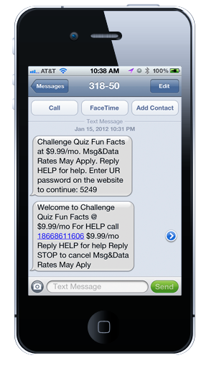
What is text?
A text message on phone

Slide 8
What is text?
a menu

Slide 9
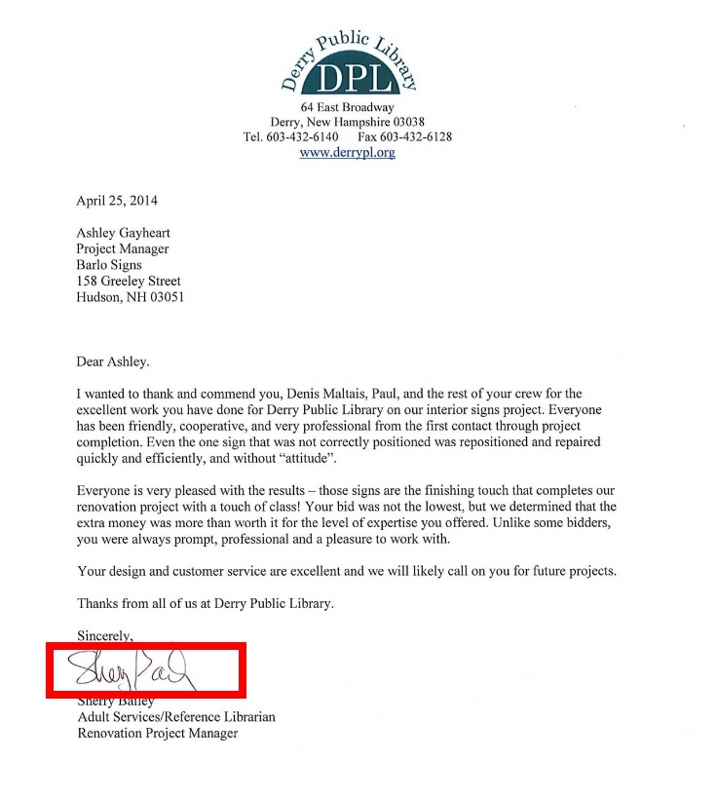
What is text?
a letter

Slide 10
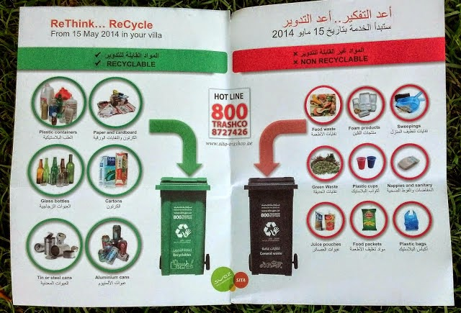
What is text?
a leaflet

Slide 11
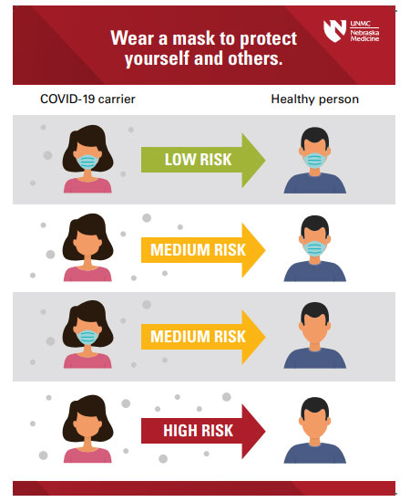
What is text?
a notice
a poster

Slide 12
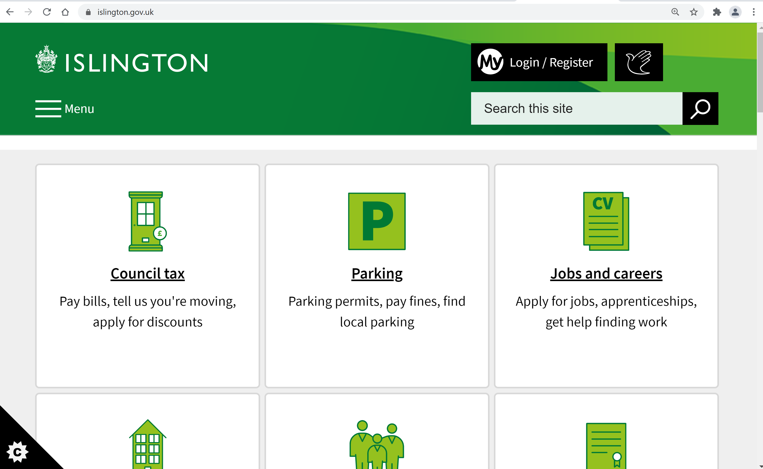
What is text?
a web page

Slide 13
What is text?
an advert

Slide 14
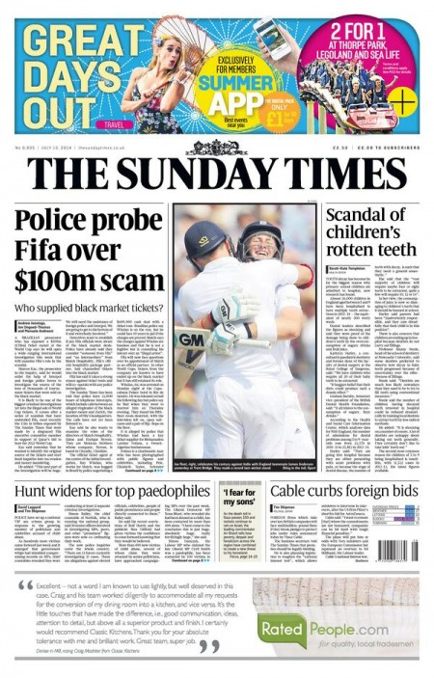
What is text?
a newspaper article
(a magazine article)

Slide 15
What is text? Text is any type of writing
It could be
a letter
an email
a recipe
a note
a leaflet
instructions
an article in a newspaper or magazine
writing on a webpage
an advert.

Slide 16
What is the purpose of the text?
When you’re reading the text think about the purpose of the text or why it has been written.
to discuss
to describe
to give information
to invite
to persuade
to give instructions

Slide 17
What is the purpose of the text?
When you’re reading, think about the purpose of the text or why it was written.
An advert might want you persuade you to buy something. •
A letter from school might give you information about something or invite you to something.
An article might describe something or discuss different ideas.
A notice might tell you to do something.
A leaflet might give you instructions or explain how to do something.

Slide 18
Reading sample paper – examples of questions about text

Slide 19
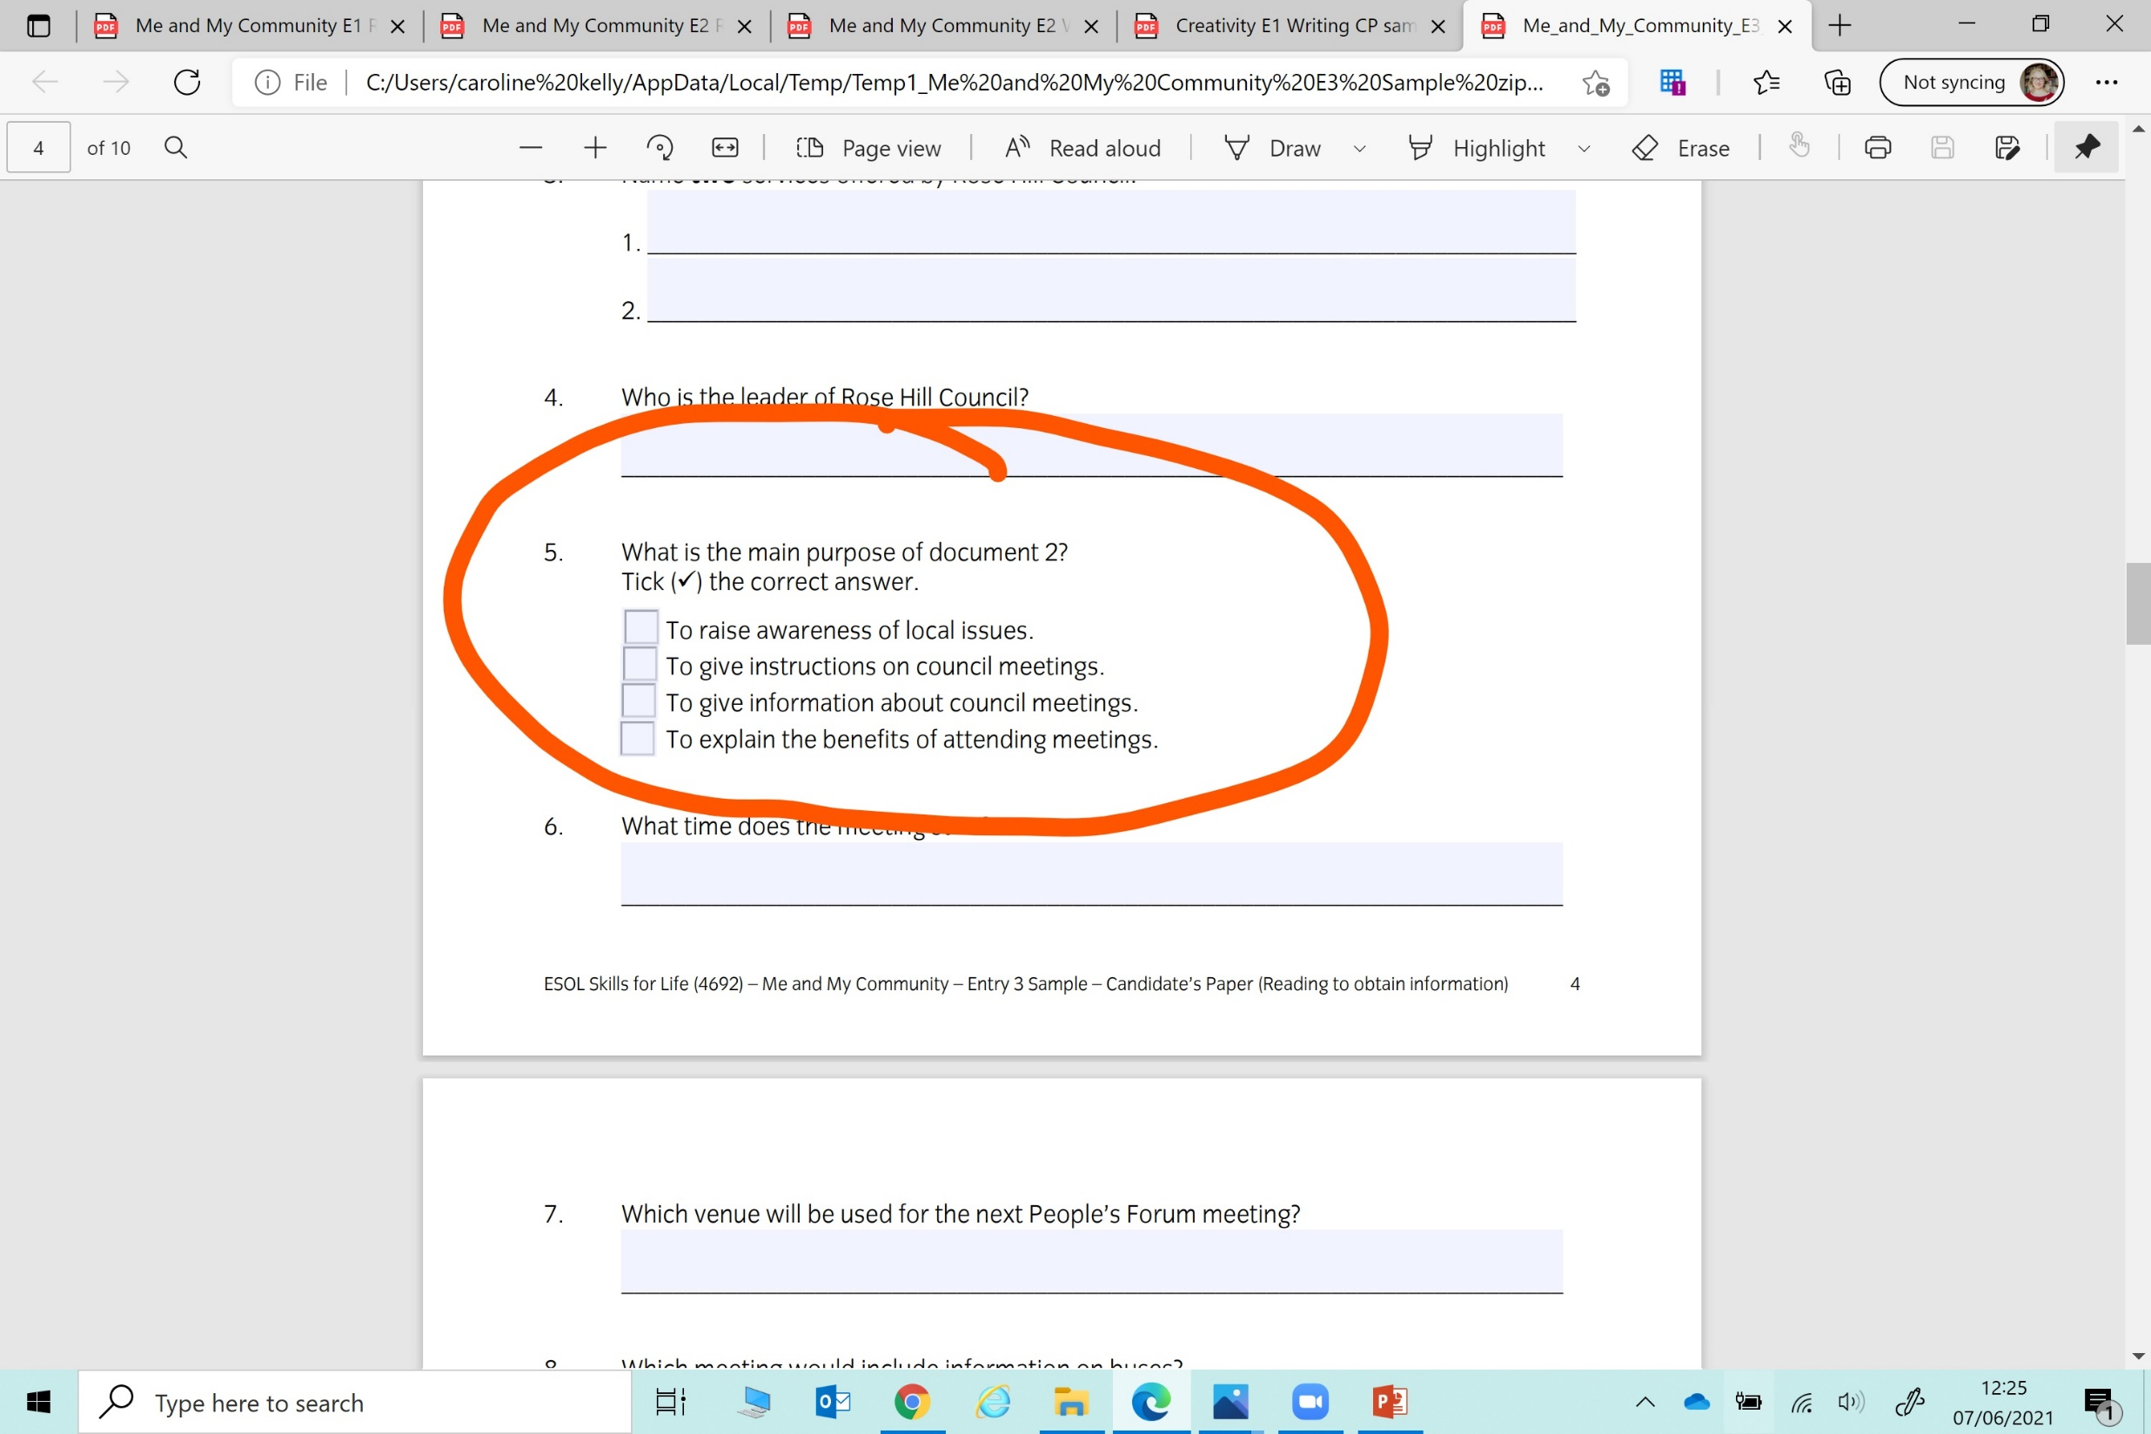

Slide 20
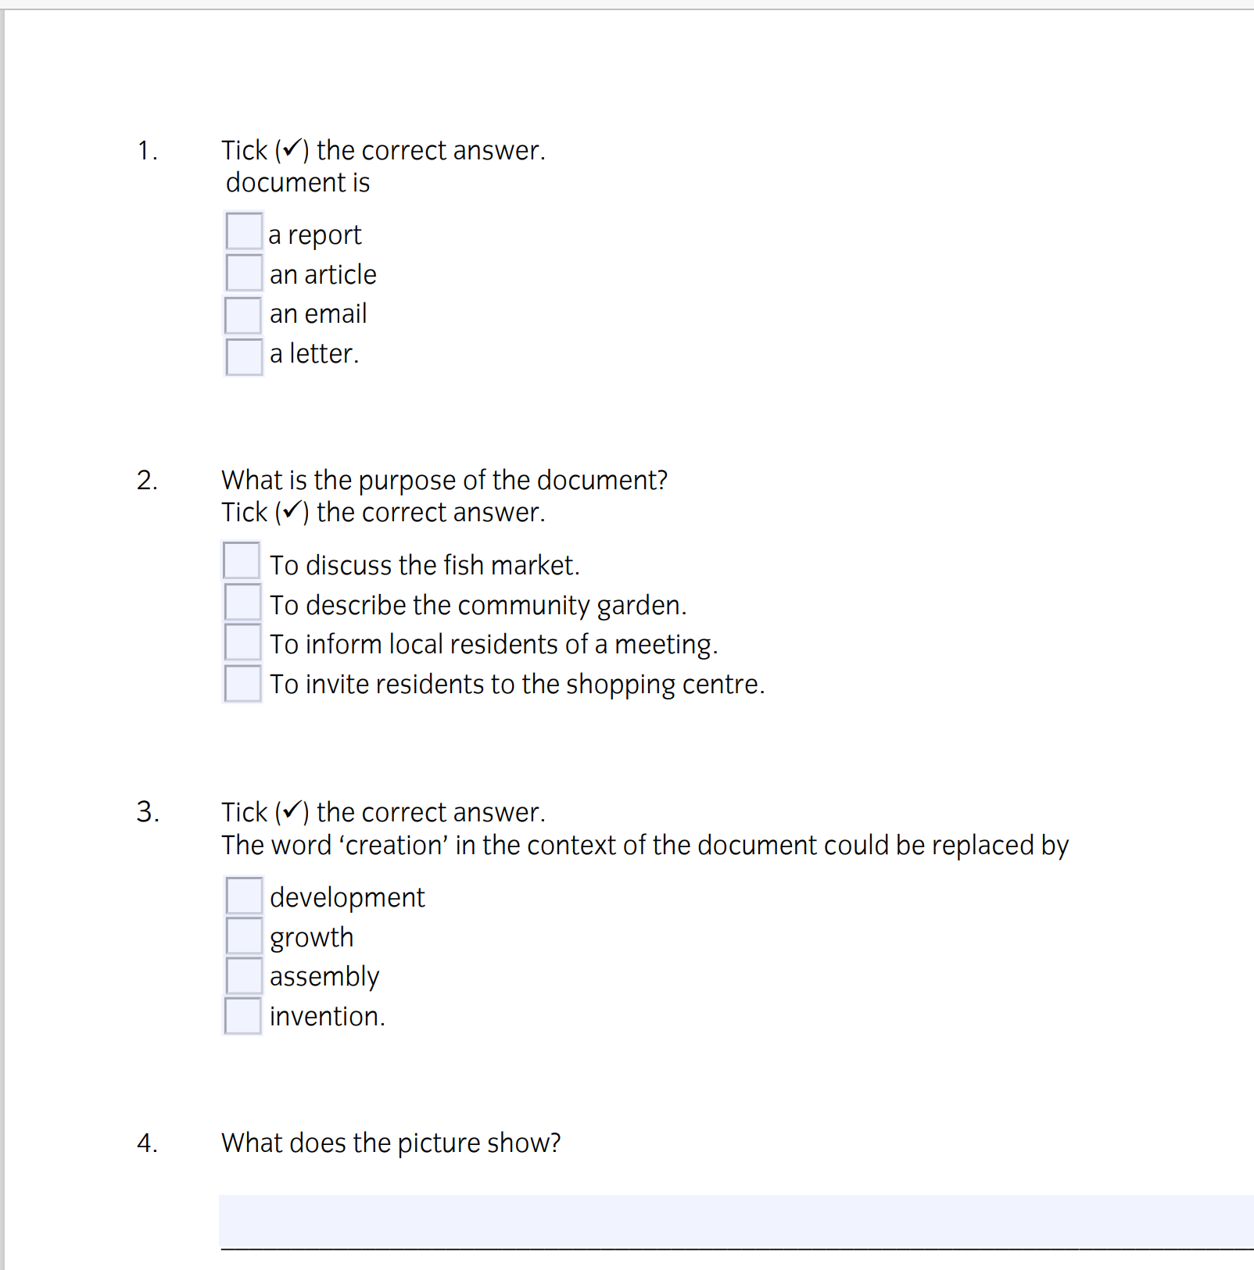

Slide 23
A
B
C
D

Slide 24
A
B
C
D

Slide 25
Summary of lesson
In the lesson, you…(change the verb to its past form)
Put words in alphabetical order.
Learned about different types of text and how to recognise them.
Practised reading different types of text and finding the purpose of text.
Read some example exam activities.

Slide 26
The end

Slide 27
Conversation segment
Suggest a topic that you would like to talk about…
the most popular topic wins and you will talk about that.
It can be about anything (non-political):
Any interesting facts you recently learned/discovered
Arts and culture
Books

Slide 28
References
https://esol.britishcouncil.org/content/teachers/lessons-and-activities/activities/titanic-and-third-conditional

