Slide 1
Welcome to Session 4
Family Language with Lauren
DAILY ROUTINE
ROTINA DIÁRIA
ROUTINA ROJANE
JIDKA MAALMINTA AH
দৈনন্দিন রুটিন
Dainandina ruṭina

Slide 2
1. The girl has coat.
2. the boy has two shoe.
a coat.
T
shoes.

Slide 3
What Is a Verb?
jump
twinkl.com

Slide 4
What Is a Verb?
clap
twinkl.com

Slide 5
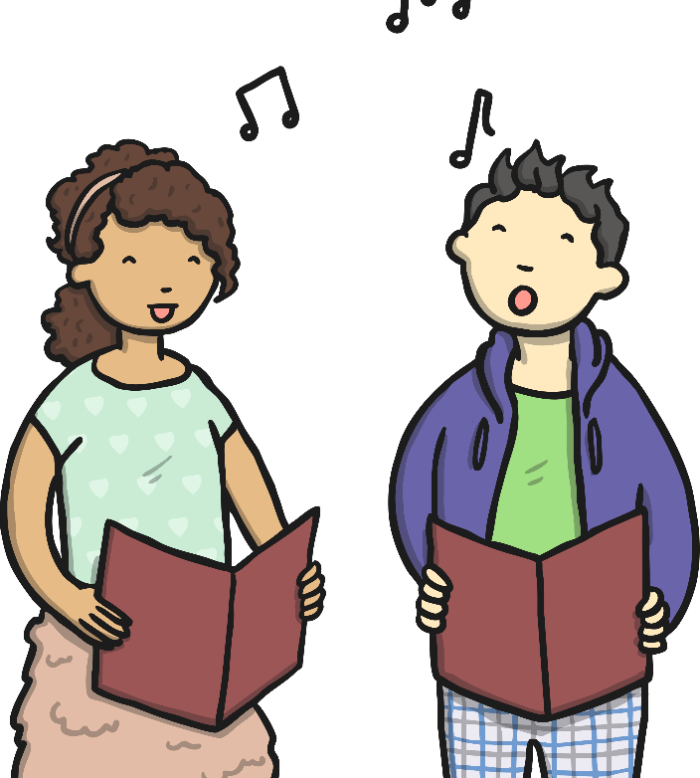
What Is a Verb?
sing
twinkl.com

Slide 6
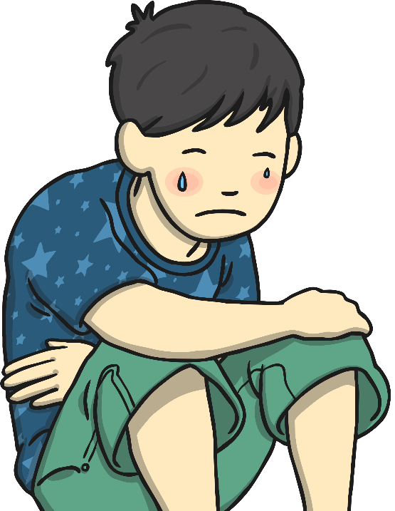
What Is a Verb?
cry
twinkl.com

Slide 7
What Is a Verb?
laugh
twinkl.com

Slide 8
What Is a Verb?
jump
clap
sing
cry
laugh
Verbs are action words. They describe what someone is doing.
twinkl.com

Slide 9
Find the Verbs
Tom painted his picture.
Tom painted his picture.
Annie brushed her hair.
Annie brushed her hair.
Amjid read his books in the library.
Amjid read his books in the library.
Neena swam without arm bands.
Neena swam without arm bands.
Ben rode his bike to school.
Ben rode his bike to school.
twinkl.com

Slide 10
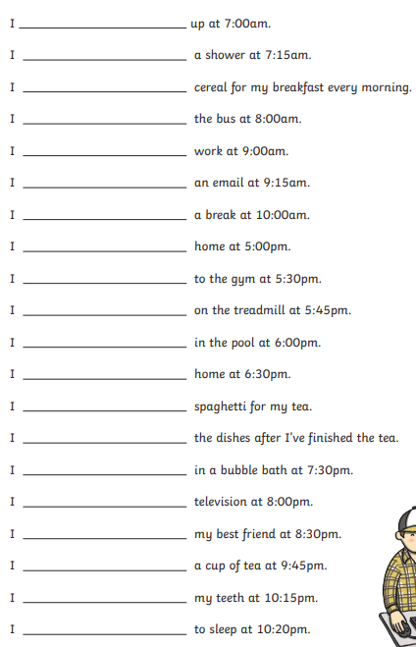
eat run walk jump swim
wake go run do watch read
take have wash clean call
brush make cook watch

Slide 11
wake
take
eat
get
start
read
take
go
go
run
swim
go
eat
do
have
watch
call
drink
brush
go

Slide 13
Which word in the sentence is a verb?
We drove to the beach on Sunday.
We
drove
on

Slide 14
Correct
Well done!
next

Slide 15
Good try!
Give it another go!
back

Slide 16
Which word in the sentence is a verb?
I eat an apple every morning.
apple
every
eat

Slide 17
Correct
Well Done!
next

Slide 18
Good Try!
Give it another go!
back

Slide 19
Which word in the sentence is a verb?
I usually walk to school in the morning.
walk
usually
morning

Slide 20
Correct
Well Done!
next

Slide 21
Good Try!
Give it another go!
back

Slide 22
Which word in the sentence is a verb?
I tripped over the rug.
rug
over
tripped

Slide 23
Correct
Well Done!
next

Slide 24
Good Try!
Give it another go!
back

Slide 25
Which word in the sentence is a verb?
The dog barked for his dinner.
dog
barked
for

Slide 26
Correct
Well Done!
next

Slide 27
Good Try!
Give it another go!
back

Slide 28
Which word in the sentence is a verb?
We found a ladybird on the leaf.
found
ladybird
on

Slide 29
Correct
Well Done!
next

Slide 30
Good Try!
Give it another go!
back

Slide 31
Which word in the sentence is a verb?
The lion roared.
lion
The
roared

Slide 32
Correct
Well Done!
next

Slide 33
Good Try!
Give it another go!
back

Slide 34
Which word in the sentence is a verb?
She paints landscapes.
paints
landscapes
She

Slide 35
Correct
Well Done!
next

Slide 36
Good Try!
Give it another go!
back

Slide 39
Daily Routine - Verbs

Slide 40
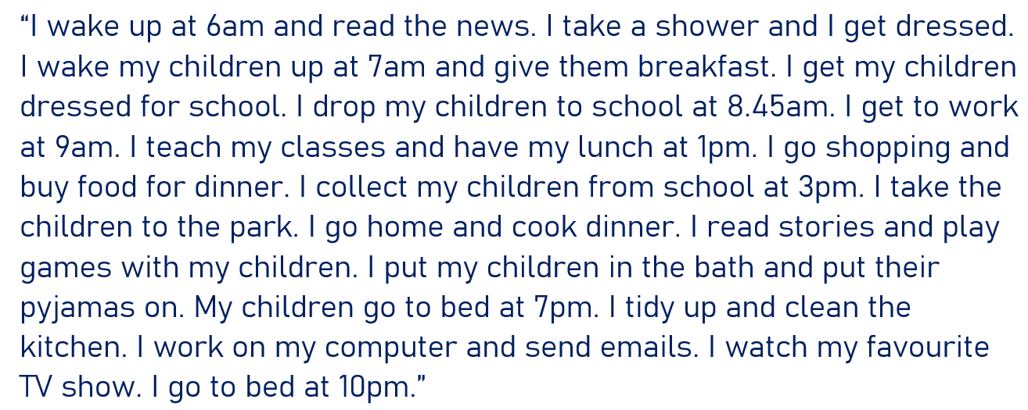
read

