Slide 1
Aim of the session:
By the end of the session learners will be able to
Check homework
Practice speaking using dates, weather
Recap-spelling names &Practice present simple tense using like/likes
Practice a phone call to emergency services

Slide 2
What’s the date today? 22nd October the twenty-second of October
What day is it today?
It’s Friday

Slide 3
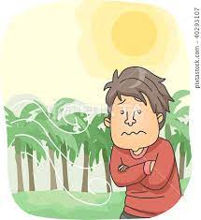
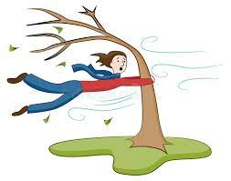
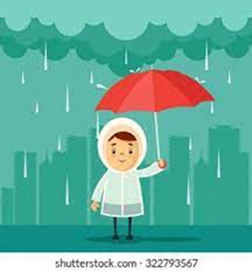
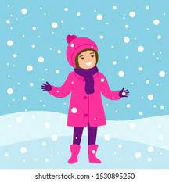
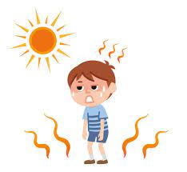
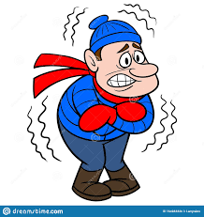
The weather
What is the weather like today?
It’s windy, cloudy, sunny and cold.
cool
windy
warm
rainy
sunny
snowy
hot
cloudy
cold

Slide 4
Homework
https://www.liveworksheets.com/worksheets/en/English_as_a_Second_Language_(ESL)/The_alphabet/Spelling_Worksheet_fd1083707ik

Slide 5
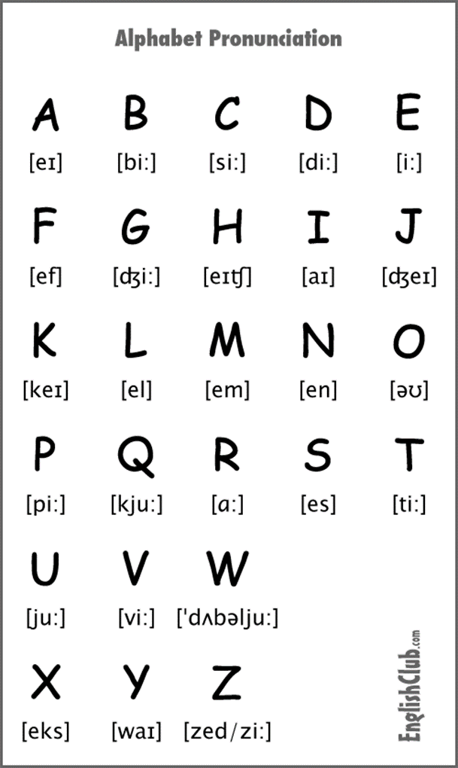
Spelling
What’s your name?
How do you spell that?

Slide 6
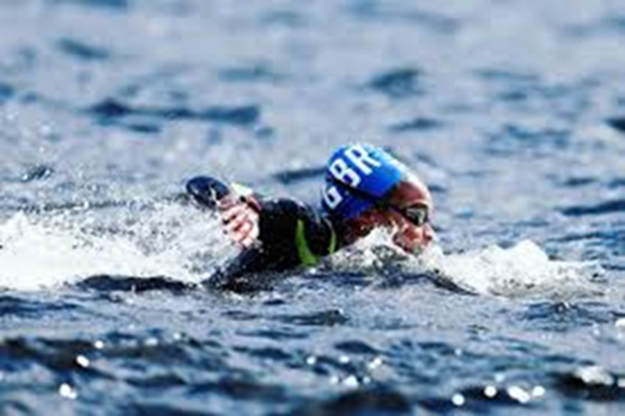
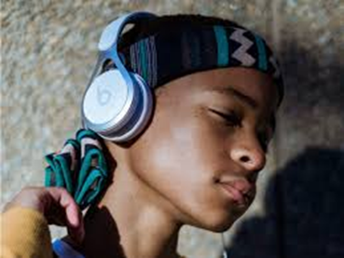
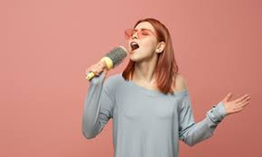
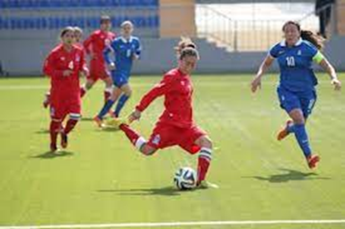
Do you like……?
Yes, I do./
No, I don’t.
Priscila likes swimming.
Dalila doesn’t like playing football.
swimming
listening to music
singing
playing football

Slide 7
What does Pinar like? She likes swimming.

Slide 8
like/likes
subject | like/likes | hobby
I | like | swimming.
You | like | swimming
He | likes | swimming.
She | likes | swimming.
It | likes | swimming.
They | like | swimming.
We | like | swimming.
https://wordwall.net/resource/8674242/esol/hobbies-like-likes-ing
https://wordwall.net/resource/23393456/untitled3

Slide 9
How to speak on the phone to the emergency services?
What service do you need?
I need an ambulance/fire brigade/police. (999)
Practise the phone call
https://www.bbc.co.uk/learningenglish/english/course/emw/unit-1/session-7/activity-1
https://wordwall.net/resource/5745666/phoning-an-ambulance
https://wordwall.net/resource/5746033/deeqa-phones-an-ambulance
https://wordwall.net/resource/23777115/emergency-services
https://wordwall.net/resource/10999852/which-service-do-you-need
https://www.liveworksheets.com/ev698006ir emergencies

Slide 10
Voice on phone Hello. Emergency services. Which service do you need?
Deeqa Sorry. Please can you speak more slowly?
Voice on phone Which service do you need? Police, ambulance, fire brigade?
Deeqa Oh. I need an ambulance, please.
Second voice Ambulance. Where are you?
Deeqa My address? It's 15 Leonard Street, Kirkdale, ST9 1XB.
Second voice What’s your emergency?
Deeqa It's my brother. He has eaten something and his stomach hurts. He is in pain.
Second voice Keep calm. We are sending someone now

Slide 11
Complete the sentences
Voice on phone Hello. Emergency services. Which service do you need?
Deeqa Sorry. Please can you s………. more slowly?
Voice on phone Which service do you n……..? P…….., a…………, f……. b………?
Deeqa Oh. I need an a………….., please.
Second voice Ambulance. Where …… you?
Deeqa My …………? It's 15 Leonard Street, Kirkdale, ST9 1XB.
Second voice What’s your e………..….?
Deeqa It's my brother. He has eaten something and his stomach hurts. He is in pain.
Second voice Keep calm. We are sending someone now.

Slide 12
Activities
https://www.liveworksheets.com/worksheets/en/English_as_a_Second_Language_(ESL)/Likes_and_dislikes/I_like...-_I_don't_like..._-_Do_you_like...$_rz1402110zt
https://www.liveworksheets.com/ug872590ab

