Slide 1
Aim of the session:
By the end of the session learners will be able to
Play letter sound bingo
talk about the weather today
Talk about myself and my hobbies
talk about ILPs –Individual Learning Plan and do diagnostic assessments

Slide 2
What’s the date today? 21st /September/2021-(How we write it) The twenty-first of September-(How we say it)
What’s the day today?
Tuesday

Slide 3
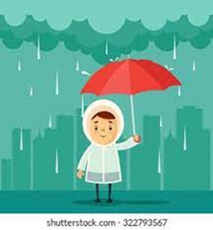
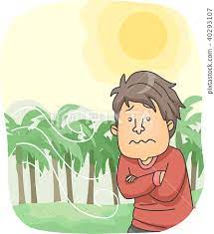
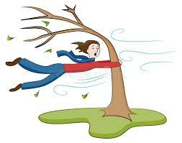
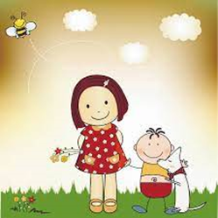
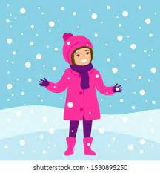
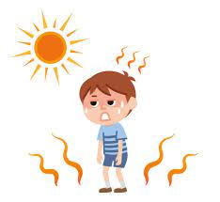
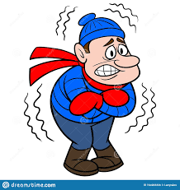
rainy
windy
cool
warm
sunny
snowy
cloudy
hot
cold

Slide 4
The weather
How is the weather today? How’s the weather today?
It’s ……………………..

Slide 5
Likes/dislikes
https://www.liveworksheets.com/worksheets/en/English_as_a_Second_Language_(ESL)/Likes_and_dislikes/What_do_you_like_to_do$_bf1631528fk

Slide 6
Questions about hobbies
What are your hobbies?
Do you have any hobbies?
What do you do in your free time?

Slide 7
I like + to V ing / I like to + Ving
I like cooking.
I like to cook ing.
I like to get up early. = I like getting up early.

Slide 8
What’s a verb? What’s a noun?
Verb noun noun
Go banana going I like bananas. I like reading books.
Come house coming
Wait hospital waiting
Take bottle taking
Eat Ice-cream eating
Sleep apple
Cook pen
read

Slide 9
I like + noun
https://www.liveworksheets.com/worksheets/en/English_as_a_Second_Language_(ESL)/Likes_and_dislikes/Do_you_like$_uq1265124ul

Slide 10
I like + noun
Look at the picture and guess the expression. Then practise the full sentence.
https://www.youtube.com/watch?v=i7s9wWNkOpc
https://www.liveworksheets.com/worksheets/en/English_as_a_Second_Language_(ESL)/Free_Time_activities/Things_i_like_doing_jd1228676vx

Slide 11
About me
My name is ………………
I am from ……………. but I live in ……………………
I am a …………………………….
I have ………………………………….
I like …………………….
I don’t like……………………………..
My favourite food is ……………….
I want to ……………………………….

Slide 13
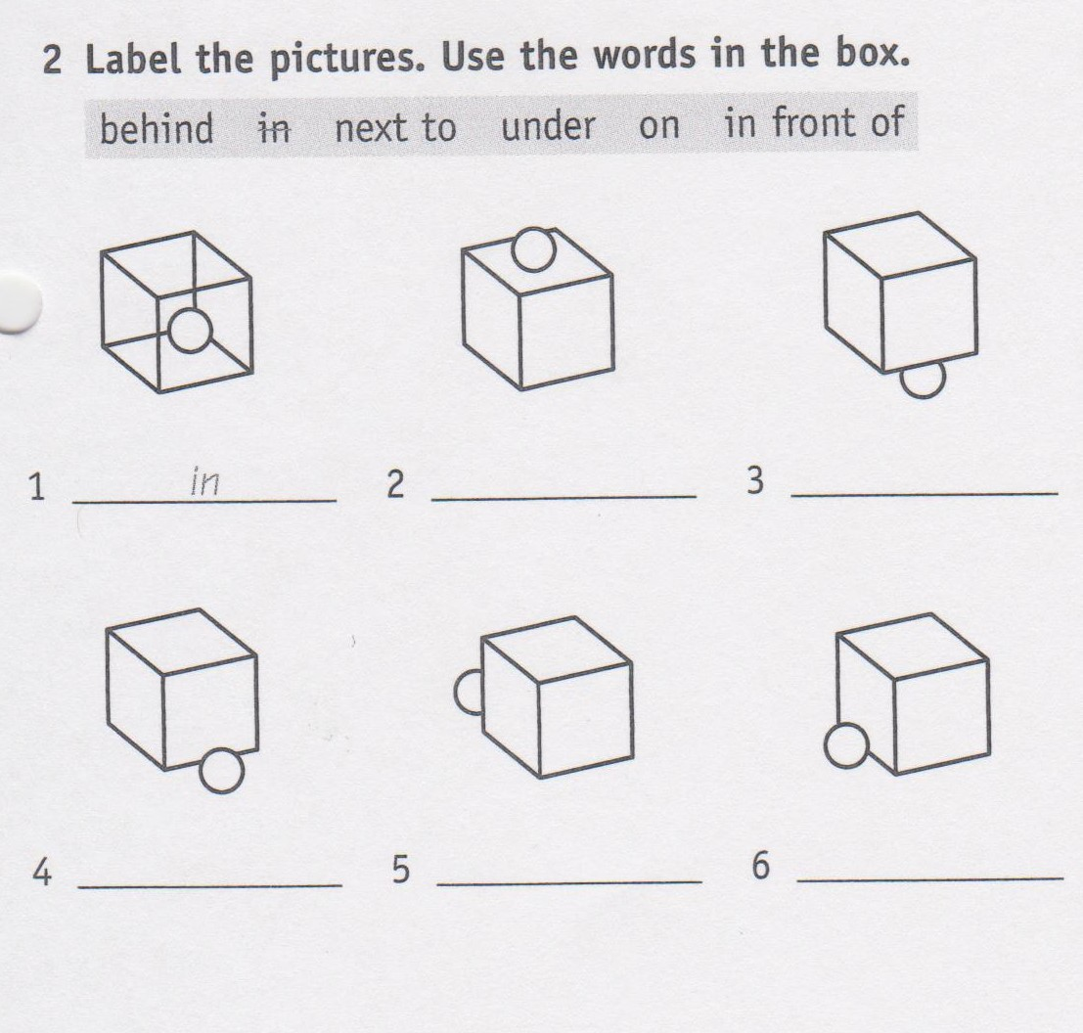
1- in
2-on
3-under
4- in front of
5- behind
6-next to

Slide 14
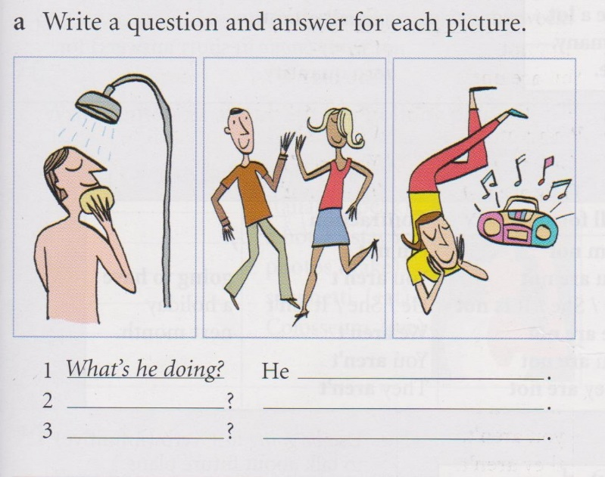
1- What’s he doing?
He is having a shower.
2- What are they doing?
They are dancing.
3- What’s she doing?
She’s listening to music.

