Slide 1
Aim of the session:
By the end of the session learners will be able to
talk about holiday
Introduce yourself
meet each other and have induction
talk about ILPs –Individual Learning Plan and do diagnostic assessments

Slide 2
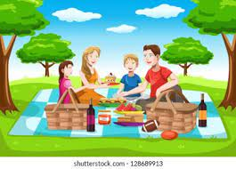
Tell about your holiday.
Seaside?
Picnic in the park?
Camping?
Going abroad?
Visiting friends?
Stay home? Cooking?

Slide 3
What’s the date today?
What’s the day today?

Slide 4
Bedroom
Living room
Where are you now?
I am in the living room.
Where is your baby now?
She is with her dad/father in the bedroom.
My partner/husband is in the bedroom with my baby.
How many rooms are there in your flat?
There are four rooms in my flat. One living room, one kitchen, one bathroom, one toilet and two bedrooms.

Slide 5
Nouns
Singular Plural (regular)
One bedroom two bedrooms
One house three houses
A window five windows
A door two doors
A car four cars
A city three cities
A country two countries
Plural (irregular)
A child two children
One person three people
A woman four women
A man five men

Slide 6
About me
My name is ………………
I am from ……………. but I live in ……………………
I am a…………….
I have ………………………………….
I like watching TV
I don’t like cooking.
My favourite food is ……………….
I want to go to my country.
What does housewife mean?
A housewife is a woman who works at home and look after her family. (clean the house, cook dinner, look after the children and husband)
What does want mean?
It means something you like to have or do.

