Slide 1
Functional Skills English Level 2 Spring Term
29th Jan – 30th Apr 2021

Slide 2
Session aims/objs
Aim: writing a covering letter
Objs: by the end of this session, you will
State features of persuasive text
Define skills and qualities (including your own)
Plan and write a covering letter
Participate in a 1:1 tutorial

Slide 3
Head of Service Q&A session
Duration: 1 hour
Date: Tuesday 2nd March
Time: 10 to 11am
If you are interested in attending this online Zoom session, please let your tutor know.

Slide 4
Interesting facts for this month Did you know on this day….

Slide 6
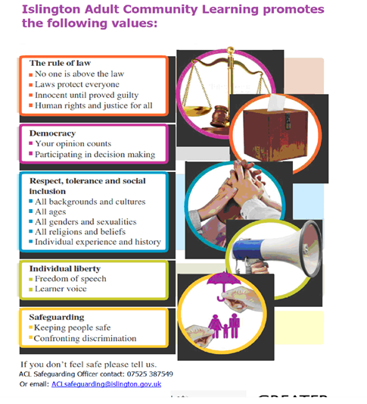

Slide 7
Q: What was your dream job as a child?
What is your dream job now?

Slide 8
Skills
and
personal qualities.

Slide 9
Skills and personal qualities.
What are they and what do they mean?

Slide 10
What are they and what do they mean?

Slide 11
What is a skill?
The ability to do something well…
or something you can do.
For e.g
I can work well under pressure.

Slide 12
What is a personal quality?
Personal qualities are personal characteristics of an individual. They are what make up one's personality.
Or
something that you are!
For e.g.
I am very reliable.

Slide 13
So…in short,
Skills = something you can do well.
Personal quality = something you are.
I can communicate effectively = skill.
I am friendly = personal quality.

Slide 14
Skills | Personal qualities
hard-working
driving
communication
dynamic
enthusiastic
I.T
public speaking
friendly
numeracy
caring
languages
Patience/patient

Slide 15
Task: write down four of your own skills and p/qualities.
Next, choose one of your skills and one of your personal qualities and give examples of when you have used these in class or in the workplace.
Skills
Personal qualities

Slide 16
Q: what factors determine the type of job you would apply for?
Interests
Skills
Personal qualities
Experiences

Slide 17
Extn task:
Thinking about the interests, experiences, skills and qualities you have identified, go to:
https://nationalcareersservice.direct.gov.uk/advice/planning/jobfamily/pages/default.aspx
Task: now make a list of at least 3 job options that you think match some of your interests, experiences, skills and qualities.

Slide 18
Independent study
Complete the task.
You have seen an advertisement for your dream job.
Write a covering letter to the employer exemplifying your skills and personal qualities (and personal interests too).
Demonstrate why you would be the right candidate for the post you are applying for through examples.

Slide 19
Dear sir/madam,
I am writing a covering letter to support my application for …
Skills
Personal qualities
Experience
Interest
Call to action
Closing

Slide 20
1 Example drive
London
N1 1AB
29th Jan 2021
Dear Mr Jones,

Slide 21
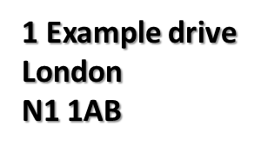

Slide 22
Summary
Features of persuasive text
Skills and personal qualities
Dream jobs
How to write a covering letter

Slide 23
The end

Slide 24
References:
https://www.britannica.com/on-this-day/January-29

