Slide 1
FS English L2 Spring Term
5th Mar 2021

Slide 2
Session aims/objs
Aim: prepare to take a mock reading exam
Objs: by the end of this session, you will be able to
Communicate your thoughts and ideas clearly
Take part in a discussion
Prepare to sit a mock reading exam

Slide 3
Online Learning Class Rules
Try to be somewhere quiet.
Even if you’re at home wear appropriate clothes.
Be on time.
Respect everyone and do as the teacher asks.
Wait until you’re asked to speak.
Turn your microphone off when others are talking.
Be patient because sometimes the systems don’t work.
Do your homework.
Never record or screenshot any part of the lesson.
Have fun and learn!

Slide 4
Safeguarding
David Coleman
Safeguarding Lead
Tel 020 7527 3343
ACLSafeguarding@islington.ac.uk

Slide 5
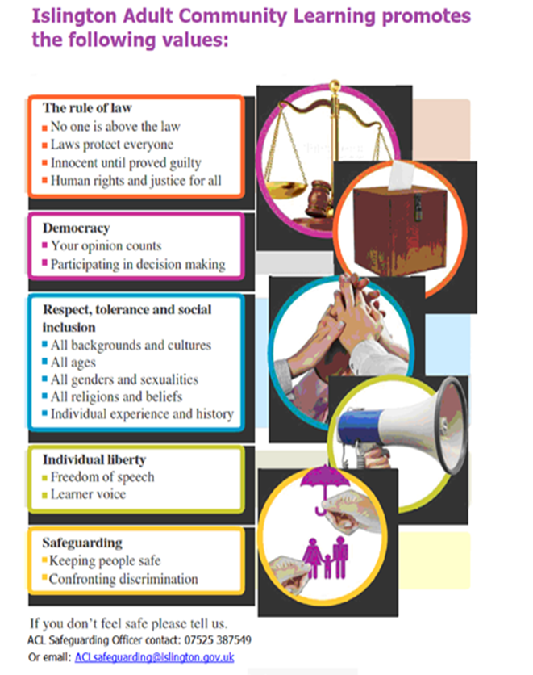

Slide 6
Our ACL 1-1 IAG offer
A confidential service for learners
Up to 3 one hour sessions with a qualified adviser
Adherence to the Guidance Council’s Code of Principles (impartial, current, confidential, in accordance with equality and diversity legislation, accessible, individual ownership, transparency)
and the Career Development Institute’s Code of Practice (as above, also duty of care, accountability and CPD)
Notes:
Any organisation which manages, administers and delivers an IAG service to support individuals in their career, learning, work or life goals has the chance to achieve matrix accreditation.
This is regardless of whether the service or services are delivered face-to-face, through training, learning, remotely, or through a website.

Slide 7
How can you book an appointment?
For the summer term we are offering IAG sessions via telephone and/or via MS Teams
For general appointments:
Contact Alison on 07808 879044
Email Alison.moore@islington.gov.uk
Appointments available:
Tuesdays and Thursdays
9.30am - 12.30pm and 1 – 4pm
To find out about all or our courses on offer visit: www.adultlearning.islington.gov.uk

Slide 9
Announcement:
WBD (What it is? Key date)

Slide 10
https://readtheory.org/reading-comprehension-worksheets/adult-abe/

Slide 11
Conversation game
We are going to play a yes/no game.
Time allowance: 1min for each person.
I will ask you a (closed ended) question and you have to answer it without saying yes or no.
We are going to explore useful phrases that you can use.
Grammar focus: closed ended questions can start with the verb to be (are you/do you/have you) and modal auxiliary verbs (could/can/would/will/shall)

Slide 12
Conversation game
We are going to play a yes/no game.
Time allowance: 1min for each person.
I will ask you a (closed ended) question and you have to answer it without saying yes or no.
We are going to explore useful phrases that you can use.
Grammar focus: closed ended questions typically start with the verb to be (are you/do you/have you) and modal auxiliary verbs (could/can/would/will/shall).

Slide 13
Useful phrases that you can use
Answers in the affirmative form | Answers in the negative form
I would say so others would say so | others would disagree
I do (indeed) | I do not
I would agree with that view/you | I disagree with that view I don’t agree with that view
I like to think so | I do not think so
I do believe so | I do not believe so
that is correct | that is incorrect

Slide 14
Useful phrases that you can use
Answers in the affirmative form | Answers in the negative form
I would say so others would say so | others would disagree
I do (indeed) | I do not
I would agree with that view/you | I disagree with that view I don’t agree with that view
I like to think so | I do not think so
I do believe so | I do not believe so
that is correct | that is incorrect

Slide 15
Class discussion on last week’s homework
The task was to watch the video and note down important points for a discussion this week.
My Digital Rights
Privacy online: an introduction
https://www.bl.uk/my-digital-rights/videos/privacy

Slide 16
Thoughts and/or any reflections on the video?
Anonymity
Digital footprint (online presence)
Cookies
Data harvesting
Freedom to be forgotten

Slide 18
Lesson summary
In the lesson, you…
Played a game
Communicated your thoughts and ideas clearly
Took part in a discussion
Independent task
Take a mock reading exam (City and Guilds)

Slide 19
References:
Extra resource on My Digital Rights
Privacy online: an introduction
https://www.bl.uk/my-digital-rights/videos/privacy
World Book Day link
https://www.worldbookday.com/books/
https://readtheory.org/reading-comprehension-worksheets/adult-abe/

