Slide 1
Small business & Tax Your Questions answered

Slide 3
Part One

Slide 4
Essential/Important/Optional
Some of the information contained in the following slides is relevant, but not important at this stage
It is important you are aware of the information. Schedule some study/development time and watch the Youtube videos, webinars
Remember KIS!

Slide 5
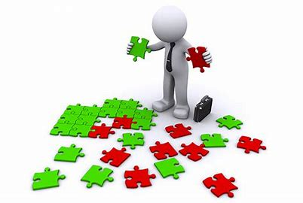
Key Considerations
Your Personal/Household Survival Budget
Are you on any benefits such as Universal Credit, Housing Benefit or Council Tax Relief
Your Operations
Potential Contracts
You – how organised are you?

Slide 6
Operations
How will you produce your product/service?
How will you distribute your product?
How will your people access your service?
What quality control checks do you have in place?

Slide 7
How will you record your sales, payment to suppliers and receipt of payment from customers.

Slide 8
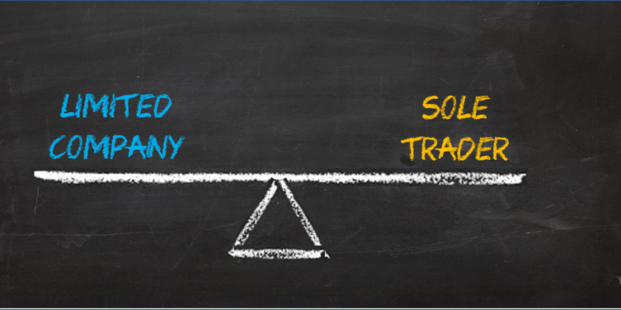
Business Structure
Typically a business will be either incorporated (a limited company), paying corporation tax,
Or unincorporated (a sole trader or a partnership), paying income tax

Slide 9
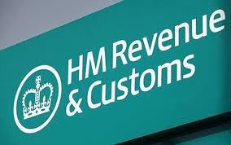

Slide 10
There are other types of business structures available such as community interest companies and limited liability partnerships.

Slide 11
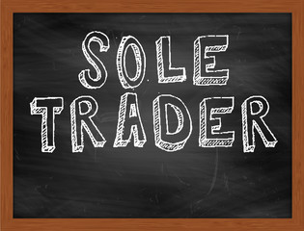
Sole Trader
Easy to start trading
Inform the HMRC that you are self employed
If you are trading under a name other than your own name, you need to include your name and address on any official correspondence:
Letterhead
Invoices
Quotes
Terms & Conditions
Contracts

Slide 12
Sole Trader
As a sole trader you need to keep accounts for
6 years, they must be accurate, you don’t
need to have them audited

Slide 13
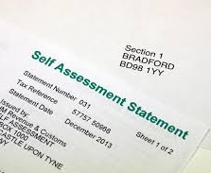
Sole Trader
You will need to
complete a self
assessment for tax
purposes if your
turnover is more
than £1,000 in the
tax year.

Slide 14
Advantages
You have full autonomy over all business decisions

Slide 15
Disadvantages
A sole trader has unlimited liability for all money the business owes
If the business loses money, you may have to sell your personal assets to pay off business debts or in extreme cases bankruptcy
It can be difficult to obtain capital to expand the business

Slide 16
Disadvantages
Dependant on one person
Growth of the business can be limited as it relies on one person’s capacity
As a sole trader you are entitled to fewer social security benefits than an employee

Slide 17
Partnership
In a partnership, two or more people can set up a business together (normally no more than 20).
They share all the risks, costs and responsibilities as well as the profits or losses both need to register as self-employed
Class 2 & Class 4 NICs are the same as a sole trader

Slide 18
Partnership
No legal requirement to have a written partnership agreement, however, it is recommended you consult a solicitor to have one drawn up.
Governed by the Partnership Act 1890 if there isn’t a Deed of Partnership in place

Slide 19
Advantages
The business is more likely to survive and continue trading
Day to day management can be made easier
More capital may be available to invest in the business

Slide 20
Deed of Partnership
Business Name
Nature of Business
The start date of the partnership
The place where business is carried out
The terms on which capital is introduced
How the accounts will be kept
Details of banking arrangements
Insurance provisions

Slide 21
Working arrangements
Provisions for expulsion of partners

Slide 22
Disadvantages
Unlimited liability for business debts
Disagreements between partners can lead to
dissolution of the partnership
A partnership relies on the legal concept ‘the
utmost’ good faith, If one partner is dishonest
it may cause the others financial difficulty, all
partners are jointly liable for the debt

Slide 23
The partnership has no legal existence of its own and is simply a collection of individuals. If a partner resigns, dies or goes bankrupt, the partnership can be dissolved.

Slide 24
Limited Company
The business is a separate entity from its owners, with its own legal existence
Finances are separate and distinct from the personal finances of the owners
You do not have to appoint a Company Secretary
Visit: www.companieshouse.gov.uk

Slide 25
Advantages
Liability for debts is limited
Capital can be raised from shares
A board of directors and a management team control the business

Slide 26
The overall tax might be lower
As a company director only the salary you pay yourself as an employee of
the company is taxed at the personal rate (along with Class 1 NICs)
If you wish opt to receive dividends
The business may be perceived as being ‘credible’

Slide 27
Shareholders or members of the
company can be individuals or
companies.
They are not liable for the debts
of the company unless they
have given a personal
guarantee

Slide 28
Excercise

Slide 29
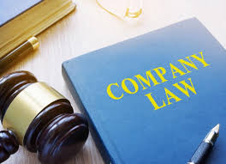
Disadvantages
Costs to set up are higher
You need to draw up a Memorandum
and Articles of Association
You must register with the Registrar of
Companies at Companies House
Accounts must be kept and filed, in
addition to filing a confirmation
statement

Slide 30
Limited Liability Partnership
Each partner’s liability is limited to the money they have invested and the amount of personal guarantees they have given to raise finance
At least 2 of the partners must be ‘designated members’, which brings extra responsibilities
Must register at Companies House
Must file annual returns

Slide 31
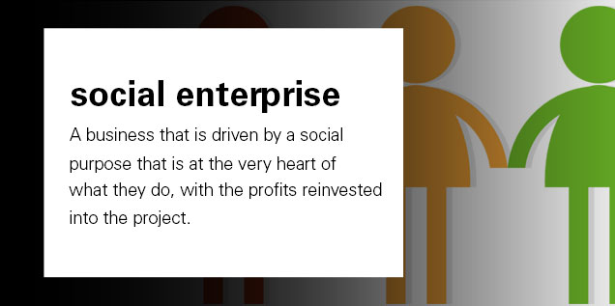
Social Enterprise
'a social enterprise is a business with primarily social objectives whose surpluses are principally reinvested for that purpose in the business or in the community, rather than being driven by the need to maximise profit for shareholders and owners.‘

Slide 32
It can bring wealth and empowerment to communities which may be otherwise marginalised
Social enterprises take on a range of different company legal structures, including Community Interest Company, Industrial & Provident Society, a Limited Company, a Trust, and Co-operatives

Slide 33
Social enterprises operate over many different industry
sectors, including health and social care, arts and design,
childcare, sport and leisure, finance and transport

Slide 34
Examples of well known social enterprises based in London include:
Better is the customer-facing brand from GLL
Jamie Oliver’s Fifteen restaurant
The Big Issue
Trading arms of charities are also social enterprises, so for example charity shops and Oxfam’s Unwrapped catalogue

Slide 35
Limited by Guarantee
Companies limited by guarantee
The most common route for a not-for-profit organisation is to incorporate as a company limited by guarantee. This type of company does not have shares or shareholders - it has members instead. Members agree, in the event of liquidation, to provide a sum of money that may be required to meet the demands of any creditors. The amount is defined in the Memorandum of Association and is usually set at £10.

Slide 36
Community Interest Company
The Community Interest Company (CIC) is a legal format designed for use by social enterprises. The CIC status can take the form of a private company limited by shares, a private company limited by guarantee or a public limited company.

Slide 37
To qualify as a CIC, an organisation's constitution must feature an 'asset lock', meaning that profits and assets must be employed in the community interest rather than distributed to company members.

Slide 38
Its aims must also satisfy a community interest test, and must deliver an annual report to Companies House (or the Companies Registry in Northern Ireland) with its accounts. In order to encourage investment, CICs limited by shares are entitled to pay a dividend to investors.

Slide 39
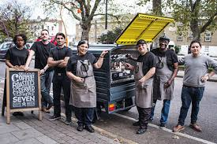
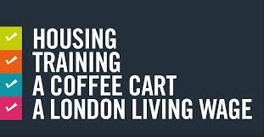
https://www.youtube.com/watch?v=q4BmXeoU_7M

Slide 40
Legal Status
https://www.youtube.com/watch?v=c4QS6KS_BsI
Social Enterprise
https://www.youtube.com/watch?v=aTo0qtdVMpM

Slide 41
How do I register – Sole Trader
Cost – FREE!

Slide 42
How do I register – Ltd Company
£s – cost vary

Slide 43
Your Cash

Slide 44
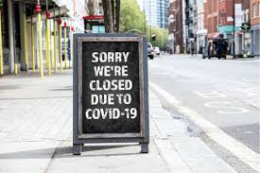
Exercise/Homework
Registration
Compliance
Banking
Ensure you can provide evidence of trading just in case…

Slide 45
Part Two

Slide 46
Invest in yourself
Watch
Listen
Read
Invest in You!
Be mindful of what you
Watch
Listen to
Read

Slide 47
Professional Associations and Unions

Slide 48
Threshold - £85,000

Slide 49
Personal Tax Allowance £12,500

Slide 50
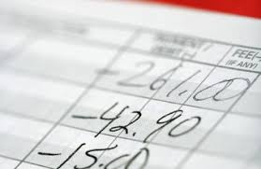
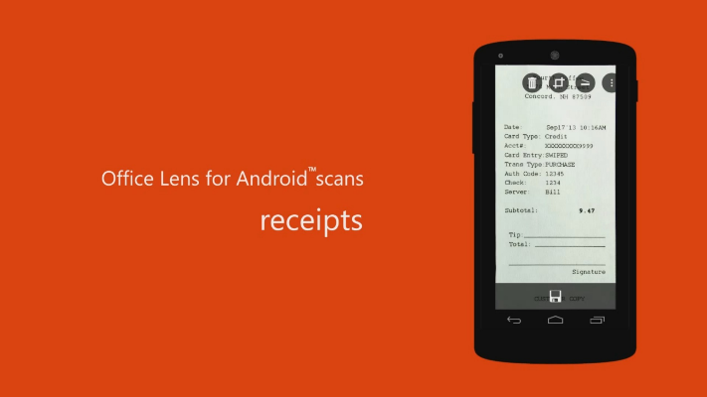
If you put a robust system in place from day one, simple bookkeeping, will not turn into a nightmare – even if number crunching isn’t your thing.
So what makes up a basic bookkeeping system?
Cashbook, Excel, Accounting Software, Application

Slide 51
Premises
Pop up shops
Offices
Incubators/hot desking/hubs
Working from home
Permission - ENQUIRE
Landlord
Mortgage company
Local Authority

Slide 52
Legal Requirements
Licences and registration

Slide 53
Good Use of GDPR

Slide 54
Protecting Yourself & Others
The Sale of Goods Act 1979
General Data Protection Regulation (GDPR) and the Data Protection Act 2018
The Consumer Rights Act 2015 and the Sale and Supply of Goods Act 1994
The Consumer Contracts (Information, Cancellation and Additional Charges) Regulations 2013 - This replaced the distance selling act

Slide 55
Employing staff
Any business that employs people also needs to comply with a number of regulations, including:
The Maternity and Parental Leave etc. Regulations 1999 (as amended)
The National Minimum Wage Act 1998
The Working Time Regulations 1998 (as amended)
The Employment Act 2002 (and subsequent amendments)
The Equality Act 2010

Slide 56
Protecting Yourself
In Groups
Discuss ways in which you can protect yourself while at work
For example
Health & Safety
Meeting clients of the opposite sex
Working late
Business Insurance
Professional Indemnity Insurance

Slide 57
Excercise
Mandatory Contacts & Cobra

Slide 58
Copyright & Intellectual Property

Slide 59
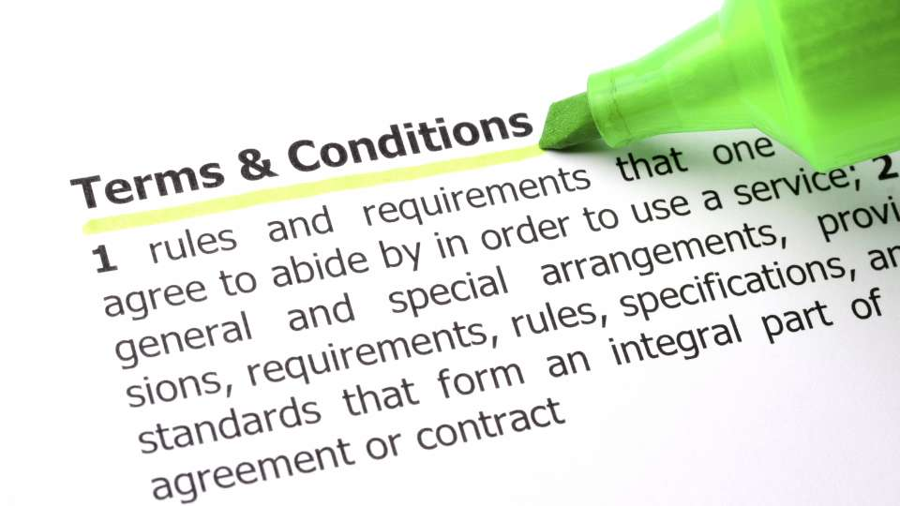
Policies

Slide 60
BPP legal advice clinic: BPP University offers a free advice service for family, residential property, landlord and tenant issues and other civil matters. Student advisors take the details of your case.
They will then research the issue at hand, supervised by qualified legal professionals, and provide a letter of advice. To contact BPP Legal Advice Clinic call 020 7430 5668 (residential property law/landlord and tenant) email BPP.

Slide 61
Queen Mary University Legal Advice Centre: These sessions are for clients with concerns relating to their creative work. The Centre provides them with written legal advice and research on their case that they may not otherwise be able to afford, under the supervision of volunteer lawyers.

Slide 62
Tax Aid
TaxAid offers free, confidential advice on tax to those on low incomes.
http://taxaid.org.uk/

Slide 63
Contracts
www.lawsociety.org.uk/lfyb/
www.clickdocs.co.uk/
www.simply-docs.co.uk

Slide 64
Public liability
Public liability insurance covers your business against accidents to members of the public or damage to property that occurs as a result of negligence. It also covers any related legal costs and is normally linked to employers' liability insurance in policies for small businesses.

Slide 65
Product liability
Product liability insurance is a type of cover that protects you specifically from claims made following loss, damage or injury sustained as a result of a product manufactured or supplied by your business.

Slide 66
Professional indemnity
This insurance covers you against being sued for giving poor advice or acting negligently in some way. It is obligatory in certain professions, such as law, accountancy and financial services. It is also now common in areas such as management and computer consultancy, engineering and design.

Slide 67
Cover usually includes breach of professional duty, breach of copyright, breach of confidentiality, libel and slander, and loss of documents.

Slide 68
Income protection and critical illness
As a self-employed person, you can buy insurance cover to pay out if your income ceases unexpectedly. There are several types of income protection policies.

Slide 69
You need to consider
Insurance costs may be based on your turnover
Ensure you have the correct level of cover
You may get a discount if you are a member of a professional association

Slide 70
Keeping financial records
To remain within the law (and run your business effectively), you must maintain accurate financial records, detailing all money entering and leaving your business. These accounts must be kept for at least six years – even if the business ceases trading.

Slide 71
If you put a robust system in place from day one, simple bookkeeping, will not turn into a nightmare – even if number crunching isn’t your thing.
So what makes up a basic bookkeeping system?
Cashbook, Excel, Accounting Software, Application

Slide 72
System
S is for...system - spend time setting up a system which you stick to
Allocate a regular time every week/month to deal with your financial administration, or outsource it.
File your records logically - put receipts in date-marked envelopes and file bank statements in order

Slide 73
Separate
Keep your finance separate - one of the
biggest mistakes business owners make is to
mix their personal and professional finances. It
is best to treat the business as a separate
person, from which you only take income in
the form of wages, dividends and in claiming back
business expenses against receipts
So keep it separate - and simple

Slide 74
Security
S is for...security - the fewer people involved in your record keeping, the fewer the errors that are likely to creep in.
Make it very clear whose responsibility it is to maintain records. It is a good idea to password-protect your computer records, and only divulge the password to a small number of people.

Slide 75
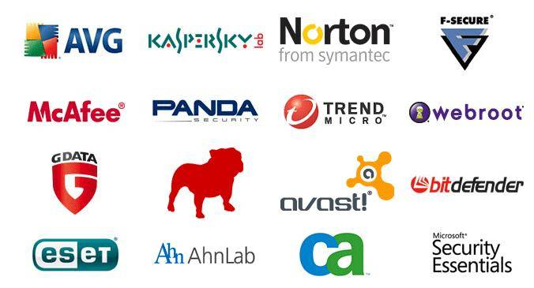
Safe
S is for...(safe) storage - even if you choose to keep all your records on a computer it is vital that you keep a regular (weekly, if not nightly) electronic back-up, and a paper copy elsewhere
Store records that cannot be copied, such as chequebook stubs and paying-in books, in a fireproof box
Anti-Virus Protection

Slide 76
Next Steps

Slide 77
Any Questions?

