Slide 1
HELLO!
Janice Beckles
B Consultancy Ltd
www.bconsultancy.co.uk
jb@bconsultancy.co.uk
07737 018367
Mentor, Coach, Trainer, Business Advisor, NLP Trainer (FIoEE)
Notes:
Replace this photo with your own by going to Insert → Photo → Picture from File.

Slide 2
Workshop Etiquette
One conversation at any one time
100% support for each other
Mobile phones on silent
Comfort breaks

Slide 3
Expected Outcomes
How to start and grow your business
How to generate revenue
Clear goals
Why do you want to start a business?
A list of what you need to do now
What makes a successful business
Defining your business values
Your business vision
The business skills you need

Slide 5
REMOTE-LEARNING
Reflection and Resources
Read through the worksheets and complete
Complete the reflection exercises
Connect with thought leaders

Slide 6
Trainers and Speakers
Janice Beckles Business Advisor & Trainer
Michael Henry – Business Advisor, Business Plan and Bid Writer
Ernest Hanson – Trade
Janet Martin – Websites and Marketing
Noah Lagunda – Insurance & Entrepreneur
Eben Afriyie – Accountant
City Business Library
Lere Fisher – Entrepreneur

Slide 7
Why do you want to start a business?

Slide 8
Your Goals

Slide 11
Reflection
Reflective practices allow us to evaluate ourselves and our teams, enhance creativity, and dedicate time to deep thinking – but how do we actually achieve this in practice?

Slide 13
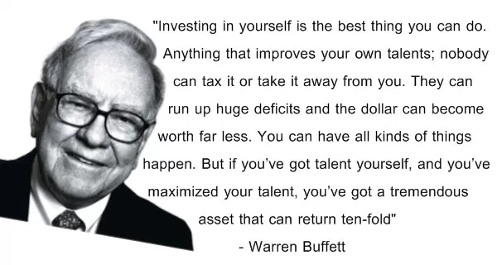
Self-worth

Slide 14
Your Purpose

Slide 15
Problem
What problem are you solving?
Think about this from your target customers perspective

Slide 16
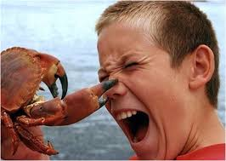
Solving a problem or need – customer pain point
Understanding
Speed
Price
Variety
Ethical

Slide 17
Skills

Slide 18
SWOT – Make it Personal!
STRENGTH
WEAKNESS
OPPORTUNITY
THREAT
What advantages do you have that others don’t, for example, knowledge, skills, behaviours?
Is there anything holding you back in your field?
What are your areas of development?
What opportunities are presenting themselves to you to grow and develop.
Is there anything holding you back which is out of your control.

Slide 19
Your Idea & Your Business

Slide 20
Business Idea
What will you need or use for your idea?
What materials/equipment are essential for your business?
What skills will you or do you use?
What help/materials from other people or organisations will you need or have you utilised?

Slide 21
Keep it simple

Slide 22
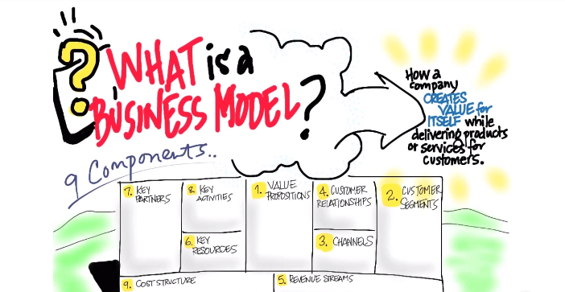
Your Business Model
Show me the money!

Slide 23
Products and Services
How will the products and services differ from those offered by competitors?
Why should customers want to use them?
How will the business be differentiated to make it successful?
It should give a clear summary of the purpose of the business, and should be easily understood by owners, staff, customers and potential investors

Slide 24
Your Ideal Customer

Slide 25
YOUR CUSTOMERS?
Who are you targeting
What needs/wants are you meeting?
Who are they?
What do they want?
When do they want it?
Where do they want it?
How do they order, pay and receive it?

Slide 26
Customer Persona

Slide 27
Step into Your Customer Shoes

Slide 29
Customer Needs
Write down five needs / reasons why your people will buy from you…
Class Exercise

Slide 30
Essential Preparation

Slide 31
Business Canvas

Slide 32
Schedule Your Time

Slide 33
Develop Your USP
Be different...!

Slide 34
Humble & Shameless

Slide 35
Market Research

Slide 36
Questions, Questions, Questions
The key is to learn to ask questions
This will help to shape and bring life to your vision
At this stage of your journey you will discover which types of customers you want
Who you will be competing against for their money - Competition
What are their wants and needs – Information about your customers

Slide 37
Quality Questions
Asking the right questions and researching your market properly will underpin the success of your business
You will be able to find out if you are targeting the right customers, if you are selling the right services and products to customers at the right time and at the right price

Slide 38
Your research should include
Your Industry
Customers
Competition
Suppliers
Pricing
Location
Marketing and Communications

Slide 39
Sources of Market Research
Trade/Professional Associations
Libraries (City Business Library)
Market Research Reports
Test trading
Banks
Newspapers
Trade press
Internet

Slide 40
P.E.S.T Analysis

Slide 41
Your Customer is King & Queen
It’s all about the customer and nothing about you

Slide 42
Customer
Get
Keep
Grow
Website, Online, Physical

Slide 43
Channels – How does your product/service get to the customer?
Distribution channels
Website
Mobile
Online

Slide 44
Work on yourself
Tap into your talents, skills, knowledge
Build a healthy, positive mindset
Believe in yourself – daily practice
Focus on past experience, skills, successes & wins
Take risks
Stop negative thinking
Act ‘As if’

Slide 45
Work on your business
Know your trade/profession
Know the marketplace
Keep building your business skills & experience
Makes plans and stick to them!
Keep the momentum flowing
Get feedback

Slide 46
Continue to build your network
Find out who you need to network with
Go out and meet them (virtually)
Know your customers/clients
Build your support system – Know, like, trust

Slide 48
Metrics
The change you want to make
What you plan to measure
How will you measure it
How will you tell people about it
Finance
Social Media engagement

Slide 49
Social Enterprises only - Impact
Your business plan needs to show not only a financial return, but also a social one
This social return is your impact – the difference you make for the people and communities you work with
Use this section to give a clear and concise description of your impact.
Back this up with details of how you measure, learn from and communicate your impact

Slide 50
Revenue Structure
How do you make money from each customer segment?
Pricing
What value are they paying for?

Slide 51
Resources – What are the most important assets?
Finance
Skills
Intellectual Property
People and organisations you work with (e.g. partners and suppliers)
Premises and the equipment you use
Process for taking payments (if relevant)

Slide 54
SMART Goals

Slide 55
Group Discussion
Action Plan
What will you:
Be
Do
Build
Know

Slide 56
Exercise - Action Planning – Break it down
Goal | Action | Target date | Review by

Slide 58
Questions, Learnings, Discoveries

