Slide 1
What’s the date today? 15th October The fifteenth of October yesterday? 14th October the fourteenth of October tomorrow? 16th October the sixteenth of October
What day is it today?
It’s Friday.
Yesterday?
Thursday
Tomorrow?
Saturday
https://wordwall.net/resource/400941/esol/months-of-the-year

Slide 2
Aim of the session:
By the end of the session learners will be able to
Practice speaking using dates, weather, months and hobbies
recap previous sessions
Watch the video about UK and finish answering comprehension questions
Practice present simple tense using like/likes and live/lives
Write about the UK

Slide 3
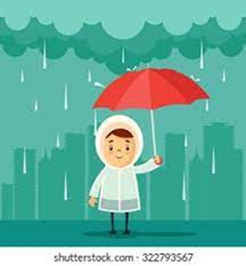
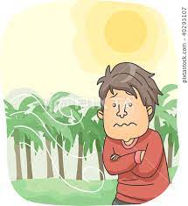
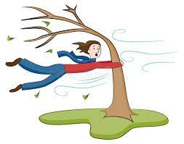
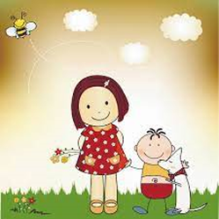
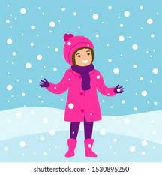
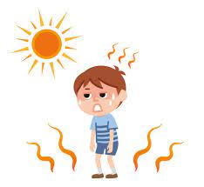
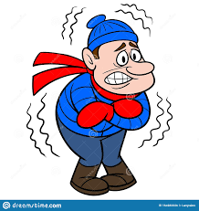
rainy
cool
windy
warm
sunny
snowy
cold
hot
cloudy

Slide 4
The weather
What is the weather like today?
It’s windy and cloudy.
I can’t see it.
I can’t hear it.

Slide 5
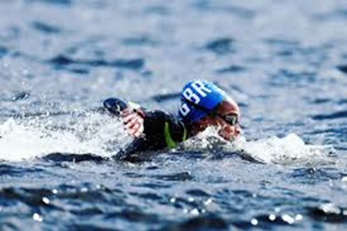
like/likes
subject | like/likes | hobby
I | like | swimming.
You | like | swimming.
He | likes | swimming.
She | likes | swimming.
It | likes | swimming.
We | like | swimming.
They | like | swimming.
https://wordwall.net/resource/8188910/esol/hobbies
https://wordwall.net/resource/8674242/esol/hobbies-like-likes-ing
https://wordwall.net/resource/23393456/untitled3

Slide 6
Registering with a GP
Family name: What’s your family name?
First name: What’s your first name?
Date of birth: What’s your date of birth?
Address: Where do you live? /What’s your address?
Post code: What’s your post code?
Telephone number: Do you have a telephone number? /What’s your telephone number?
Nationality: What’s your nationality?
https://wordwall.net/resource/2488259/esol/questions
https://wordwall.net/resource/3810845/esol/personal-information
https://wordwall.net/resource/15658794/fill-a-form
https://wordwall.net/resource/22060412/english/personal-questions

Slide 7
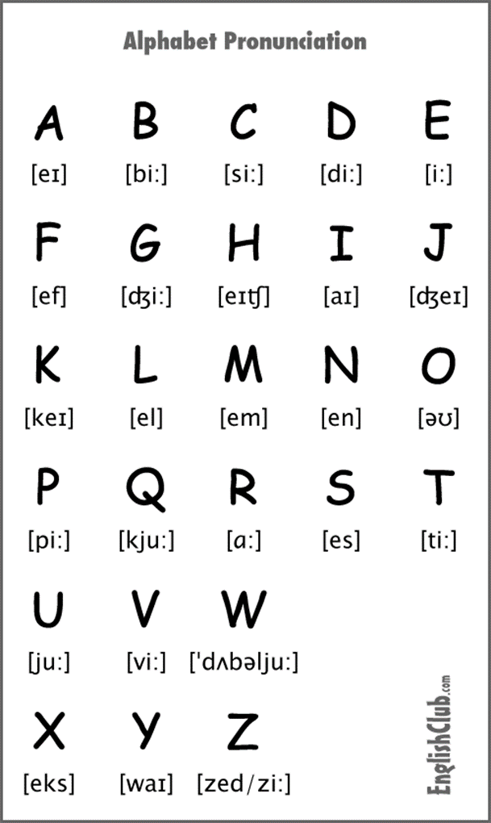
Spelling
What’s your name?
How do you spell that?
Aysha
Ayse
Ayesheh

Slide 8
Homework
Activity- spelling- Homework-1
https://www.liveworksheets.com/worksheets/en/English_as_a_Second_Language_(ESL)/Listening/My_friends_and_my_pets_-_Part_3_im2312947df

Slide 9
About UK-
https://esol.britishcouncil.org/content/learners/grammar-and-vocabulary/beginners/we-live-uk

Slide 10
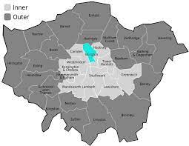
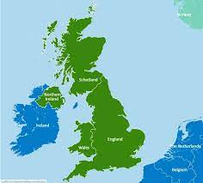
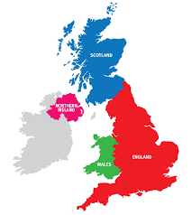
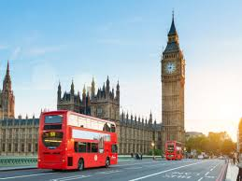
live/lives
https://wordwall.net/resource/23393760/live-lives-simple-present-tense
https://wordwall.net/resource/349538/english/present-simple
subject | live/lives | in | the UK
I | live | in | Islington
You | live | in
She | lives | in
He | lives | in
It | lives | in
We | live | in
They | live | in

Slide 11
The UK
My name is ……………
I am Vietnamese but I live in the UK.
There are four countries in the UK. England, Scotland, Wales and Northern Ireland.
I live in England.
The capital city of England is London.
I live in London.
I live in Islington.

Slide 12
About UK-
https://esol.britishcouncil.org/content/learners/grammar-and-vocabulary/beginners/we-live-uk
Activity-UK countries
https://wordwall.net/resource/3803199/esol/2-uk-countries
Activity-nationalities
https://www.liveworksheets.com/en1181576gj
Activity-
https://www.liveworksheets.com/hz1183979ht

Slide 13
Homework
https://www.liveworksheets.com/worksheets/en/English_as_a_Second_Language_(ESL)/Present_Simple/Simple_Present_Tense_test-2_vz1891862io

