Slide 1
Aim of the session:
By the end of the session learners will be able to
recap previous session
listen to a conversation, practise it and answer the questions about it

Slide 2
What’s the date today? 04/10/2021 The forth of October
What was the date yesterday?
The third of October
3/10/2021

Slide 3
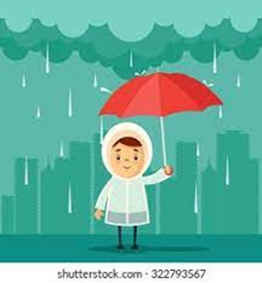
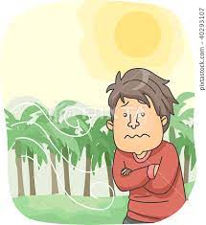
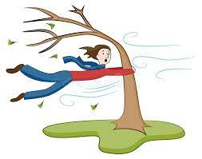
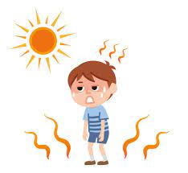
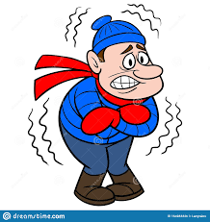
rainy
cool
windy
warm
sunny
snowy
cold
hot
cloudy

Slide 4
The weather
What is the weather like today?
It is sunny, a little windy, a little warm.
Is it warmer than yesterday?
Yes, It is.
What was the weather like yesterday?
It was sometimes rainy, sometimes sunny.

Slide 5
Conversations about health problems- recap and fill in the gaps
https://www.vocabulary.cl/english/health-problems.htm

Slide 6
What’s wrong?- watch the video and do the activities
https://learnenglishteens.britishcouncil.org/skills/speaking/beginner-a1-speaking/not-feeling-well

Slide 7
Put these words in alphabetical order
1- Asthma
2- fever
3- flue
4-headache
5- heartburn
6-sunburn

