Slide 1
What’s the date today? 12th October The twelfth of October yesterday? 11th October The eleventh of October tomorrow? 13th October The thirteenth of October
What day is it today?
It’s Tuesday.
Yesterday?
Monday
Tomorrow?
Wednesday

Slide 2
Aim of the session:
By the end of the session learners will be able to
Practice speaking using dates, weather, hobbies and classroom language
recap previous sessions
Watch a video about UK and answer comprehension questions

Slide 3
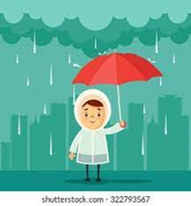
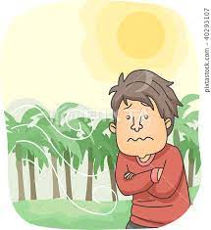
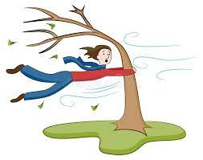
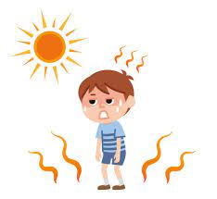
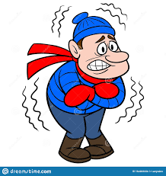
rainy
cool
windy
warm
sunny
snowy
cold
hot
cloudy

Slide 4
The weather
What is the weather like today?
It’s cold and cloudy.

Slide 5
Classroom language
Repeat
Can you repeat that please? (Say it again please)
Mean
What does that mean?
What does cool mean? (Tell me the meaning of cool)
It means not very cold.

Slide 6
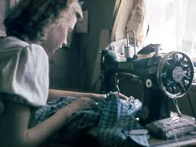
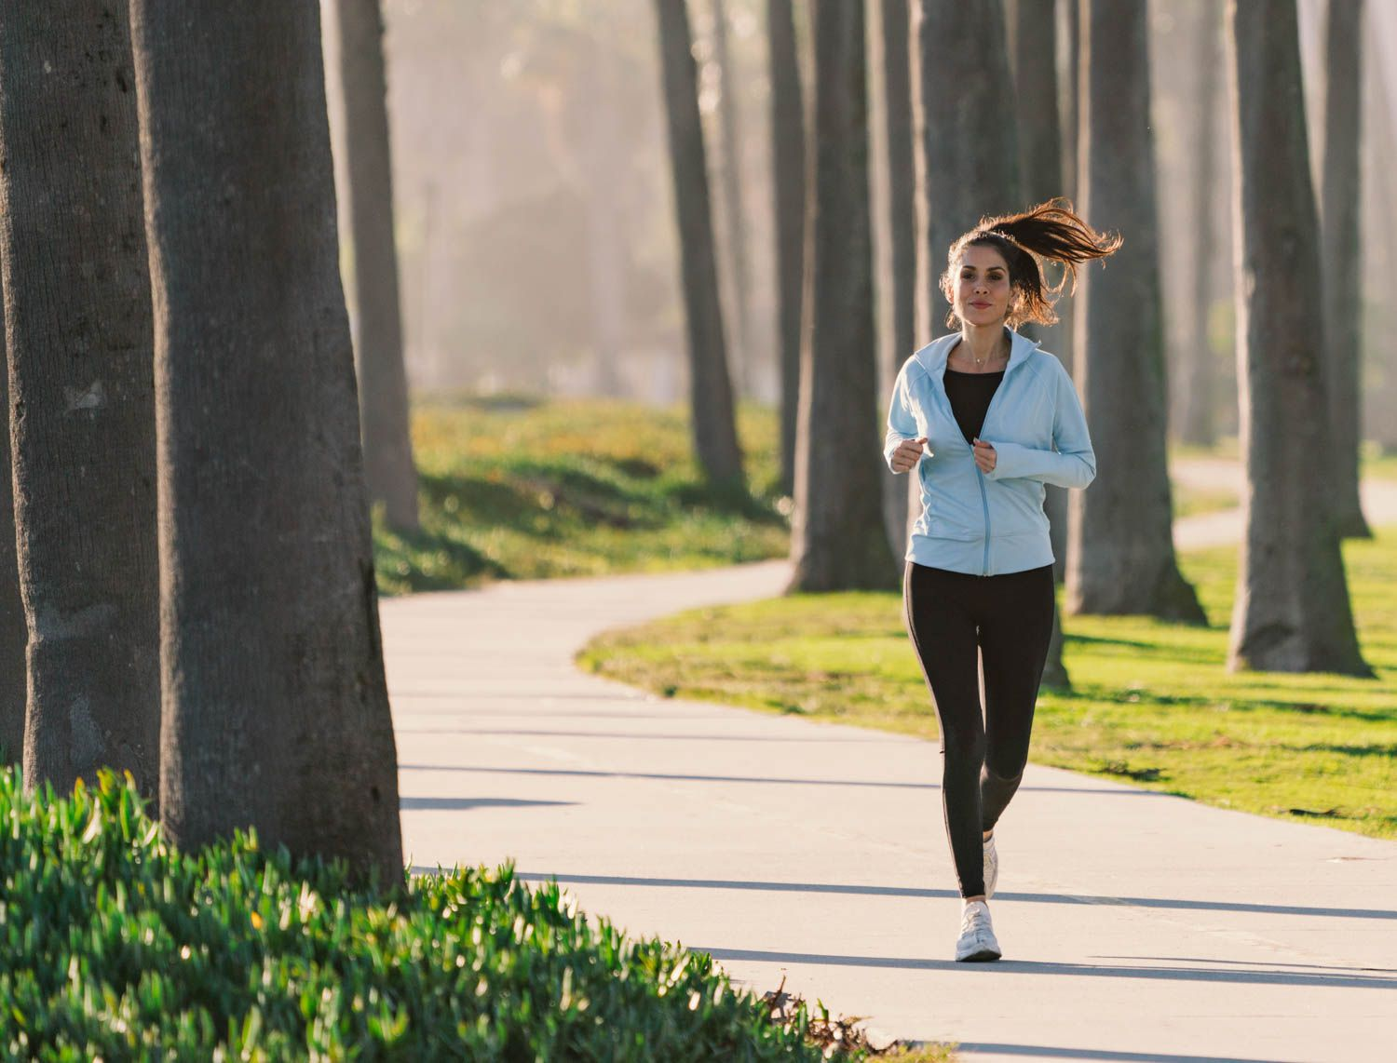
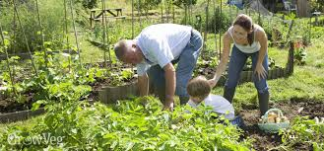
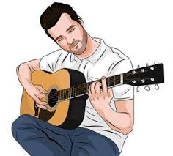
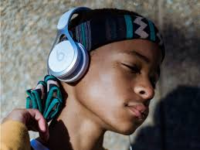
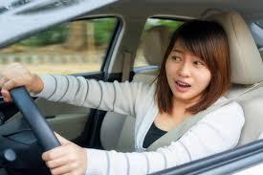
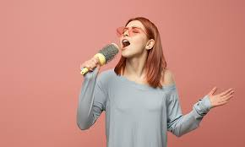
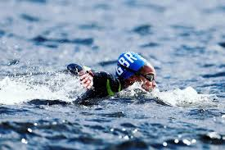
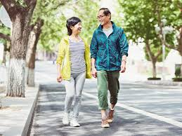
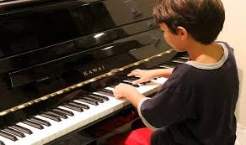
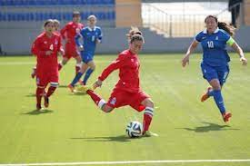
Hobbies-playing football, watching TV, running, singing, playing the guitar, playing the piano, walking, swimming, painting, sewing, gardening, driving, listening to music

Slide 7
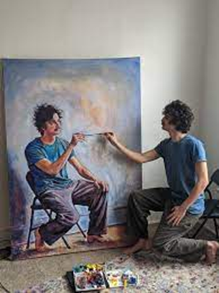
1- What’s he doing?
He is painting.

Slide 8
1- What’s he doing?
He is listening to music.
He’s listening to music.

Slide 9
1- What’s she doing?
She is driving.

Slide 10
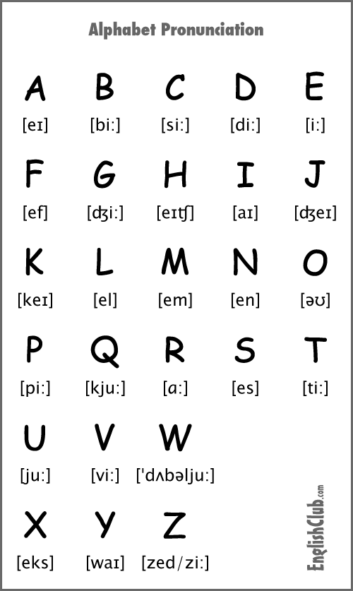
Painting-3
Swimming-5
Football-1
Walking-6
Running –4
Gardening -2

Slide 11
Games- illnesses
https://wordwall.net/resource/16990783/illnesses
What’s the matter?
https://wordwall.net/resource/16990783/illnesses
I’ve got
https://wordwall.net/resource/17085739/esol-esl/whats-the-matter-whats-wrong-illness
Anagram-illnesses
https://wordwall.net/resource/16390585/whats-the-matter
Quiz-illnesses
https://wordwall.net/resource/3467115/whats-the-matter-memory

Slide 12
Registering with a GP
Family name: What’s your family name?
First name: What’s your first name?
Date of birth: What’s your date of birth?
Address: Where do you live? /What’s your address?
Post code: What’s your post code?
Telephone number: Do you have a telephone number? /What’s your telephone number?
Nationality: What’s your nationality?

Slide 13
Family name: ……… First name: ……….. Date of birth:………… Address:……………. …………………………… ……………………… Telephone number:……………. Nationality: ……………. Male/Female (please circle)

Slide 14
About UK-
Watch the video and answer the questions
https://esol.britishcouncil.org/content/learners/grammar-and-vocabulary/beginners/we-live-uk
Homework- spelling
https://www.liveworksheets.com/worksheets/en/English_as_a_Second_Language_(ESL)/Listening/My_friends_and_my_pets_-_Part_3_im2312947df

