Slide 1
Week 3 Customer service
Level 1 OCN
Tutor Alison moore

Slide 2
Welcome to the Adult and Community Learning Service
Notes:
This powerpoint was designed by Charlotte Hopkins and Natalie Palmen.
It is called a ‘simplified version’ and uses images to convey the important messages of induction to our centres for learners.
By reducing the amount of text on each slide the presentation also works as a prompt to the CM or tutor aiding them to really engage with their learners without reading from the board. It makes the message more real!

Slide 3
Learning objectives for today
Assessment Criteria 1.2
1.2 Identify examples of good practice in customer service
Assessment Criteria 3.1
Know about the value of giving customers a positive first impression of an organisation.
Be able to outline why it is important to make a positive first impression on customers.

Slide 4
What customer service skills do you have?
Last week we filled out a self assessment and started to think about what skills we already have.
Let’s take a closer look.

Slide 5
Customer service skills What are they?
The ability to communicate positively
An in-depth knowledge of the products or services you are selling
Knowing what your customers expect
Knowing your company and what they offer
Treating people equally
Knowing who your customers are
Knowing your job – procedures and practices/ your limits / when to refer problems

Slide 6
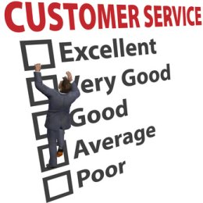
Customer service skills
Working as part of a team
Behaving professionally:
Tone of voice/words/actions
Creating and maintaining a safe working environment
Knowing where to find information
Keeping information safe and confidential

Slide 7
Examples of good practice
Let’s watch the following films and look out for some examples of good practice.
Make some notes about when you see the skills we have discussed being used effectively.

Slide 8
Examples of good practice in customer service
https://www.youtube.com/watch?v=W6yXonvwRVs
https://www.youtube.com/watch?v=RDGiy4Vyy1w Budgens
https://www.youtube.com/watch?v=bTbHwnxCGaI&t=3s funny

Slide 9
In your pairs share about a time when:
You received really good customer service.
What skills were being used that made it so?

Slide 10
Now answer question 2 using the examples you have seen and discussed.

Slide 11
Creating a good first impression
Assessment Criteria 3.1
Know about the value of giving customers a positive first impression of an organisation.
Be able to outline why it is important to make a positive first impression on customers.

Slide 12
The UK Customer Satisfaction Index (UKCSI)
How UKCSI works:
The UKCSI is a national measure of customer satisfaction providing insight into the state of customer satisfaction in the UK, across 13 key sectors.
Launched in 2008, it provides a unique way of measuring the current customer satisfaction of UK customers, as well as trends over time.

Slide 13
To create the UKCSI, The Institute of Customer Service runs an online survey of consumers twice a year. Respondents are representative of the UK adult population by region, age and gender.

Slide 14
The UKCSI results are based on 45,000 survey responses, 3,000 from each sector except for Transport and Utilities which includes 6,000 responses each.
Each response is a completed online questionnaire relating to a customer’s experience with a specific organisation. These responses are provided by over 10,000 individual customers.
Source https://www.instituteofcustomerservice.com/

Slide 15
What makes up a first impression?

Slide 16
Making a good first impression
You've heard it before: you never get a second chance to make a first impression. Once people make an initial judgement about you, everything you do gets filtered through that lens. It’s more difficult to change someone’s mind than it is to agree with what they are thinking.

Slide 17
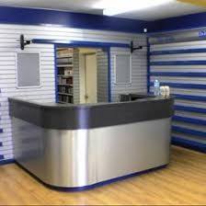
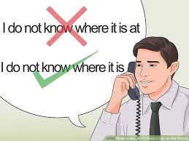
How do we create a professional first impression?

Slide 18
First Impressions Are Influenced By…
Our values
Biases
Cultural background
Personal experiences
Mood
Environment

Slide 19
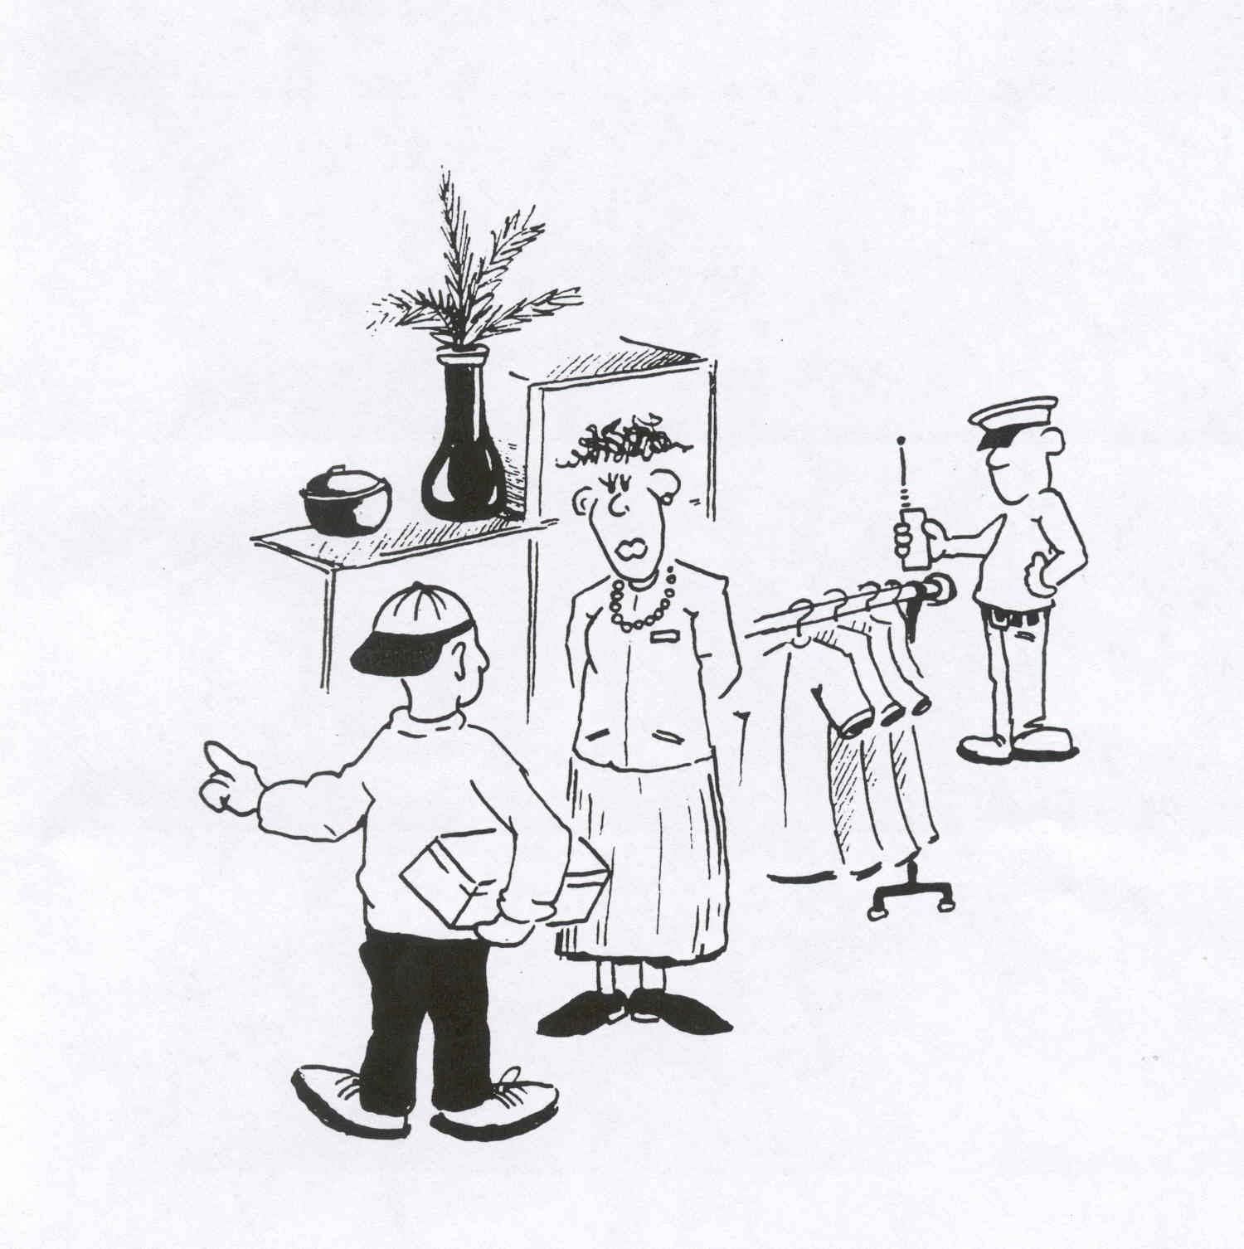

Slide 21
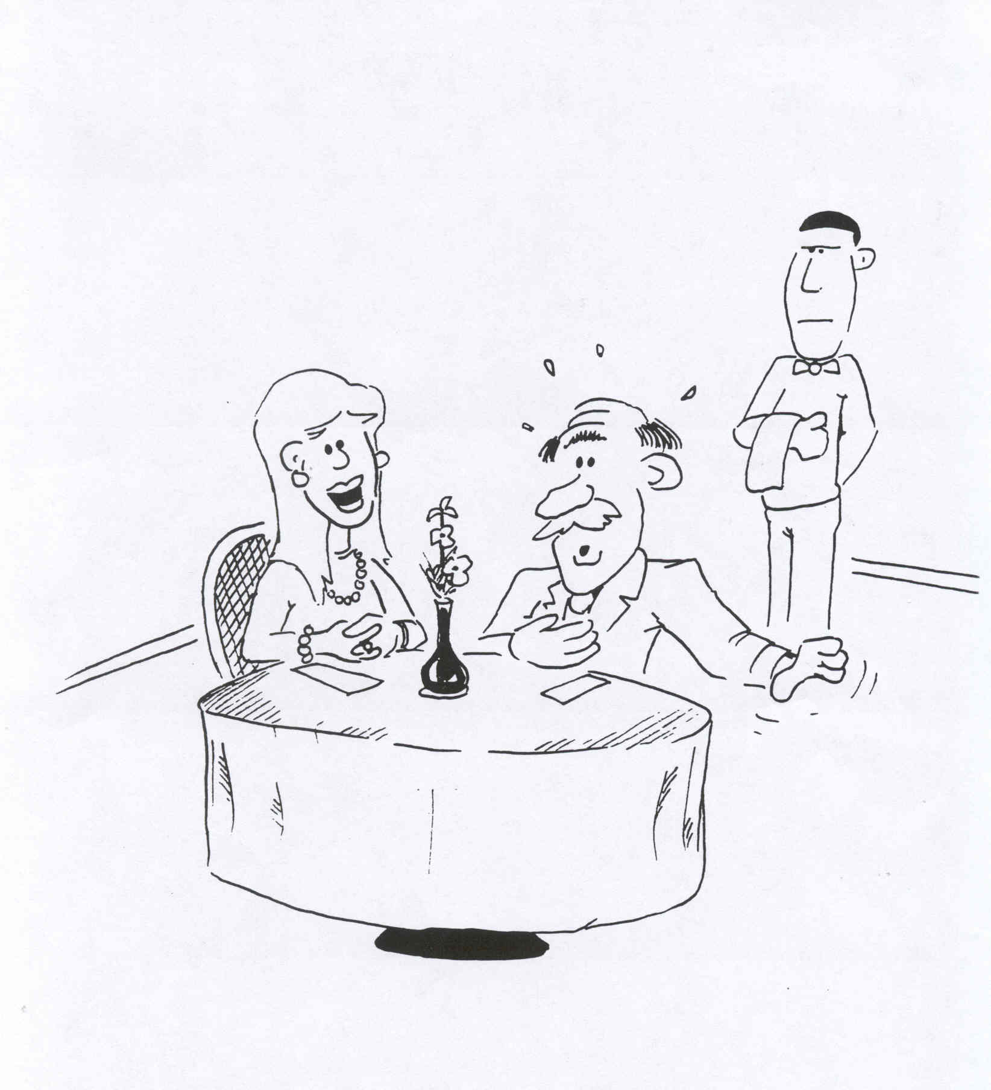

Slide 23
What can you see?

Slide 24
First Impressions
https://www.youtube.com/watch?v=EalQI-BBR7w – North West security
https://www.youtube.com/watch?v=W6yXonvwRVs –Ace Hardware
https://www.youtube.com/watch?v=tnouJ42wNqE – Distilled Man
https://www.youtube.com/watch?v=zydh3Zgd_Gg - Parmita

