Slide 1
What’s the date today? 12th October the twelfth of October 12th January the twelfth of January 2nd March the second of March
What day is it today?
Tuesday
yesterday?
Monday
tomorrow?
Wednesday

Slide 2
Aim of the session:
By the end of the session learners will be able to
check homework
recap previous sessions- anagram game-health problems
Three different ways of giving advice
Recap previous learning- reading a hospital letter- vocabulary
Writing a text message/WhatsApp message to teacher

Slide 3
Check homework
https://www.liveworksheets.com/worksheets/en/English_as_a_Second_Language_(ESL)/Illnesses_and_health_problems/Day_at_the_Clinic_vm1592314ic

Slide 4
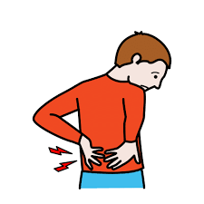
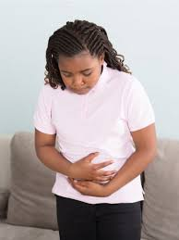
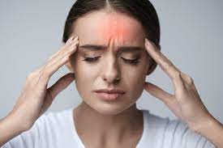
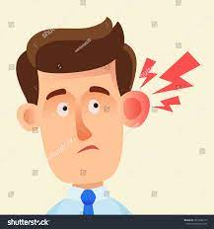
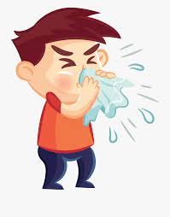
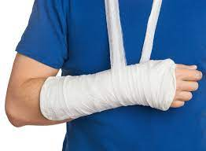
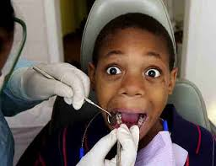
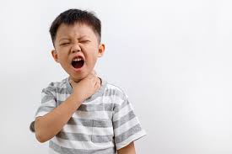
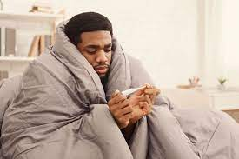
a broken arm
backache
the flue
a cold
toothache
a stomach ache
a sore throat
an earache
a headache

Slide 5
Anagram-illnesses
https://wordwall.net/resource/16390585/whats-the-matter

Slide 6
Give some advice
What’s the matter?
I have a headache.
You should take a medicine.
Why don’t you take a medicine?
Take a medicine.
What’s the matter?
I’ve got a sore throat.
Why don’t you drink mint tea?
You should drink mint tea.
Drink mint tea.
What’s the matter?
I’ve got backache.
Go and lie down.
Why don’t you go and lie down?
You should go and lie down.

Slide 7
Give some advice
What’s the matter?
I have a earache.
You should see your GP.
What’s the matter?
I’ve got a stomach ache.
Why don’t you drink some milk?
What’s the matter?
I’ve got a cold.
Drink hot tea.
Go to bed.
Have a rest.

Slide 8
Give some advice
What’s the matter?
I have toothache.
You should see a dentist.
What’s the matter?
I’ve got the flue.
Why don’t you wear some more clothes?
What’s the matter?
I’ve got a broken arm.
Have a rest.

Slide 9
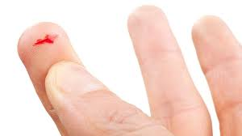
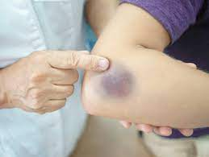
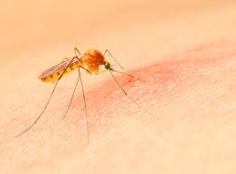
accidents
a burn
I’ve got a burn.
a cut
I’ve got a cut on my finger.
a bruise
I’ve got a bruise.
a mosquito bite
I’ve got a mosquito bite.

Slide 10
Games-
Giving advice -done
https://wordwall.net/resource/2165970/angielski/giving-health-advice
Sorting out giving advice and others -done
https://wordwall.net/resource/14811390/speaking/go-getter-3-unit-54-giving-health-advice-group-sort

Slide 11
Reading a hospital letter

Slide 12
Alphabetical order
confirm-1
Slippers-8
nurse-6
dressing gown-3
Ward-9
operation-7
jewellery-4
consultant-2
make-up-5

Slide 13
Reading a hospital letter
https://esol.britishcouncil.org/content/learners/grammar-and-vocabulary/beginners/reading-letter-hospital

Slide 14
NHS Hospital 2/January/2018
Tel: 01222 44443
Dear Mrs. Osman,
Your operation is on Monday 14th January. Please go to B ward at 12.30. Your consultant is Mr. Hamilton.
You can have a light breakfast at 7.30am and have water up to 10.15am. Please do not wear jewellery or make up. You will need to bring your slippers and a dressing gown.
Please contact the above number to confirm your bed for this date as soon as possible.
Yours sincerely,
Jane Manning

Slide 15
A phone call for confirmation:
Mrs. Osman- Hi. Can I speak to Jane Manning please?
Hospital- Speaking. How can I help you?
Mrs. Osman- This is Mrs Osman.
Hospital- Hi, Mrs. Osman.
Mrs.Osman- I am calling you to confirm that I will be there on Monday 14th January at 12.30am.
Hospital- OK. Thank you for your confirmation.
Mrs. Osman- Bye.
Hospital- Bye.

Slide 16
A text message to teacher:
Hi teacher
I can’t come to class on Monday 14th January because I am having an operation.
Regards
Mrs Osman

Slide 17
Homework
Activity-giving advice-You can write the answers on your notebook
https://www.liveworksheets.com/vj2011005ab

