Slide 1
Islington Adult Community Learning Service.
Autumn 2023. Parent House. Thursday 1 to 3 pm
Lessons 5
Teacher: Mercedes F Regalado-Tivy
Phone:07595462023 Email: Mercedes.Regalado@islington.gov.uk

Slide 2
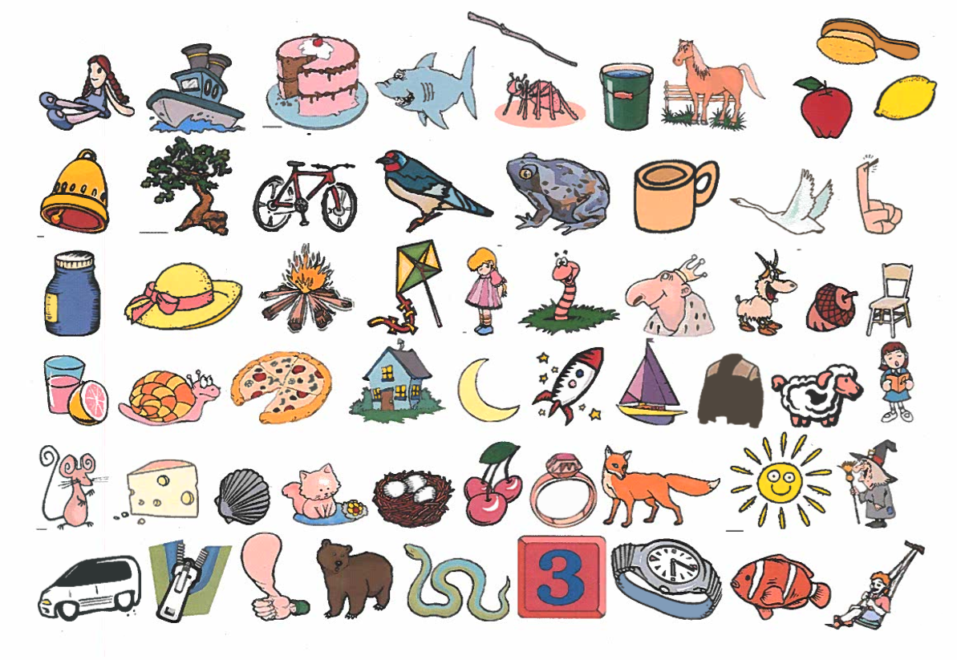
Find word and make a sentence: Writing and speaking
Examples:
There is a doll
I see a cake
I like red apples

Slide 3
Listening- questions:
What are the parents’ names?
How many children are there in this family?
What is the text about (CIRCLE ONE): (1) Family (2) Transport (how they get to work/ school) (3) Food
What is Hassan’s job?
What does Maria do?
How does Hassan go to work?
How does Peter to go college?
How does Mo go to university?
How does Abdul go to school?

Slide 4
Read and correct your answers:
Hassan and Maria have 3 children. They are a busy family. Hassan works in a factory at night. Maria goes to college to learn hairdressing. Mo goes to University, Abdul and Peter go to school. The problem is they don’t have a car .
How do they get to work, college, university and school?
Hassan goes to work by bike, it takes about 30 minutes, he loves cycling but he is saving up for a motorbike. Peter goes to college by bus, she catches two buses and it takes 45 minutes. Mo goes to university by train, it takes an hour. He reads his books while he is travelling. Abdul walks to school with her friends, it takes about 10 minutes on foot. Abdul rides to school on his skateboard, it only takes five minutes.

Slide 5
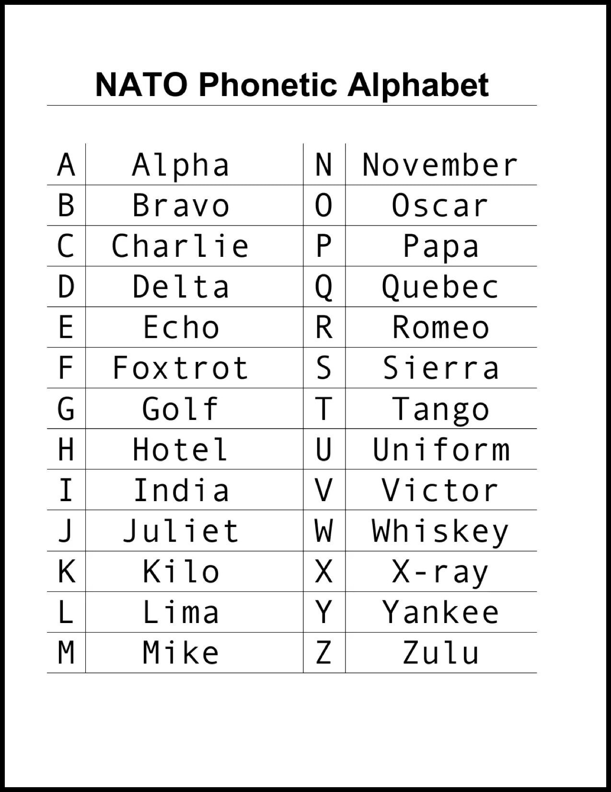
In pairs:
What is your name?
My name is……. (Mercedes)
How do you spell that?
M for Mike, E for Echo, R for Romeo, C for Charlie, E for Echo, D for Delta, E for Echo and S for Sierra.

Slide 6
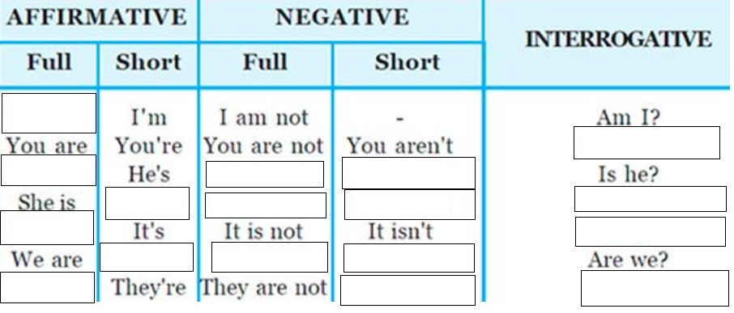
TO BE verb: positive, negative and questions –
https://wordwall.net/resource/54917841/%d0%b0%d0%bd%d0%b3%d0%bb%d1%96%d0%b9%d1%81%d1%8c%d0%ba%d0%b0-%d0%bc%d0%be%d0%b2%d0%b0/questions-with-be

Slide 7
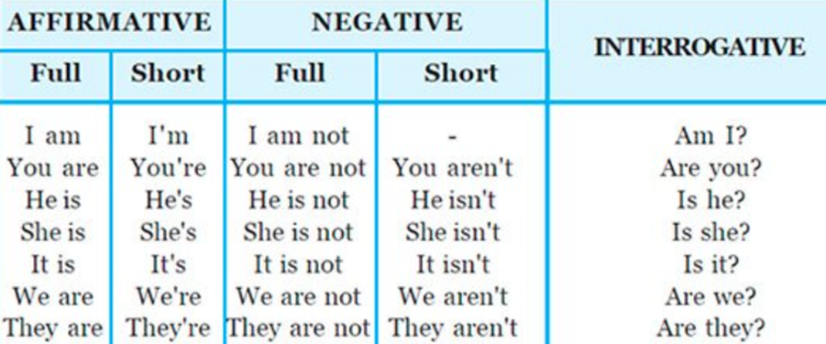
AM IS ARE????? Fill in and make sentences into questions, and yes and no answers
Sentence: Question yes answer no answer
My teacher ………. Beautiful …………………………….. …………………………. ………………………
The students in this class ………. clever …………………………….. …………………………. ………………………
Those buildings ……………very tall ……………………………… ……………………….... ………………………
…………………………………… ... your sister a student? ……………………….... ………………………
We……. very happy at Parents House ……………………….... ……………………… ………………………
I …… good at maths ……………………….... ……………………… ………………………

Slide 8
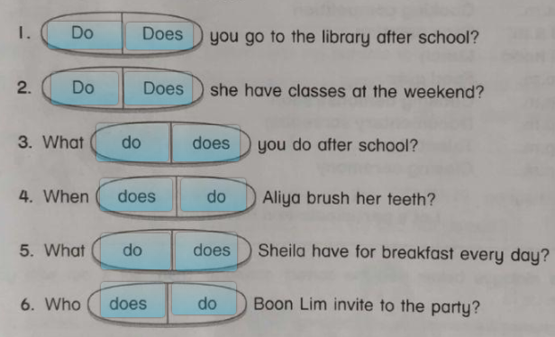
DO/DOES for other verbs for questions and negatives
https://www.liveworksheets.com/w/en/english-language/1517412

Slide 9
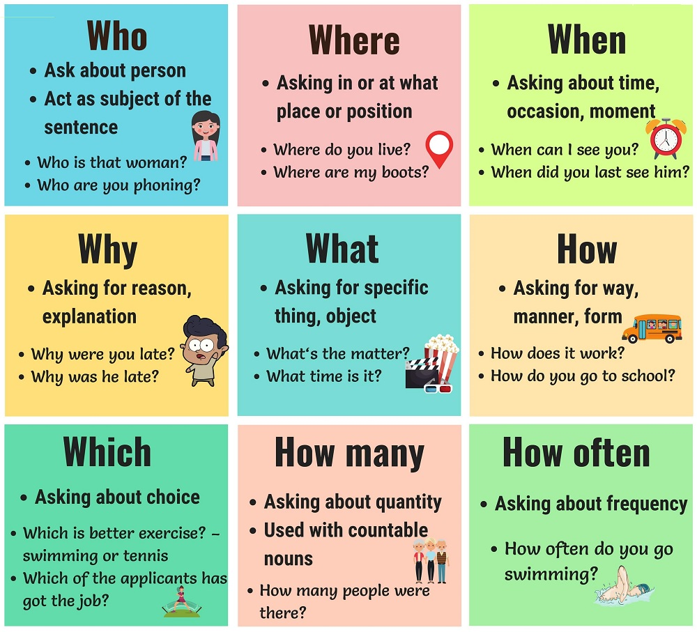

Slide 10
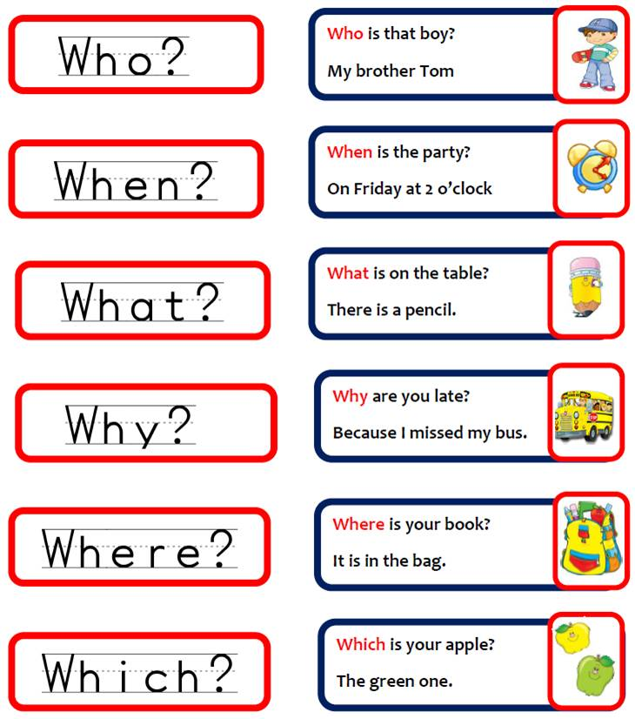

Slide 11
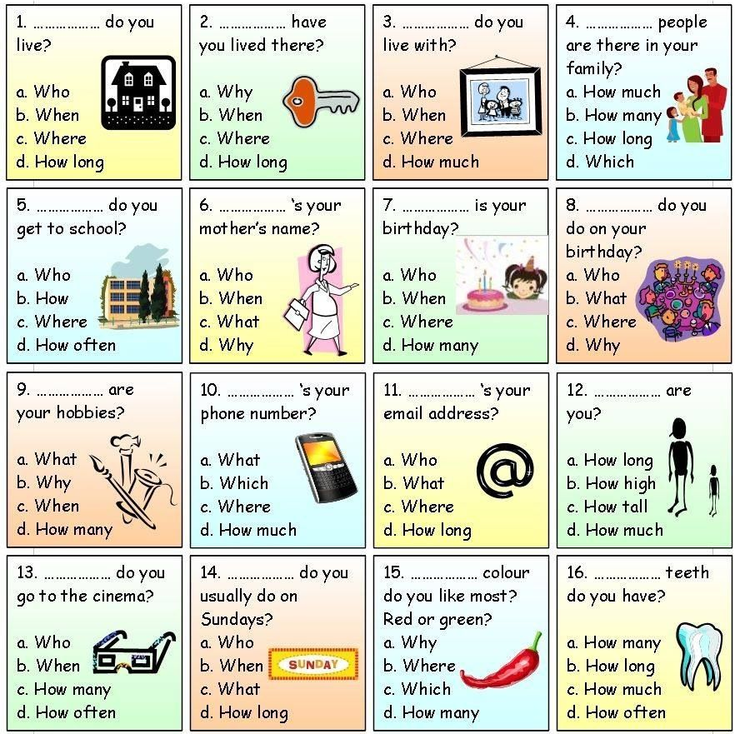
Where- Place, country, city, location
Where do you live? I live in Islington
Where do you come from? I come from Somalia
When- Time, date
When do we have English class? On Thursday
When is half term holiday? It is on 23rd October.
What- Asking about things
What is your favourite food? My favourite food is pasta
What is the time? It is ten o’clock
Who- asking about people
Who is your teacher? My teacher is Mercedes
Who is better Ronaldo or Messi? I do not know
Which- asking about choice
Which is better eating or drinking?
Which colours do you like?
How- We will study later in the term, but look at:
How long, How old, How much, How many, How often
How tall…

Slide 12
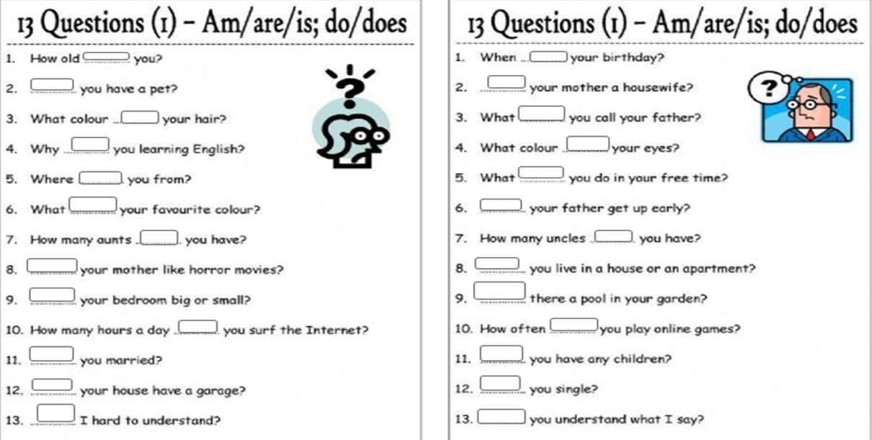
AM, IS, ARE, DO ,DOES?????
https://www.liveworksheets.com/w/en/english-second-language-esl/1430437
https://www.liveworksheets.com/w/en/english-second-language-esl/1430448

Slide 13
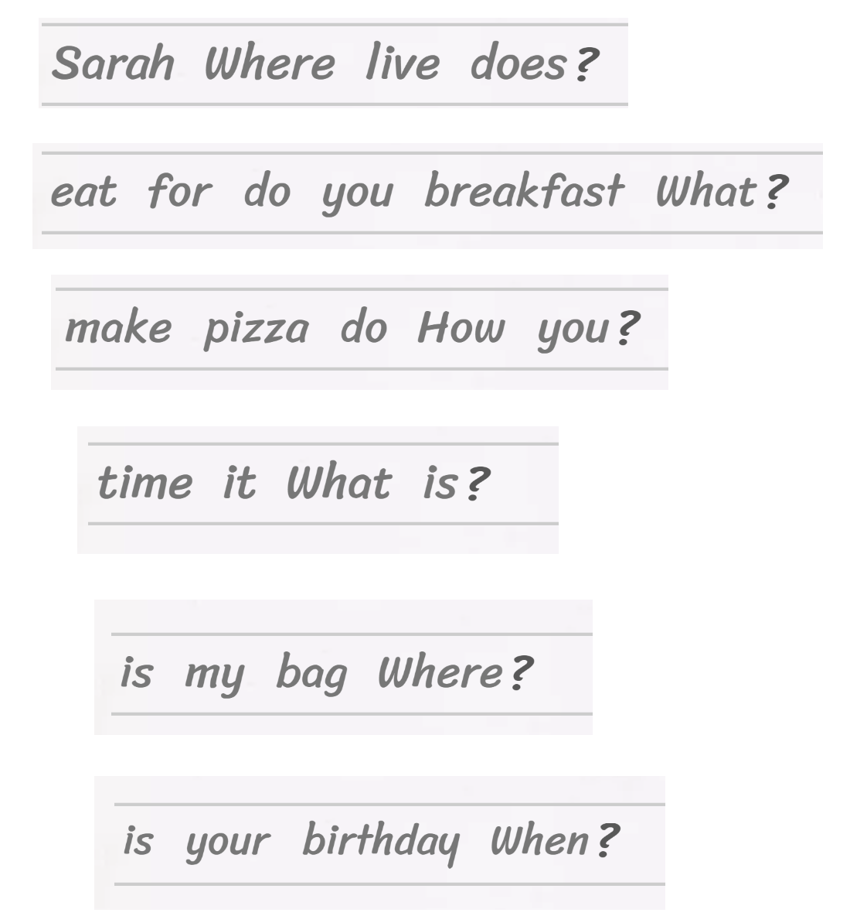
WH- QUESTIONS and word order who, what, when, where, how much/many
Where does Sarah live?
W…………………………………………………………?
H………………………………………………………..?
W………………………………………?
W…………………………………………….?
W………………………….?

Slide 14
General or Yes/No Questions
Is it cold outside?
Yes, it is cold outside Yes it is
No, it is not cold outside No, it is not (it isn’t)
Are they hungry?
Yes, they are Yes, they are hungry
No, they are not (aren’t) hungry No, they aren’t
Do you like this country?
Yes I like this country Yes I do
No, I do not (don’t) like this country No, I don’t
Does Jane study hard?
Does Jane study hard?
Yes, she studies hard Yes, she does
No, she does not study hard No, she doesn’t

Slide 15
2. Special or Wh-Questions
A special question, as you can guess, uses a certain word at the beginning of the sentence to ask a specific question. The questions words who, what, where, when, why, how, how many, etc., are used to begin the question:
Where is he from?
When does he come here?
How do you know her?
How many eggs do we need for this cake?
Who goes to the cinema?
What is on the table?
You can see that after the question words who and what, the third-person singular form of the verb should be used, no auxiliary.
Answers: More detailed.
3. Choice Questions
There is a choice, and the word OR in the middle.
Does she like ice cream or sweets? – She likes ice cream.
Is he a teacher or a student? – He is a student.

Slide 16
Capital letters- https://wordwall.net/resource/36270982/english/capital-letters
Nationalities/ countries:
Where are you from? I am from Spain. I am Spanish
All repeat from their own country
https://wordwall.net/resource/3352231/esol/countries-and-nationalities-e1
Numbers/ date/ time https://www.liveworksheets.com/w/en/english-language/2322222
A/AN- https://wordwall.net/resource/25729634/english/a-an
THE/THIS/THESE/THAT/THOSE- https://wordwall.net/resource/58590056/%d0%b0%d0%bd%d0%b3%d0%bb%d1%96%d0%b9%d1%81%d1%8c%d0%ba%d0%b0-%d0%bc%d0%be%d0%b2%d0%b0/this-that-these-those

Slide 17
HOMEWORK:
Please look at the maths booklet and fill in the form
Please study to be: I am you, you are, he is, she is, it is, we are, they are
Please study do/does
Please study wh- questions ( who, what, when, where)
Please study countries and nationalities: Where are you from? I am for Spain, I am Spanish
Please study a/an and the- this/ that, these/those
No class on 27th October, but there will be a little exam/ test on Thursday 3rd November
Homework and practice during half term break
https://wordwall.net/play/36270/982/582
https://wordwall.net/play/25729/634/42252
https://wordwall.net/play/58590/056/42064
https://wordwall.net/play/15449/538/76000https://www.liveworksheets.com/worksheets/en/English_as_a_Second_Language_(ESL)/Wh_questions/Question_words_iq1459212ak
https://www.liveworksheets.com/da2886397tn
https://www.liveworksheets.com/worksheets/en/English_as_a_Second_Language_(ESL)/Wh_questions/Question_words_jj118035nx
https://www.liveworksheets.com/worksheets/en/English_as_a_Second_Language_(ESL)/Wh_questions/WH_questions_with_DO_or_DOES_uj1599143ll
https://www.liveworksheets.com/worksheets/en/English_as_a_Second_Language_(ESL)/Yes-no_questions/Yes-No_questions_-_to_be_and_to_have_got_sv1390350jq
https://www.liveworksheets.com/worksheets/en/English_as_a_Second_Language_(ESL)/Yes-no_questions/Simple_present_yes-no_questions_yf29389gaIs/are
https://www.liveworksheets.com/worksheets/en/English_as_a_Second_Language_(ESL)/Wh_questions/What,_where_and_when_la1804076cy

