Slide 1
ESOL L1 Spring Term
22nd Feb 2021

Slide 2
Session aims/objs
Aim: Virtual trip to British Library
Objs: by the end of this session, you will be able to
Explore the British Library online
View some collections and resources from the British Library
Explore different ways of communicating ideas
Develop confidence in using language effectively

Slide 4
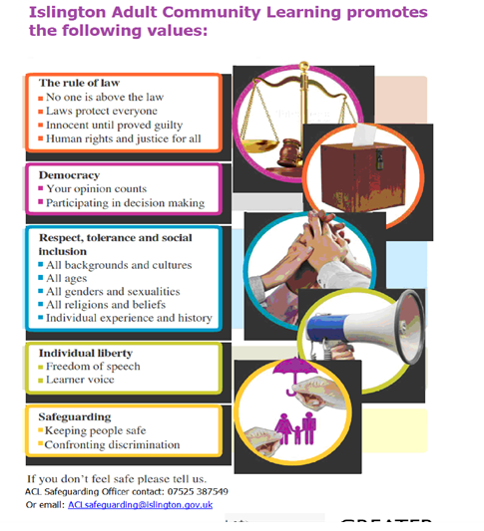

Slide 5
Our ACL 1-1 IAG offer
A confidential service for learners
Up to 3 one hour sessions with a qualified adviser
Adherence to the Guidance Council’s Code of Principles (impartial, current, confidential, in accordance with equality and diversity legislation, accessible, individual ownership, transparency)
and the Career Development Institute’s Code of Practice (as above, also duty of care, accountability and CPD)
Notes:
Any organisation which manages, administers and delivers an IAG service to support individuals in their career, learning, work or life goals has the chance to achieve matrix accreditation.
This is regardless of whether the service or services are delivered face-to-face, through training, learning, remotely, or through a website.

Slide 6
How can learners book an appointment?
For the summer term we are offering IAG sessions via telephone and/or via MS Teams
For ESOL tutors and their learners:
Contact Gulcoy on 07712 403428
Email gulcoy.esen@islington.gov.uk
Appointments available:
Mondays and Tuesdays 1.30 - 3pm
For general appointments:
Contact Alison on 07808 879044
Email Alison.moore@islington.gov.uk
Appointments available:
Tuesdays and Thursdays
9.30am - 12.30pm and 1 – 4pm
To find out about all or our courses on offer visit: www.adultlearning.islington.gov.uk

Slide 8
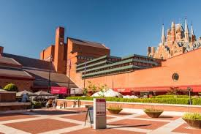
The British Library
what sort of library is this?
What is its purpose?
Who visits the British Library?

Slide 9
We are going to take a virtual trip to the British Library
https://www.bl.uk/magna-carta/videos/what-is-magna-carta
What does the Magna Carta mean?
What year was it written?
Why was King John considered a bad king? Examples from the video?
The Magna Carta is a considered what around the world?
What is the famous clause in the Magna Carta that is used today?
How many years has it lived on for?
Can you give some examples from the video where the Magna Carta was used?
What is the important legacy of the Magna Carta?

Slide 10
Transcript of video
This may look like a plain, unassuming piece of parchment, but it’s actually one of the most famous documents in the world. Magna Carta, meaning ‘the Great Charter’, has inspired people across the centuries, from Thomas Jefferson to Mahatma Gandhi. But why was the charter originally created? And what does it actually say?
Let us take you back to medieval England. It’s the year 1215, and the ruler is King John. Many people believe that King John was one of the worst kings in history. He imprisoned his former wife; he starved his opponents to death; he allegedly murdered his own nephew, and pulled the beards of the Irish Chiefs.
King John had imposed heavy taxes on his barons in order to pay for his expensive foreign wars. If they refused to pay, he punished them severely or seized their property. The barons demanded that King John obey the law; when he refused, they captured London and John was forced to negotiate.
The two sides met at Runnymede in June 1215. The result of the negotiations was written down by the king’s clerks in the document we know as Magna Carta. Although most of the charter’s clauses dealt with medieval rights and customs, Magna Carta has become a powerful symbol of liberty around the world.
The most famous clause, which is still part of the law today, for the first time gave all ‘free men’ the right to justice and a fair trial.
‘No man shall be arrested or imprisoned except by the judgment of their equals and by the law of the land. To no one will we sell, to no one deny or delay right or justice.’
However, this clause was not as liberal at it sounds. The Charter only applied to ‘free men’, the vast majority of people in 1215 were unfree peasants who were ruled over by their landowners.
And although, Magna Carta was intended to create peace between King John and his rebellious barons, England was plunged into civil war after the Pope declared the Charter invalid.
When King John died of dysentery in 1216, nine year old Henry III took to the throne. To keep the peace, Magna Carta was reissued several times during the 13th century, until it was finally made part of English law.
Magna Carta has lived on for 800 years, and is echoed in the United States Declaration of Independence and the Universal Declaration of Human Rights.Perhaps Magna Carta’s most important legacy is that everyone – including our leaders – must obey the law.
What started out as a document of specific complaints from a group of barons has turned into an international symbol of liberty, without which we might not have the rights we value so much today.

Slide 11
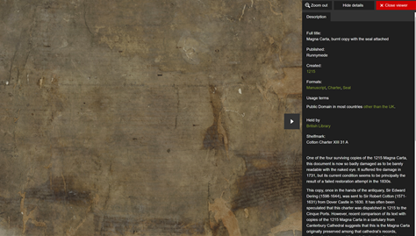
https://www.bl.uk/collection-items/burnt-copy-of-magna-carta-with-the-seal-attached

Slide 12
Task
Imagine you were interviewing the King?
1. What questions would you ask him?
Now imagine you are one of the baron (king’s clerk).
2. What things would you demand he does?

Slide 13
English Grammar: Modals of Obligation
When we talk about obligation in English, we can use “must”, “have to”, “need to” and “can’t”.
To say when something is necessary
We use “must” to talk about obligations.
Often, when we use “must”, the authority for the obligation comes from the person who is speaking.

Slide 14
Grammar structure
Obligation may be described as pressure on a person to do something or not to do something.
There are strong obligations such as rules and necessities, and weak obligations such as advice.
Obligations may be internal, from the speaker's body or mind, and external obligations such as regulations.
Form and use
Remember that “must” is a modal auxiliary verb. This means that it doesn’t change its ending I/he/you must + infinitive (without ‘to’).
E.g. “You must phone me” not “you must to phone me”.

Slide 15
3. List some (3-5) obligations for the king.
1. E.g. You must stop pulling the beards of men in your court.

Slide 16
Lesson summary
In the lesson, you…
Explored the British Library online
Watched a video on the Magna Carta
Viewed some collections and resources from the British Library
Explored different ways of communicating ideas
Developed confidence in using language effectively
Practised grammar/pronunciation

Slide 17
Independent task:
Watch the video and note down important points for you. We will discuss them next lesson.
My Digital Rights
Privacy online: an introduction
https://www.bl.uk/my-digital-rights/videos/privacy

Slide 18
References:
https://www.bl.uk/magna-carta/videos/what-is-magna-carta#
https://www.bl.uk/learning/teaching-resources
https://www.bl.uk/learning/online-resources
https://www.english-at-home.com/grammar-modals-obligation/
Extra resource on My Digital Rights
Privacy online: an introduction
https://www.bl.uk/my-digital-rights/videos/privacy

