Slide 1
Viability

Slide 2
Market Research

Slide 3
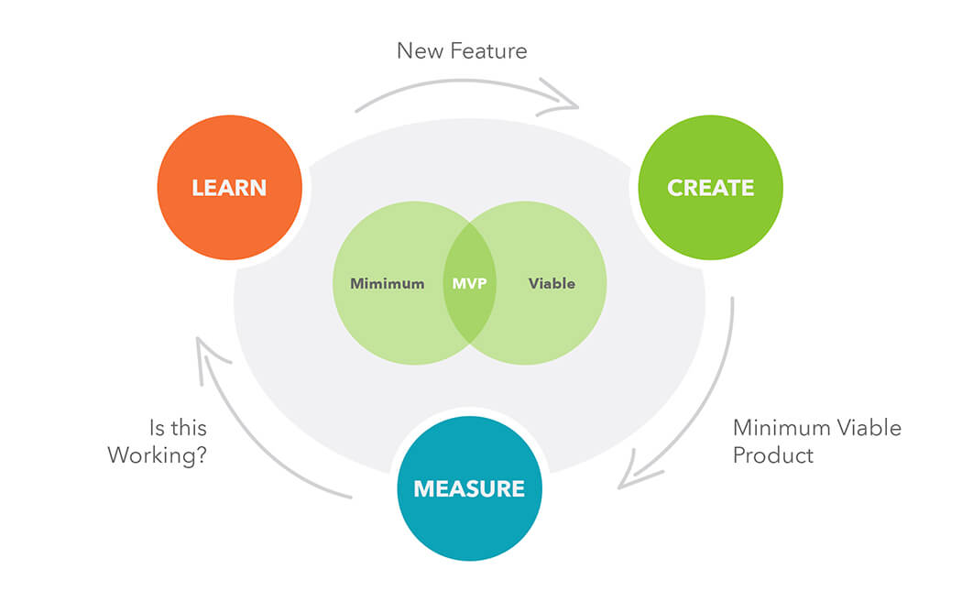
Minimal Viable Product
An MVP may be a prototype, an entire product, or a subset of the product (such as a core feature)
Source:
https://www.cygnismedia.com/blog/minimum-viable-product/

Slide 5
Introduction: Porters Five Forces
The model of the Five Competitive Forces
Developed by Michael E. Porter
Featured in his book “Competitive Strategy: Techniques for Analysing Industries and Competitors”.
Published in 1980
‘Five Forces Tool‘ has become an important method for analysing an organisations industry structure in strategic processes.

Slide 6
What is it?
Five competitive forces that shape every industry and every market.
These forces determine the intensity of competition and hence the profitability and attractiveness of an industry.
The objective of corporate strategy should be to modify these competitive forces in a way that improves the position of the organization.
Porters model supports analysis of the driving forces in an industry.
Based on the information derived from Porter’s Five Forces Analysis, management can decide how to influence or to exploit particular characteristics of their industry.

Slide 7
SIC Codes
The United Kingdom Standard Industrial Classification of Economic Activities (SIC) is used to classify business establishments and other standard units by the type of economic activity in which they are engaged. The new version of these codes (SIC2007) was adopted by the UK as from 1st January 2008.

Slide 8
Sector: Definition
A sector is an area of the economy in which businesses share the same or a related product or service.
Primary - extraction and harvesting of natural products from the earth (e.g., agriculture, mining and forestry)
Secondary - processing, manufacturing and construction
Tertiary - services, such as retail sales, entertainment and financial services
Quaternary - made up of intellectual pursuits, like education
http://www.investopedia.com/terms/s/sector.asp

Slide 9
Industry: Definition
A classification that refers to a group of companies that are related in terms of their primary business activities.
In modern economies, there are dozens of different industry classifications, which are typically grouped into larger categories called sectors.
Individual companies are generally classified into industries based on their largest sources of revenue.
For example, an automobile manufacturer might have a small financing division that contributes 10% to overall revenues, but the company will still be universally classified as an auto maker for attribution
http://www.investopedia.com/terms/i/industry.asp

Slide 10
Overview of Porter’s Five Forces
Porter’s Forces model is an “outside looking in” business unit strategy tool that is used to make an analysis of the attractiveness or value of an industry structure.
The Competitive Forces analysis is made by the identification of 5 fundamental competitive forces:
The entry of competitors (how easy or difficult is it for new entrants to start to compete, which barriers do exist)
The threat of substitutes (how easy can our product or service be substituted, especially cheaper)
The bargaining power of buyers (how strong is the position of buyers, can they work together to order large volumes)
The bargaining power of suppliers (how strong is the position of sellers, are there many or only few potential suppliers, is there a monopoly)
The rivalry among the existing players (is there a strong competition between the existing players, is one player very dominant or all equal in strength/size)

Slide 11
High Profit Vs Low Profit
http://www.bloomberg.com/profiles/companies/1044Q:LN-virgin-group-ltd
http://www.bloomberg.com/quote/KO:US

Slide 12
Airline Industry
Very intensive competitor rivalry – mainly on price
Low barriers to entry – lots of new airlines who want to set up
Suppliers of aircraft & equipment are powerful – can charge high margins
Customers have lots of substitute options – e.g. rail, car
High fixed costs – airline losses rise significantly if revenues fall only slightly since it costs roughly the same to fly half-empty planes as full ones

Slide 13
Soft Drinks Industry
Customers and suppliers have little power – Pepsi has many millions of individual consumers, and thousands of retail distributors none of whom has much influence over the business
There is high brand awareness & loyalty = less consumer desire for substitutes
High barriers to entry – how do you enter a market dominated by Coca-Cola and Pepsi?

Slide 14
Characteristics

Slide 15
The Model

Slide 16
Barriers to Entry

Slide 17
Power of Suppliers
Exercise that power
Sell their products at a higher price
Squeeze industry profits
If the supplier forces up the price paid for inputs, profits will be reduced.
Suppliers find themselves in a powerful position when:
There are only a few large suppliers
The resource they supply is scarce
The cost of switching to an alternative supplier is high
The product is easy to distinguish and loyal customers are reluctant to switch
The supplier can threaten to integrate vertically
The customer is small and unimportant
There are no or few substitute resources available

Slide 18
Power of Customers

Slide 19
Threat of Substitutes

