Slide 1
Management Information Systems

Slide 2
Image credited to: Management Information Systems (MIS). Kindle Edition

Slide 3
What is Management Information Systems (MIS)?
A management information system (MIS) is a computer system consisting of hardware and software that serves as the backbone of an organization’s operations. An MIS gathers data from multiple online systems, analyses the information, and reports data to aid in management decision-making
MIS is also the study of how such systems work

Slide 4
Improved Decision-Making
The purpose of an MIS is improved decision-making, by providing up-to-date, accurate data on a variety of organisational assets, including:

Slide 5
Financials
Inventory
Personnel
Project timelines
Manufacturing
Real estate
Marketing
Raw materials
Research & Development

Slide 6
MIS Meaning and Definition
An MIS focuses on the management of information systems to provide efficiency and effectiveness of strategic decision making

Slide 7
Definition
Management Information System or 'MIS' is a planned system of collecting, storing, and disseminating data in the form of information needed to carry out the functions of management

Slide 8
Ability to record and document all of its recurring and routine business transactions
These are transactions such as orders of raw materials, inventories, customer transactions and sales

Slide 9
Objectives of MIS
The goals of an MIS are to implement the organisational structure and dynamics of the enterprise for the purpose of managing the organisation in a better way and capturing the potential of the information system for competitive advantage

Slide 10
MIS is recognised as a major resource like capital and time
If this resource has to be managed well, it calls upon the management to plan for it and control it, so that the information becomes a vital resource for the system
It requires good planning
Take an holistic approach, content and processing

Slide 11
Businesses are able to record all of their transactions using this mechanism
This provides the ability to observe trends
e.g. if a business receives more customer orders in certain months, it can infer there is more demand during those periods

Slide 12
Operation Information System (OIS)
Systems are tools used to plan and schedule production and assembly functions
Using these tools, business owners are able to decide inventory levels and raw materials to stock
What product/service are to be produced
The operations also involves and oversees the deployment of manpower for production purposes
With effective processes in place, the businesses are unlikely to face downtimes or shortage of resources

Slide 13
Decision Support Systems (DSS)
DSS (decision support systems) are used by top management for decision-making. This tool extensively makes use of computers, computing tools, mathematical and scientific models for analysis
With the DSS, businesses can analyse, scrutinise and evaluate all the methods it could deploy for use in functions such as production, sales, marketing and finance
Businesses are then able to choose the most effective options in terms of cost, time, human and material effort while reaping the maximum benefits

Slide 14
It should provide support for the management planning, decision-making and action
It should provide support to the changing needs of business management

Slide 15
Attributes of Quality Information
Quality information needs to possess several attributes:
1. Timely and available when needed and not outdated when made available
2. Complete - includes all founder needs to know about the situation where the information will be used
3. Concise
4. Relevant

Slide 16
When
How

Slide 17
Market Research

Slide 18
Who are your customers?

Slide 19
Customer Relationship Management
Age
Gender
Location
Spend
Location
Information received…

Slide 20
YOUR CUSTOMERS?
Who are you targeting?
What needs/wants are you meeting?
Who are they?
What do they want?
When do they want it?
Where do they want it?
How do they order, pay and receive it?

Slide 21
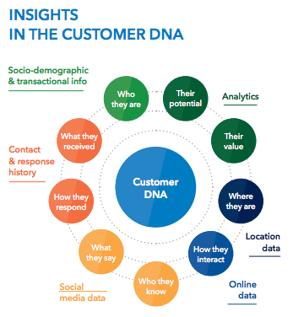
Data
Source: http://www.black.ninja/how-to-blow-away-your-customers-with-data-analytics/

Slide 23
Activity

Slide 30
Any Questions?

