Slide 1
What’s the date today? 9/11/2021
What day is it?

Slide 2
Aim of the session:
By the end of the session learners will be able to
Check homework
https://www.liveworksheets.com/worksheets/en/English_as_a_Second_Language_(ESL)/Personal_information/Personal_information_sr534164hl
Read a text and answer the questions
https://www.liveworksheets.com/worksheets/en/English_Language_Arts_(ELA)/Reading_comprehension/Amusement_Park_pj986202ie
Ask questions and answer them

Slide 3
Love love X hate
I love watching football.
I love playing football.
My favourite sport is football.
Hate
I hate watching football. I love watching tennis.
I hate playing football. I love playing tennis.
My favourite sport is not football. My favourite sport is tennis.

Slide 4
Amusement park= Fun fair excited X sad
I am so excited. X I am sad.
I want to go to the park.
Where do you want to go? To the park.
My sister wants to go to the cinema.
Where does my sister want to go? To the cinema.
My mum wants to go to the museum.
Where does my mum want to go? To the museum.
My brother wants to go to the zoo.
Where does my brother want to go? To the zoo.

Slide 5
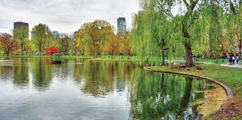
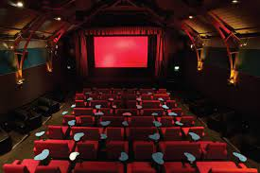
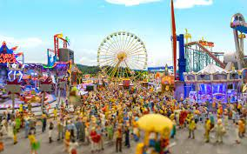
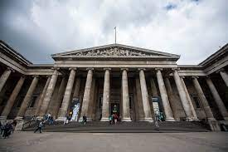
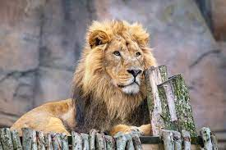
park
cinema
Fun fair
museum
zoo

Slide 6
park
cinema
Fun fair
Where do you want to go?
I want to go to the ………….
museum
zoo

Slide 7
Where does Serkan want to go?
He wants to go to the cinema.
Where does Mohammed want to go?
He wants to go to the zoo.
Where does Mamadou want to go?
He wants to go to the museum.
Where does Hafida want to go?
She wants to go to the park.
Where does Thi want to go?
She wants to go to the museum.
Where does Amal want to go?
She wants to go to the cinema.
Where do you want to go?
I want to go to the park.
Where do they want to go?
They want to go to the cinema.
Where do we want to go?
We want to go to the zoo.

Slide 8
Where does he want to go?
He wants to go to the cinema.
Where does she want to go?
She wants to go to the park.
Where do you want to go?
I want to go to the park.
Where do they want to go?
They want to go to the cinema.
Where do we want to go?
We want to go to the zoo.

Slide 9
homework
https://www.liveworksheets.com/worksheets/en/English_as_a_Second_Language_(ESL)/Verbs/Want_to_-_Wants_to_rb1961585mf

