Slide 1
Aim of the session:
By the end of the session learners will be able to
Recap and check homework
Familiarize with Moodle website
Expand health vocabulary
Keep a spelling diary
Understand questions and say what’s wrong.

Slide 2
What’s the date today? 1/10/2021 The first of October
What day Is it today?
Friday

Slide 3
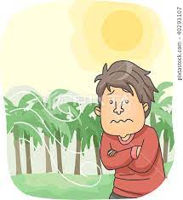
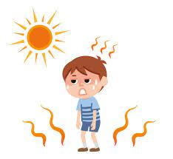
rainy
windy
cool
warm
sunny
snowy
cloudy
cold
hot

Slide 4
The weather
What is the weather like today?
It is rainy, cloudy and a little windy.

Slide 5
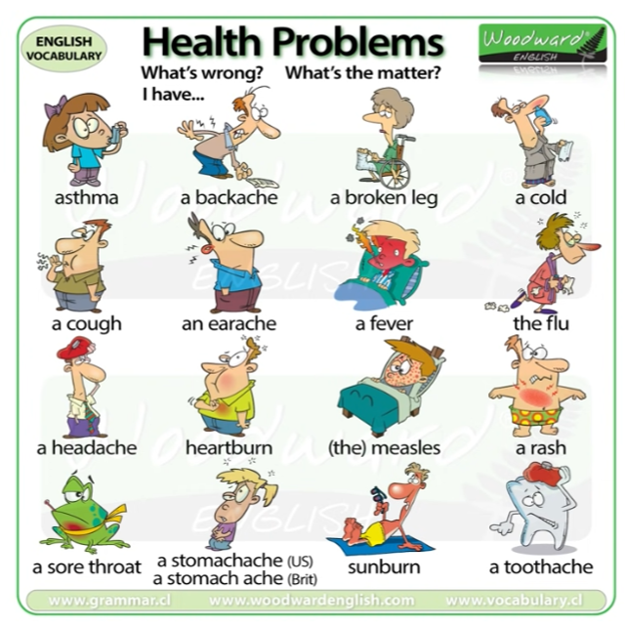

Slide 6
Health vocabulary- video
https://www.vocabulary.cl/english/health-problems.htm

Slide 7
Homework1:
https://www.liveworksheets.com/worksheets/en/English_as_a_Second_Language_(ESL)/Illnesses_and_health_problems/What's_the_Matter_oe615158tf
Homework2:
https://www.liveworksheets.com/worksheets/en/English_as_a_Second_Language_(ESL)/What's_the_matter$/Matters_hd1841240qk

