Slide 1
Week 5
Layout features

Slide 2
Aims of the session
Be able to recognise particular types of text by their unique layout features

Slide 3
To check your learning …
Please complete the Layout Features activity on ACL Gateway

Slide 4
Types of text
What are the things that make these texts what they are?
In other words, what makes a letter a letter?

Slide 5
42, Greyhound Road
Birmingham
B42 6HJ
25 April 2020
Mr. E. Splatt
The Manager
Bestdeal Electrics
113 Main Street
Andover
AN4 9ET
Dear Mr. Splatt,
Complaint about member of staff
I am writing to complain about a member of your staff who was very rude to me on my recent visit to your shop………….
I have been a loyal customer of Bestdeal for many years. I would like you to contact me to tell me how you are going to deal with this member of staff.
Yours sincerely
Jane Teller

Slide 6
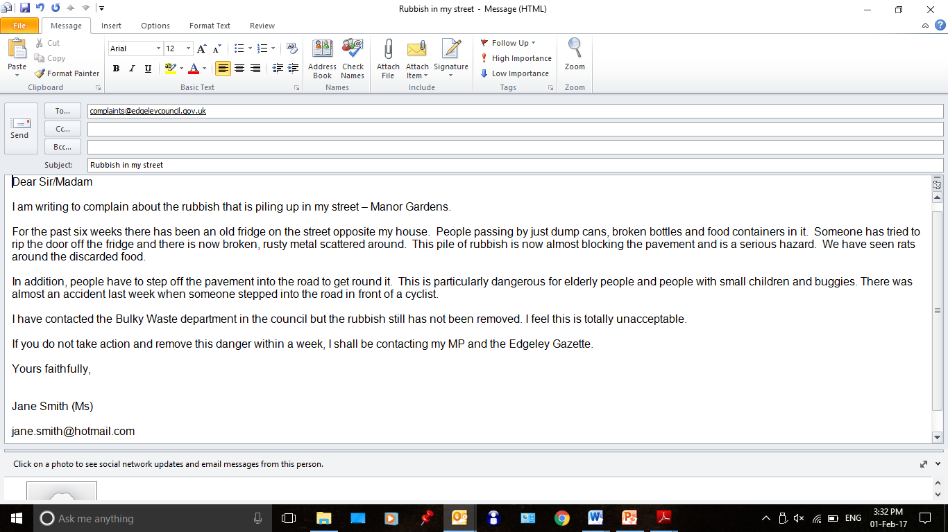

Slide 7
Grandad and two grandsons in "miraculous" escape after car clips side of house and lands upside down
27 January 2020
by Alex Kingston
A grandad and his two grandsons had a "miraculous" escape after the car they were travelling in launched into the air, clipped the side of a house and landed upside down.
The three are lucky to be alive after their vehicle - which was being driven by the elderly man - left the road and launched over a six foot wall. Paramedics found the vehicle teetering upside down on top of a parked car.
Emergency services said it was a miracle nobody was hurt in the accident in Seabridge Lane in Newcastle-under-Lyme, at around 5.30pm today.
A West Midlands Ambulance Service (WMAS) spokeswoman said: "When the emergency services arrived they found a car which had reportedly left the road, cleared a six foot wall and clipped the side of a house before landing on top of a parked car. Miraculously the three occupants, an elderly man and his two grandsons, believed to be in their late teens, were out of the car and had sustained no serious injuries.”

