Slide 1
Aim of the session:
By the end of the session learners will be able to
talk about holiday
Introduce yourself
meet each other and have induction
talk about the weather today
talk about hobbies (recap)
talk about ILPs –Individual Learning Plan and do diagnostic assessments
set smart targets

Slide 2
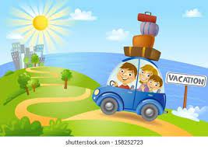
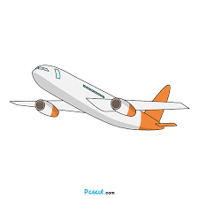
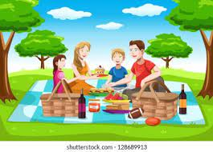
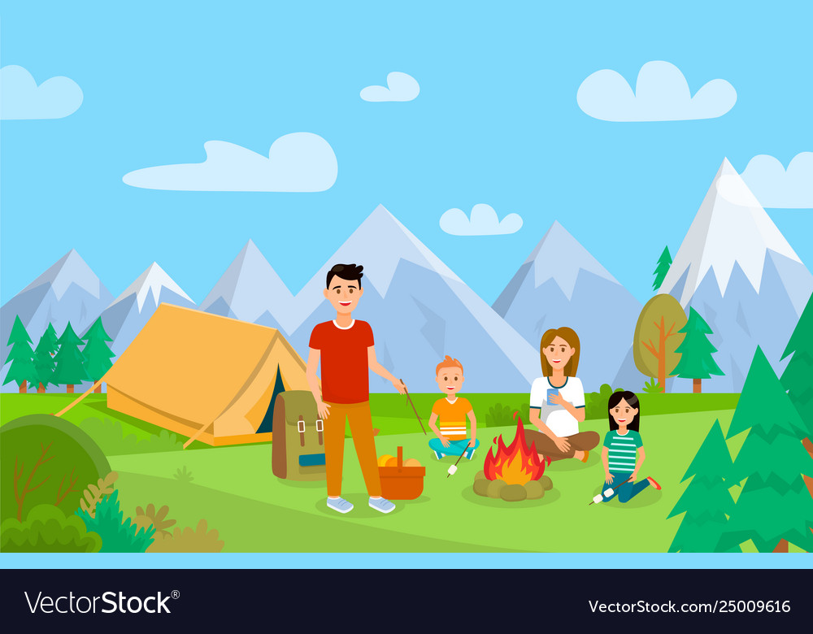
Tell about your holiday.
What did you do?
Where did you go?
Seaside?
Camping?
Picnic in the park?
Going abroad?

Slide 3
What’s the date today? 27/09/2021 The twenty-seventh of September
What’s the day today?
Monday

Slide 4
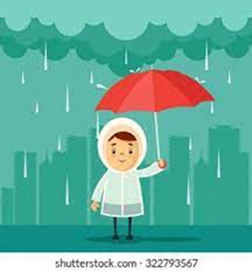
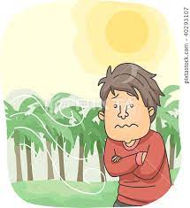
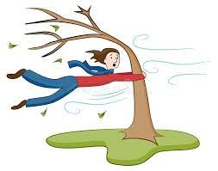
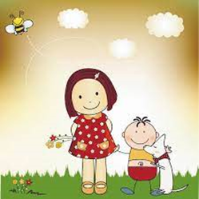
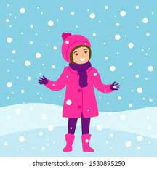
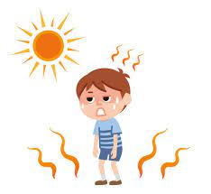
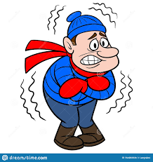
rainy
cool
windy
warm
sunny
snowy
cloudy
hot
cold

Slide 5
The weather
How is the weather today?
What is the weather like today?
It’s rainy, cloudy and windy. It’s gloomy.
It’s miserable.
It was sunny in the morning but now it is cloudy and raining.

Slide 6
1- It’s Monday. It was Sunday.
2-It’s September. It was August.
3-No, it isn’t. Yes, it was.
4- I am at home. I was at home.

Slide 7
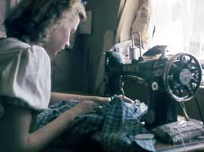
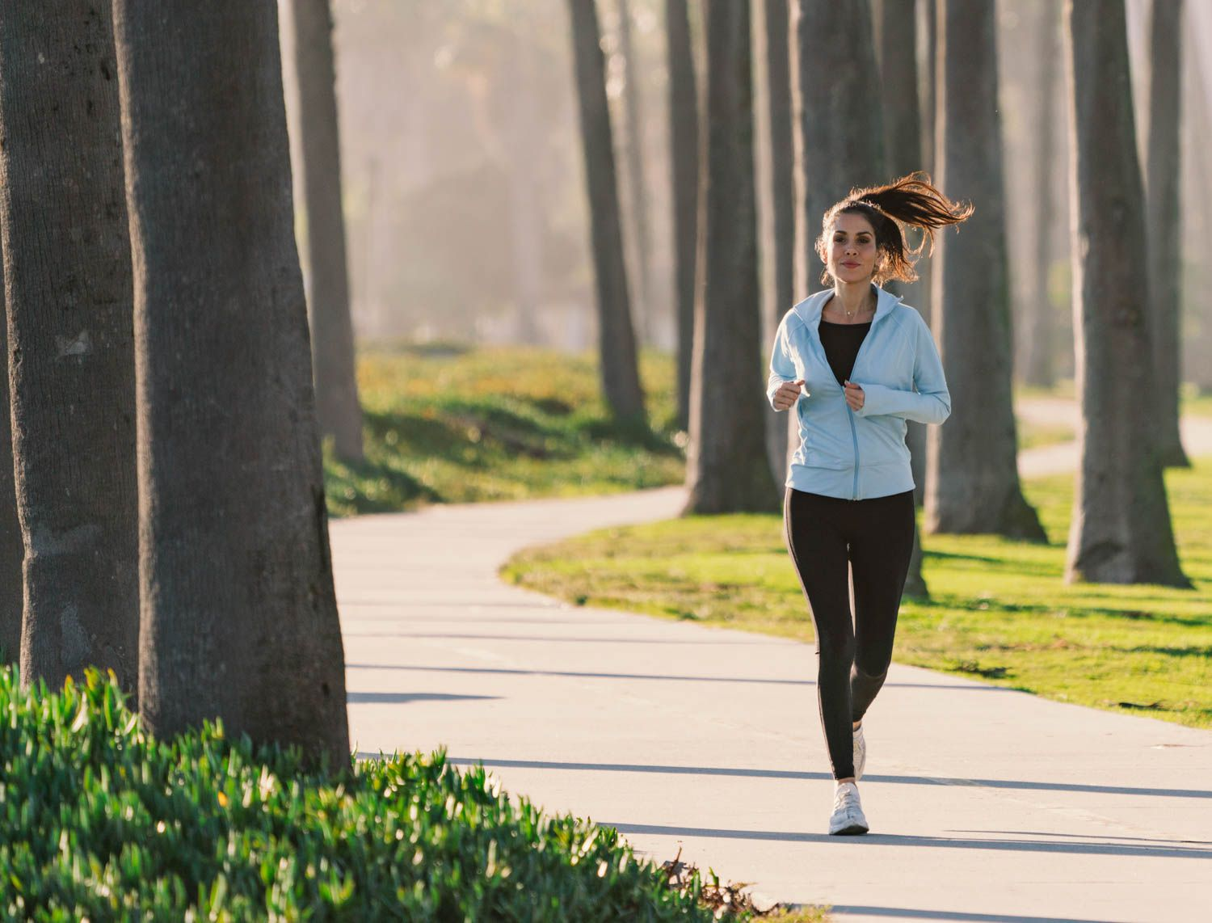
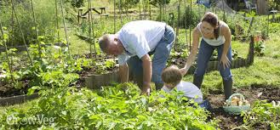
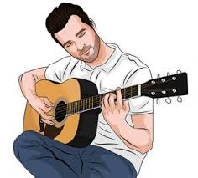
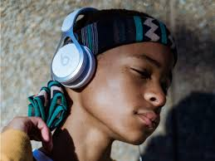
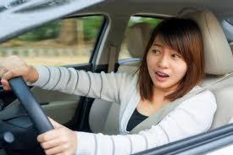
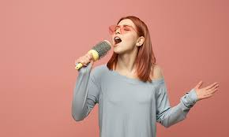
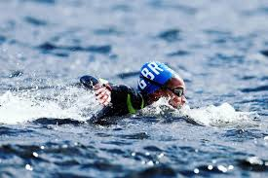
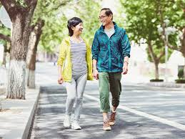
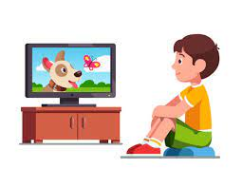
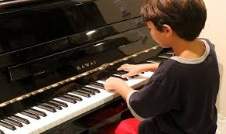
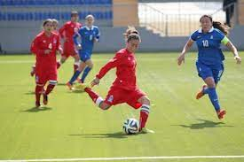
Hobbies-playing football, watching TV, running, singing, playing the guitar, playing the piano, walking, swimming, painting, sewing, gardening, driving, listening to music

Slide 8
Likes/dislikes
I like ……ing. = I like shopping.
I like to Verb = I like to shop.
I like painting. = I like to paint.
I like playing football. = I like to play football.
I like sewing. = I like to sew.
I like gardening. = I like to do gardening.
To shop=Verb
Shopping= noun (gerund)

Slide 9
Likes
I like ……….. football. = I like to ……. football.
I like to ………… music. = I like ………….. music.
Dislikes

Slide 10
Likes/dislikes
https://www.liveworksheets.com/worksheets/en/English_as_a_Second_Language_(ESL)/Likes_and_dislikes/What_do_you_like_to_do$_bf1631528fk

Slide 11
activities
I like to + Verb.
https://www.liveworksheets.com/worksheets/en/English_as_a_Second_Language_(ESL)/Likes_and_dislikes/Do_you_like_to_------------$_1_uk424716kh
https://www.liveworksheets.com/sa1556529jd

Slide 12
What’s a verb? What’s a noun?
Verb noun noun
Go banana going I like bananas.
Come house coming
Wait hospital
Take bottle
Eat Ice-cream
Sleep apple
Cook pen

Slide 13
I like + noun
https://www.liveworksheets.com/worksheets/en/English_as_a_Second_Language_(ESL)/Likes_and_dislikes/Do_you_like$_uq1265124ul

Slide 14
I like + noun
Look at the picture and guess the expression. Then practise the full sentence.
https://www.youtube.com/watch?v=i7s9wWNkOpc
https://www.liveworksheets.com/worksheets/en/English_as_a_Second_Language_(ESL)/Free_Time_activities/Things_i_like_doing_jd1228676vx

Slide 15
About me
My name is ………………
I am from ……………. but I live in ……………………
I am a…………….
I have ………………………………….
I like ……………
I don’t like …………….
My favourite food is ……………….
I want …………………………..

Slide 17
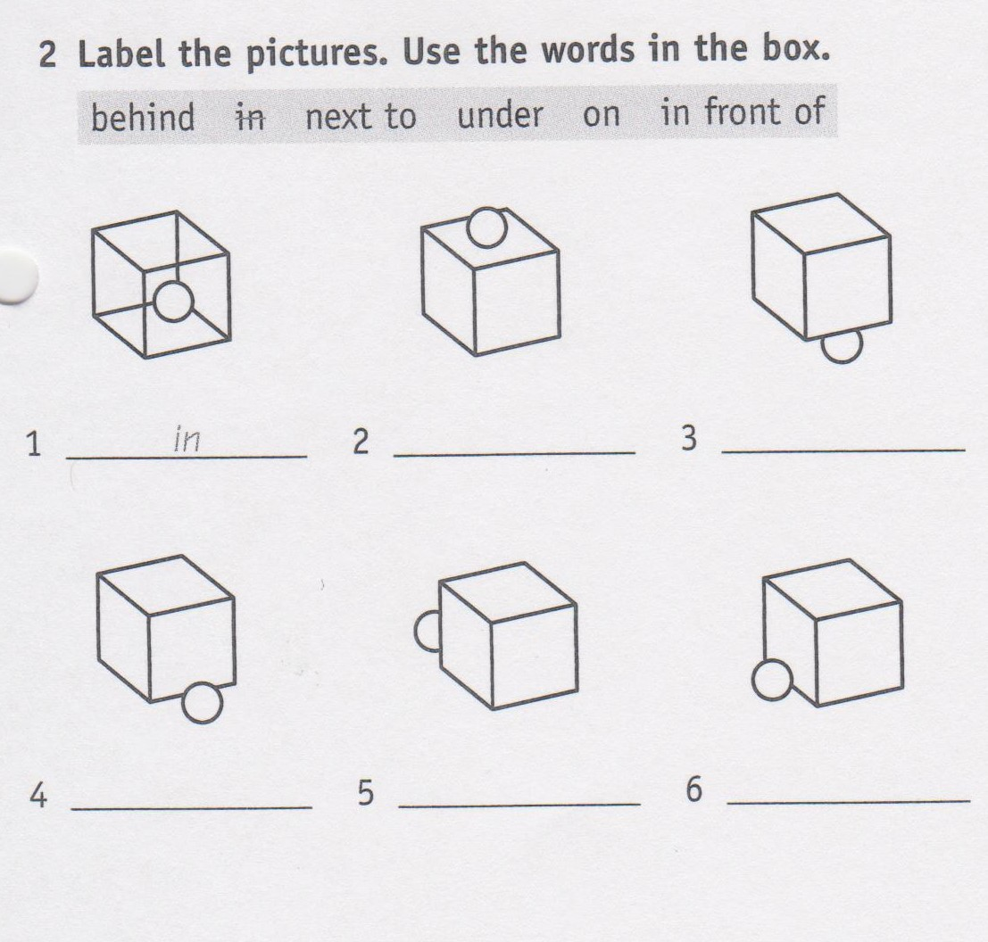
1- in
2-

Slide 18
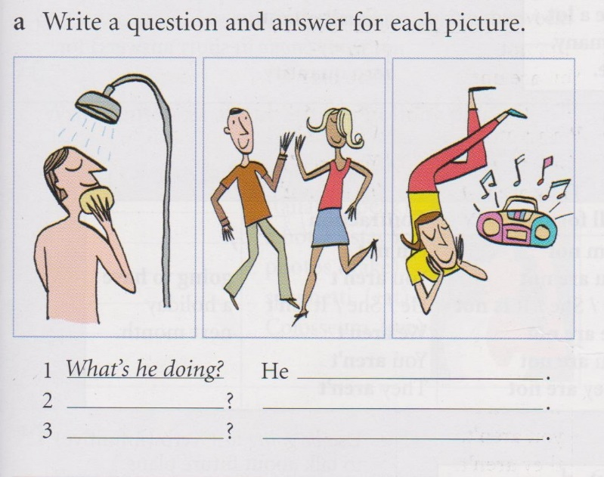
1- What’s he doing?
He…….
2-

