Slide 1
What’s the date today? 11/10/2021 The eleventh of October yesterday? The tenth of October 10/10/2021 tomorrow? The twelfth of October 12/10/2021
What day is it today?
Monday
yesterday?
Sunday
tomorrow?
Tuesday

Slide 2
Aim of the session:
By the end of the session learners will be able to
recap previous sessions-health problems
Check homework
Read a hospital letter and answer comprehension questions
Practise a phone call to confirm booking an operation.
Write a text/WhatsApp message

Slide 3
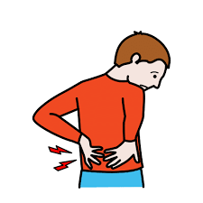
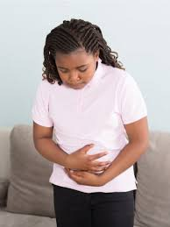
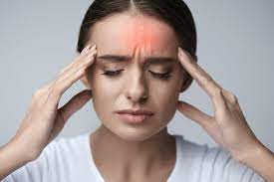
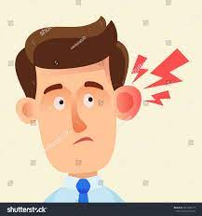
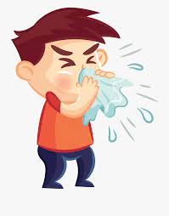
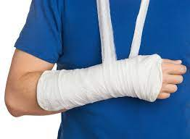
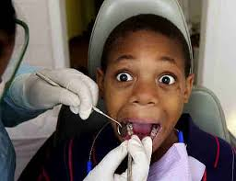
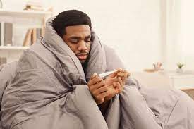
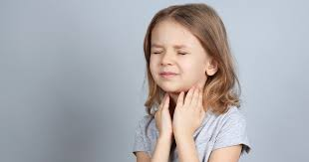
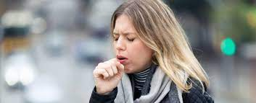
a headache
backache
a stomach ache
an earache
the flue
a broken arm
toothache
a cold
a sore throat
a cough

Slide 4
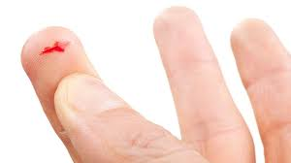
Accidents- What’s the matter?
a cut
I’ve got a cut on my finger.
I have a cut on my finger.
a burn
I’ve got a burn.
I have a burn.

Slide 5
Games- illnesses (recap)
I have a headache.
https://wordwall.net/resource/16990783/illnesses
Quiz-illnesses
https://wordwall.net/resource/3467115/whats-the-matter-memory
Making sentences
https://wordwall.net/resource/876872/angielski/giving-health-advice

Slide 6
Check homework
https://www.liveworksheets.com/worksheets/en/English_as_a_Second_Language_(ESL)/Giving_advice/Should_or_Should_not_uu80388sr

Slide 7
Reading a hospital letter
https://esol.britishcouncil.org/content/learners/grammar-and-vocabulary/beginners/reading-letter-hospital

Slide 8
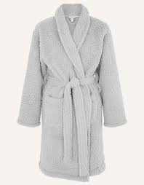
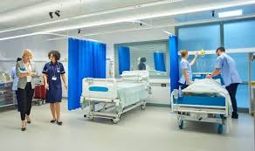
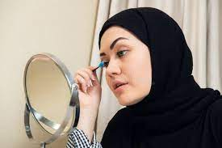
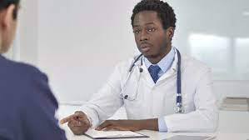
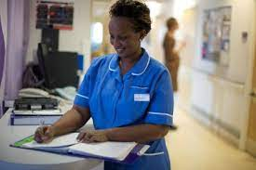
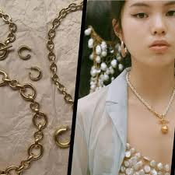
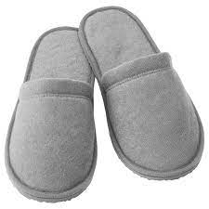
words
operation
make-up
ward
dressing gown
consultant
nurse
confirm
jewellery
slippers

Slide 9
NHS Hospital 2/January/2018
Tel: 01222 44443
Dear Mrs. Osman,
Your operation is on Monday 14th January. Please go to B ward at 12.30. Your consultant is Mr. Hamilton.
You can have a light breakfast at 7.30am and have water up to 10.15am. Please do not wear jewellery or make up. You will need to bring your slippers and a dressing gown.
Please contact the above number to confirm your bed for this date as soon as possible.
Yours sincerely,
Jane manning

Slide 10
Questions A:
How many paragraphs are there in the letter? There are three paragraphs.
What are the opening words? Dear Mrs.Osman,
What is the date of the letter? 2/January/2018
What are the closing words? Yours sincerely,

Slide 11
Questions B:
When is her operation? Monday 14th January/ It’s on Monday 14th January.
Where does she need to go and when? B ward at 12.30./ She needs to go to B ward at 12.30.
Who is her consultant? Mr Hamilton./ Her consultant is Mr. Hamilton.
After what time should she stop eating? after7.30am/ She should stop eating after 7.30am.
After what time should she stop drinking water? 10.15am./She should stop drinking water after 10.15am.
Can she wear jewellery? No, she can’t./ No, she can’t wear jewellery.
Can she wear make-up? No, she can’t.
What does she need to bring? Her slippers and a dressing gown./ She needs to bring her your slippers and a dressing gown.

Slide 12
A phone call for confirmation:
Mrs. Osman- Hi. Can I speak to Jane Manning please?
Hospital- Speaking. How can I help you?
Mrs. Osman- This is Mrs Osman.
Hospital- Hi, Mrs. Osman.
Mrs.Osman- I am calling you to confirm that I will be there on Monday 14th January at 12.30am.
Hospital- OK. Thank you for your confirmation.
Mrs. Osman- Bye.
Hospital- Bye.

Slide 13
A text message to teacher:
Hi …………..
I …………. come to class on ……………..because …. am having an …………………
Regards
………………

Slide 14
A listening activity-
https://www.liveworksheets.com/worksheets/en/English_as_a_Second_Language_(ESL)/Illnesses_and_health_problems/What's_the_matter$_qd1293546kr

Slide 15
Homework- reading&writing activity
https://www.liveworksheets.com/worksheets/en/English_as_a_Second_Language_(ESL)/Illnesses_and_health_problems/Day_at_the_Clinic_vm1592314ic

