Slide 1
Functional Skills English Level 2 Spring Term
22nd Jan – 30th Apr 2021

Slide 2
Session aims/objs
Aim: course induction
Objs: by the end of this session, you will
Recognise format of letters
Identify register
Organising parts of a letter
Plan and write a formal letter

Slide 3
Interesting facts
Did you know on this day….

Slide 5
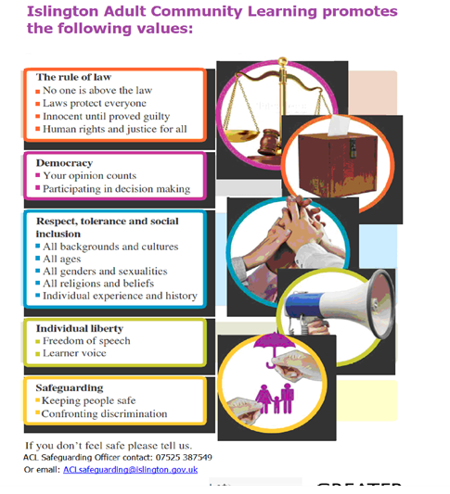

Slide 6
Organising text
The most common way of organising a text is to split it into paragraphs.
There are three main types of paragraph.
An introductory paragraph – A paragraph at the start of a text that explains its purpose and the overall subject.
Contents paragraph(s) – Paragraph(s) that contain the text’s main point(s) and important details. This / these paragraph(s) follow the introductory paragraph.
Concluding paragraph – A paragraph that is placed at the end of a text that gives an overview of what has been discussed and the final opinion of the writer.
The best way to decide what information belongs where (and in what order each of the contents paragraphs should appear) is to carefully plan your writing before you begin.
How might you organise your writing?
main types of paragraph.
An introductory paragraph – A paragraph at the start of a text that explains its purpose and the overall subject.
Contents paragraph(s) – Paragraph(s) that contain the text’s main point(s) and important details. This / these paragraph(s) follow the introductory paragraph.
Concluding paragraph – A paragraph that is placed at the end of a text that gives an overview of what has been discussed and the final opinion of the writer.
The best way to decide what information belongs where (and in what order each of the contents paragraphs should appear) is to carefully plan your writing before you begin. One way to do this is to use a spider diagram.
To understand how to use a spider diagram
Spider gram

Slide 7
Register
What does register mean in literacy?
It is informal/formal language used in text.
Spend the next few minutes discussing the features and register of formal letters with each other.

Slide 8
Formal/informal writing have the following features:
Formal
Avoidance of slang
Avoidance of shortened words
Avoidance of abbreviated words
Longer and more complex sentences
Avoidance of exclamation marks (!)
Informal
Slang words
Shortened words (for example: isn’t, can’t, shouldn’t)
Abbreviated words (for example: TV, ads)

Slide 9
Structure of formal letters
Formal letters have a particular format and should include the following features:
Sender's Address
Recipient's Address
Date
Formal Greeting: Dear Sir or Madam should be used if you don't know the name of the recipient
Subject: a subject heading can be shown before the main content
Content: this should be logically structured in paragraphs and formally written
Closing: a closing must be used. Use Yours faithfully if you don't know the name of the recipient and Yours sincerely if you do know the name
Organisations often use their own house style. A common style used is the left block format, where the whole text is left aligned.

Slide 10
Work together and decide and divide the following text into appropriate paragraphs.
https://www.bbc.co.uk/bitesize/topics/zvgg4qt/articles/zcjcxfr

Slide 11
Read the following text and identify 11 spelling & proper noun errors
10 Defoe Road Brandon Suffolk IP44 7UJ 10 June 2011 Dear mrs james, I am writeing to let you know that my daughter Joanne will not be abel to do her detention after school next tuesday. This is becuase she has an apointment with the dentist that day. Is it posible to put of the detention untill the following week, when I can collect her by car from school at 5pm? Yours sinserely, Chris Johnson

Slide 12
10 Defoe Road Brandon Suffolk IP44 7UJ 10 June 2011 Dear Mrs. James, I am writing to let you know that my daughter Joanne will not be able to do her detention after school next Tuesday. This is because she an appointment with the dentist that day. Is it posible to put off the detention until the following week, when I can collect her by car from school at 5pm. Yours sincerely, Chris Johnson

Slide 13
Now organise the text into a formal letter using appropriate paragraphs
10 Defoe Road Brandon Suffolk IP44 7UJ 10 June 2011 Dear Mrs. James, I am writing to let you know that my daughter Joanne will not be able to do her detention after school next Tuesday. This is because she an appointment with the dentist that day. Is it possible to put off the detention until the following week, when I can collect her by car from school at 5pm. Yours sincerely, Chris Johnson

Slide 14
Independent study
Complete the task.
read the text ‘Writing formal letters’
http://teach.files.bbci.co.uk/skillswise/en11lett-l1-f-writing-formal-letters.pdf
and complete the task ‘Writing a letter of complaint’
http://teach.files.bbci.co.uk/skillswise/en11lett-l1-w-writing-a-letter-of-complaint.pdf

Slide 15
Summary
Purpose of paragraphs
Format of letters
Register
Organising parts of a letter
Planning and writing a formal letter

Slide 16
The end

Slide 17
References:
https://www.bbc.co.uk/bitesize/topics/zvgg4qt/articles/zcjcxfr
Video and tasks
http://teach.files.bbci.co.uk/skillswise/en11lett-l1-f-writing-formal-letters.pdf
Factsheet on formal letter writing
http://teach.files.bbci.co.uk/skillswise/en11lett-l1-w-writing-a-letter-of-complaint.pdf
Complaints letter framework and task
https://www.bbc.co.uk/teach/skillswise/writing-a-letter/zbc8vk7
Planning and writing letters
https://www.britannica.com/on-this-day/January-22
Interesting facts

