Slide 1
Aim of the session:
By the end of the session learners will be able to
Have induction
Talk about hobbies
use ‘and’ in a sentence
Listen to a song and complete the sentences

Slide 2
What’s the date today? 1/10/2021 The first of October
What day is it today?
Friday

Slide 3
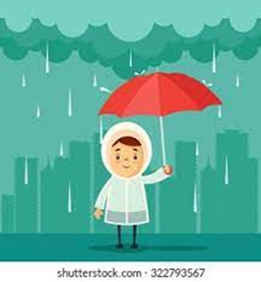
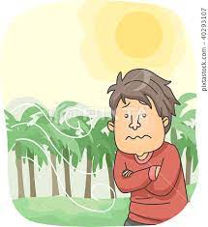
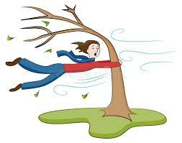
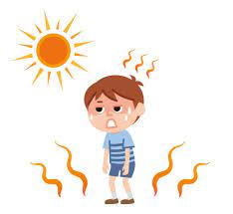
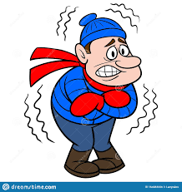
rainy
cool
windy
warm
sunny
snowy
cold
hot
cloudy

Slide 4
The weather
What is the weather like today?
It is cloudy and cool now.
It was rainy in the morning.

Slide 5
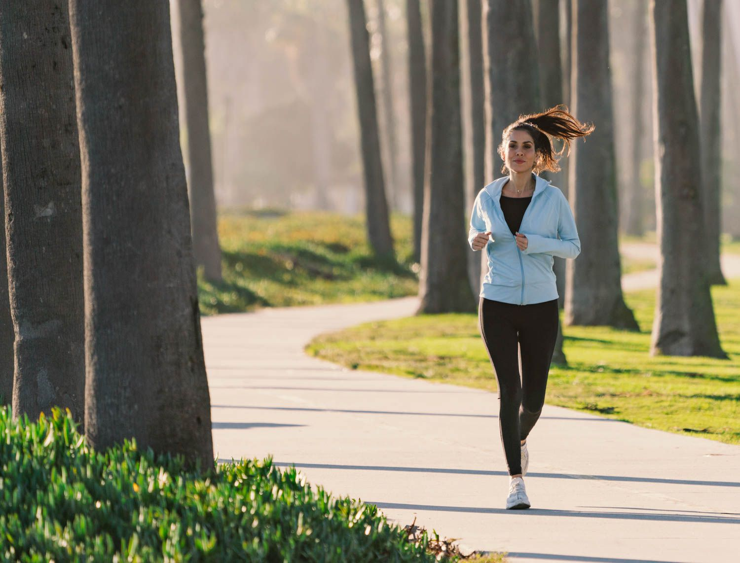
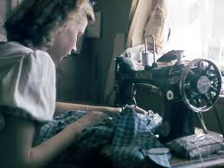
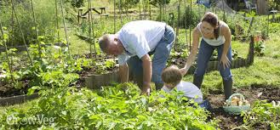
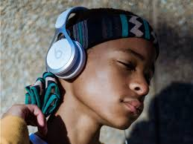
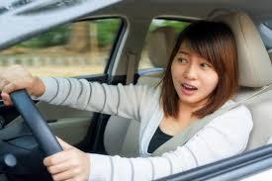
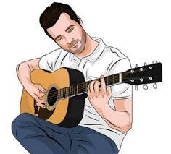
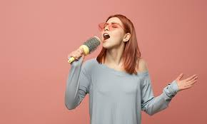
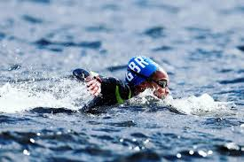
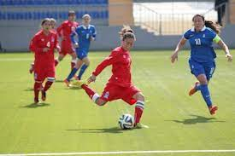
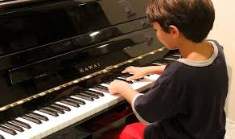
Hobbies- playing football, watching TV, running, singing, playing the guitar, playing the piano, walking, swimming, painting, sewing, gardening, driving, listening to music

Slide 6
Tell me what you like doing.
I like singing, watching TV and playing football.
I like gardening, walking and painting.
I like driving, running and gardening.
Tell me what you don’t like doing.
I don’t like playing the piano and sewing.
I don’t like swimming and playing the piano.
I don’t like playing football and sewing.

Slide 7
Activities: Listen to the song and fill in the gaps
https://www.liveworksheets.com/worksheets/en/English_as_a_Second_Language_(ESL)/Like_%5E_ing/What_do_you_like_doing$_nd627182mf

Slide 8
Activities: order the words to make a sentence
https://www.liveworksheets.com/worksheets/en/English_as_a_Second_Language_(ESL)/Like_%5E_ing/What_do_you_like$_Order_ep246021uf

Slide 9
Homework:
https://www.liveworksheets.com/worksheets/en/English_as_a_Second_Language_(ESL)/Like_%5E_ing/What_do_you_like_doing$_nd627182mf

