Slide 1
Aim of the session:
By the end of the session learners will be able to
Check homework
Practice speaking using dates, weather
spell names
Practice present simple tense using like/likes

Slide 2
What’s the date today? 15th October The fifteenth of October yesterday? 14th October The fourteenth of October tomorrow? 16th October the sixteenth of October
What day is it today?
It’s Friday.
Yesterday?
Thursday
Tomorrow?
Saturday
https://wordwall.net/resource/400941/esol/months-of-the-year

Slide 3
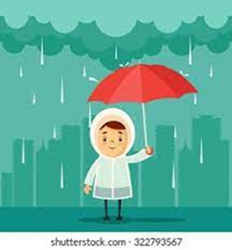
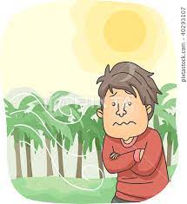
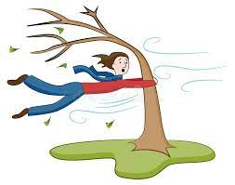
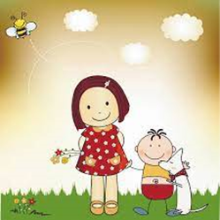
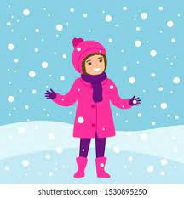
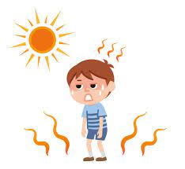
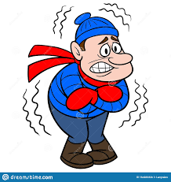
rainy
cool
windy
warm
sunny
snowy
cold
hot
cloudy

Slide 4
Homework
https://www.liveworksheets.com/worksheets/en/English_language/Personal_Information/Questions_gk564842eu

Slide 5
The weather
What is the weather like today?
It’s cloudy and warm.

Slide 6
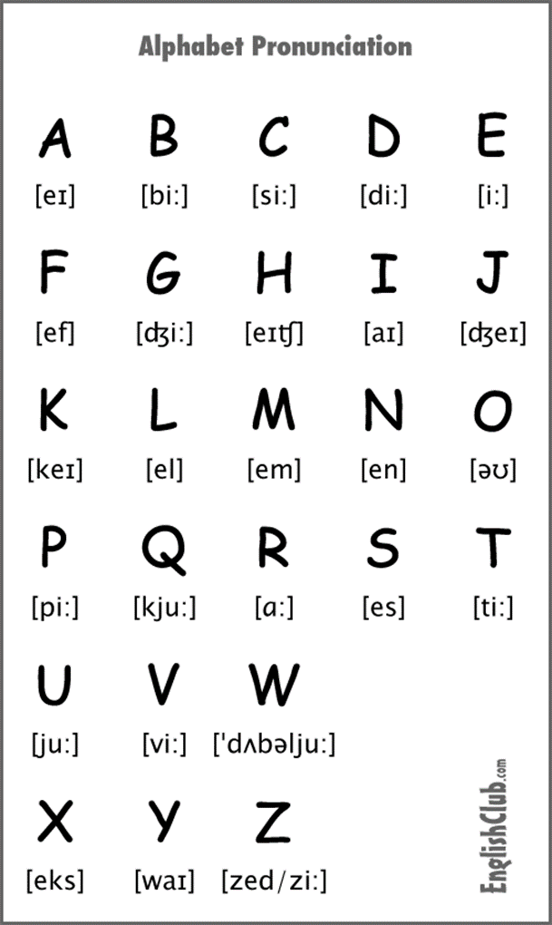
Spelling
What’s your name?
How do you spell that?

Slide 7
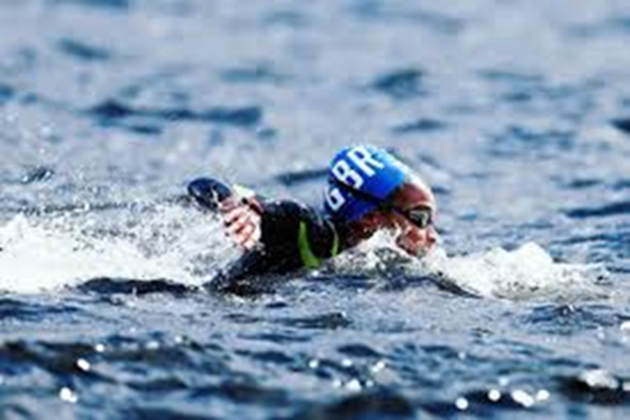
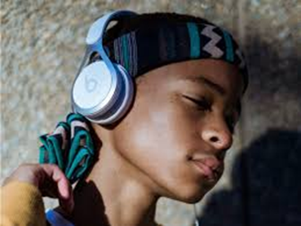
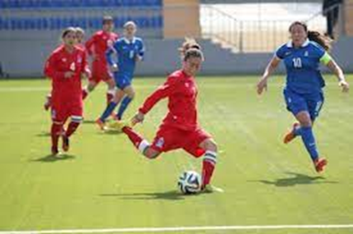
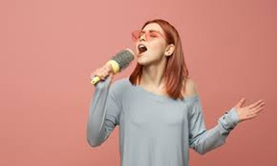
Do you like……?
Swimming
Listening to music
Playing football
Singing
Yes, I do./
No, I don’t.

Slide 8
Like/likes
Priscila likes swimming, listening to music and singing.
Dalila likes swimming and listening to music.
Ersin and Harun like playing football.
Dalila and Ersin like listening to music.
Ersin likes swimming.
Dalila, Priscila, Harun like listening to music.
Priscila and I like singing.

Slide 9
like/likes
subject | like/likes | hobby
I | like | swimming.
You | like | swimming
He | likes | swimming.
She | likes | swimming.
It | likes | swimming.
They | like | swimming.
We | like | swimming.
https://wordwall.net/resource/8188910/esol/hobbies
https://wordwall.net/resource/8674242/esol/hobbies-like-likes-ing
https://wordwall.net/resource/23393456/untitled3

Slide 10
Homework:
https://www.liveworksheets.com/worksheets/en/English_as_a_Second_Language_(ESL)/Family_members/SPELLING_Family_ce1491756da
https://www.liveworksheets.com/worksheets/en/English_as_a_Second_Language_(ESL)/The_alphabet/Spelling_Worksheet_fd1083707ik

