Slide 1
ESOL Level 1 Spring Term
11th Jan – 26th Mar 2021

Slide 2
Welcome to the session a new course/term

Slide 3
Session aims/objs
Aim: course induction
Objs: by the end of this session, you will
Familiarise yourself with ACL VLE (Moodle)
List some online learning classroom rules
Familiarise yourself on ACL Safeguarding procedures
Introduce yourself to the group and give some personal information
Ask and answer some questions relating to the course

Slide 4
Getting to know you
Spend to minutes introducing yourself to the rest of the group and talk about the following:
Your name, some personal info that you want to share (i.e. country of origin etc) What are you most proud of currently?
(speaking: “I am most proud of….”)
What are your current aspirations?
(speaking: “My current aspiration is/ aspirations are….”)

Slide 5
Skills you will develop on this course (ESOL Level 1)
Spelling
Grammar
Language related
to Me and My Home
ESOL Level 1
Speaking &
listening
Writing
Reading
Punctuation

Slide 6
Group Agreement
How can we work together, effectively?
Discuss acceptable boundaries
Negotiate at least 5 class rules

Slide 8
Islington Council Adult Community Learning
Learner Code of Conduct for on-line learning
We ask that you:
1. Respect others, regardless of culture, ability, race, gender, age or sexual orientation. Harassment, bullying, discrimination, swearing, racist, homophobic or sexist terms are not acceptable actions will not be tolerated.
2. Are always courteous and respectful to staff members and other learners
3. Show a positive commitment to your own development and learning.
4. Show respect for another learners’ development and cooperate appropriately
5. Attend and arrive punctually to training/assessment events that you have been scheduled to take.
6. Locate yourself in an appropriate area if attending live classes e.g. not in bedrooms
7. Understand that learners progress at different paces.
8. Understand that there is a certain amount of necessary paperwork which must be completed by each learner
9. Wear appropriate dress when attending online learning sessions and ensure other members of your household are aware
10. Complete work and collect evidence for assessment within agreed timescales
11. Use an appropriate and professional email address
12. Follow agreed guidelines when instructed by the tutor e.g. muting sound when presentations are occurring
13. Be patient as responses online/phone can sometimes take slightly longer as the tutor or individual is having to record/respond to others within the class at the same time
14. Do not record or distribute any online learning sessions to others, abide by ACL Islington Safeguarding, e-safety and Prevent Policy

Slide 9
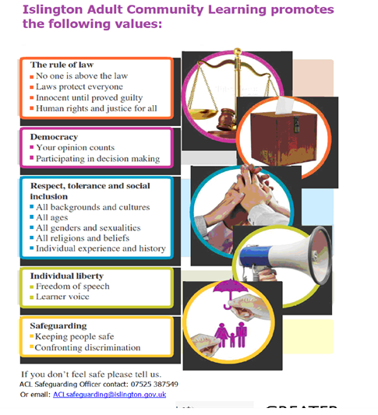

Slide 10
My role
Ensure successful learning of all
Make learning relevant
Group work & individual tasks
Peer support
Provide individual feedback and support

Slide 11
Your responsibility
Ensure you take responsibility for your own learning
Attend classes regularly
Be punctual
Complete group work & individual tasks
Provide/seek support form your peers

Slide 12
Our ACL 1-1 IAG offer
A confidential service for learners
Up to 3 one hour sessions with a qualified adviser
Adherence to the Guidance Council’s Code of Principles (impartial, current, confidential, in accordance with equality and diversity legislation, accessible, individual ownership, transparency)
and the Career Development Institute’s Code of Practice (as above, also duty of care, accountability and CPD)
Notes:
Any organisation which manages, administers and delivers an IAG service to support individuals in their career, learning, work or life goals has the chance to achieve matrix accreditation.
This is regardless of whether the service or services are delivered face-to-face, through training, learning, remotely, or through a website.

Slide 13
What do the IAG sessions involve?
Our qualified advisors provide 1-1 confidential interviews with learners where the focus is on your learning journey.
You can tell your story and be actively listened to, challenged, supported and inspired to overcome personal barriers, plan for the future, and progress.
There is a chance for you to ask questions, and explore any aspect of training, learning or employment you are thinking of progressing onto, in a non – judgemental and safe, up to date, environment.
It’s an opportunity for you to plan a specific and realistic route into employment, training or further qualifications.
We can give you help to tackle change and identify your strengths, skills and transferable skills to use effectively for the future.
You will also be given information about training courses, qualifications and employment opportunities which is relevant to you, up to date, impartial in line with current equality and diversity legislation.

Slide 14
How can learners book an appointment?
For the summer term we are offering IAG sessions via telephone and/or via MS Teams
For ESOL tutors and their learners:
Contact Gulcoy on 07712 403428
Email gulcoy.esen@islington.gov.uk
Appointments available:
Mondays and Tuesdays 1.30 - 3pm
For general appointments:
Contact Alison on 07808 879044
Email Alison.moore@islington.gov.uk
Appointments available:
Tuesdays and Thursdays
9.30am - 12.30pm and 1 – 4pm
To find out about all or our courses on offer visit: www.adultlearning.islington.gov.uk

Slide 15
Summary
Self introductions
Course information
H/S induction
Agreed boundaries
H/W: complete diagnostic assessment and learner profile on Moodle

Slide 16
The end

