Slide 1
Learning objectives
By the end of the class you will be able to:
understand the requirements for the writing exam
recognise the correct format and purpose of texts
plan writing

Slide 2
Writing exam
current situation
homework
handout

Slide 3
Types of text

Slide 4
42, Greyhound Road
Birmingham
B42 6HJ
25 April 2016
Mr. E. Splatt
The Manager
Bestdeal Electrics
113 Main Street
Andover
AN4 9ET
Dear Mr. Splatt,
Complaint about member of staff
I am writing to complain about a member of your staff who was very rude to me on my recent visit to your shop………….
I have been a loyal customer of Bestdeal for many years. I would like you to contact me to tell me how you are going to deal with this member of staff.
Yours sincerely
Jane Teller

Slide 5
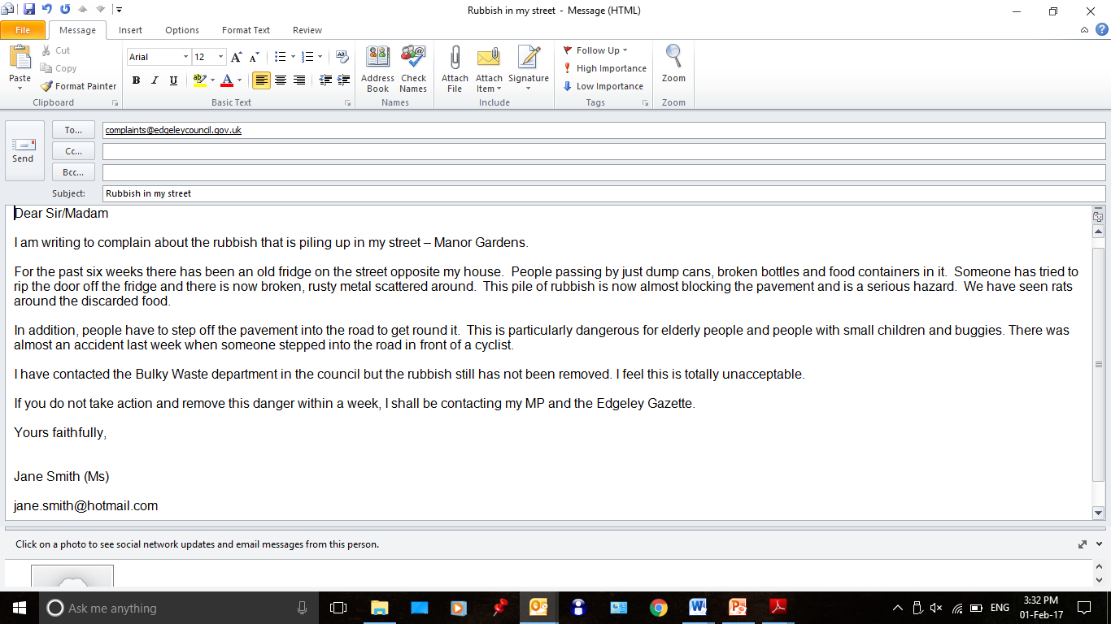

Slide 6
Grandad and two grandsons in "miraculous" escape after car clips side of house and lands upside down
by Alex Kingston 27 January 2020
A grandad and his two grandsons had a "miraculous" escape after the car they were travelling in launched into the air, clipped the side of a house and landed upside down.
The three are lucky to be alive after their vehicle - which was being driven by the elderly man - left the road and launched over a six foot wall. Paramedics found the vehicle teetering upside down on top of a parked car.
Emergency services said it was a miracle nobody was hurt in the accident in Seabridge Lane in Newcastle-under-Lyme, at around 5.30pm today.
A West Midlands Ambulance Service (WMAS) spokeswoman said: "When the emergency services arrived they found a car which had reportedly left the road, cleared a six foot wall and clipped the side of a house before landing on top of a parked car.
Miraculously the three occupants, an elderly man and his two grandsons, believed to be in their late teens, were out of the car and had sustained no serious injuries.”

Slide 8
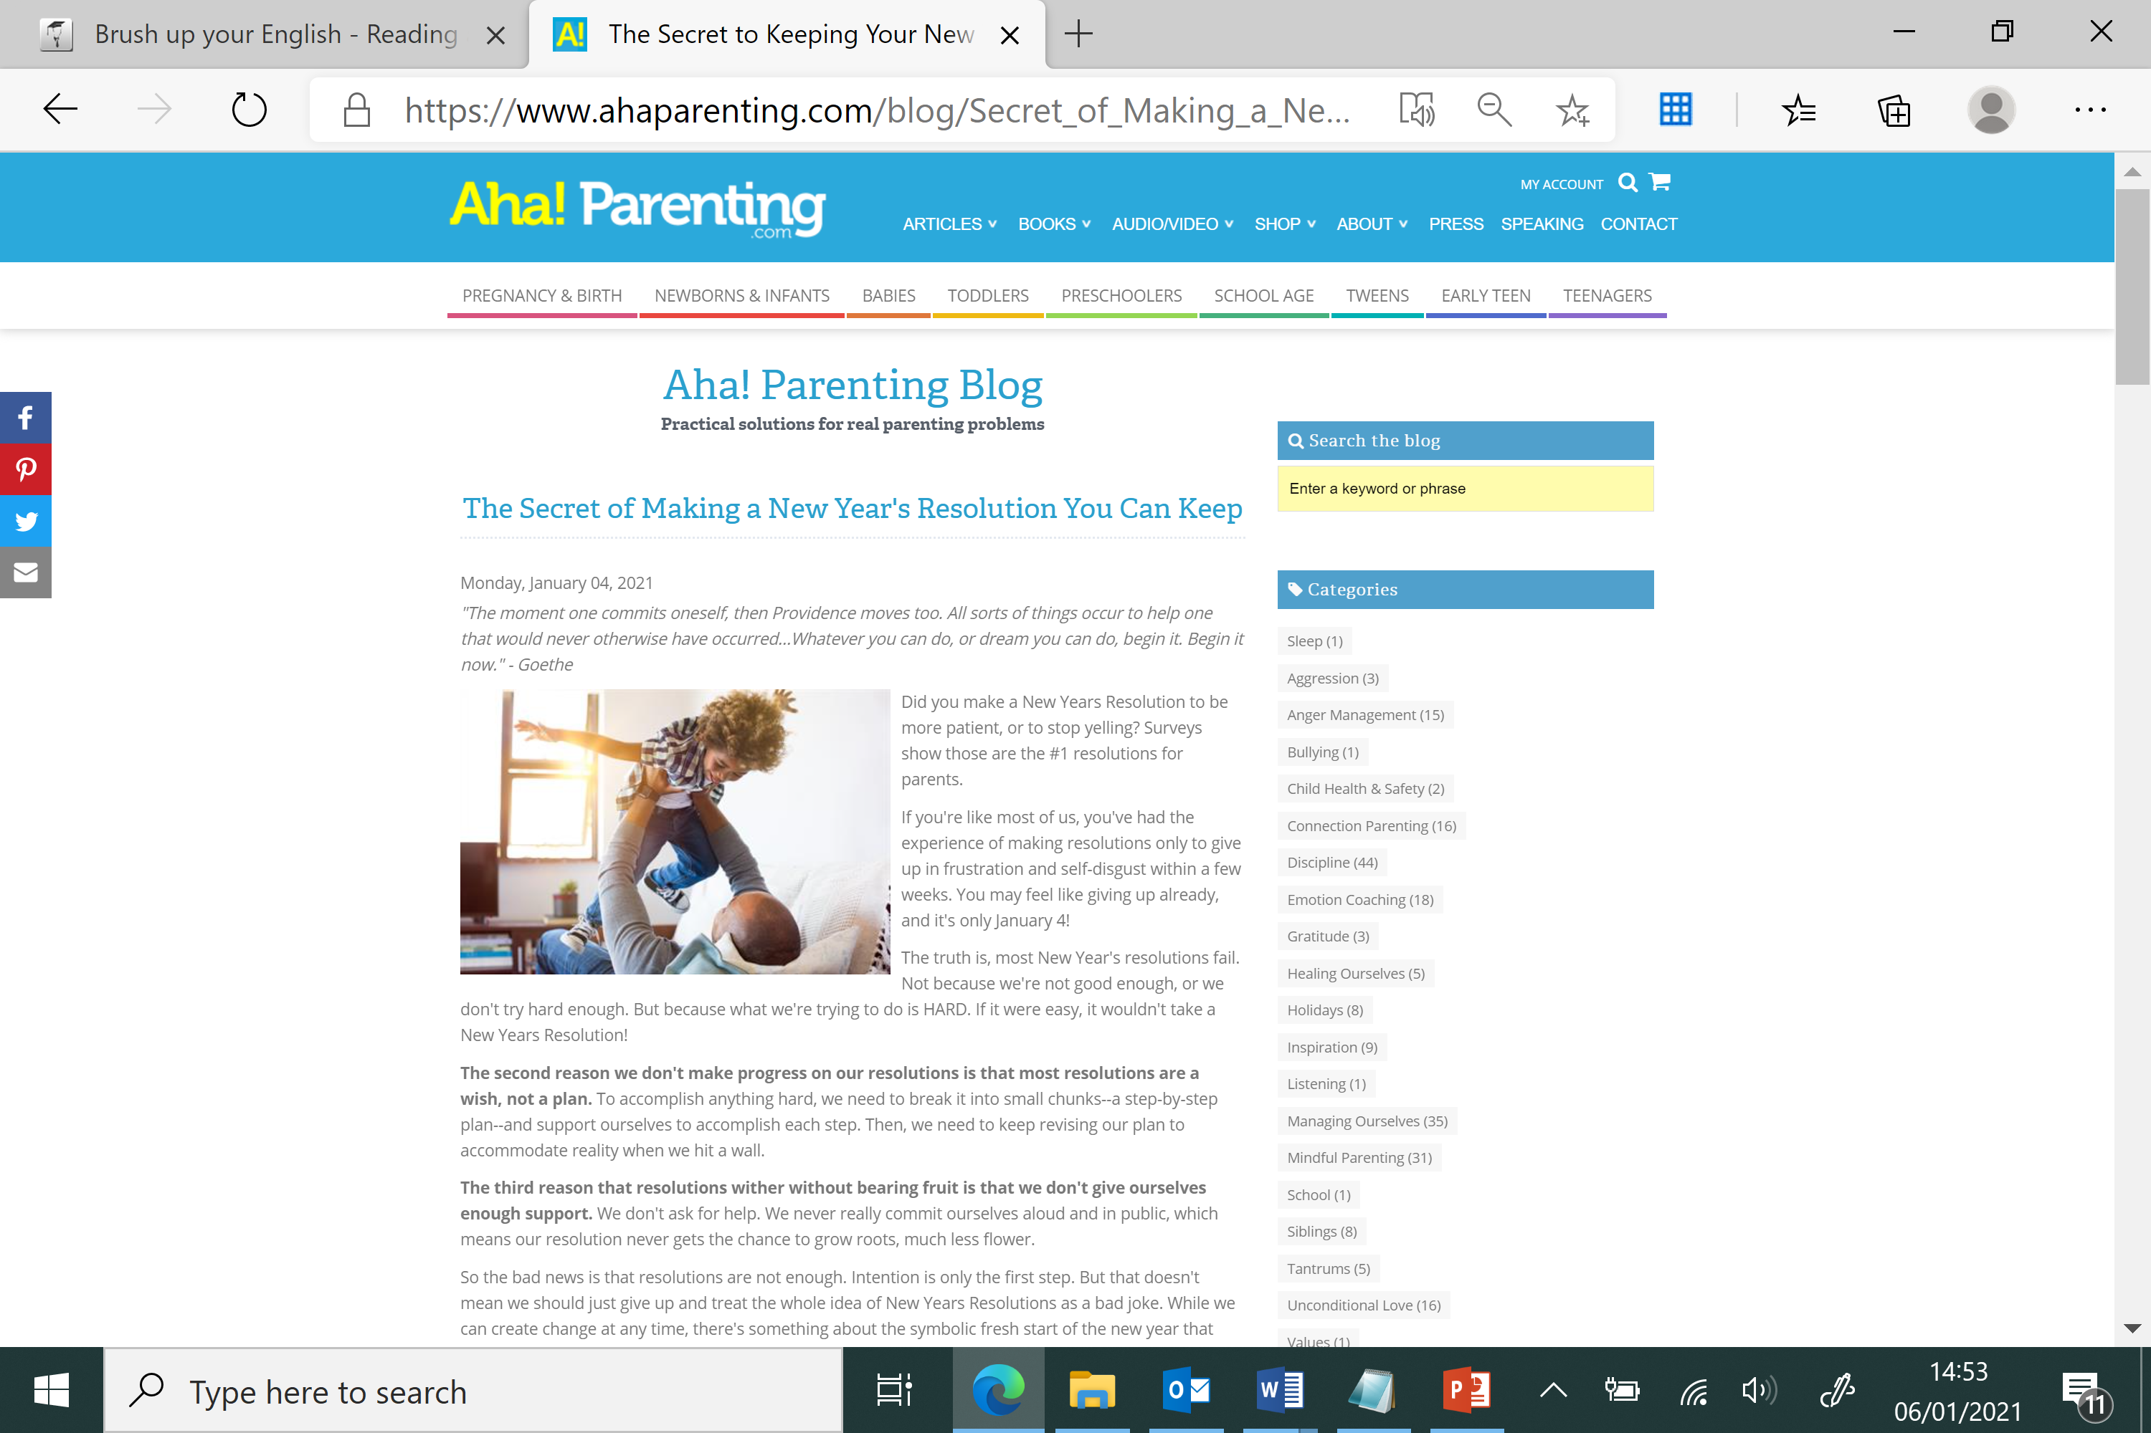
Notes:
The Secret to Keeping Your New Year's Resolution (ahaparenting.com)

Slide 9
Resources
how to spell - https://howtospell.co.uk/
grammar – University of Bristol - Grammar and punctuation (bris.ac.uk)
The Skills Toolkit – Free digital courses to help you progress in work and boost your job prospects (campaign.gov.uk)

Slide 10
Writing process
Planning (essential for thinking)
Drafting (essential in longer writing when
studying but no time in an exam)
Neat copy (marked in exam)
Proofreading ( marked in exam)

Slide 11
Planning
Lists
Spider diagrams
Initial brainstorm of ideas
In note form
Add detail to each point on list/diagram
Thinking/ideas
How do you do it?

Slide 12
Over to you
Use a planning method of your choice to plan an article on your top 5 parenting tips.

