Slide 1
Welcome to your online class today
What day is it today?
What’s the weather like?

Slide 2
Today we will:
Learn new words describing food
Speak about our favourite food
Write about things I like or don’t like

Slide 3
What meals do you have in a day? What meal is on a picture?
Is it breakfast, lunch or dinner?
Soft-boiled egg
Toast
Tea/coffee

Slide 4
People in the UK have 3 or 4 meals during the day
Breakfast - morning
Lunch – noon (12pm)
Dinner – 5pm – 8pm
Supper – last meal of the day

Slide 5
What time do you have these meals?
Lunch or dinner?
Day or night?

Slide 6
Match the words with times
Breakfast
Lunch
Dinner
supper
In the afternoon or evening
After 12 until 5pm
In the morning - until 12pm
At noon -12 pm
In the evening – last meal of the day – 6pm – 9pm

Slide 7
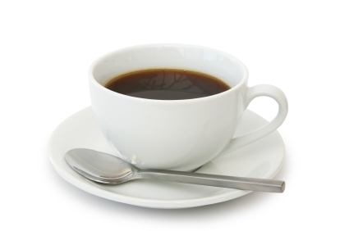
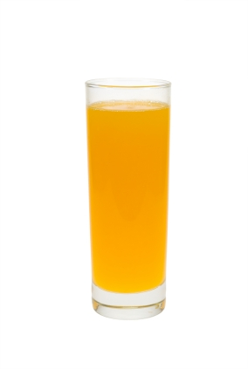
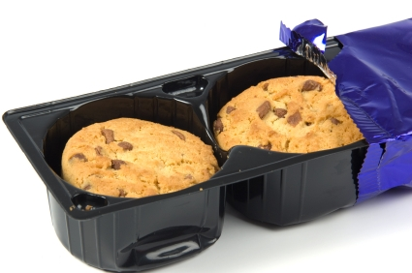
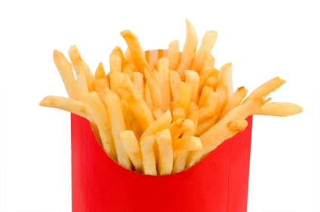
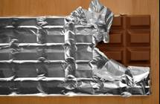
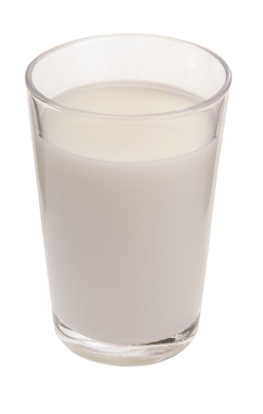
Types of food - words
Apple
Sweets
Coffee
Juice
Chocolate cake
Sandwich
Cookies/biscuits
Cereal
Coke

Slide 8
Food or drink? Fill in the columns with food and drink from the list
Food Drink

